Slide 1
Animal
Breeding & Reproduction
Discuss the meaning and importance of reproduction in animal agriculture
Describe benefits of using genetically superior animals for breeding
Define common terms and describe the function of reproductive organs
Compare estrous cycles and gestation of different species and list common signs of breeding readiness
Describe signs of parturition and dystocia
Describe the purpose and benefits of reproductive technologies

Slide 2
Why is it important for animal producers to understand principles of animal breeding?

Slide 3
Importance of Reproduction
Discuss the meaning and importance of reproduction in animal agriculture
Producers rely on successfully reproducing young for economic success
  Cow/Calf Operation without calves?
  Hog farm without piglets?
  Sheep farm without lambs?
  Dairy farm without calves?
Each would fail in a short amount of time without successful reproduction

Slide 4
Importance of Reproduction
Discuss the meaning and importance of reproduction in animal agriculture
Our food supply would be in jeopardy without sound animal reproductive practices

Slide 5
Should any or all animals be used for breeding?

Slide 6
Choosing Superior Animals
B. Describe benefits of using genetically superior animals for breeding
Responsible Animal Breeding:
  Only breed animals with desirable characteristics to be passed on
    Natural selection would eliminate most genetic problems, but artificial selection does not
    It is our responsibility to be responsible animal breeders

Slide 7
Choosing Superior Animals
B. Describe benefits of using genetically superior animals for breeding
Responsible Animal Breeding:
  Improve the next generation
    Hybrid Vigor
    Eliminate poor characteristics
    Improve efficiency of food production

Slide 8
Terminology
C. Define common terms and describe the function of reproductive organs
Pregnancy -- carrying a fetus
Fertilization -- the union of the EGG and SPERM nuclei
Conception - occurrence of fertilization
Ovulation - release of an ovule from the female.
Gestation - the time from fertilization or conception of a female until she gives birth

Slide 9
Terminology
C. Define common terms and describe the function of reproductive organs
Ovaries - FEMALE reproductive gland in which eggs are formed and hormones are produced.
  Egg or Ovule- Female Reproductive Cell
Testes - MALE reproductive gland that produces sperm and testosterone.
  Sperm- Male Reproductive Cell
  Semen- Fluid that carries sperm

Slide 10
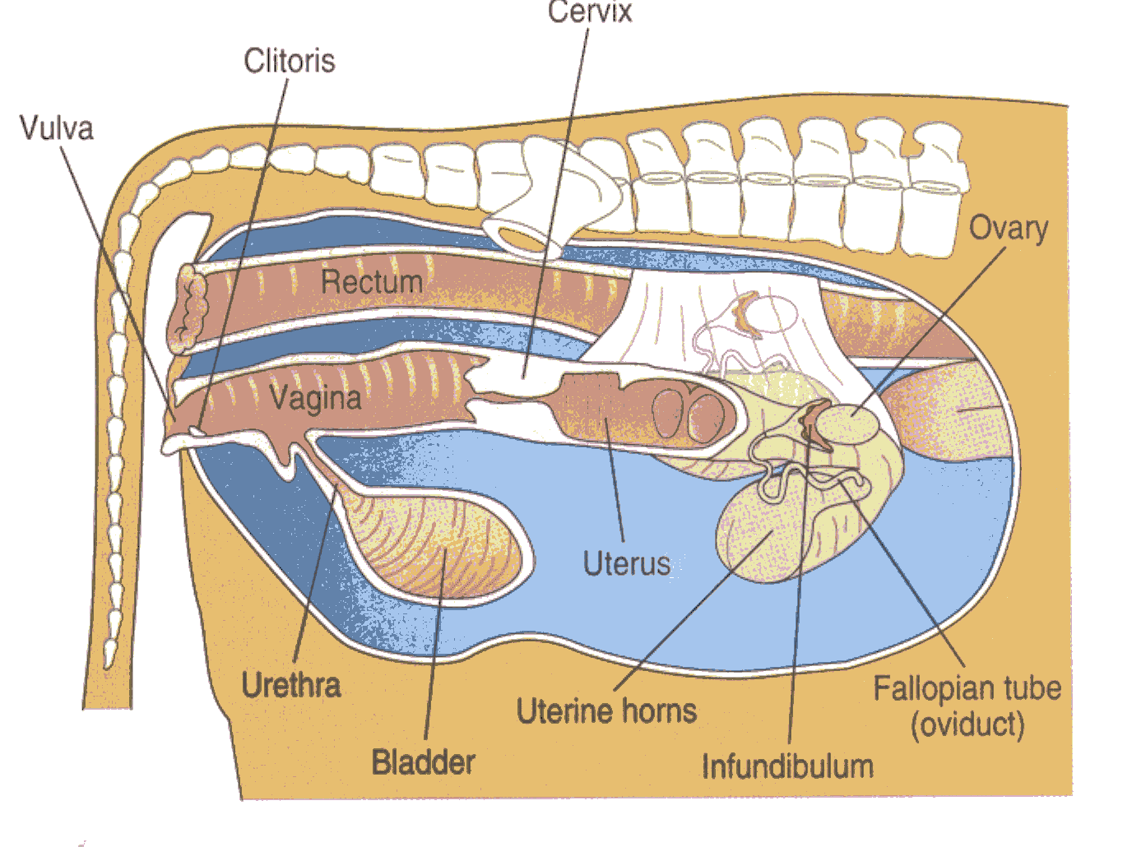
Female Reproductive Organs
C. Define common terms and describe the function of reproductive organs

Slide 11
Female Reproductive Organs
C. Define common terms and describe the function of reproductive organs
Vulva- opening of reproductive tract
Vagina- channel for birth and copulation
Cervix- divides vagina and uterus
Uterus- Where fetus grows & receives nourishment
Fallopian Tube- where fertilization occurs
Ovaries- produces eggs and hormones

Slide 12
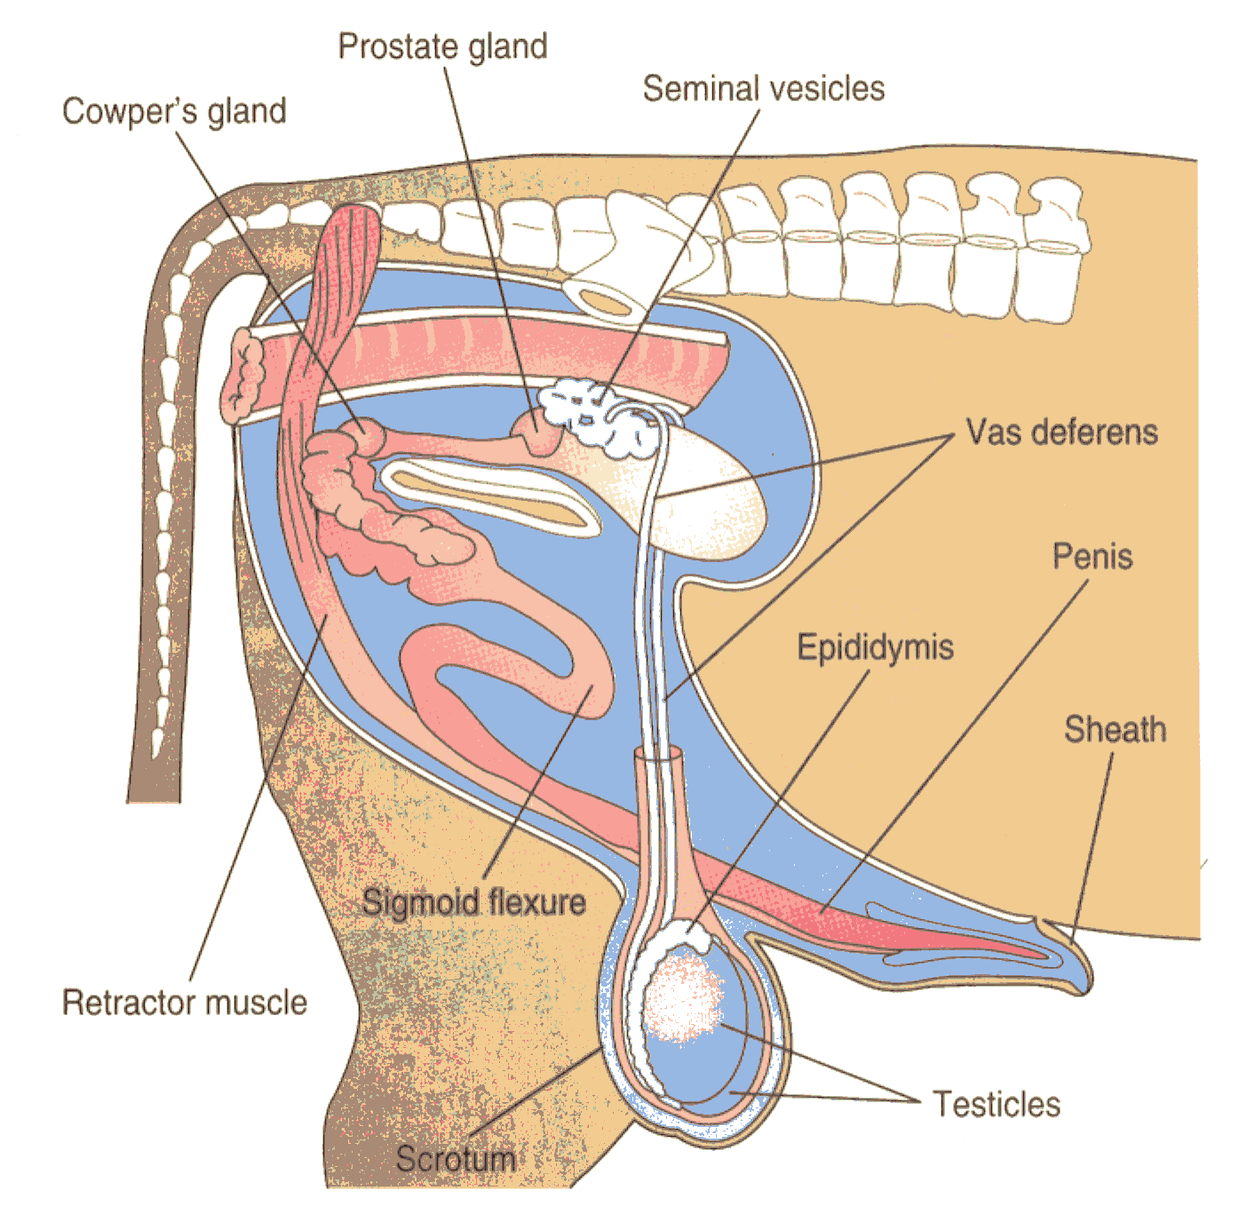
Male Reproductive Organs
C. Define common terms and describe the function of reproductive organs

Slide 13
Male Reproductive Organs
C. Define common terms and describe the function of reproductive organs
Testes - produce sperm and testosterone
Epididymis - collects and stores sperm
Vas deferens - transports sperm
Penis - places sperm in female
Cowper's Gland
Prostate Gland produce semen
Seminal Vesicle
Scrotum - protects testes & maintains temp.
Sheath - opening of reproductive tract

Slide 14
Estrous Cycles
D. Compare estrous cycles and gestation of different species and list common signs of breeding readiness
Estrous Cycle:
  Time between periods of estrus, or “heat”
  Often influenced by of hours of light in the day

Slide 15
Estrous Cycles
D. Compare estrous cycles and gestation of different species and list common signs of breeding readiness
Estrous Cycles by Species:
Species | Estrous Cycle | Length of Estrus (heat) | Ovulation
Cow | 21 | 12-18 hours | 10-14 hours after estrus
Mare | 22 | 6-8 days | 1-2 days before estrus ends
Doe (goat) | 21 | 30-40 hours | At end of estrus
Doe (rabbit) | Constant | Constant | 8-10 hours after mating
Sow | 20-21 | 40-72 hours | Mid estrus
Ewe | 17 | 24-36 hours | Late estrus
Dog | - | 9 days | 1-2 days after estrus begins
Cat | 14-21 | 5 days | 24 after mating

Slide 16
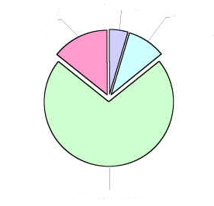
Estrous Cycles
D. Compare estrous cycles and gestation of different species and list common signs of breeding readiness
1- Estrus- also known as “heat.” The period of time when female is receptive to male and conception can occur.
  -Hormone: Estrogen
1-Estrus
2-Metestrus
2- Metestrus- follows estrus. Usually when ovulation occurs
  -Hormone: LH (leutenizing hormone)

Slide 17
Estrous Cycles
D. Compare estrous cycles and gestation of different species and list common signs of breeding readiness
3- Diestrus- Period of cycle when system assumes pregnancy.
  -Hormone: Progesterone
1-Estrus
2-Metestrus
4-Proestrus
4- Proestrus- If not pregnant, body prepares to begin cycle again
  -Hormone: Progesterone drops
3- Diestrus

Slide 18
Breeding Readiness
D. Compare estrous cycles and gestation of different species and list common signs of breeding readiness
Cattle-
Standing to be mounted or trailing other cattle
Clear, viscous mucous from vulva
Swelling of vulva
Restlessness
Horses-
Restlessness whinnying
Frequent urination in small amounts
Backing up and pushing on fences or other objects

Slide 19
Breeding Readiness
D. Compare estrous cycles and gestation of different species and list common signs of breeding readiness
Pigs-
Erect ears
Moist vulva
Standing or “Locked up Response” when touched
Sheep-
Seeking out and standing for ram
(symptoms are much less noticeable than other species)

Slide 20
Breeding Readiness
D. Compare estrous cycles and gestation of different species and list common signs of breeding readiness
Chickens-
None
Sperm from a rooster can be viable in a hen for up to 30 days. Once inseminated, it’s stored until the next egg is produced
Rabbits-
None
Does ovulate at presence of sperm, not on a cycle

Slide 21
Gestation
D. Compare estrous cycles and gestation of different species and list common signs of breeding readiness
Length of PREGNANCY.
Begins with FERTILIZATION and ends with PARTURITION (BIRTH).
All animals have different gestation lengths. Usually the LARGER the animal, the LONGER the gestation.

Slide 22
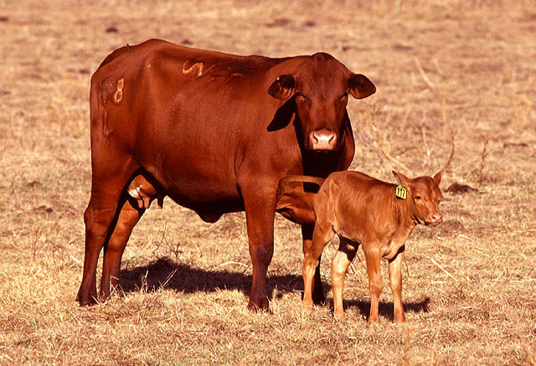
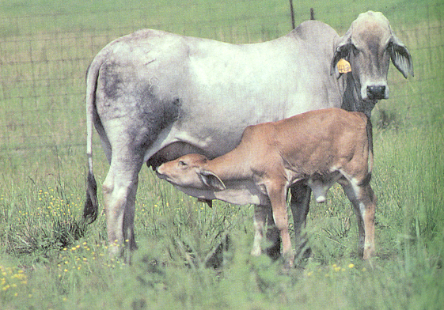
Cattle Gestation
D. Compare estrous cycles and gestation of different species and list common signs of breeding readiness
Gestation- 283 days or 9 Months
Breeding Season- Dairy: Year round, Beef: Summer-Fall
Cycle: Year round, every 21 days

Slide 23
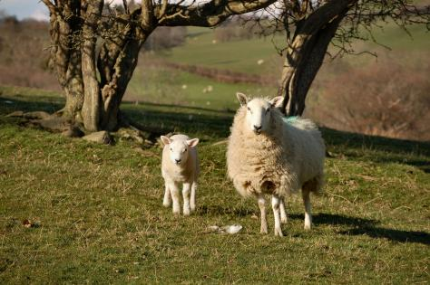
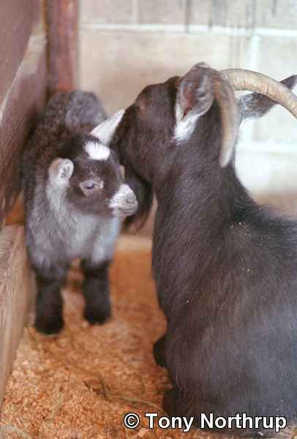
Sheep & Goat Gestation
D. Compare estrous cycles and gestation of different species and list common signs of breeding readiness
Gestation: 145-150 days or 5 months
Breeding Season- Fall/Winter (dairy goats year round)
Cycle: Late fall when days get short
  “Short day breeders”

Slide 24
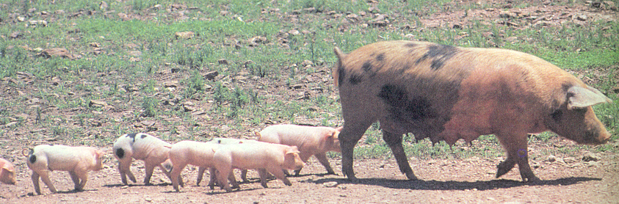
Pig Gestation
D. Compare estrous cycles and gestation of different species and list common signs of breeding readiness
Gestation- 115 days
  OR 3 months, 3 weeks, 3 days
Breeding Season- year round
Cycle- Year round every 21 days

Slide 25
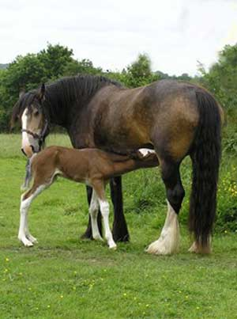
Horse Gestation
D. Compare estrous cycles and gestation of different species and list common signs of breeding readiness
Gestation- 336 days or 11 months
Breeding Season- Spring
Cycle- Spring/Summer when days are long
  “Long day breeders”

Slide 26
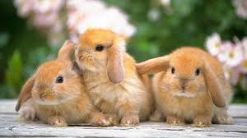
Rabbit Gestation
D. Compare estrous cycles and gestation of different species and list common signs of breeding readiness
Gestation- 30 days
Breeding Season- Year round
Cycle- Constantly, year round

Slide 27
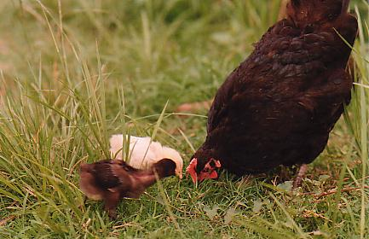
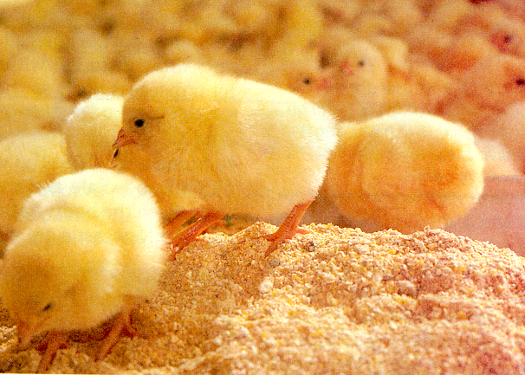
Chicken Gestation
D. Compare estrous cycles and gestation of different species and list common signs of breeding readiness
Gestation- 21 days (incubation)
Breeding Season- Year round or spring
Cycle- Year round, but more productive when days are long

Slide 28
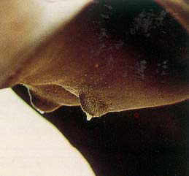
Parturition
E. Describe signs of parturition and dystocia
Parturition- The act of giving birth
Signs:
  Milk develops in udder
  Abdomen drops
  Nesting
  Restlessness or pacing
  Abdomen muscles contract (watch for young!)

Slide 29
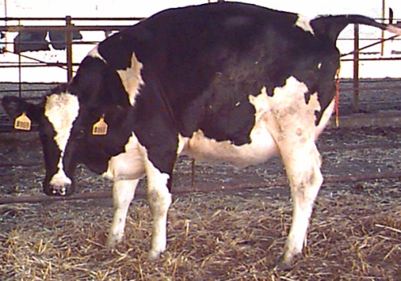
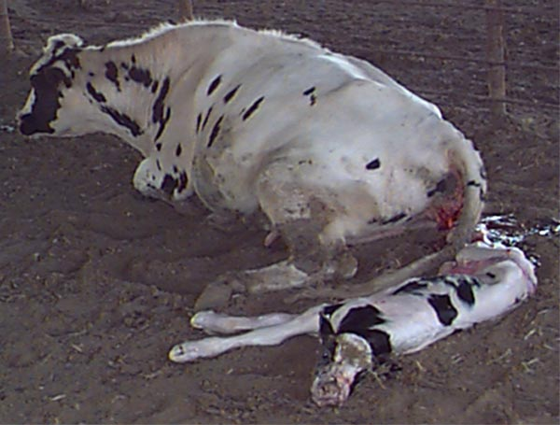
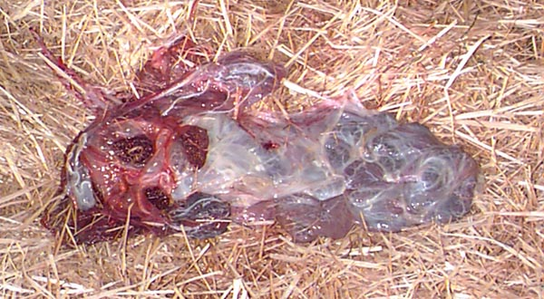
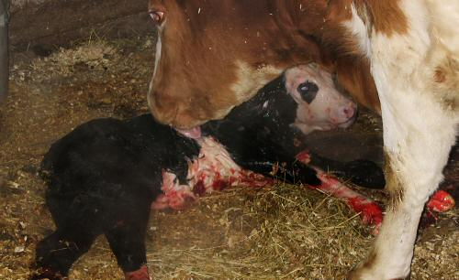
Stages of Parturition
E. Describe signs of parturition and dystocia
Stage 1 –
  Preparatory Stage (Labor)
Stage 2 –
  Delivery of Fetus
Stage 3 –
  Expulsion of the placenta
Stage 4 –
  Period of Rest

Slide 30
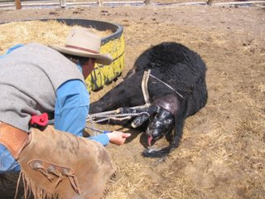
Dystocia
E. Describe signs of parturition and dystocia
Dystocia- Difficulty giving birth
Causes:
  Presentation
  Oversized fetus
  Multiple births
  Exhaustion, uterine contractions stop
Solutions: Call vet or assist yourself
  Cesarean Section (c-section)
  Assist manually

Slide 31
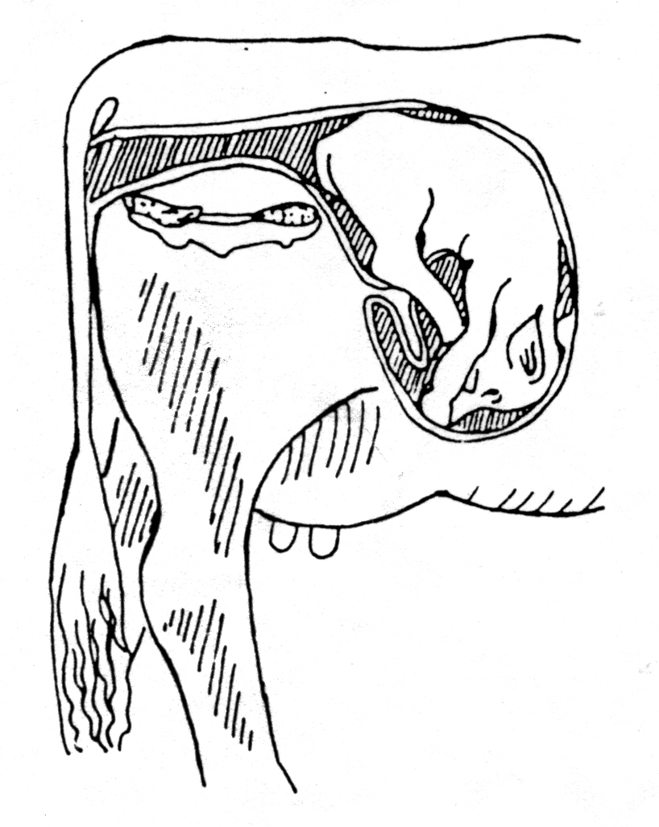
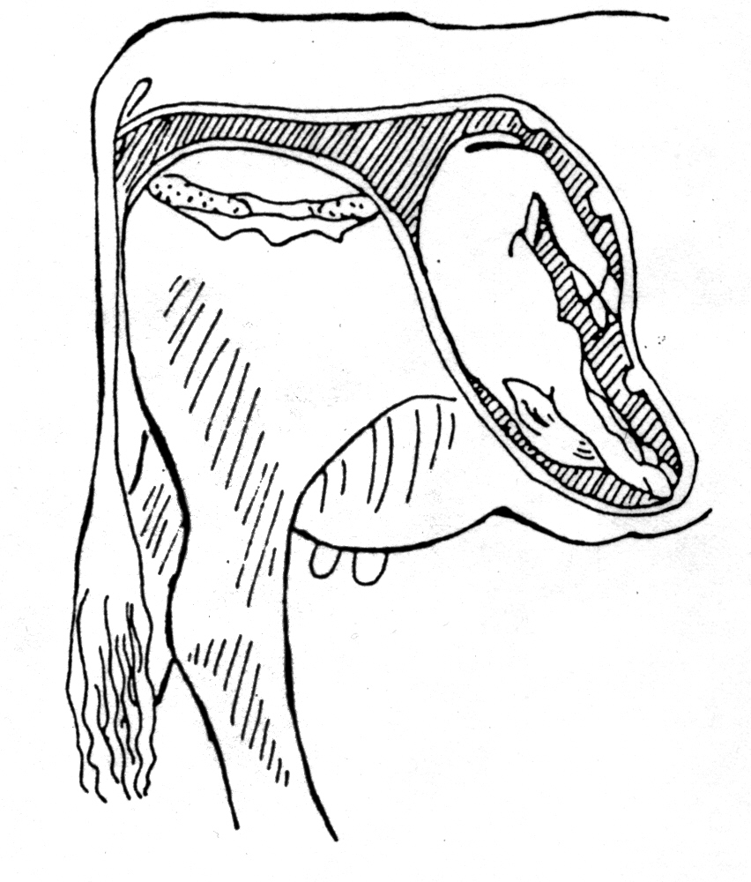
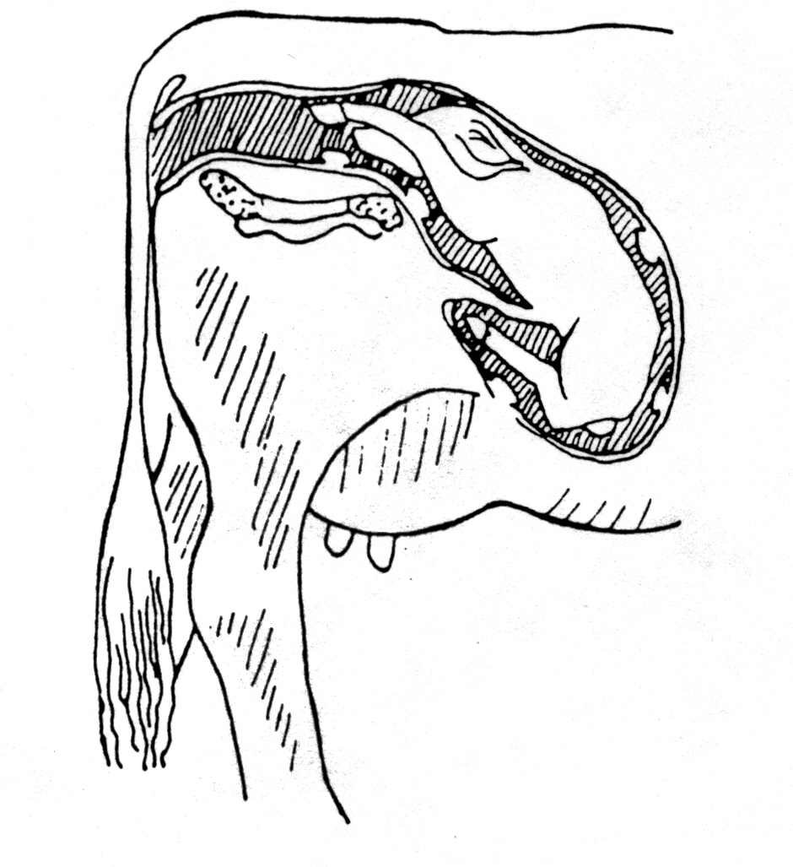
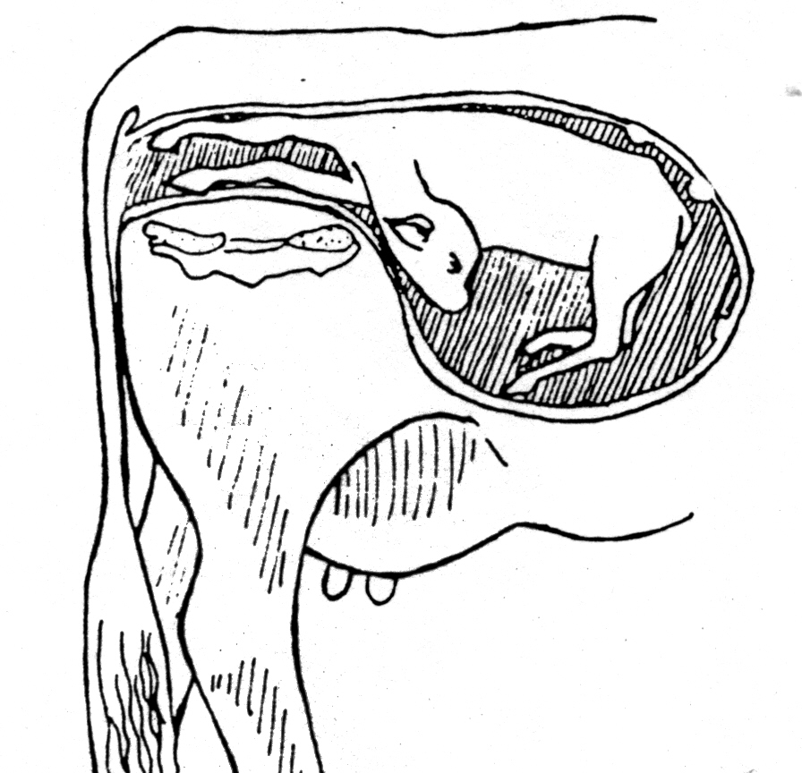
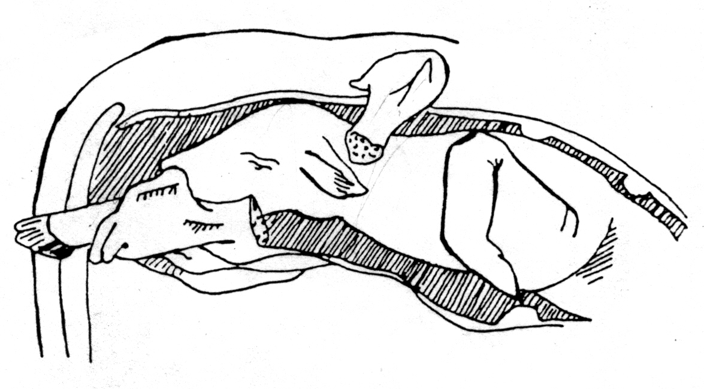
Dystocia
E. Describe signs of parturition and dystocia
Birth Presentations
Upside down & Backward
Breech
Normal
Head Back
Leg Back

Slide 32
Reproductive Technologies
F. Describe the purpose and benefits of reproductive technologies
Any method of reproduction that is not a natural method

Slide 33
Reproductive Technologies
F. Describe the purpose and benefits of reproductive technologies
Artificial Insemination
Collecting and placing sperm from the male to the female reproductive tract without natural mating

Slide 34


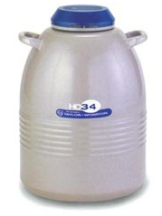
Reproductive Technologies
F. Describe the purpose and benefits of reproductive technologies
Artificial Insemination
Step 1: Collect & Store Semen
-Collect Semen
-Extend sample and place in straws
-Store in liquid nitrogen

Slide 35
Reproductive Technologies
F. Describe the purpose and benefits of reproductive technologies
Artificial Insemination
Step 2: Manually inject semen into female reproductive tract at correct stage of estrus

Slide 36
Reproductive Technologies
F. Describe the purpose and benefits of reproductive technologies
Advantages of
Artificial Insemination
1- Wider selection & use of outstanding sires
2- Rapid Genetic and herd improvement
3- Overcome physical barriers to mating
  Examples: Aggressive behavior or injuries
4- Danger of the bull is eliminated
5- Eliminate cost of purchasing and keeping a bull

Slide 37
Reproductive Technologies
F. Describe the purpose and benefits of reproductive technologies
Disadvantages of
Artificial Insemination
1- Skilled Technician or training required
2-Very close supervision of females is necessary to accurately determine stage of estrus

Slide 38
Reproductive Technologies
F. Describe the purpose and benefits of reproductive technologies
Synchronized Ovulation
The process of causing a herd of cows or heifers to come into estrus and ovulate at or near the same time

Slide 39
Reproductive Technologies
F. Describe the purpose and benefits of reproductive technologies
Embryo Transfer
The transfer of fertilized egg(s) from a donor female to one or more recipient females
Utilizes genetics of superior FEMALES by producing more offspring per year than by natural breeding methods

Slide 40
Reproductive Technologies
F. Describe the purpose and benefits of reproductive technologies
Cloning
Producing an EXACT genetic copy of an organism

Slide 41
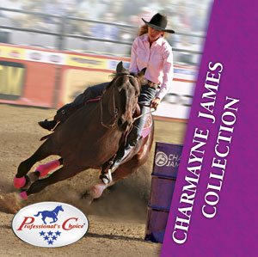
Reproductive Technologies
F. Describe the purpose and benefits of reproductive technologies
Cloning “Scamper”
Charmayne James was first Million Dollar Cowgirl, 1990
11 Consecutive Barrel Racing Championships
First WPRA Member listed in Guinness Book of World Records, 1987&92
WPRA Record Most NFR Qualifications, 19 (consecutive)
All won on her beloved horse, “Scamper”

Slide 42
Reproductive Technologies
F. Describe the purpose and benefits of reproductive technologies
Cloning “Scamper”
Few people involved in the horse industry haven't heard the legendary story of Gill's Bay Boy, affectionately known as "Scamper," and his jockey and partner Charmayne James who together set the world of pro rodeo on fire beginning in 1984. Scamper came to Charmayne as an untrained young prospect with a renegade reputation and was best known in those days for bucking off ranch cowboys. At the tender age of 14 Charmayne did the inconceivable. She trained and cared for Scamper and in the process revealed the limitless potential concealed beneath his common exterior. With dedication and careful attention to conditioning Charmayne produced an equine legend whose historical achievements will not soon if ever be duplicated. The young horsewoman was herself a prodigy honing her training skills to take Scamper from the anonymity of the feedlot to the spotlight of the rodeo arena. The two inevitably raced to unforgettable performances in arenas from Houston to Las Vegas and most everywhere in between along the way. Scamper and Charmayne's list of accolades together are endless and include Scamper's induction into the PRCA Hall of Fame, as well as Charmayne's place in the National Cowgirl Hall of Fame, National Cowboy Hall of Fame, and Texas Cowboy Hall of Fame, among others.

Slide 43
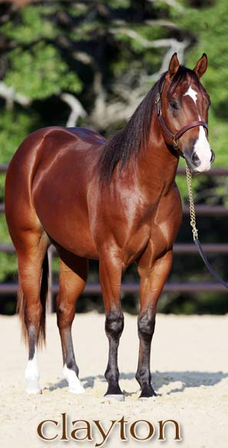
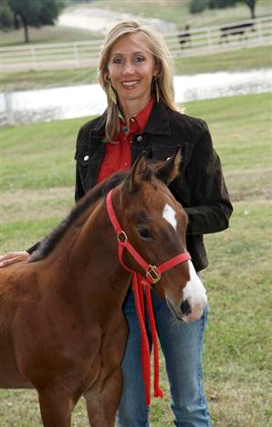
Reproductive Technologies
F. Describe the purpose and benefits of reproductive technologies
Scamper’s Clone: “Clayton”
Notes:
-More information about Clayton can be found on website: http://www.charmaynejames.com/index.php/clayton
-Answers to FAQ’s about cloning can also be found at: http://www.charmaynejames.com/index.php/clayton/fact-vs-fiction

Slide 44
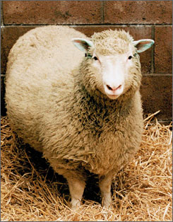
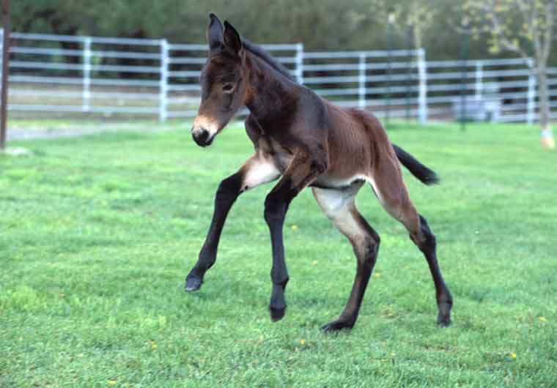
Reproductive Technologies
F. Describe the purpose and benefits of reproductive technologies
Is cloning new?
Mule cloned at USU in 2003
“Dolly” cloned in 1996

Slide 45
Bell Quiz
Objective A, B, & C
Why is successful animal reproduction important to the finances of farming and ranching?
How would it effect our food supply if animal producers were NOT successful at reproducing their animals?
Should all animals be used for breeding?
What is the male & female reproductive cell?
What 3 glands produce semen in the male reproductive tract?

Slide 46
Bell Quiz
Objective D
What is the difference between “estrous” and “estrus?”
How long is the gestation of a sheep or goat?
How does daylight effect the estrous cycle of some animals?
What is unique about a rabbit’s reproductive system that allows them to reproduce quickly?

Slide 47
Bell Quiz
Objective E
What is the definition of dystocia?
What does the word, parturition mean?
Name 3 signs that could indicate that an animal will give birth soon.
What purpose does the placenta serve in the growth and development of a fetus?
Describe a normal birth presentation of a calf.

Slide 48
Bell Quiz
Objective F
What reproductive technology is used to enhance the # of offspring a superior SIRE can have
What reproductive technology is used to enhance the # of offspring a superior DAM can have
What are 2 benefits of Artificial insemination?
What are 2 disadvantages of Artificial Insemination?

