Slide 1
Animal Anatomy & Physiology
Describe the role of the muscular and skeletal system
Describe the role of the respiratory & circulatory system
Describe the role of the nervous system
Describe the role of the excretory system

Slide 2
Muscular System
Describe the role of the muscular and skeletal system

Slide 3
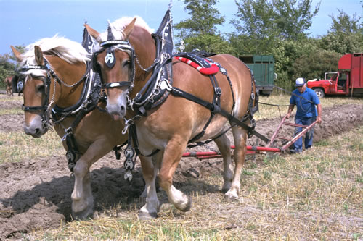
Draft Horse Trivia
Weighs average of 1500-3000 lbs
4 major breeds
Used today mostly for pleasure
Where once a necessity for work before the tractor
On average, can pull 2-3 times it’s body weight

Slide 4
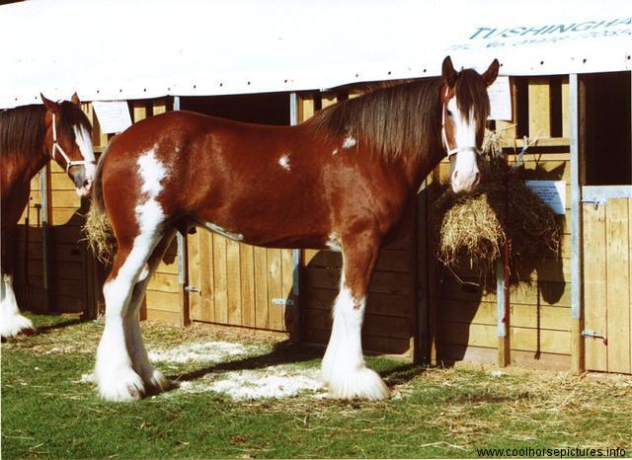
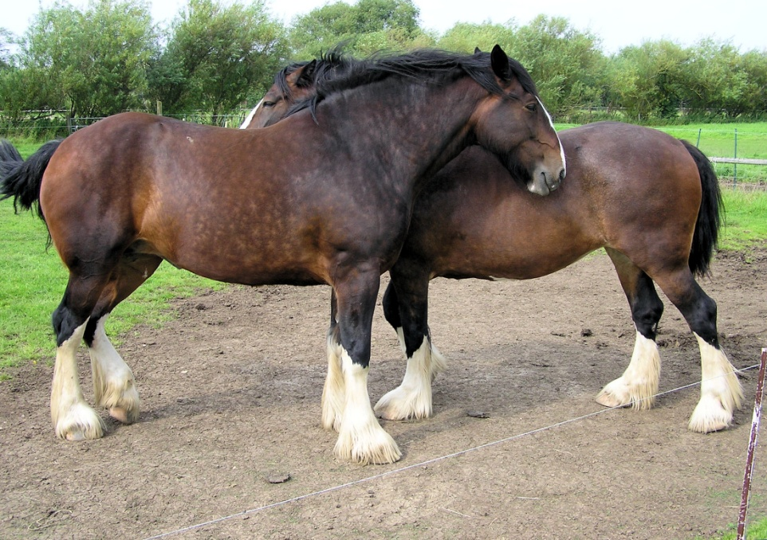
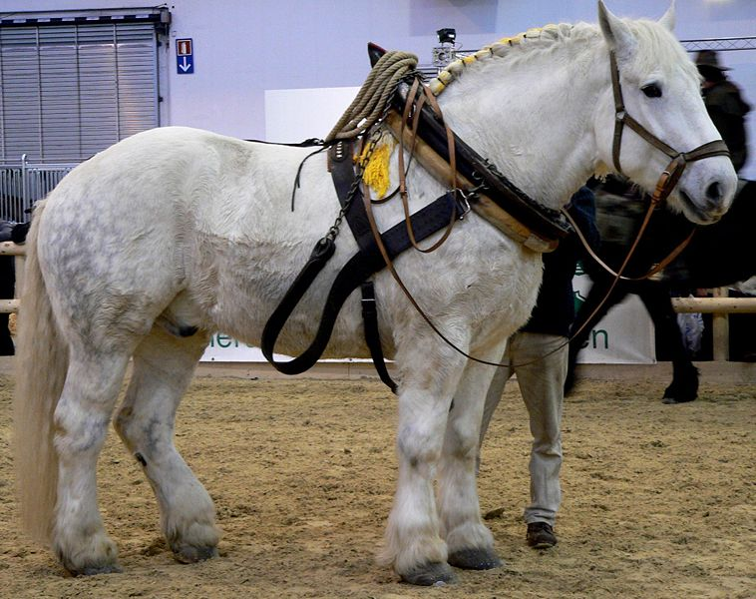
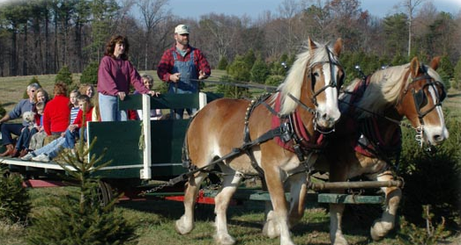
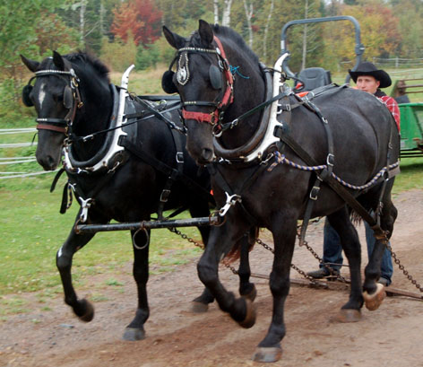
Notes:
Top left: Clydesdale. Most well known breed of draft horse. Fanciest looking breed with white legs and feathering. Usually bay colored with white markings
Top Right: Shire. Usually bay colored with white legs. Typically shorter than clydesdale
Bottom Left: Percheron. Black, Gray, or White in color. Largest of draft breeds
Bottom Right: Belgium. Always a solid brown color ranging from sorrel/red to a light colored brown

Slide 5
Muscular System
Describe the role of the muscular and skeletal system
Function & Purpose:
Provides movement to the body
System is made up of:
Skeletal Muscle
Smooth Muscle
Cardiac

Slide 6
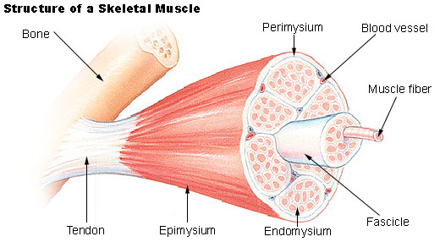
Muscular System
Describe the role of the muscular and skeletal system

Slide 7
Muscular System
Describe the role of the muscular and skeletal system
Sarcomere
Z Line
Z Line
Thick filaments
Thin Filaments

Slide 8
Muscular System
Describe the role of the muscular and skeletal system
Muscle Contraction
Distance between Z bands shorten
Thin filaments slide past thick filaments

Slide 9
Muscular System
Describe the role of the muscular and skeletal system
3 Types of Muscle:
Skeletal
Largest portion of muscle
Moves the skeleton
Attached to bones with tendons
VOLUNTARY muscles

Slide 10
Muscular System
Describe the role of the muscular and skeletal system
3 Types of Muscle:
Smooth
Controls movement of internal organs
Peristalsis of digestive system, urinary system, etc
INVOLUNTARY muscles

Slide 11
Muscular System
Describe the role of the muscular and skeletal system
3 Types of Muscle:
Cardiac
Makes up the heart
INVOLUNTARY muscles

Slide 12
Skeletal System
Describe the role of the muscular and skeletal system

Slide 13
Skeletal System
Describe the role of the muscular and skeletal system
Function & Purpose:
Provides frame and support to the body
System is made up of:
Cartilage
Bones
Connective Tissue (tendons & ligaments)

Slide 14
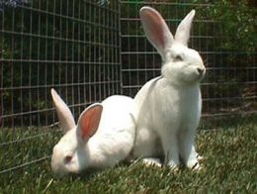
Skeletal System
Describe the role of the muscular and skeletal system
Cartilage
Firm tissue that isn’t as hard as bone and is somewhat flexible
Nose & Ears

Slide 15
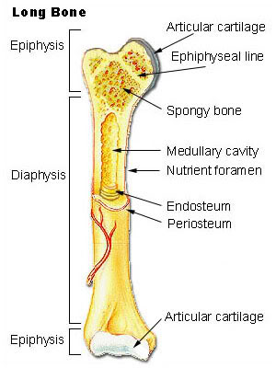
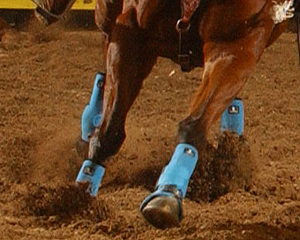
Skeletal System
Describe the role of the muscular and skeletal system
Long Bones
Longest bones in body
Provides support for animal to stand and move

Slide 16
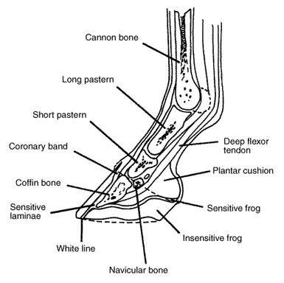
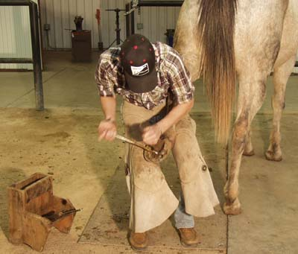
Skeletal System
Describe the role of the muscular and skeletal system
Short Bones
Are often as big around as they are long
Mostly found in joints and give flexibility

Slide 17
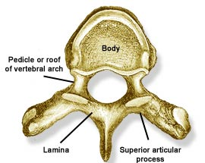
Skeletal System
Describe the role of the muscular and skeletal system
Irregular Bones
Are irregularly shaped
Function as support & protection
Vertebrae

Slide 18
Skeletal System
Describe the role of the muscular and skeletal system
Irregular Bones
Cervical Vertebrae = Neck
Thoracic Vertebrae = Rib cage
Lumbar Vertebrae = Lower back
Sacral Vertebrae = Pelvic (hip) area
Coccygeal = From pelvis to end of tail

Slide 19
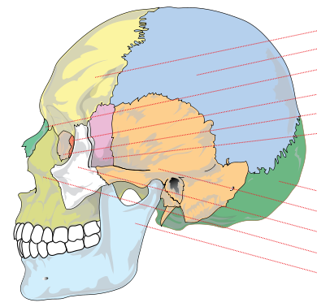
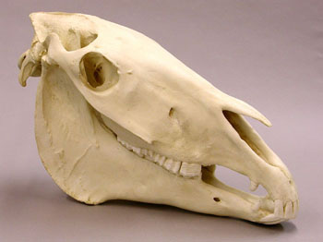
Skeletal System
Describe the role of the muscular and skeletal system
Flat Bones
Relatively thin and flat
Usually multiple flat bones fused together
Usually help protect organs
Ribs & skull

Slide 20
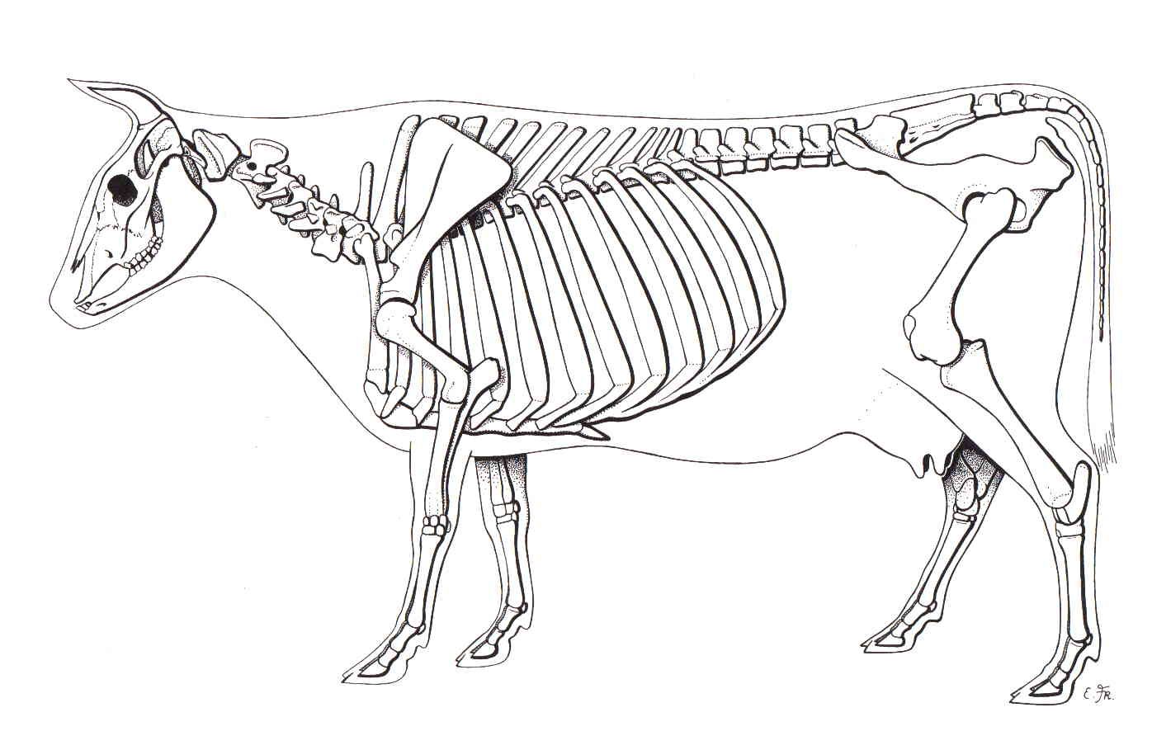
Skeletal System
Describe the role of the muscular and skeletal system
On the Cow Skeleton, color the following:
Red- Long bones
Green- Short bones
Grey- Flat Bones
Irregular Bones:
Purple- Cervical
Pink- Thoracic
Blue- Lumbar
Orange- Sacral
Yellow- Coccygeal

Slide 21
Skeletal System
Describe the role of the muscular and skeletal system
Joints
Connections of bone in the animal’s body
Held together with ligaments
Hinge
Ball & Socket
Gliding

Slide 22
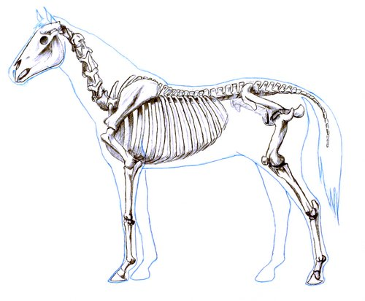
Skeletal System
Describe the role of the muscular and skeletal system
Draw a shape around the following joints:
Triangle = Hinge Joint
Circle = Ball & Socket
Square = Gliding

Slide 23
Skeletal System
Describe the role of the muscular and skeletal system

Slide 24
Respiratory System
B. Describe the role of the respiratory & circulatory system

Slide 25
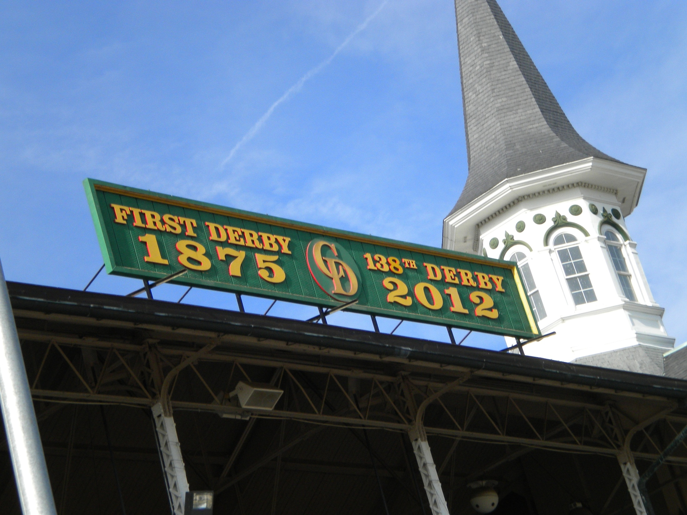
Notes:
Churchill Downs- Home of the Kentucky Derby since 1875

Slide 26
JOCKEY- PAT DAY
4’11”
100 pounds
8,803 Career Victories
$297,941,912 in career earnings
Born in Colorado where he wanted to be a Rodeo Cowboy…
Notes:
Photo is statue of Pat Day at Churchill Downs
Facts about Jockeys:
-Jockeys wear “silks” to represent the farm they are riding for
-Jockeys do not have a height limit, but can’t weigh more than 126 lbs including their saddle
-Jockeys are hired by the trainer and paid a small wage for running as well as a portion of the earnings if the horse wins or places
-Can be a dangerous job

Slide 27
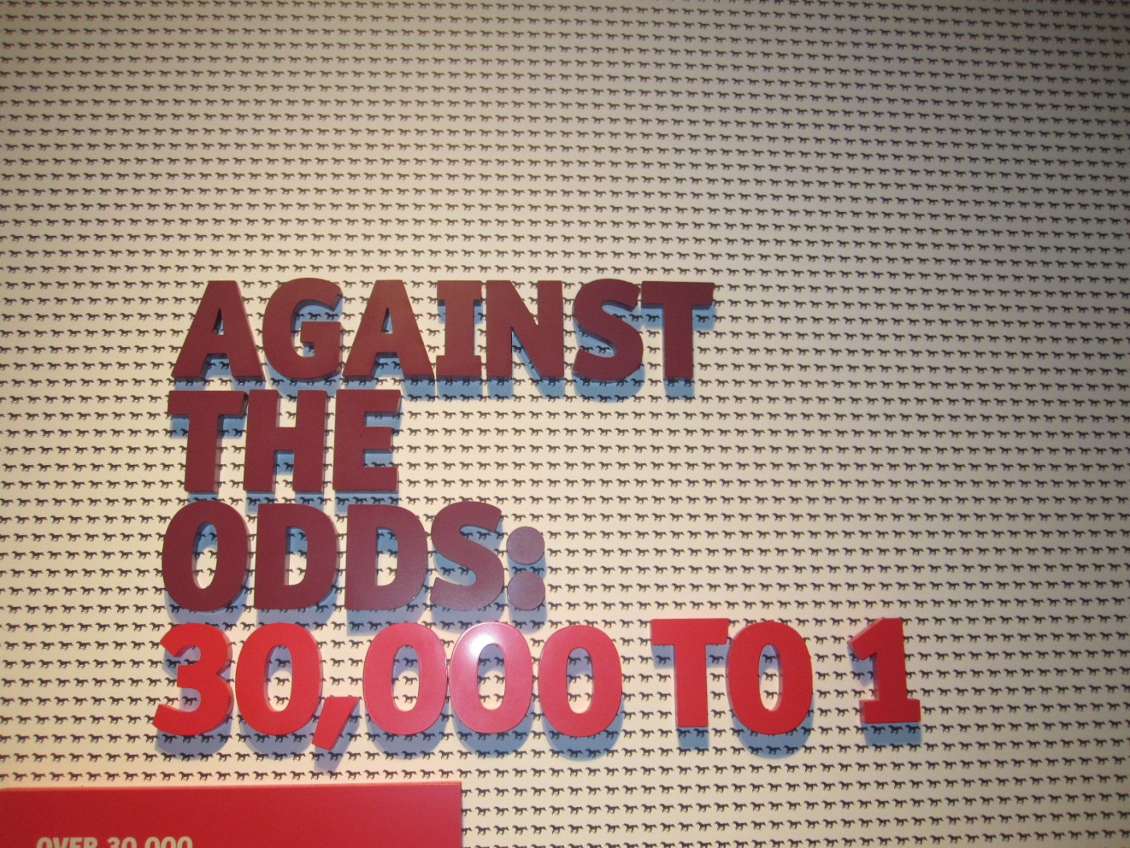
Notes:
Every year approximately 30,000 thoroughbred foals are born with the hopes of winning the Kentucky Derby. They only have 1 shot when they are 3 years old.

Slide 28
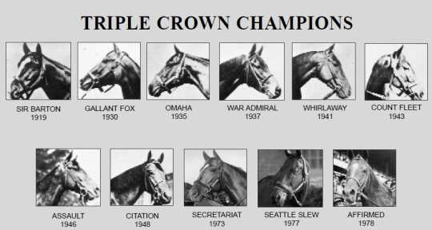
The greatest horse racing honor…
A horse must win:
1-Kentucky Derby 2- Belmont Stakes 3- Preakness
Notes:
The greatest honor a race horse can receive is to win the Triple Crown, which hasn’t been done since 1978.

Slide 29
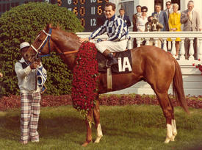
Secretariat
Notes:
Secretariat was a famous racehorse who won the Triple Crown in 1973. He won the final race (the longest in distance) by an astounding 31 lengths. When he died, an autopsy showed his heart to be larger than average. Secretariat’s efficient heart could have played a factor in his extreme success as a race horse.

Slide 30
Respiratory System
B. Describe the role of the respiratory & circulatory system
Function & Purpose:
Obtain & use oxygen and get rid of carbon dioxide
System is made up of:
Nasal Cavity
Larynx & Pharynx
Trachea
Lungs

Slide 31
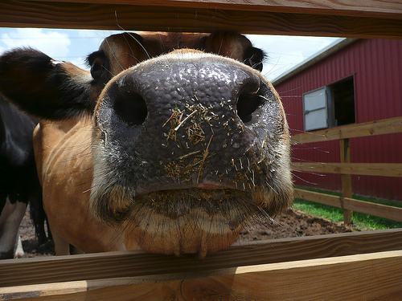
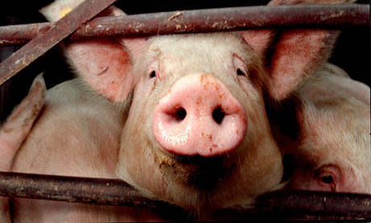
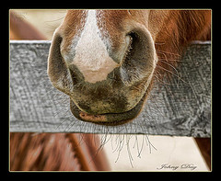
Respiratory System
B. Describe the role of the respiratory & circulatory system
1. Nostrils
Also called nares
Paired, external openings
Separated by nasal septum

Slide 32
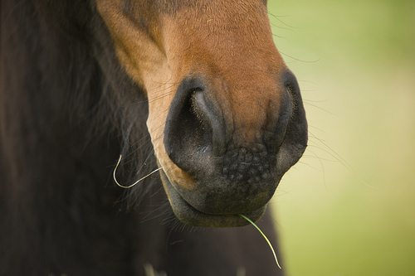
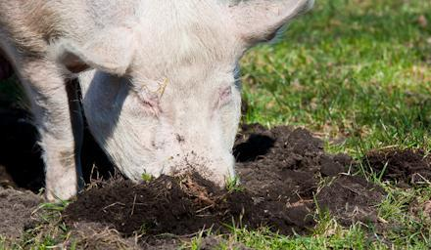
Respiratory System
B. Describe the role of the respiratory & circulatory system
1. Nostrils
Dilatable
Species Differences
Horse Very Pliable and Dilatable
Pig Rigid

Slide 33
Respiratory System
B. Describe the role of the respiratory & circulatory system
2. Nasal Cavities
Paired
Separated by Nasal Septum, and from mouth by palate
3. Pharynx

Slide 34
Respiratory System
B. Describe the role of the respiratory & circulatory system
4. Larynx
"Voice Box"
Organ of phonation (Sound Production)
Passing air causes vibration of vocal chords
Syrinx
Voice Box for Birds

Slide 35
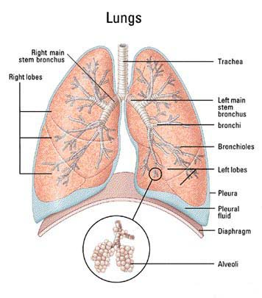
Respiratory System
B. Describe the role of the respiratory & circulatory system
5. Trachea
Primary passage way to Lungs
Cartilage Rings prevent collapse of airway
6. Bronchi
2 main branches from trachea

Slide 36
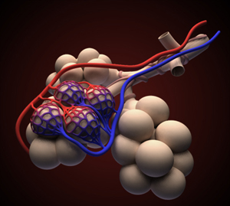
Respiratory System
B. Describe the role of the respiratory & circulatory system
7. Bronchioles
Smaller stems of bronchi
8. Alveoli
Principle site of gaseous diffusion between air and blood

Slide 37
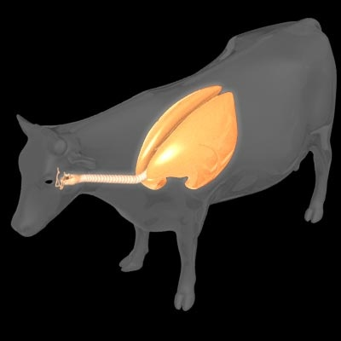
Respiratory System
B. Describe the role of the respiratory & circulatory system
Lungs
Principle Organ of Respiratory System
Paired, found in Thorax
a. Thorax expansion causes Lung expansion

Slide 38
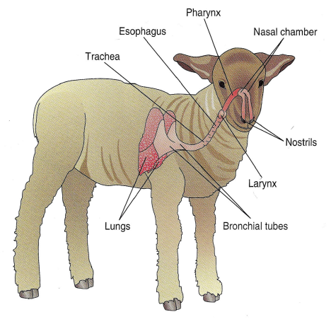
Respiratory System
B. Describe the role of the respiratory & circulatory system

Slide 39
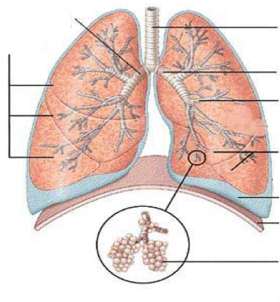
Respiratory System
B. Describe the role of the respiratory & circulatory system
Right Bronchus
Trachea
Right Lobes
Left Bronchus
Bronchioles
Left Lobes
Pleura
Diaphragm
Alveoli

Slide 40
Circulatory System
B. Describe the role of the respiratory & circulatory system

Slide 41
Circulatory System
B. Describe the role of the respiratory & circulatory system
Function & Purpose:
Circulates blood carrying oxygen
System is made up of:
Heart
Arteries
Veins
Capillaries

Slide 42
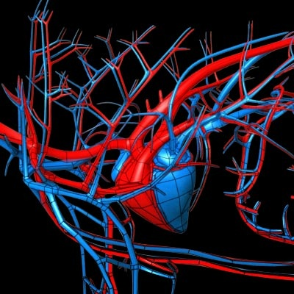
Circulatory System
B. Describe the role of the respiratory & circulatory system
Closed circuit pathway
Blood cells follow this path over, and over, and over again

Slide 43
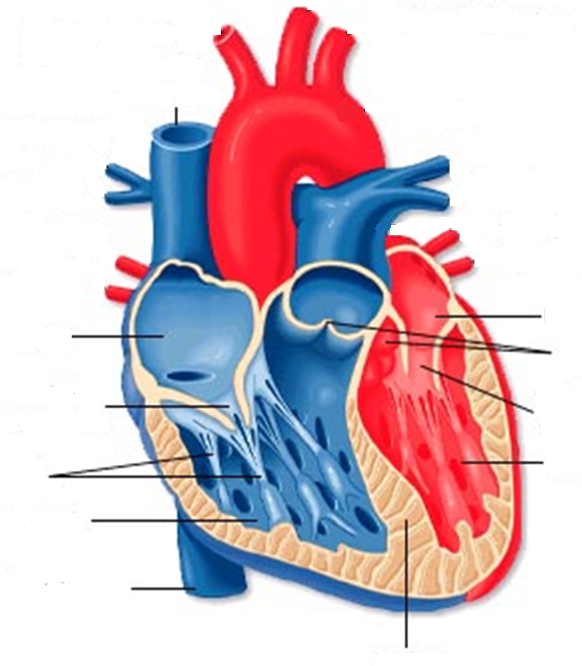
Circulatory System
B. Describe the role of the respiratory & circulatory system
Superior Vena Cava
Red = Oxygenated
Blue = Deoxygenated
Left Atrium
Right Atrium
Semilunar Valve
Tricuspid Valve
Mitral Valve
Perkinje Fibers
Left Ventricle
Right Ventricle
Inferior Vena Cava

Slide 44
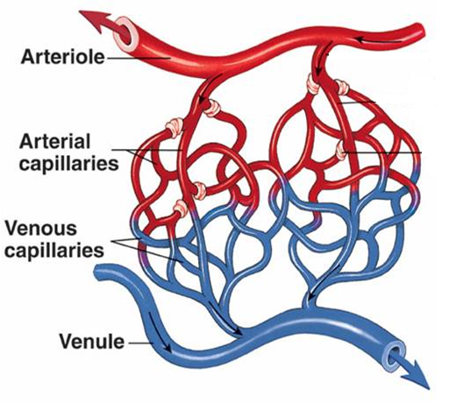
Circulatory System
B. Describe the role of the respiratory & circulatory system
1-Capillary:
Site of gas exchange
Microscopic in size
Every inch of your body is covered in hundreds of capillaries

Slide 45
Circulatory System
B. Describe the role of the respiratory & circulatory system
2-Vein:
Pathway of blood headed BACK to the heart
Always deoxygenated
With 1 exception
Small Veins are called Venules

Slide 46
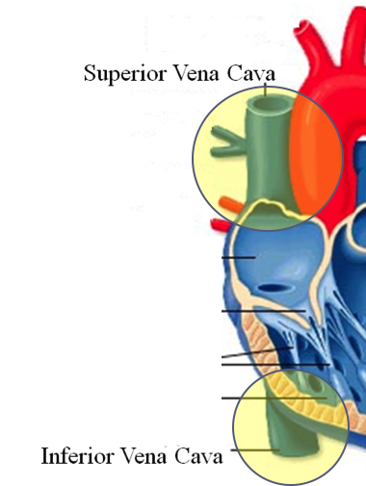
Circulatory System
B. Describe the role of the respiratory & circulatory system
3-Superior/Inferior Vena Cava
Where blood ENTERS heart

Slide 47
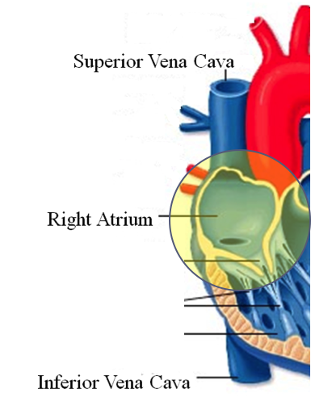
Circulatory System
B. Describe the role of the respiratory & circulatory system
4-Right Atrium
1st Chamber of the heart

Slide 48
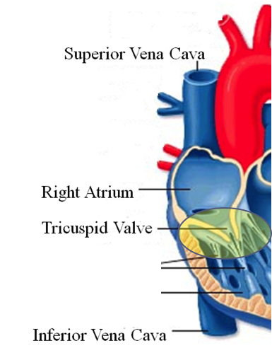
Circulatory System
B. Describe the role of the respiratory & circulatory system
5-Tricuspid Valve
3 Sections

Slide 49
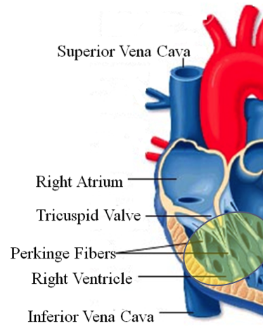
Circulatory System
B. Describe the role of the respiratory & circulatory system
6-Purkinje Fibers
Prevent backflow of blood

Slide 50
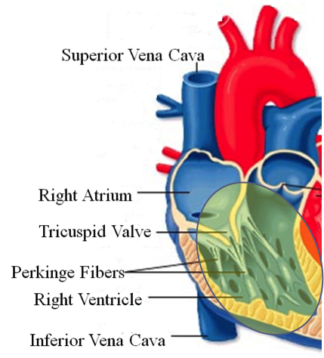
Circulatory System
B. Describe the role of the respiratory & circulatory system
7-Right Ventricle
2nd Chamber of heart

Slide 51
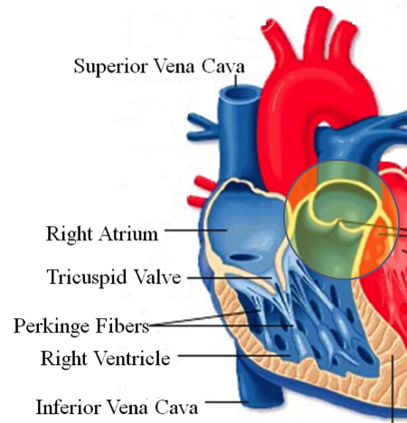
Circulatory System
B. Describe the role of the respiratory & circulatory system
8-Semilunar Valve
Deoxygenated blood LEAVES the heart through this valve

Slide 52
Circulatory System
B. Describe the role of the respiratory & circulatory system
9-Lungs
Blood is oxygenated by lungs
Oxygen exchange takes place by passing from the alveoli (respiratory system) to the capillaries (circulatory system)

Slide 53
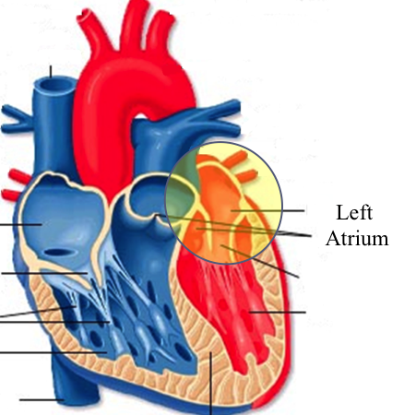
Circulatory System
B. Describe the role of the respiratory & circulatory system
10-Left Atrium
3rd Chamber
OXYGENATED blood re enters the heart

Slide 54
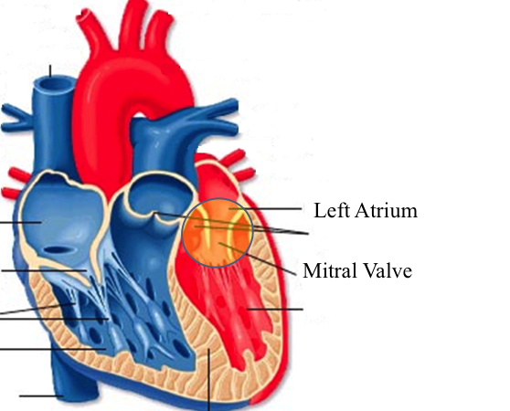
Circulatory System
B. Describe the role of the respiratory & circulatory system
11-Mitral Valve
Valve between LEFT atrium & ventricle

Slide 55
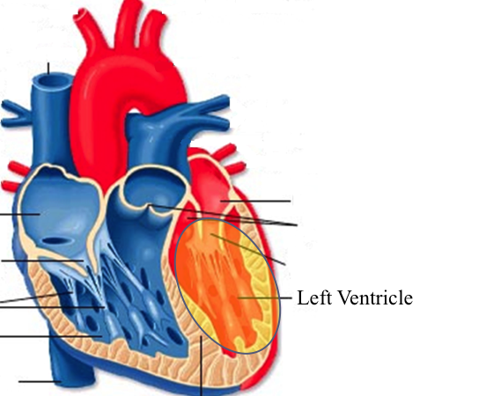
Circulatory System
B. Describe the role of the respiratory & circulatory system
12-Left Ventricle
Last (4th) chamber of the heart before blood leaves the heart through arteries

Slide 56
Circulatory System
B. Describe the role of the respiratory & circulatory system
13-Arteries
LARGE Blood passageways that take blood AWAY from the heart (usually oxygenated)
14-Capillaries (again)
Here is where the process starts all over
Junction between arteries and veins

Slide 57
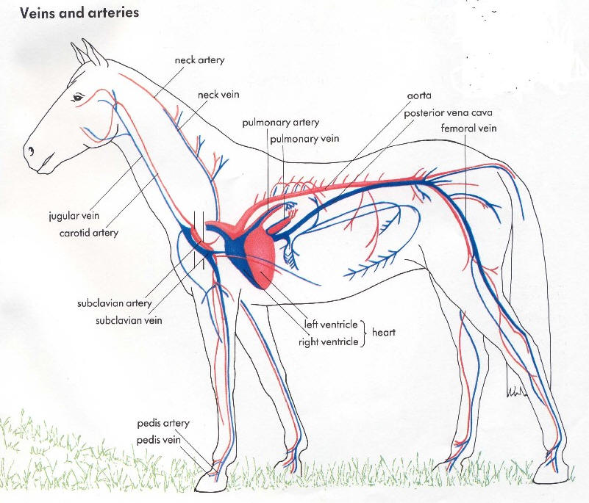
Circulatory System
B. Describe the role of the respiratory & circulatory system

Slide 58
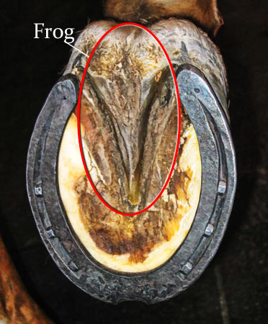
Circulatory System
B. Describe the role of the respiratory & circulatory system
Trivia Question: Which species of animal has a “second heart?”
The frog is an important part of the horse's circulatory system — it pumps blood up the horse's leg each time the frog makes contact with the ground. The blood flows down the horse's leg into the digital cushion, a fibrous part of the inner hoof located just above the frog which contains a network of blood vessels. The horse's weight then compresses the frog on the ground, squeezing the blood out of the digital cushion, and pushing it back up the horse's legs.

Slide 59
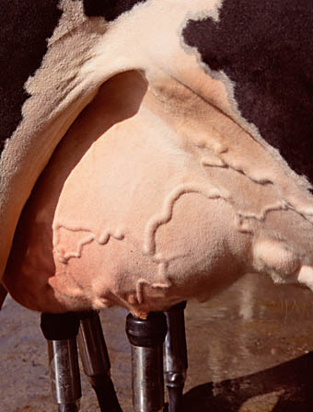
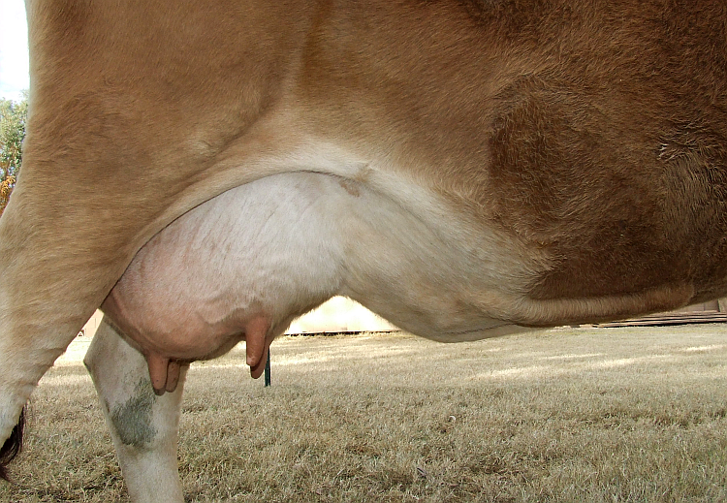
Circulatory System
B. Describe the role of the respiratory & circulatory system
Apply what you are learning: When judging dairy cattle, large venation around the udder is a good characteristic. Why?

Slide 60
Nervous System
C. Describe the role of the nervous system

Slide 61
Nervous System
C. Describe the role of the nervous system
Function & Purpose:
Control center for all body movements and processes
System is made up of:
Brain
Spinal Cord
Nerves

Slide 62
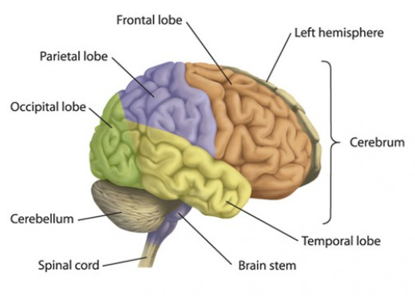
Nervous System
C. Describe the role of the nervous system
Brain
Control center of the nervous system

Slide 63
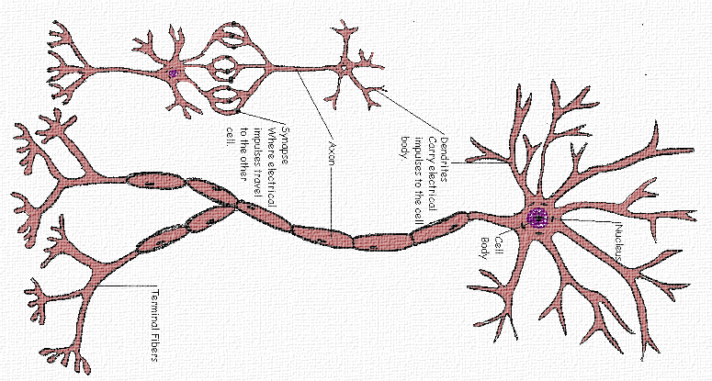
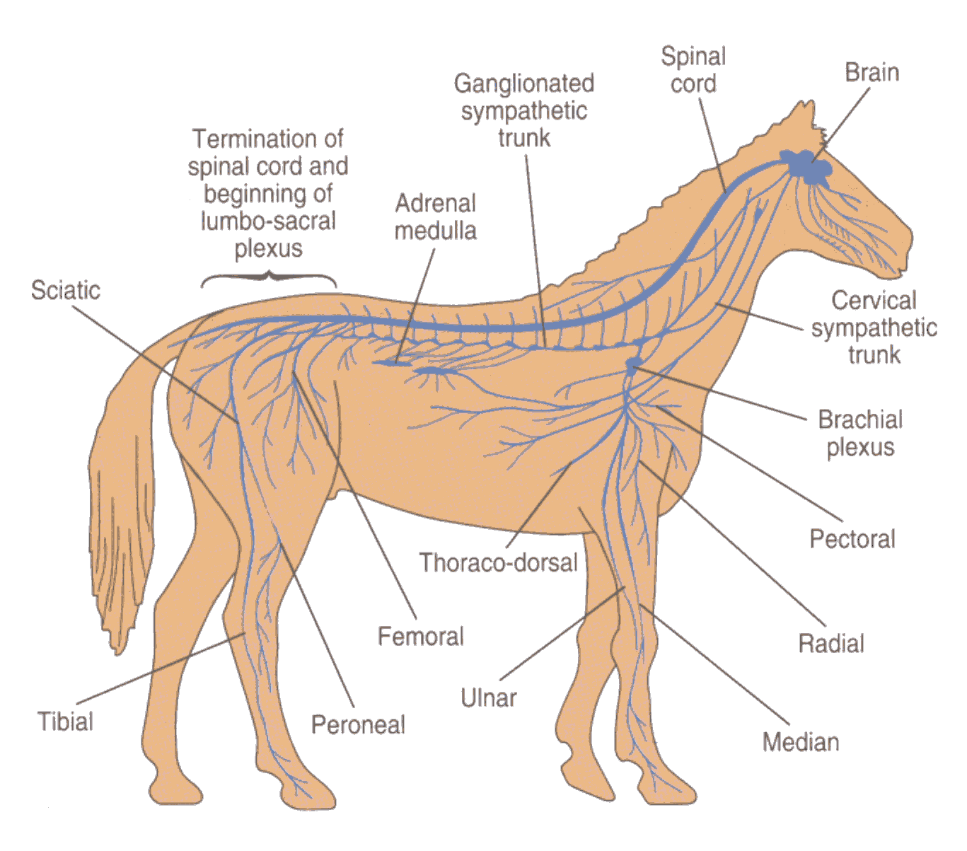
Nervous System
C. Describe the role of the nervous system
Nerves
Long, fiber like structures that send messages from the body to the brain

Slide 64
Nervous System
C. Describe the role of the nervous system
Spinal Cord
Long bundle of nervous tissue extending from the brain to the lumbar vertebrae

Slide 65
Excretory System
D. Describe the role of the excretory system

Slide 66
Excretory System
D. Describe the role of the excretory system
Function & Purpose:
Get rid of waste products from the body
System is made up of:
Kidneys
Ureters
Bladder
Urethra

Slide 67
Excretory System
D. Describe the role of the excretory system

Slide 68
Excretory System
D. Describe the role of the excretory system
Kidneys
Each animal has 2
Filter toxins from blood
Toxins are excreted as urine

Slide 69
Excretory System
D. Describe the role of the excretory system
Ureters
Each animal has 2
Tube carrying urine from kidney to bladder

Slide 70
Excretory System
D. Describe the role of the excretory system
Bladder
Each animal has 1
Stores urine til it is excreted

Slide 71
Excretory System
D. Describe the role of the excretory system
Urethra
Each animal has 1
Passageway from bladder for urine to exit the body

Slide 72
Muscular System Bell Quiz
Name 3 types of muscle
Draw a picture of a contracted sarcomere
Describe the difference between voluntary and involuntary
Give an example of a muscle that is voluntary?
Give an example of a muscle that is involuntary?

Slide 73
Skeletal System Bell Quiz
What is the definition and purpose of a flat bone?
Describe a long bone and give an example.
What is the definition of interdependence? Give an example of 2 interdependent systems.
What type of bones give movement and flexibility?
What is the name of the vertebrae that are found in an animal’s loin.

Slide 74
Respiratory System Bell Quiz
Name 2 purposes of the respiratory system
Compare the structure of the “nares” of the horse and the pig
What is the name of the voice box?
What is the name of the rooster’s voice box?
List the pathway of an air molecule from the time it enters the nasal passages til it reaches the alveoli.

Slide 75
Circulatory System Bell Quiz
Name the 4 chambers of the heart in the order that blood passes through them
What valve connects the right atrium and ventricle?
What valve connects the left atrium and ventricle?
What structure is the site of gas (oxygen) exchange?
What is the definition of a vein?

Slide 76
Nervous System Bell Quiz
What is the purpose of the nervous system?
List 3 organs that are included in the nervous system
What is the control center of the body?
What are long, thread like structures that send signals to and from brain?
What nervous system structure extends from the brain to the lumbar vertebrae?

Slide 77
Excretory System Bell Quiz
What is the purpose of the kidneys?
What do the ureters connect?
What is the purpose of the bladder?
What does urine contain?
What is the purpose of the urethra?

