Slide 1
Dairy Products & Processing
List the nutritional benefits dairy products provide to our diets
Breakdown the components found in milk
Describe how fluid milk is graded and processed
Describe the process of making other dairy products such as cheese, butter, ice cream, etc

Slide 2
Nutrition in Milk
List the nutritional benefits dairy products provide to our diets
What ad campaign promotes dairy consumption, especially in teenagers?

Slide 3
Nutrition in Milk
List the nutritional benefits dairy products provide to our diets
Read your nutrition article and be ready to answer your question…

Slide 4
Nutrition in Milk
List the nutritional benefits dairy products provide to our diets
How does MILK compare to other drinks?

Slide 5
Nutrition in Milk
List the nutritional benefits dairy products provide to our diets
What are the benefits of eating yogurt?

Slide 6
Nutrition in Milk
List the nutritional benefits dairy products provide to our diets
What are the benefits of eating cheese?

Slide 7
Nutrition in Milk
List the nutritional benefits dairy products provide to our diets
What 9 essential nutrients do milk products provide?

Slide 8
Nutrition in Milk
List the nutritional benefits dairy products provide to our diets
In addition to building bones, what diseases does calcium help prevent?

Slide 9
Nutrition in Milk
List the nutritional benefits dairy products provide to our diets
How much calcium do YOU need?
How many servings of dairy should you consume daily?

Slide 10
Nutrition in Milk
List the nutritional benefits dairy products provide to our diets
Why should athletes consume chocolate milk?

Slide 11
Nutrition in Milk
List the nutritional benefits dairy products provide to our diets
How can milk & milk products help you lose weight?

Slide 12
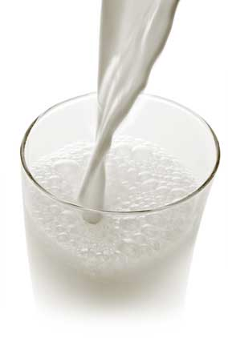
Components of Milk
B. Breakdown the components found in milk
What exactly is milk?

Slide 13
Components of Milk
B. Breakdown the components found in milk
88% Water
4-5% Protein
3-5% Fat
Minerals (Calcium)
Enzymes

Slide 14
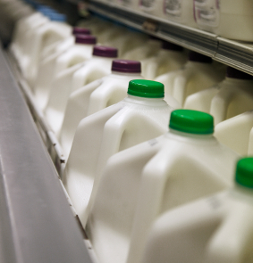
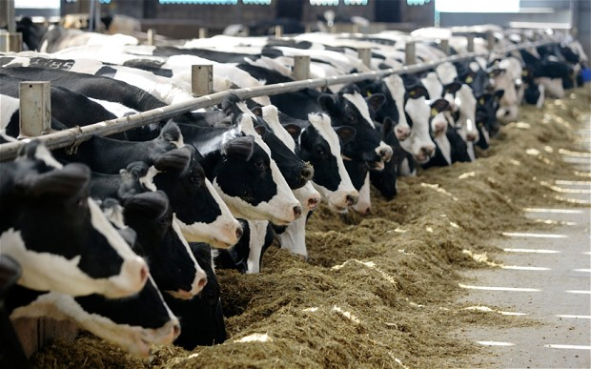
Processing Fluid Milk
C. Describe how fluid milk is graded and processed
How is milk processed between the farm and the grocery store?

Slide 15
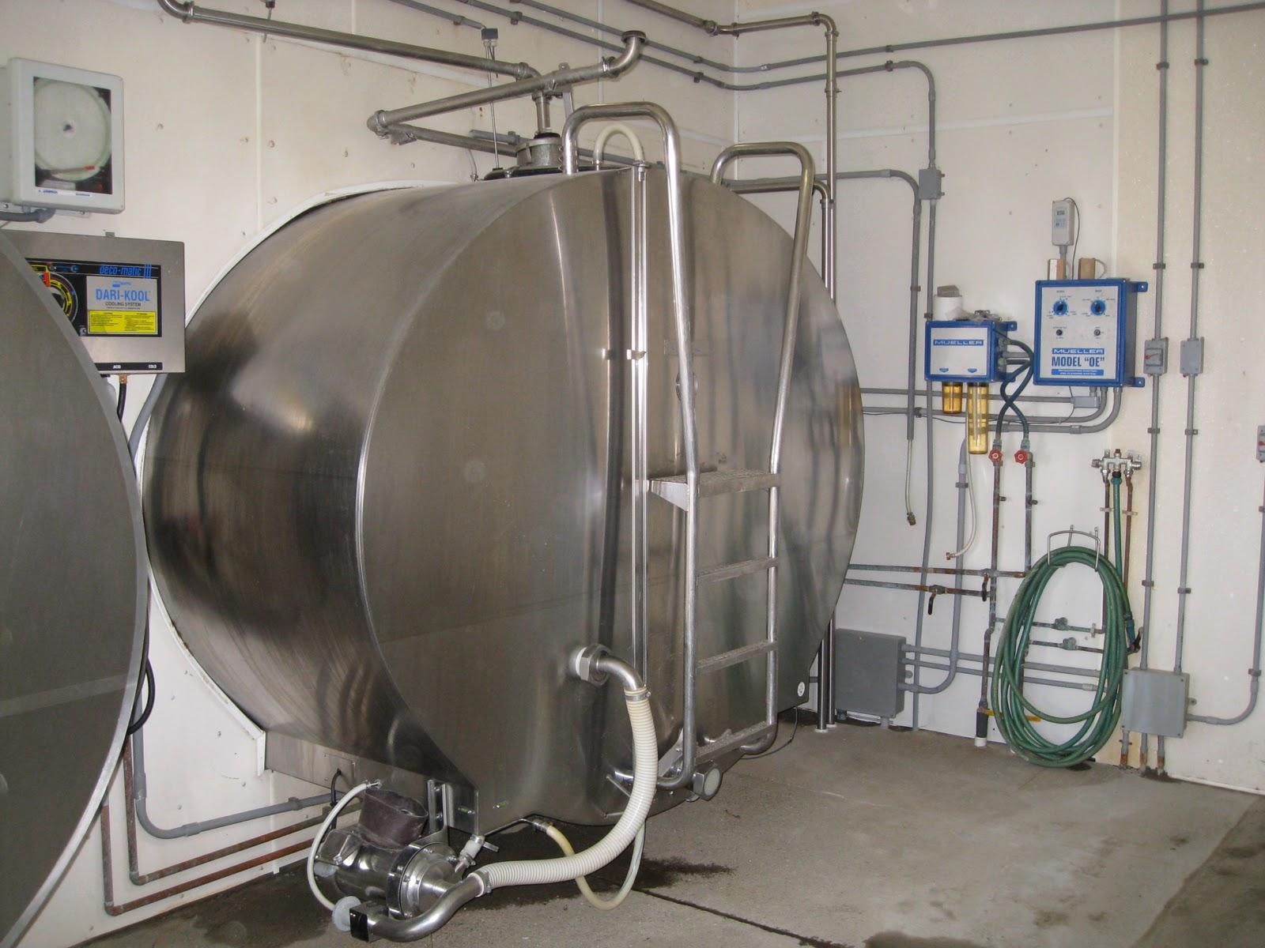
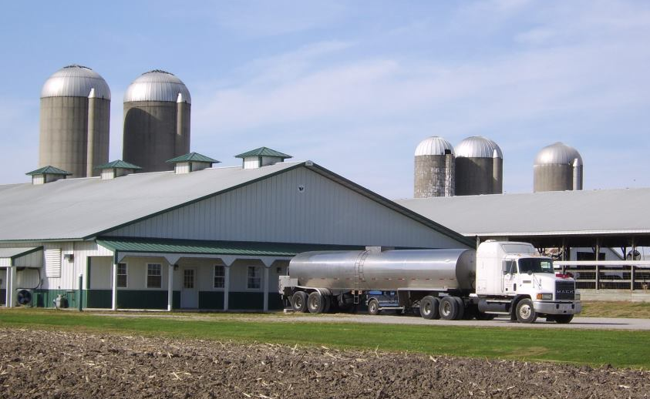
Processing Fluid Milk
C. Describe how fluid milk is graded and processed
1- Milk is stored in refrigerated tank until milk truck picks it up

Slide 16
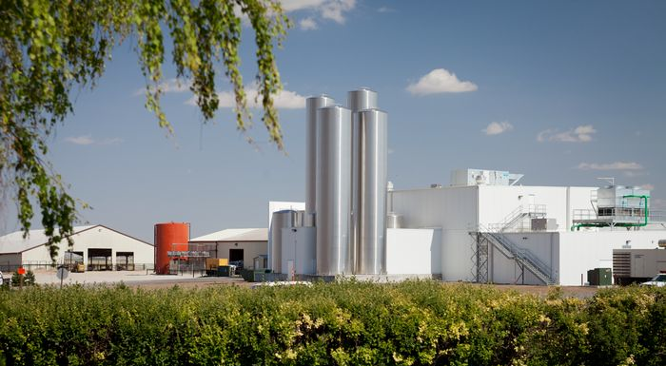
Processing Fluid Milk
C. Describe how fluid milk is graded and processed
2- Milk is delivered to a milk processing plant

Slide 17
Processing Fluid Milk
C. Describe how fluid milk is graded and processed
3- Clarification:
Process of removing any non milk particles

Slide 18
Processing Fluid Milk
C. Describe how fluid milk is graded and processed
3- Clarification:

Slide 19
Processing Fluid Milk
C. Describe how fluid milk is graded and processed
4- Separation:
Process of separating the cream (fat) from the milk

Slide 20
Processing Fluid Milk
C. Describe how fluid milk is graded and processed
4- Separation:

Slide 21
Processing Fluid Milk
C. Describe how fluid milk is graded and processed
5- Standardization:
Recombining skim and cream after separation to match a specific fat content
Whole Milk- No less than 3.25% milk fat
Reduced Fat- 2% milk fat
Low fat- 1.0% milk fat
Skim/Non Fat – less than .5% milk fat

Slide 22
Processing Fluid Milk
C. Describe how fluid milk is graded and processed
6- Pasteurization:
Process of heating milk to kill bacteria, increase shelf life, and improve food safety

Slide 23
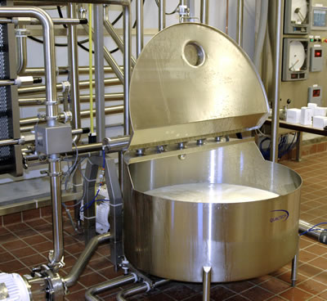
Processing Fluid Milk
C. Describe how fluid milk is graded and processed
6- Pasteurization:

Slide 24
Processing Fluid Milk
C. Describe how fluid milk is graded and processed
7- Homogenization:
Process of breaking up fat globules to create a uniform texture. (prevents milk from separating from the cream)

Slide 25
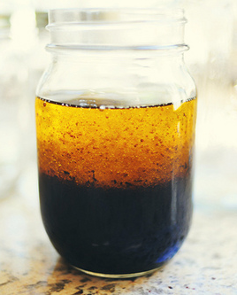
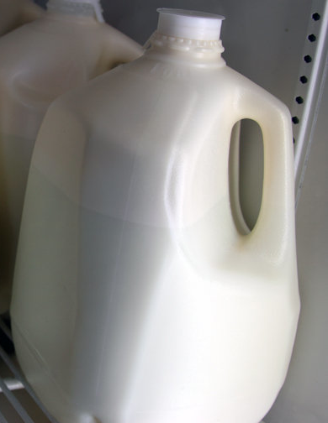
Processing Fluid Milk
C. Describe how fluid milk is graded and processed
7- Homogenization:
Raw milk will also separate. If it sits, the cream will rise to the top
Why does salad dressing separate after it sits?

Slide 26
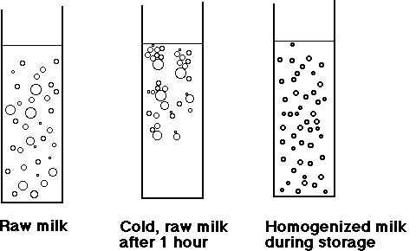
Processing Fluid Milk
C. Describe how fluid milk is graded and processed
7- Homogenization:
Homogenized milk will NOT separate because fat globules are same size as milk
Fat is more dense in raw milk, allowing it to separate

Slide 27
Processing Fluid Milk
C. Describe how fluid milk is graded and processed
8- Fortification:
Adding vitamins, minerals, or protein.
Vitamin D is added to 98% of fluid milk in the U.S.
Vitamin A is added to all reduced fat, lowfat and skim/nonfat/fat free milk.

Slide 28
Other Dairy Products
D. Describe the process of making other dairy products such as cheese, butter, and ice cream
How many dairy products can you list?

Slide 29
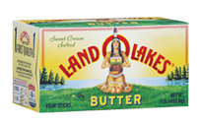
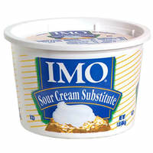
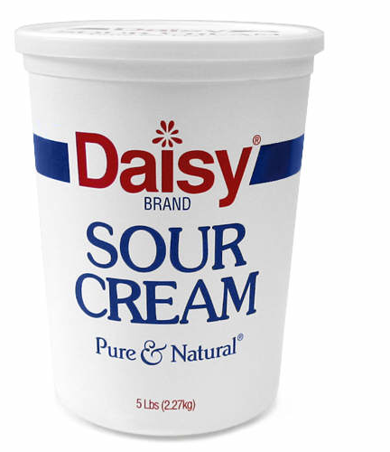
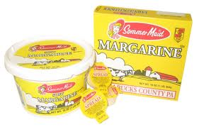
Other Dairy Products
D. Describe the process of making other dairy products such as cheese, butter, and ice cream
Some products are not actually made with milk. They are imitation dairy products

Slide 30
Other Dairy Products
D. Describe the process of making other dairy products such as cheese, butter, and ice cream
Real dairy products have the seal
“Milk” will be one of the first ingredients

Slide 31
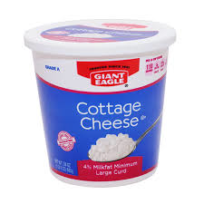
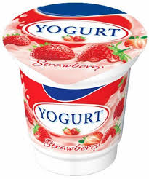
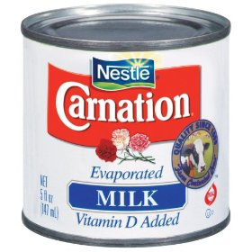
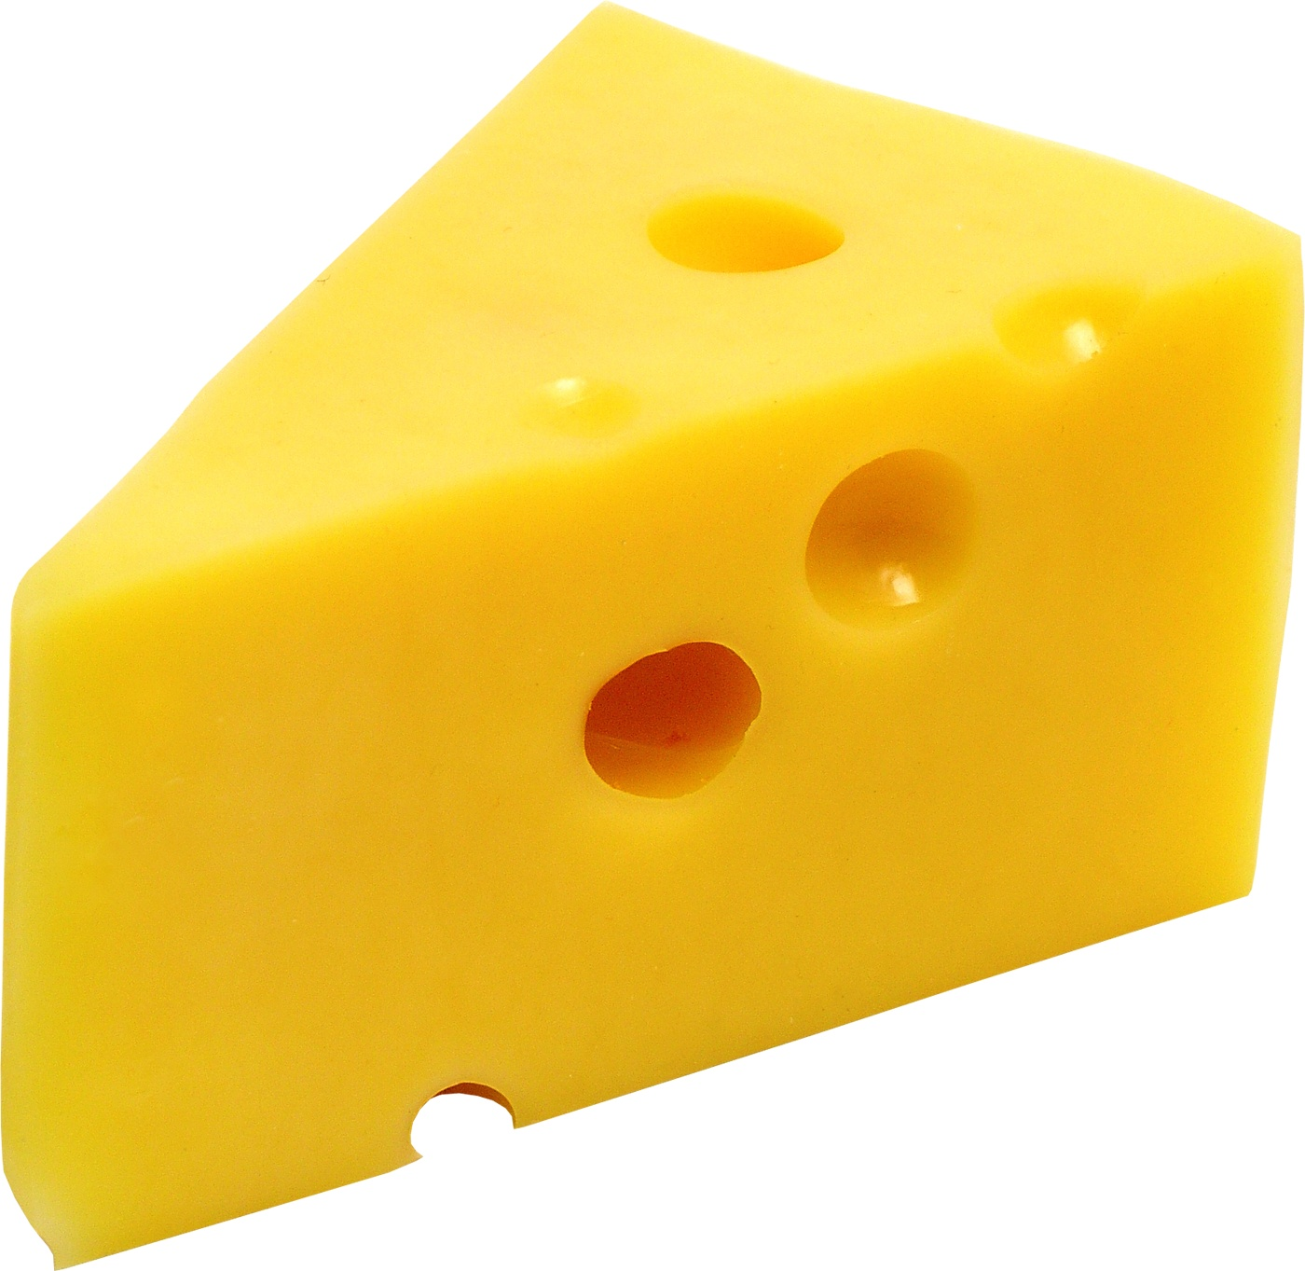
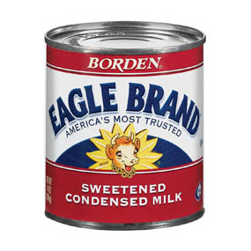
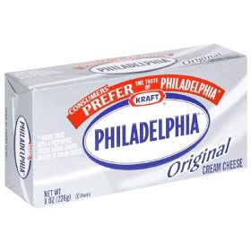
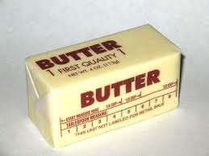
Other Dairy Products
D. Describe the process of making other dairy products such as cheese, butter, and ice cream
What is….

Slide 32
Other Dairy Products
D. Describe the process of making other dairy products such as cheese, butter, and ice cream
What is….
“How It’s Made”
Assignment

Slide 33
Bell quiz Objective A & B
How many servings of dairy should you have each day?
What is the main component in milk?
What mineral is a component of milk?
Why should athletes drink plenty of milk?
Dairy products help prevent many diseases. Name 2.

Slide 34
Bell quiz Objective C & D
List 5 dairy products made primarily from milk
Define the following processes:
Homogenization
Pasteurization
Standardization
Fortification
Clarification & Separation

