Slide 1
Animal Health & Housing
Relate concepts of animal welfare and animal rights to the well being of animals
Identify equipment used to maintain animal health
List measures used to prevent disease and parasites in livestock
Identify animal housing needs
Design an animal health & housing plan to promote efficiency of production

Slide 2
Animal Rights vs Animal Welfare
Relate concepts of animal welfare and animal rights to the well-being of animals
Advocates that animals have the same rights and freedoms as humans. They should not be used for human benefit
Advocates high standards of welfare for animals. They should be fed, housed and cared for to meet their needs.

Slide 3
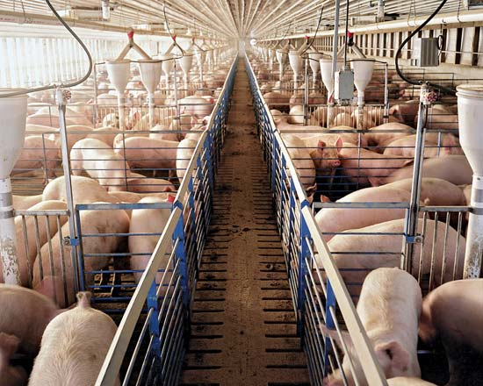
Animal Rights vs Animal Welfare
Relate concepts of animal welfare and animal rights to the well-being of animals
Example:
Large scale hog farms have been a target of concern for some.
Decide which perspective is animal RIGHTS & which is Animal WELFARE…
Animal WELFARE

Slide 4
Animal Rights vs Animal Welfare
Relate concepts of animal welfare and animal rights to the well-being of animals
Perspective 1:
Pigs shouldn’t have to live on concrete floors.
There’s too many pigs in this facility
Pigs should roam free, not be raised for meat
Look at all of these baby pigs! Isn’t it awful that they will all be bacon one day!
It’s wrong to raise pigs for meat!...how would you like to live like this?

Slide 5
Animal Rights vs Animal Welfare
Relate concepts of animal welfare and animal rights to the well-being of animals
Perspective 2:
The air is clear and well ventilated
The pigs are bright and alert… they look healthy and well fed
There’s a good system to remove manure and keep the pens clean.
These pigs have all of their needs provided!

Slide 6
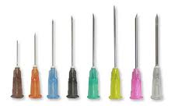
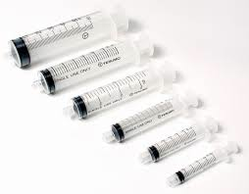
Animal Health Equipment
B. Identify equipment used to maintain animal health
Syringes & Needles
Administer vaccines & medications
Size measured by gauge (diameter) & length of needle
Size measured by CC (cubic centimeter)

Slide 7
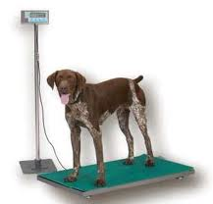
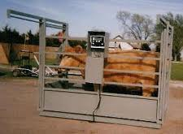
Animal Health Equipment
B. Identify equipment used to maintain animal health
Scales
Monitor weight
Vary in size according to species

Slide 8
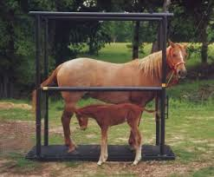
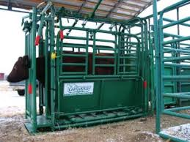
Animal Health Equipment
B. Identify equipment used to maintain animal health
Animal Holding Facilities
Makes animal handling easier and safer for animals and humans

Slide 9
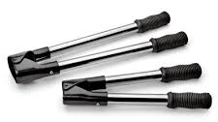
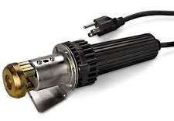
Animal Health Equipment
B. Identify equipment used to maintain animal health
Dehorning Equipment
Dehorning Spoon or Scoop
Electric
Dehorner
Barnes Dehorner

Slide 10
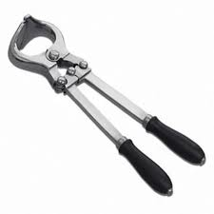
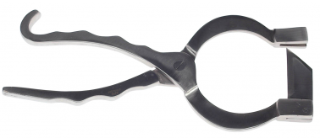
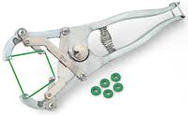
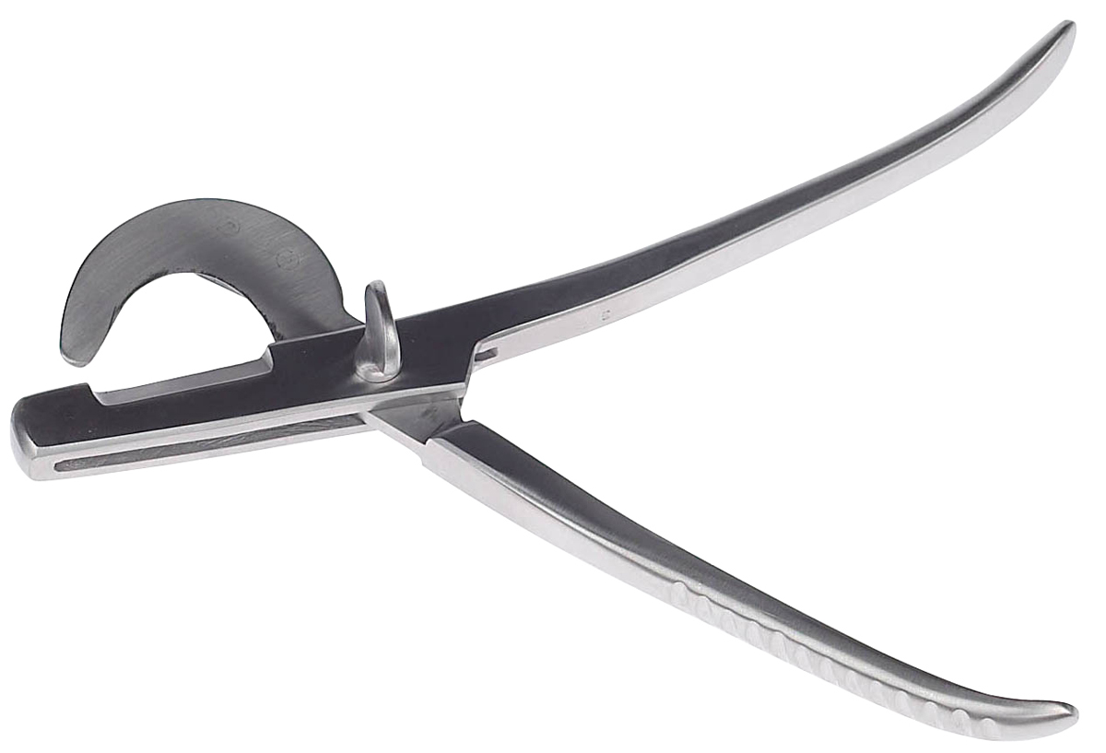
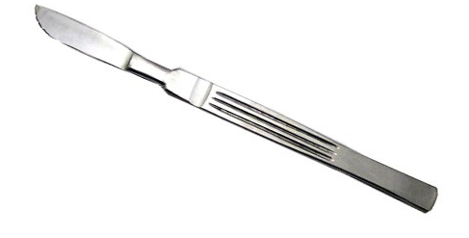
Animal Health Equipment
B. Identify equipment used to maintain animal health
Castrating Equipment
Burdizzo
Elastrator
Newberry Knife
Scalpel
Emasculator

Slide 11
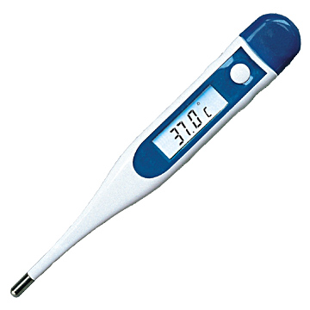
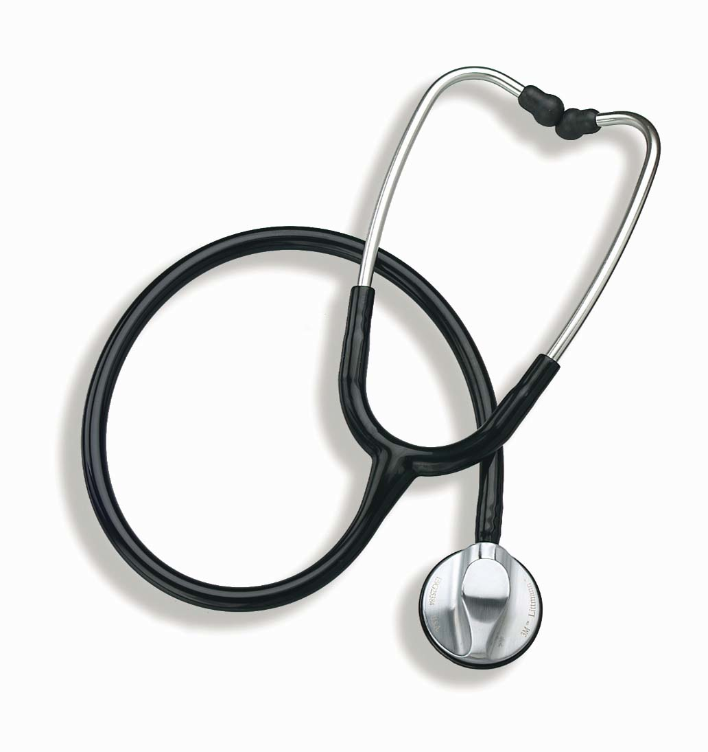
Animal Health Equipment
B. Identify equipment used to maintain animal health
Exam Tools
Stethoscope
Thermometer

Slide 12
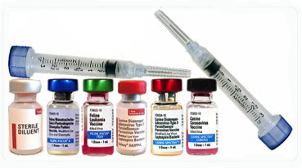
Preventing Disease
C. List measures used to prevent disease and parasites in livestock
1- Vaccinations
Prevent disease
Protects your animals & other’s

Slide 13
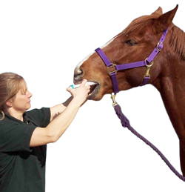
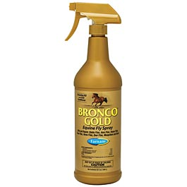
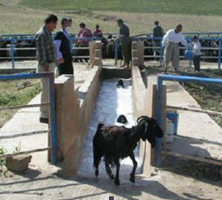
Preventing Disease
C. List measures used to prevent disease and parasites in livestock
2- Parasite Control
Dusts, sprays & baths for external parasites
Injections, pill, and pastes for internal parasites

Slide 14
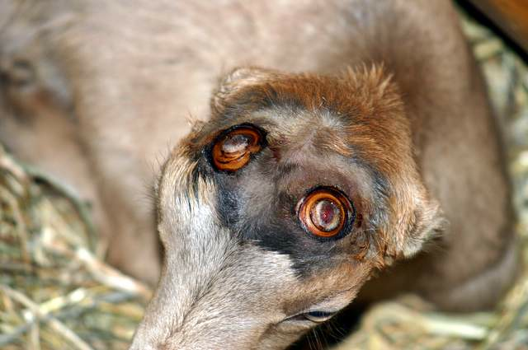
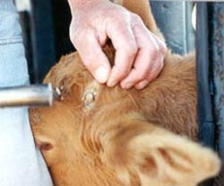
Preventing Disease
C. List measures used to prevent disease and parasites in livestock
3- Dehorning (cattle & goats)
Prevents animals from harming themselves, other animals, or people

Slide 15
Preventing Disease
C. List measures used to prevent disease and parasites in livestock
4- Castrating
Increases meat quality (in livestock)
Decreases aggressive behavior in all animals
Decreases likelihood of reproductive diseases and cancer

Slide 16
Preventing Disease
C. List measures used to prevent disease and parasites in livestock
5- Housing Management
Excessive manure and wet living spaces harbor viruses and bacteria
Proper Bedding in wet and/or cold climates decreases likelihood of disease transmission
Prevent overcrowding

Slide 17
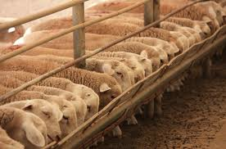
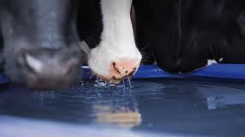
Preventing Disease
C. List measures used to prevent disease and parasites in livestock
5- Proper nutrition & clean water
Abundant, clean water supply
Proper nutrition
Requirements change with weather & life stage

Slide 18
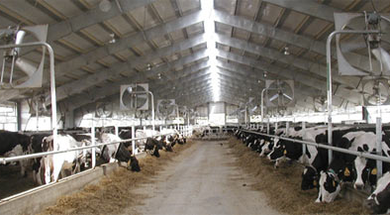
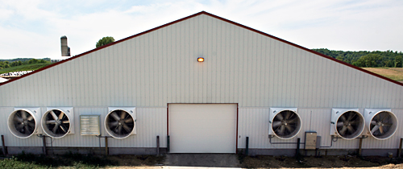
Animal Housing
D. Identify animal housing needs
Air Flow & Ventilation
Enclosed or partially enclosed buildings need ventilation

Slide 19
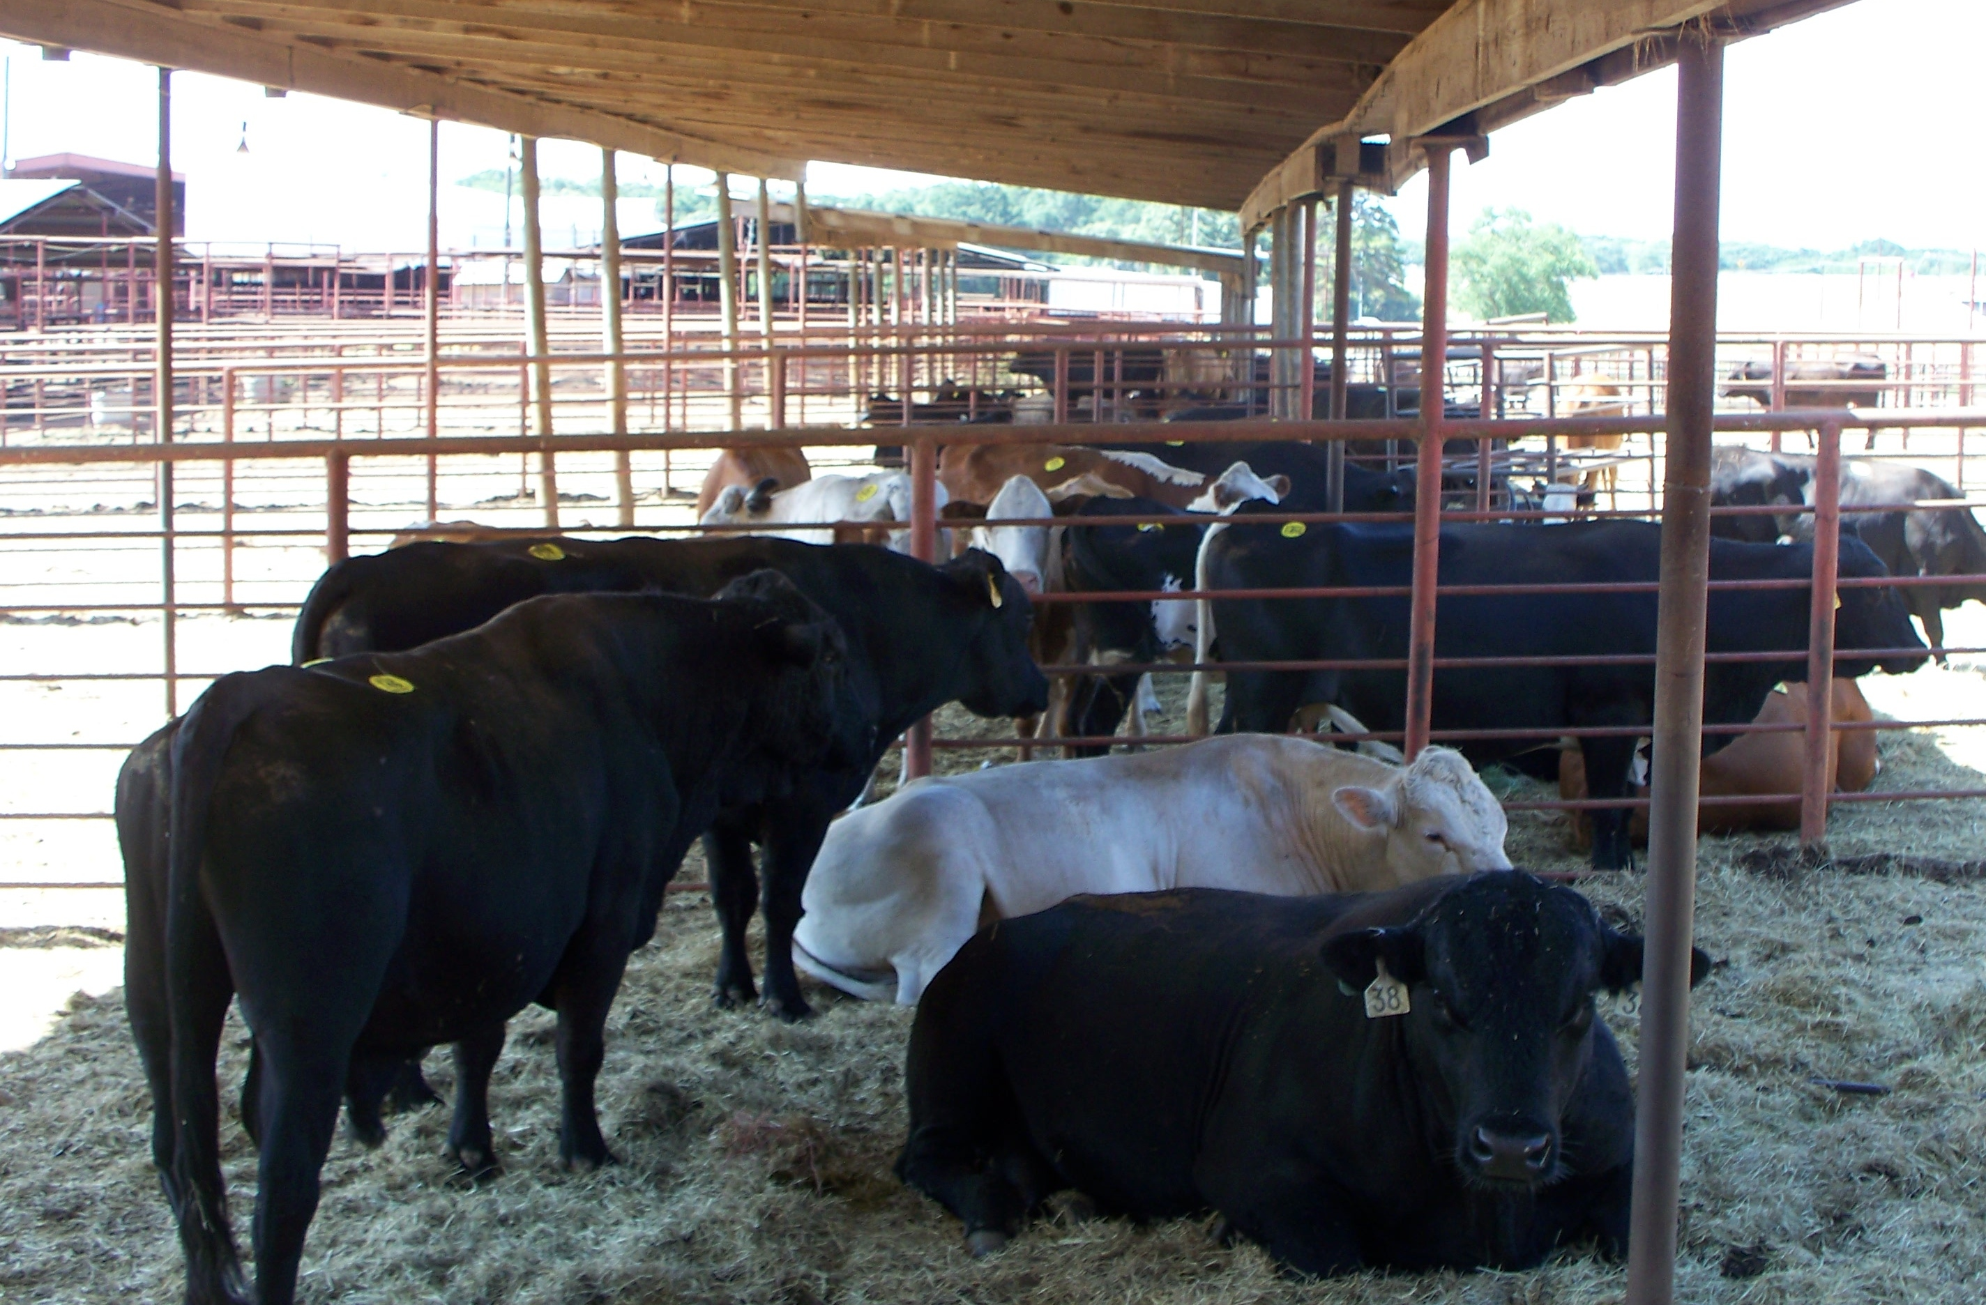
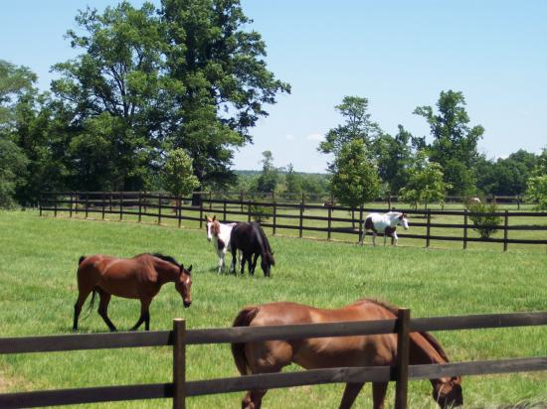
Animal Housing
D. Identify animal housing needs
Air Flow & Ventilation
Outdoor housing provides natural ventilation

Slide 20
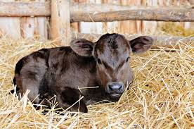
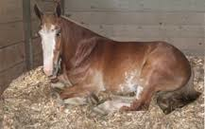
Animal Housing
D. Identify animal housing needs
Warm & Dry Place to rest
Some animals need a shelter and straw or shavings

Slide 21
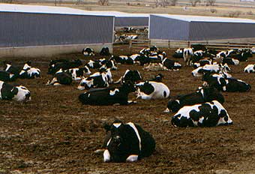
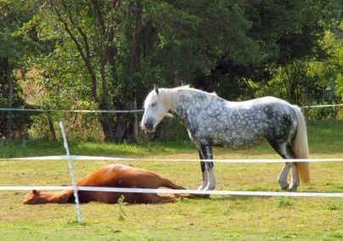
Animal Housing
D. Identify animal housing needs
Warm & Dry Place to rest
However, in good weather, outdoor pastures and dry corrals are adequate

Slide 22
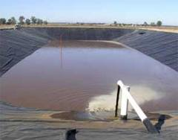
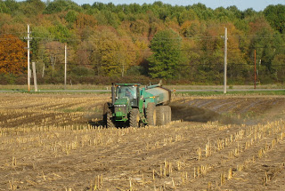
Animal Housing
D. Identify animal housing needs
Proper Waste Management
On a large scale farm, liquid manure is stored in a lagoon and solid waste can be stored in a pile until it is spread as fertilizer on fields

Slide 23
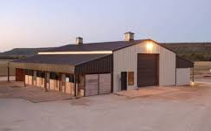
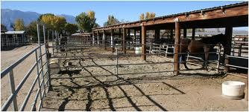
Animal Housing
D. Identify animal housing needs
Shelter
Shelters could be completely enclosed or partially covered depending on animal needs, climate, and available resources

Slide 24
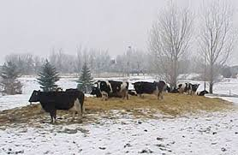
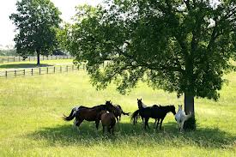
Animal Housing
D. Identify animal housing needs
Shelter
Even in the winter, animals can stay warm with a dry place to bed down. Ruminants create heat as they digest feed.
The shade and wind break of a tree may be all animals need

Slide 25
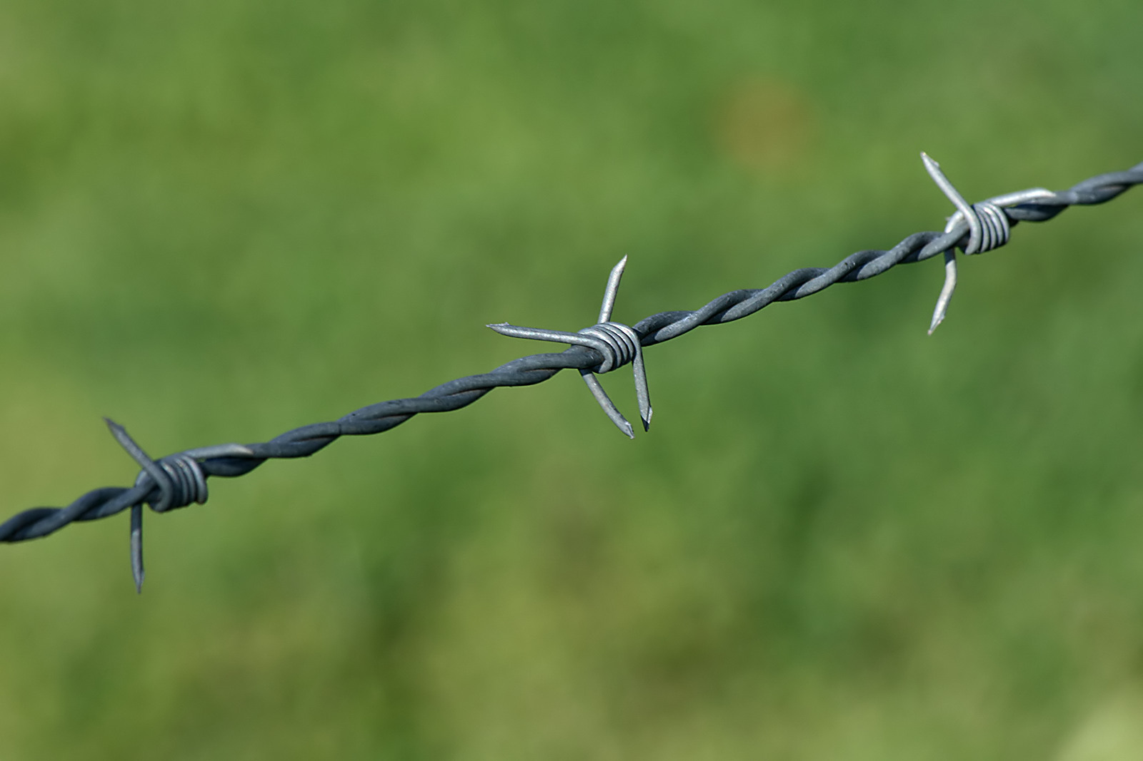
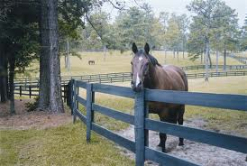
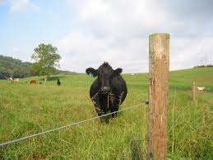
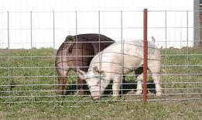
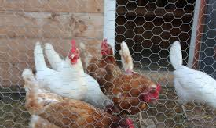
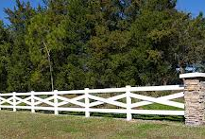
Animal Housing
D. Identify animal housing needs
Proper Fencing
Barbed Wire
Wood
Electric
Hog paneling
Chicken Wire
Vinyl

Slide 26
Design Your Own
E. Design an animal health & housing plan to promote efficiency of production
You will be designing the blue prints for your own animal facility
Barn Blueprint Project

Slide 27
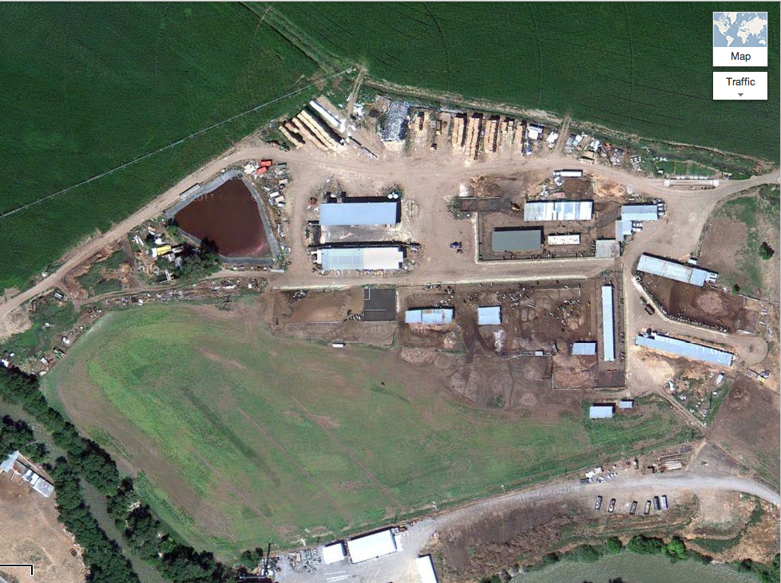
Design Your Own
E. Design an animal health & housing plan to promote efficiency of production
Commercial Dairy Farm
300 Milk Cows
Raises own replacement heifers
Grows some of their own feed

Slide 28
Design Your Own
Commercial Dairy Farm
300 Milk Cows
E. Design an animal health & housing plan to promote efficiency of production
Calving Barn:
Located on one end of shed near milk barn. Has lights to check for calves in dark
Calf Barn:
Has 100 individual calf stalls for calves from birth to 3-4 months old

Slide 29
Design Your Own
Commercial Dairy Farm
300 Milk Cows
E. Design an animal health & housing plan to promote efficiency of production
Calf Shed & Corrals:
Group pens for calves after they leave calf barn til about yearlings. Covered shed, corrals, and feed manger
Feedlot & Pasture:
Large group pens for yearling heifers to grow until breeding age
Dry Lot Pens:
Large, open corrals with open shed for shelter and shade. Dry cows and pregnant heifers are housed here

Slide 30
Design Your Own
Commercial Dairy Farm
300 Milk Cows
E. Design an animal health & housing plan to promote efficiency of production
Milk Parlor & Offices:
Milking parlor that can hold 20 cows at a time. Offices for record keeping and storage.
Milk Cow Herd Pens:
3 separate pens to separate milk cows by their milk production. Feed mangers lining each pen.

Slide 31
Design Your Own
Commercial Dairy Farm
300 Milk Cows
E. Design an animal health & housing plan to promote efficiency of production
Hay Stacks:
Covered with tarps to protect from rain and snow
Corn Silage Pit & Commodity Barn:
Corn Silage kept in center & covered with tarp. All grain & feed commodities kept under shed
Water Troughs:
Each pen has it’s own automatic trough.
Feed:
Each pen has a manger where the tractor can feed their mixed ration. Calf barn is fed milk and grain by hand

Slide 32
Design Your Own
Commercial Dairy Farm
300 Milk Cows
E. Design an animal health & housing plan to promote efficiency of production
Waste Management:
There are 3 lagoons to store manure until it is spread in fields and pastures

Slide 33
Design Your Own
Commercial Dairy Farm
300 Milk Cows
E. Design an animal health & housing plan to promote efficiency of production
Shop:
Used to fix and store tractors and implements as well as store mechanic and welding supplies
Crop Fields:
Corn, Alfalfa, and Barley is grown in surrounding fields to provide feed

Slide 34
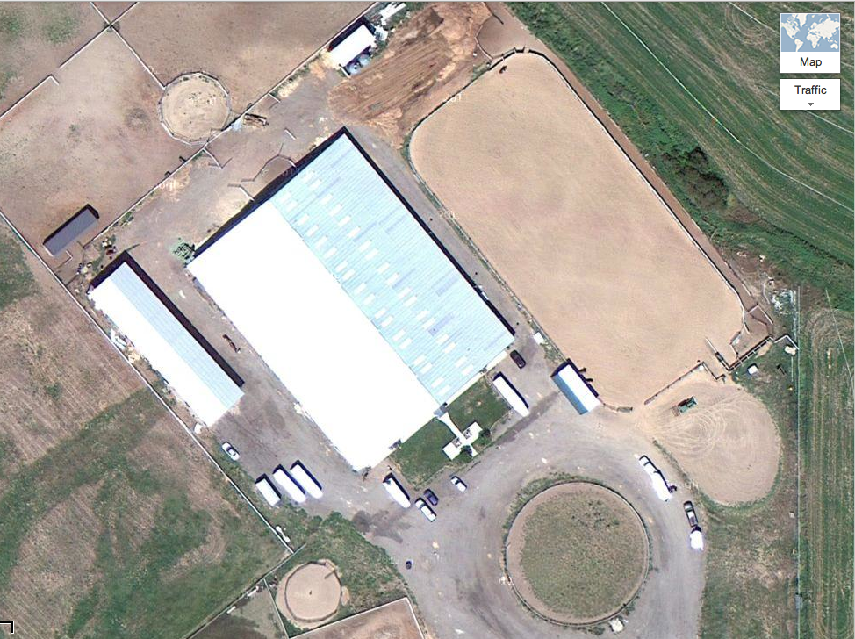
Design Your Own
Equestrian Breeding & Training Farm
Boards Horses
Hosts Roping Events
1-2 Trainers
Broodmares and studs
E. Design an animal health & housing plan to promote efficiency of production

Slide 35
Design Your Own
E. Design an animal health & housing plan to promote efficiency of production
Corrals:
Large, dirt corrals for horses and roping cattle. Automatic water troughs and hay racks for feed
Stalls:
Individual horse stalls line both sides of barn. Each has their own automatic waterer, hay rack, and tack closet.
Pastures:
Pastures line the entire entrance for mares and foals in the spring and summer.
Equestrian Breeding & Training Farm

Slide 36
Design Your Own
E. Design an animal health & housing plan to promote efficiency of production
Grain Silos:
Grain stored in silos and additional feed in the shed
Hay Shed:
Covered shed to store hay
Equestrian Breeding & Training Farm

Slide 37
Design Your Own
E. Design an animal health & housing plan to promote efficiency of production
Round Pens:
2 Round pens used for training
Indoor Arena
Outdoor Arena with roping chutes

Slide 38
Design Your Own
E. Design an animal health & housing plan to promote efficiency of production
Manure Storage:
Stall shavings stored in pile, til spread on field.
Equestrian Breeding & Training Farm

Slide 39
Bell Quiz Objectives A & B
What is the difference between animal “rights” and animal “welfare?
Name 3 tools you can use to castrate animals.
Name 2 tools you can use to dehorn animals.
What animal health equipment would you use to give vaccinations or other injections?
What animal health equipment would you use to do a health exam on an animal?

Slide 40
Bell Quiz Objectives C & D
How does excessive manure and wet living spaces for animals increase the likelihood of disease?
List 3 types of fencing you could use for animals.
When do you need ventilation in an animal pen?
Besides bedding and barns, what body processes help to keep an animal warm?
List 3 things you can do to decrease the chance of your animals getting sick.

