Slide 1
Introduction to ANIMAL SCIENCE
Objectives:
List 5 functions of domestic animals
Describe and define what considers an animal to be domesticated
Define common terminology used in animal science
Categorize & distinguish animals by breeds, species, and types
List major types & uses of each species of livestock
List & describe benefits of animal agriculture

Slide 2
Why do we CHOOSE to have animals?
A. List 4 functions of domestic animals

Slide 3
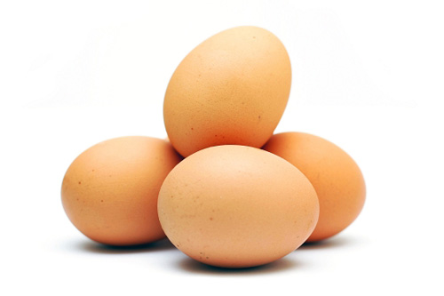
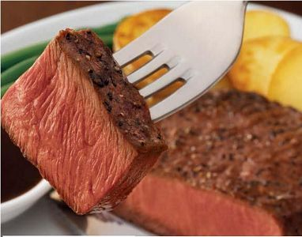
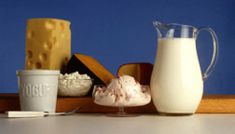
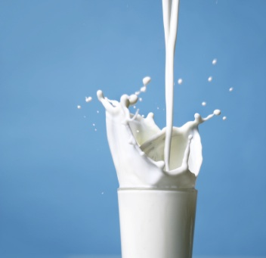
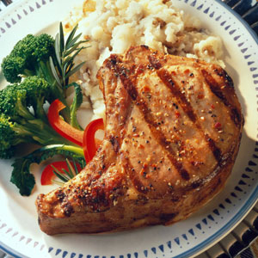
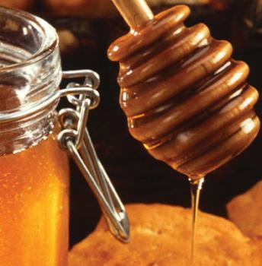
Functions of domestic animals: 1-Food
A. List 4 functions of domestic animals
Meat
Eggs
Milk
Honey

Slide 4
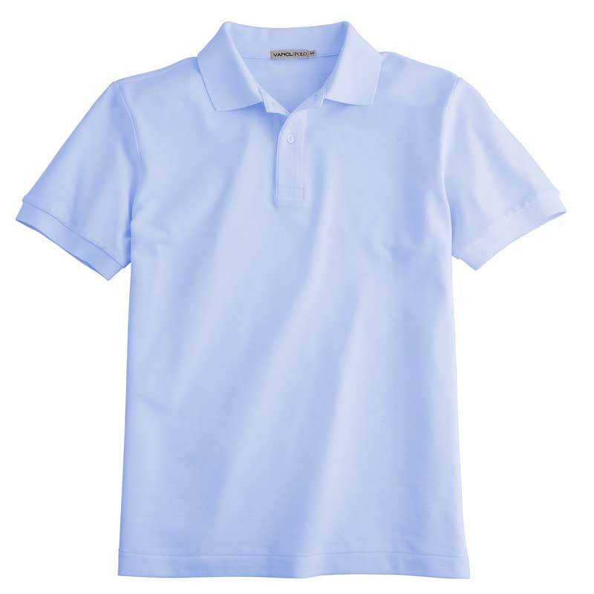
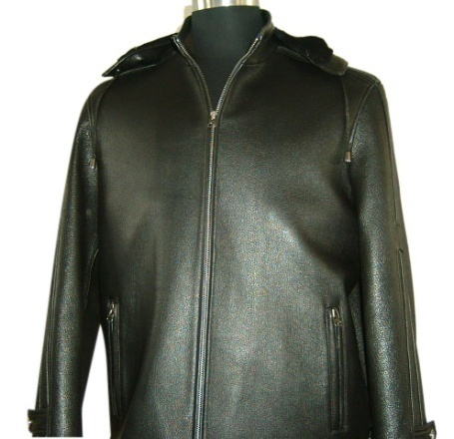
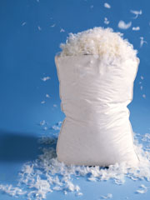
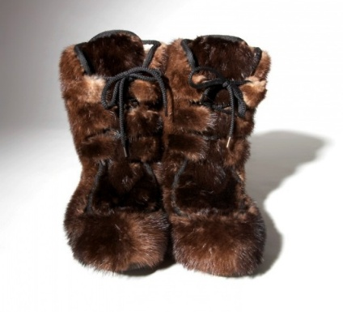
A. List 4 functions of domestic animals
Functions of domestic animals: 2- Clothing
Wool
Leather
Hair/Fur
Feathers

Slide 5
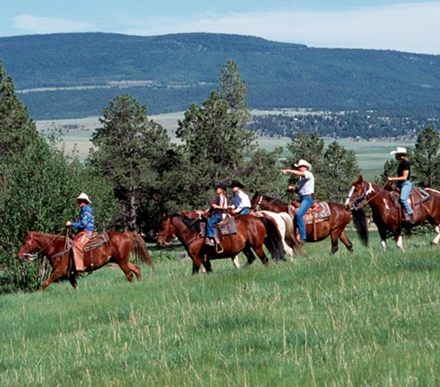
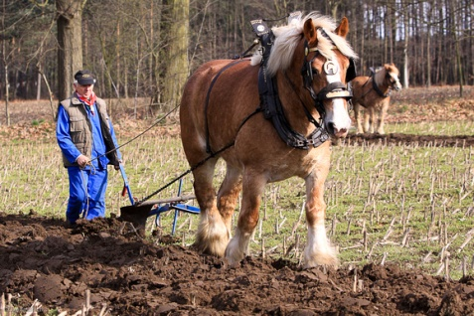
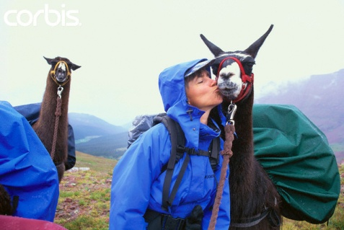
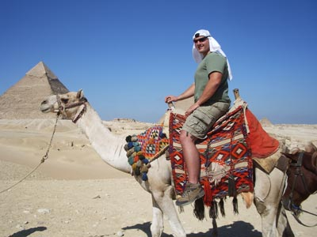
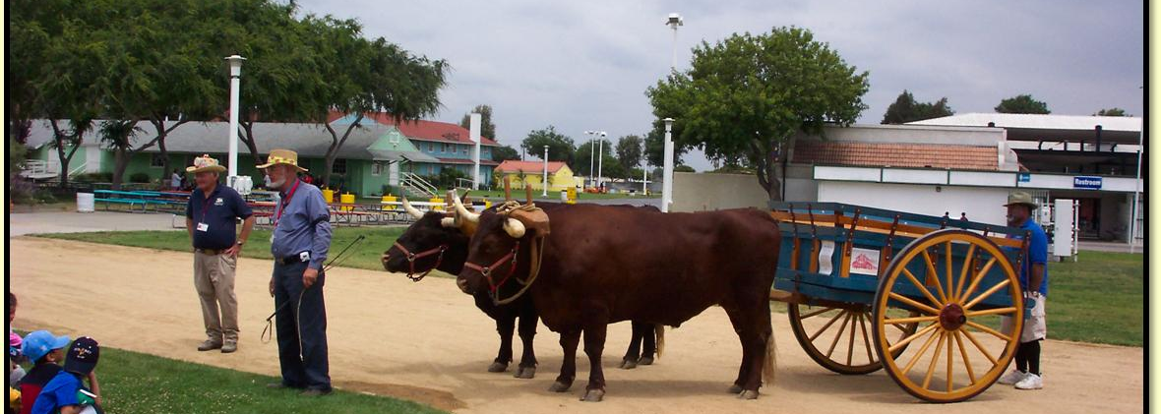
A. List 4 functions of domestic animals
Functions of domestic animals: 3-Power
Horses, Mules, Donkeys, Burros
Llamas, Alpacas
Oxen, Water buffalo, reindeer, yak, camels

Slide 6
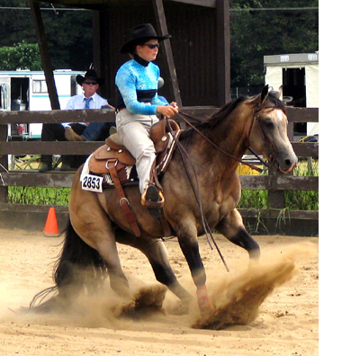
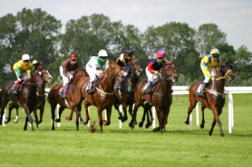
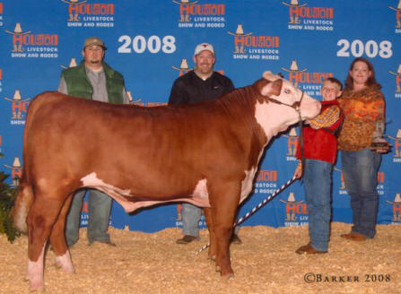
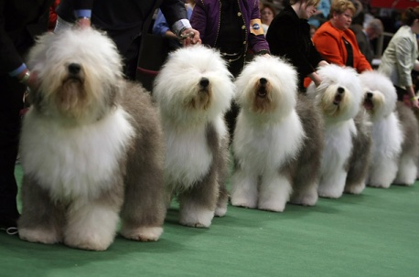
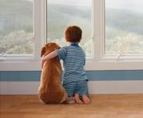
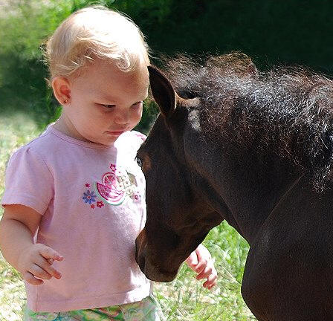
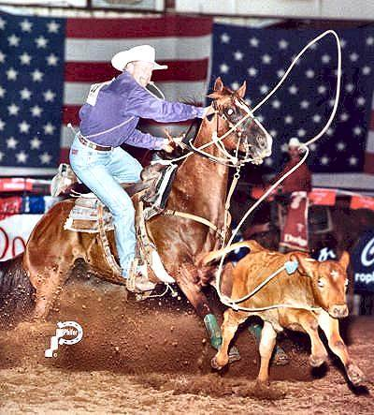
A. List 4 functions of domestic animals
Functions of domestic animals: 4- Recreation & Companionship
Pleasure Horses
Purebred Herds and Flocks
Livestock Exhibitions, Shows, Rodeos
Horse Racing

Slide 7
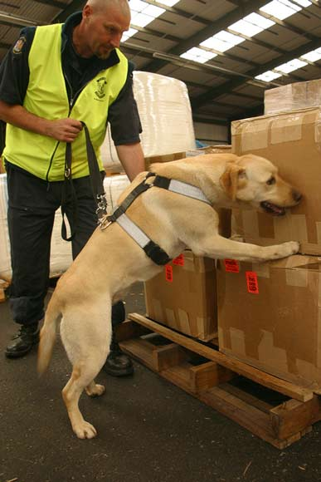
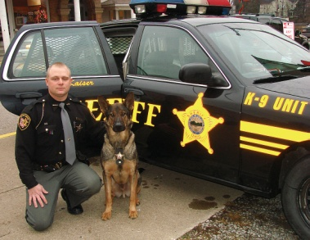
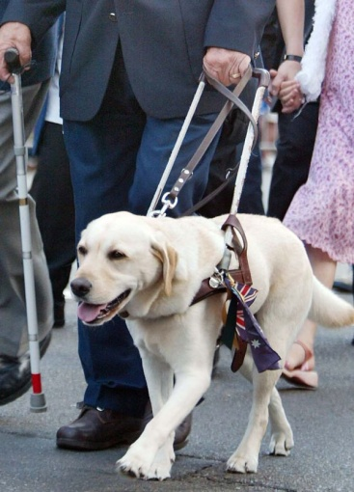
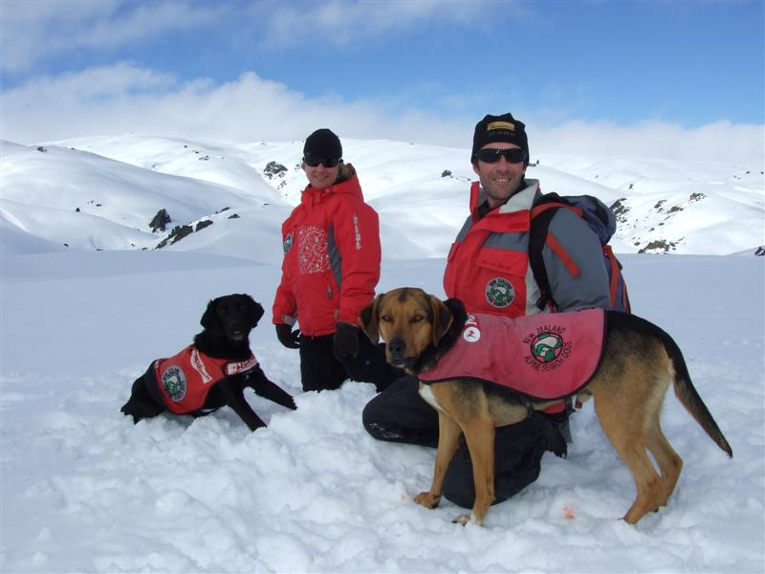
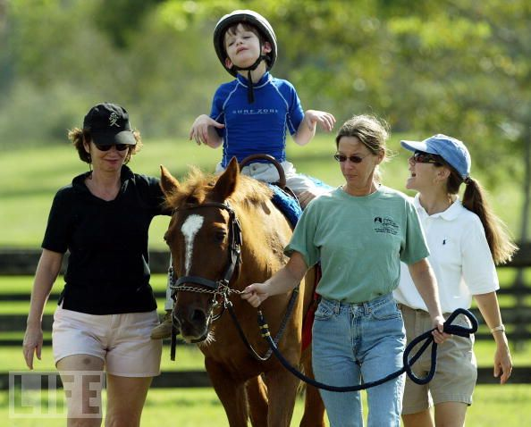
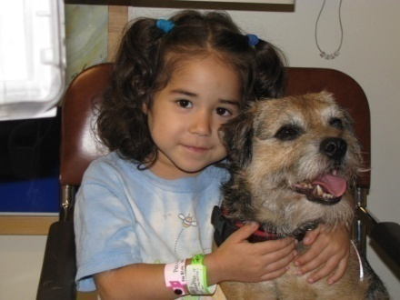
A. List 4 functions of domestic animals
Functions of domestic animals: 5- Service
Guide dogs for blind
Police Dogs
Rescue Dogs
Therapy animals

Slide 8
What is a domesticated animal?
B. Describe and define what considers an animal to be domesticated

Slide 9
B. Describe and define what considers an animal to be domesticated
Requirements for animals to be “domesticated”
1. The animal is VALUED and has a PURPOSE
2. The animal’s BREEDING is subject to human control.
3. The animal’s SURVIVAL depends upon humans.
4. The animal’s BEHAVIOR (psychology) is changed in domestication.
5. STRUCTURAL characteristics have appeared which occur rarely if at all in the wild.

Slide 10
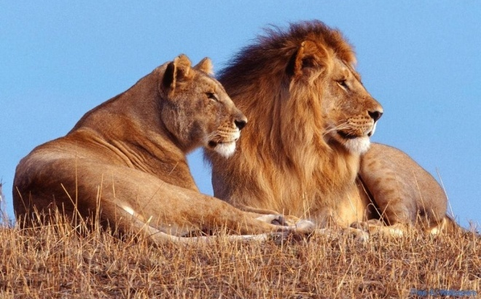
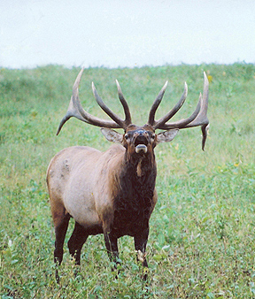
B. Describe and define what considers an animal to be domesticated
Terms:
Wild Animal
Exists without human intervention of any type (feeding, breeding selection, shelter, etc.)
Genetically: Wild
Behaviorally: Wild

Slide 11
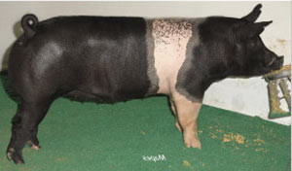
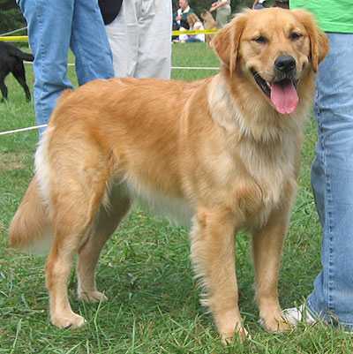
B. Describe and define what considers an animal to be domesticated
Terms:
Domestic Animals
Rely on humans for food & shelter, bred through artificial selection to choose and perpetuate desired traits
Genetically Domestic
Behaviorally= domestic

Slide 12
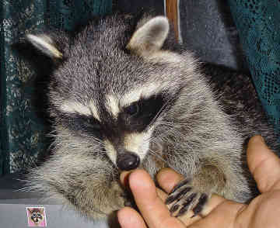
B. Describe and define what considers an animal to be domesticated
Terms:
Tame Wild Animal
A wild animal that has adapted behaviorally to be useful to humans.
Example: bottle feeding a baby raccoon
Genetically=Wild
Behaviorally=Domestic

Slide 13
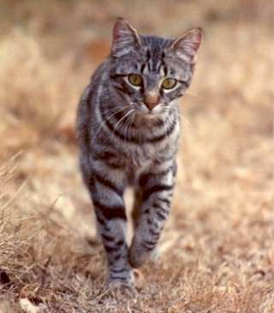
B. Describe and define what considers an animal to be domesticated
Terms:
Feral Animal
A previously domestic animal that returned to the wild
Example: Feral Cat
Genetically=Domestic
Behaviorally= Wild

Slide 14
B. Describe and define what considers an animal to be domesticated
History of Animal Domestication Group Assignment
In groups, research the domestication of the animal you are assigned. Prepare a 2-3 minute explanation answering the questions on your worksheet for the class on your assigned species.
Answer the questions found on your worksheet
Cattle
Swine
Sheep
Goats
Horses
Poultry
Dogs
Cats
Rabbits

Slide 15
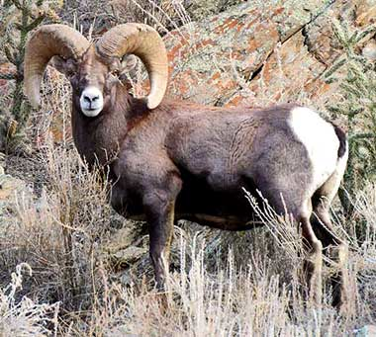
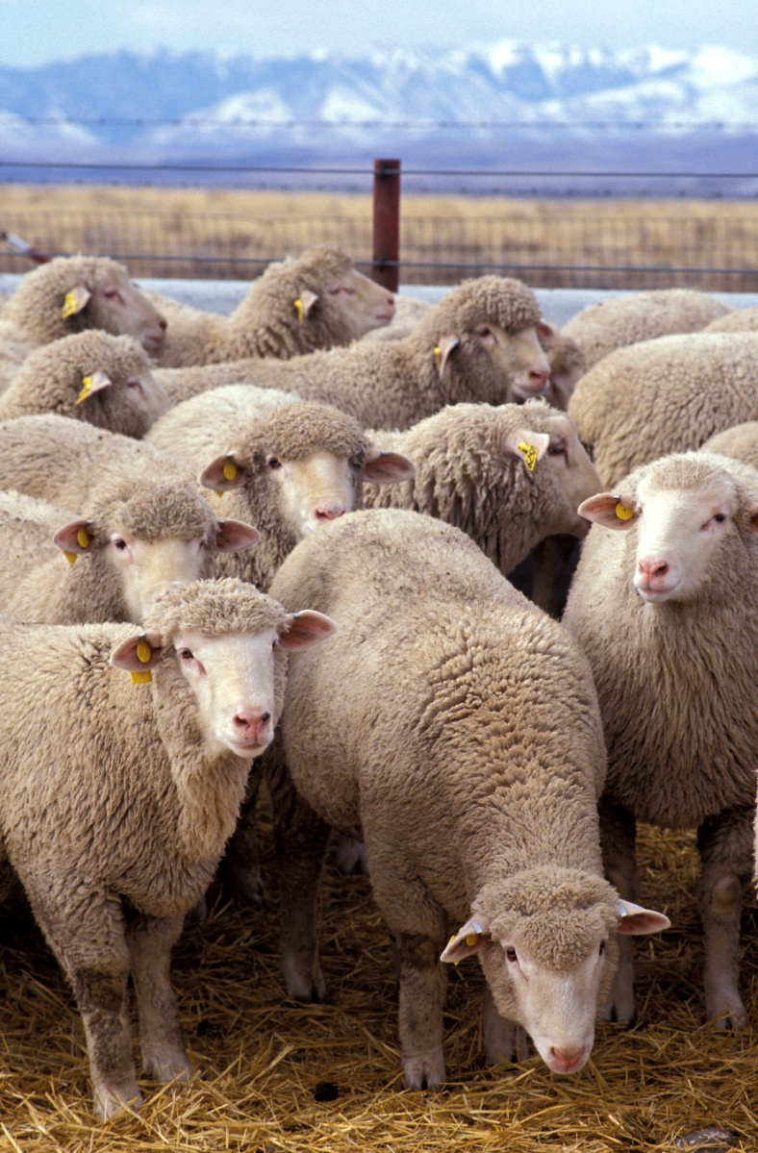
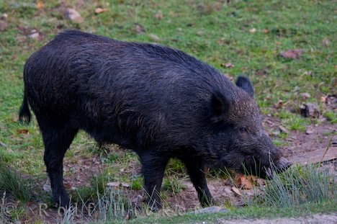
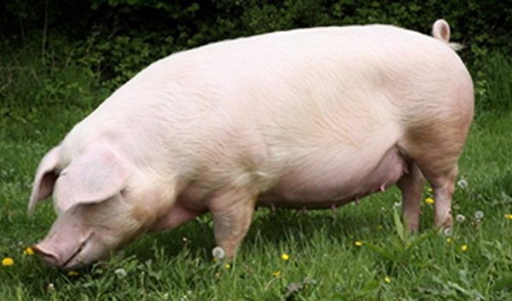
B. Describe and define what considers an animal to be domesticated
Domesticate an Animal
Choose an animal that is currently wild and domesticate it to benefit humans…
**Remember that physical appearance AND behavior changes in the process of domestication!

Slide 16
What is binomial nomenclature?
C. Define common terminology used in animal science
A system used in science to give plants and animals a name

Slide 17
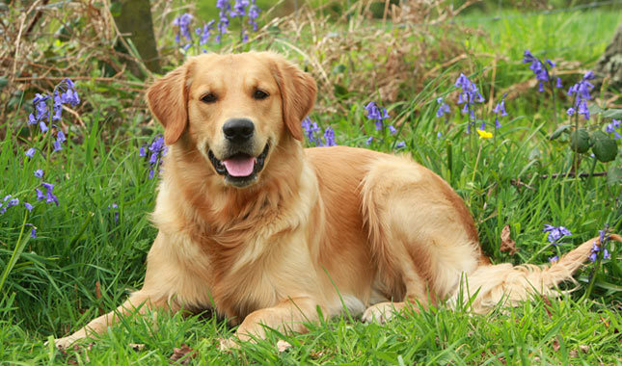
Binomial Nomenclature
C. Define common terminology used in animal science
Canis familiaris
Genus
Family Name
Capitalized & italicized
Species
Individual species name
Lower case & italicized

Slide 18
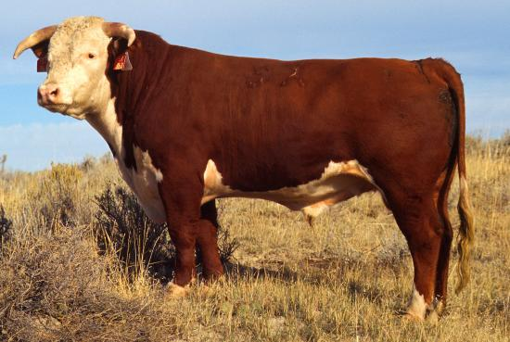
C. Define common terminology used in animal science
European Cattle (Bovine)
*Genus/Species: Bos Taurus
*Baby: Calf
*Young Male: Bullock
*Young Female: Heifer (until 1st calf is born)
*Castrated Male: Steer
*Mature Male: Bull
*Mature Female: Cow
*Group: Herd

Slide 19
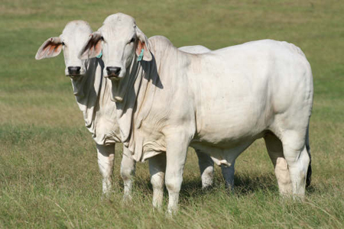
C. Define common terminology used in animal science
Indian Cattle (Bovine)
*Genus/Species: Bos Indicus
*Baby: Calf
*Young Male: Bullock
*Young Female: Heifer (until 1st calf is born)
*Castrated Male: Steer
*Mature Male: Bull
*Mature Female: Cow
*Group: Herd

Slide 20
C. Define common terminology used in animal science
Sheep (Ovine)
*Genus/Species: Ovis aries
*Baby: Lamb
*Young Male: Ram Lamb
*Young Female: Ewe Lamb
*Castrated Male: Whether
*Mature Male: Ram
*Mature Female: Ewe
*Group: Flock

Slide 21
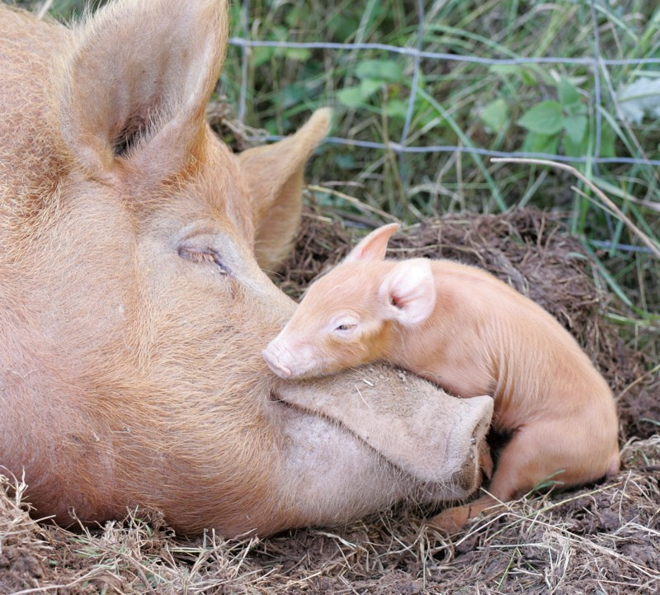
Define common terminology used in animal science
Pigs (Supine)
*Genus/Species: Sus scrofa domestica
*Baby: Piglet
*Young Male: Shoat
*Young Female: Gilt (until 1st litter)
*Castrated Male: Barrow
*Mature Male: Boar
*Mature Female: Sow
*Group: Herd, Drove, or Mob

Slide 22
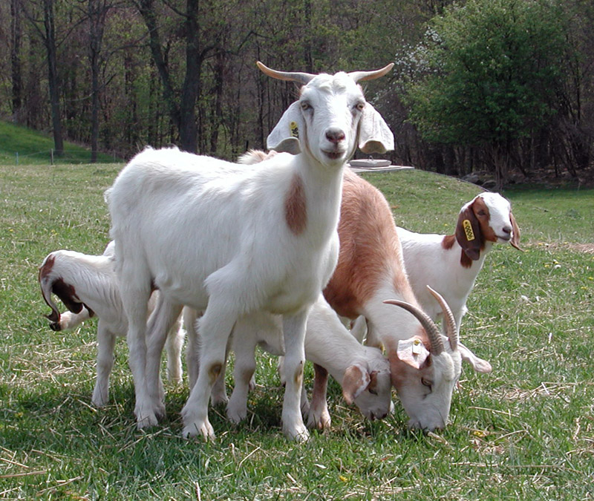
Define common terminology used in animal science
Goats (Caprine)
*Genus/Species: Capra hircus
*Baby: Kid
*Young Male: Ram Kid
*Young Female: Doe Kid
*Castrated Male: Whether
*Mature Male: Billy
*Mature Female: Doe
*Group: herd or tribe

Slide 23
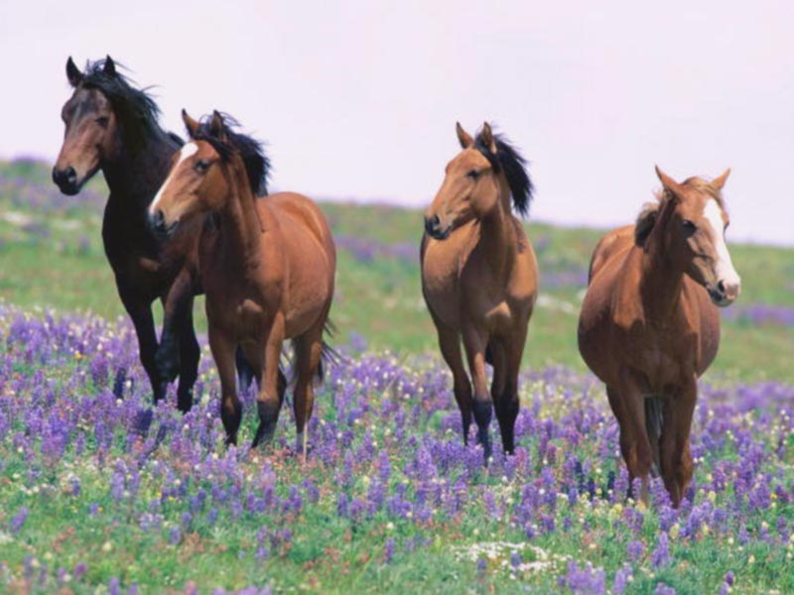
C. Define common terminology used in animal science
Horses (Equine)
*Genus/Species: Equus caballus
*Baby: Foal
*Young Male: Colt
*Young Female: Filly
*Castrated Male: Gelding
*Mature Male: Stallion
*Mature Female: Mare
*Group: Herd

Slide 24
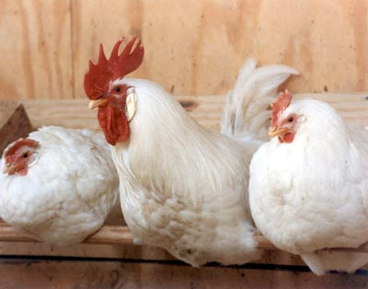
C. Define common terminology used in animal science
Chicken
*Genus/Species: Gallus domesticus
*Baby: Chick
*Young Male: Cockerel
*Young Female: Pullet
*Castrated Male: Capon
*Mature Male: Rooster
*Mature Female: Hen
*Group: Chickens: Brood, Flock, Peep
**FYI:
Turkeys: Rafter, Gobble, Gang
Geese: Gaggle (if they are in flight=Skein)

Slide 25
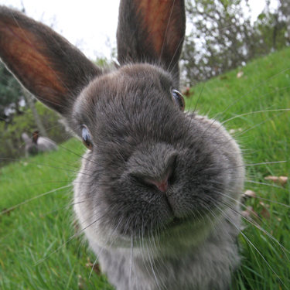
Define common terminology used in animal science
Rabbits
*Genus/Species: Oryctolagus cuniculus
*Baby: Bunny
*Young Male: (None)
*Young Female: (None)
*Mature Male: Buck
*Mature Female: Doe
*Group: Colony, Nest, Herd

Slide 26
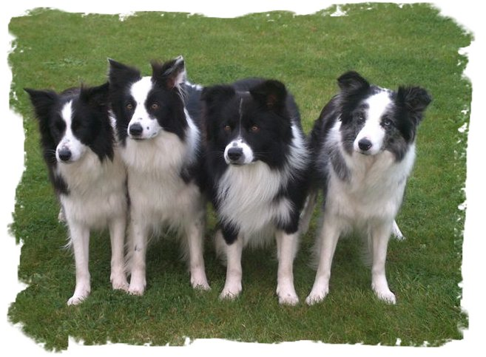
C. Define common terminology used in animal science
Dog (Canine)
*Genus/Species: Canis familiaris
*Baby: Puppy
*Young Male: (None)
*Young Female: (None)
*Mature Male: Stud
*Mature Female: Dam or Bitch
*Group: Pack

Slide 27
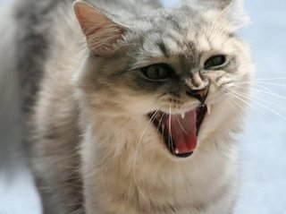
C. Define common terminology used in animal science
Cat (Feline)
*Genus/Species: Felis catus
*Baby: Kitten
*Young Male: (None)
*Young Female: (None)
*Mature Male: Tom
*Mature Female: Queen
*Group: Clowder or Clutter
Video Clip

Slide 28
What is the difference?
D. Categorize & distinguish animals by breeds, species, and types
Species
Breed
Type

Slide 29
D. Categorize & distinguish animals by breeds, species, and types
Species
A group of closely related animals that can interbreed and produce fertile offspring.

Slide 30
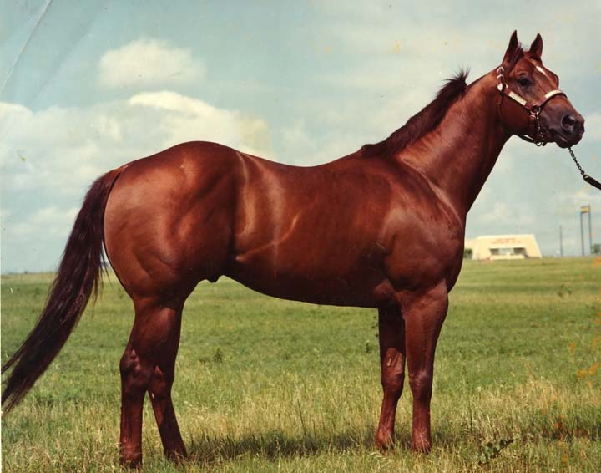
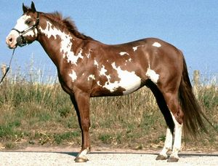
D. Categorize & distinguish animals by breeds, species, and types
Species
Example:
Equine

Slide 31
Categorize & distinguish animals by breeds, species, and types
Breed
Animals of common origin with characteristics that distinguish them from other groups within the same species

Slide 32
Categorize & distinguish animals by breeds, species, and types
Breed
Example:
Equine Breeds
Quarter Horse:
Runs ¼ mile exceptionally fast, medium build, common for ranch work, solid color
Clydesdale:
Draft horse, white feet with feathering, bay in color, usually 16-18 hands tall
Paint:
Similar to quarter horse, but distinguished by color pattern
Arabian:
Distinguished by arched neck, dished forehead, and raised tail

Slide 33
Categorize & distinguish animals by breeds, species, and types
Type
Animals of the same species that are grouped together based on the products they produce

Slide 34
Categorize & distinguish animals by breeds, species, and types
Type
Example:
Cattle
Some produce MEAT exceptionally well
Some produce MILK exceptionally well

Slide 35
Types of Livestock
D. Categorize & distinguish animals by breeds, species, and types
Each species of livestock has specific breeds that perform best for each purpose:
Meat Type: Produce meat efficiently
Dairy Type: Produce milk efficiently
Dual Purpose: Produce meat & milk efficiently
Ornamental: Don’t produce milk or meat efficiently, chosen for beauty
Performance: Chosen for performance traits

Slide 36
E. List major types & uses of each species of livestock
Cattle
Beef Type
Dairy Type
Dual Purpose

Slide 37
E. List major types & uses of each species of livestock
Sheep
Wool type
Meat type
Dual Purpose
FYI: Though they aren’t common, there are dairy type sheep. Some specialty cheeses are made from sheep milk

Slide 38
E. List major types & uses of each species of livestock
Pigs
Meat Type

Slide 39
E. List major types & uses of each species of livestock
Goats
Meat Type
Dairy Type

Slide 40
E. List major types & uses of each species of livestock
Chickens
Eggs (Layers)
Meat (Broilers)
Ornamental
Notes:
**Ornamental chickens still produce eggs and meat, but not as efficiently as layers or broilers. These breeds are typically chosen for their unique look.

Slide 41
E. List major types & uses of each species of livestock
Horses
Performance Type
Draft Type
Racing
Ranch Work/Stock Horse

Slide 42
How does animal based agriculture benefit humans?
F. List & describe benefits of animal agriculture

Slide 43
What are the benefits of Animal Agriculture??
F. List & describe benefits of animal agriculture
Animals convert feed that humans CAN’T eat to food humans CAN eat
(poor hay, corn stalks, straw, etc.)
Helps maintain fertility of the land

Slide 44
What are the benefits of Animal Agriculture??
F. List & describe benefits of animal agriculture
Personal satisfaction of working with domesticated animals
May more fully utilize capital, machinery and wasteland (range).

Slide 45
What are the benefits of Animal Agriculture??
F. List & describe benefits of animal agriculture
Food Value:
Animal proteins are superior to vegetable proteins for humans
Animal proteins have improved amino acid balance over vegetable protein
Milk -- approximately 90% of milk for human consumption in the world comes from cattle
Over 85% of the world population desires food of animal origin

Slide 46
Bell Quiz Objective A & B
List 2 out of 5 qualifications to consider an animal “domestic”
Name 5 reasons why we have domestic animals.
Name 1 reason that animals have been domesticated
Give 2 examples of animals that can be used for power
Give 1 example of a service animal

Slide 47
Bell Quiz Objective C & D
What is a young, female horse called?
What is the definition of a “gilt?”
Define a “breed.”
What is the definition of a “species?”
What term describes a group of animals within the same species that produce similar products.

Slide 48
Bell Quiz Objective E & F
Name 2 TYPES of cattle
Name 2 products produced from the sheep industry.
In the U.S., what TYPE of animals are horses?
Describe in a few sentences 2 benefits of animal agriculture.
What benefits do animal based foods have over plant based foods?

