Slide 1
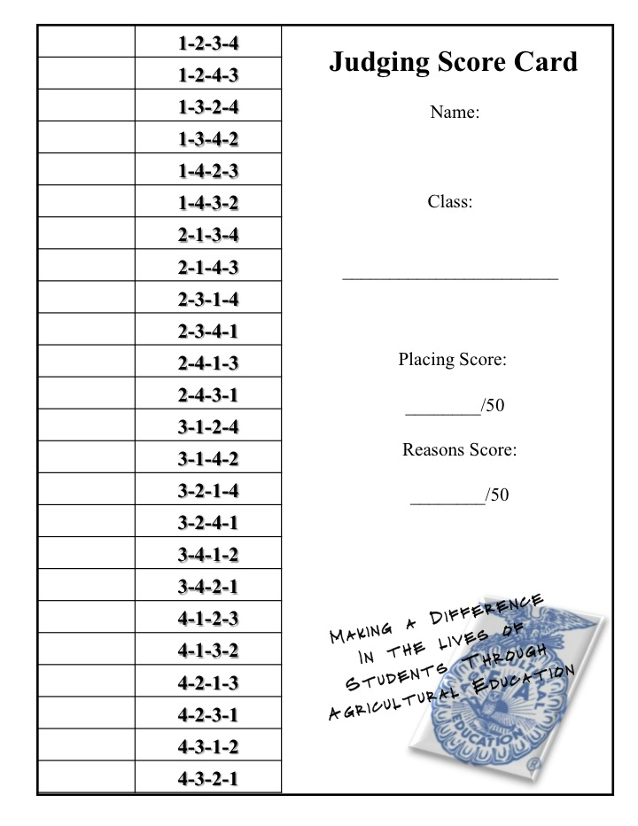
Name_________________________________ Period_______ Date_________ Livestock Judging Contest Directions: Judge each class, mark your score card, and keep track of your scores. Add up final score on the table below to pick a class winner.
Class | Score
Total

Slide 2
Judging Score Card Class: ___________ Placing Score: ________/50
 | 1-2-3-4
 | 1-2-4-3
 | 1-3-2-4
 | 1-3-4-2
 | 1-4-2-3
 | 1-4-3-2
 | 2-1-3-4
 | 2-1-4-3
 | 2-3-1-4
 | 2-3-4-1
 | 2-4-1-3
 | 2-4-3-1
 | 3-1-2-4
 | 3-1-4-2
 | 3-2-1-4
 | 3-2-4-1
 | 3-4-1-2
 | 3-4-2-1
 | 4-1-2-3
 | 4-1-3-2
 | 4-2-1-3
 | 4-2-3-1
 | 4-3-1-2
 | 4-3-2-1
Judging Score Card Class: ___________________
Placing Score: ________/50
1-2-3-4
1-2-4-3
1-3-2-4
1-3-4-2
1-4-2-3
1-4-3-2
2-1-3-4
2-1-4-3
2-3-1-4
2-3-4-1
2-4-1-3
2-4-3-1
3-1-2-4
3-1-4-2
3-2-1-4
3-2-4-1
3-4-1-2
3-4-2-1
4-1-2-3
4-1-3-2
4-2-1-3
4-2-3-1
4-3-1-2
4-3-2-1
Making a Difference
In the lives of
Students Through
Agricultural Education
Making a Difference
In the lives of
Students Through
Agricultural Education
Judging Score Card Class: ___________ Placing Score: ________/50
 | 1-2-3-4
 | 1-2-4-3
 | 1-3-2-4
 | 1-3-4-2
 | 1-4-2-3
 | 1-4-3-2
 | 2-1-3-4
 | 2-1-4-3
 | 2-3-1-4
 | 2-3-4-1
 | 2-4-1-3
 | 2-4-3-1
 | 3-1-2-4
 | 3-1-4-2
 | 3-2-1-4
 | 3-2-4-1
 | 3-4-1-2
 | 3-4-2-1
 | 4-1-2-3
 | 4-1-3-2
 | 4-2-1-3
 | 4-2-3-1
 | 4-3-1-2
 | 4-3-2-1
Judging Score Card Class:
___________ Placing Score: ________/50
1-2-3-4
1-2-4-3
1-3-2-4
1-3-4-2
1-4-2-3
1-4-3-2
2-1-3-4
2-1-4-3
2-3-1-4
2-3-4-1
2-4-1-3
2-4-3-1
3-1-2-4
3-1-4-2
3-2-1-4
3-2-4-1
3-4-1-2
3-4-2-1
4-1-2-3
4-1-3-2
4-2-1-3
4-2-3-1
4-3-1-2
4-3-2-1
Making a Difference
In the lives of
Students Through
Agricultural Education
Making a Difference
In the lives of
Students Through
Agricultural Education

