Slide 1
Plant Propagation Test Review B-I-N-G-O
Plant Propagation:
Reproduction of new plants

Slide 2
Plant Propagation Test Review B-I-N-G-O
Sexual Plant Propagation:
Reproduction of new plants by seed or spore by uniting 2 gametes

Slide 3
Plant Propagation Test Review B-I-N-G-O
Seeds:
1 method of sexual plant production

Slide 4
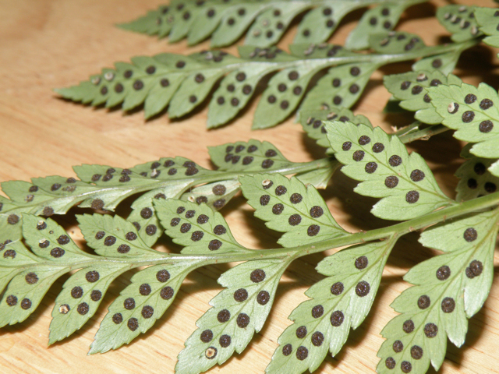
Plant Propagation Test Review B-I-N-G-O
Spores
Method of sexual plant reproduction

Slide 5
Plant Propagation Test Review B-I-N-G-O
Flower
The reproductive portion of plant

Slide 6
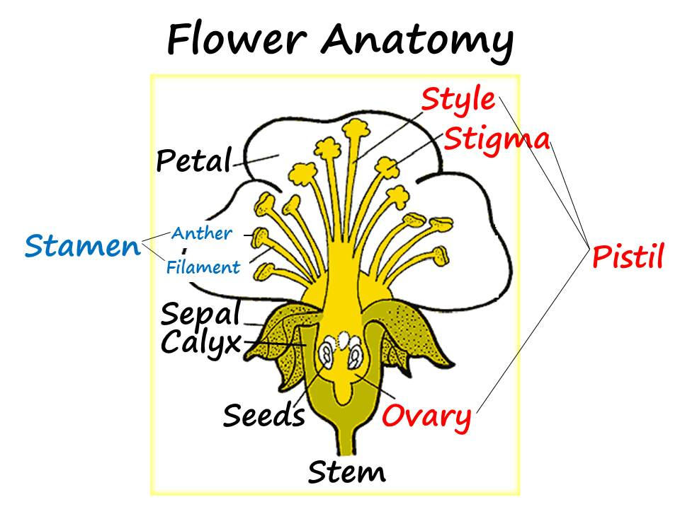
Plant Reproduction Test Review B-I-N-G-O
Ovary
Female reproductive organ of plant where seeds mature

Slide 7
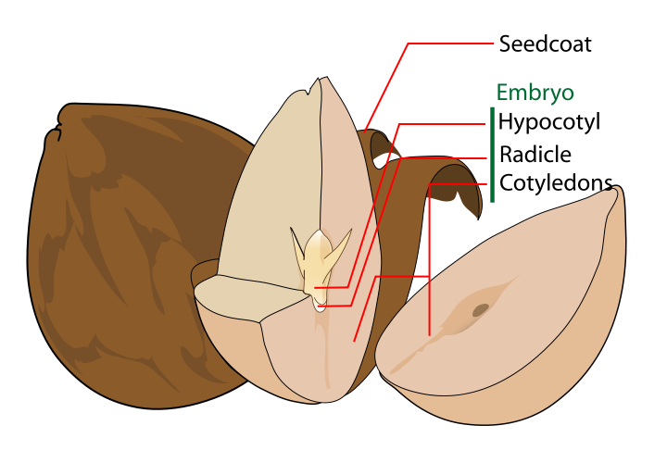
Plant Reproduction Test Review B-I-N-G-O
Seed Coat
Outer layer of a seed

Slide 8
Plant Reproduction Test Review B-I-N-G-O
Seed Embryo
Inner portion of seed

Slide 9
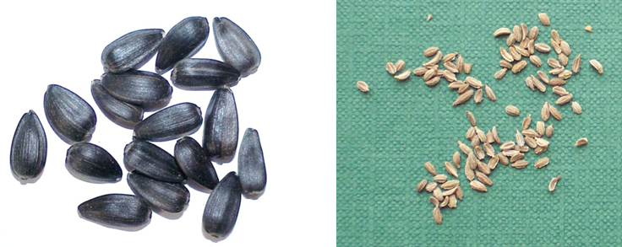
Plant Propagation Test Review B-I-N-G-O
Raw Seed
Seeds harvested from the flower of a plant

Slide 10
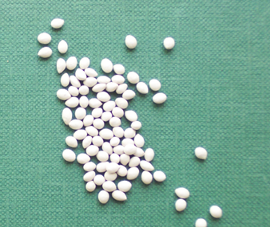
Plant Propagation Test Review B-I-N-G-O
Pelleted Seed
Commercial seed that is processed to make handling small seed easier

Slide 11
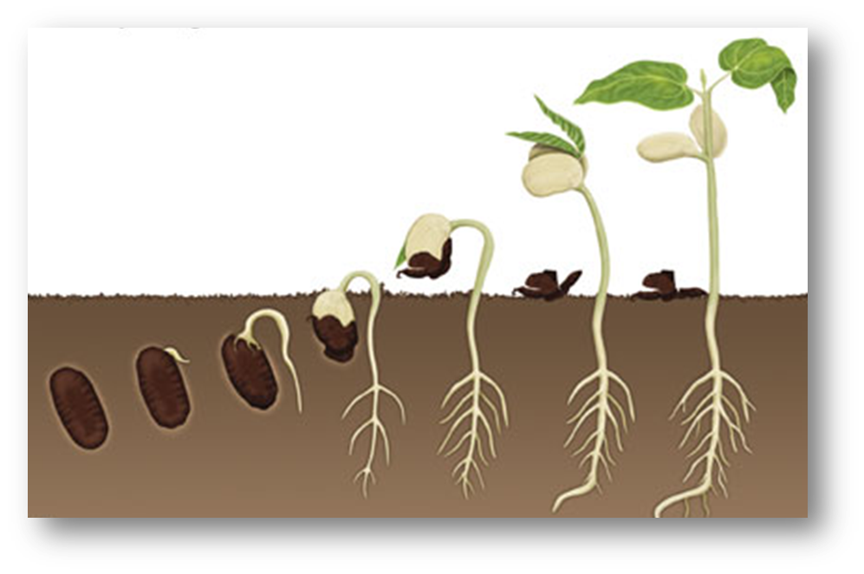
Plant Propagation Test Review B-I-N-G-O
Germination
Development of a seed from resting stage to a stage of growth

Slide 12
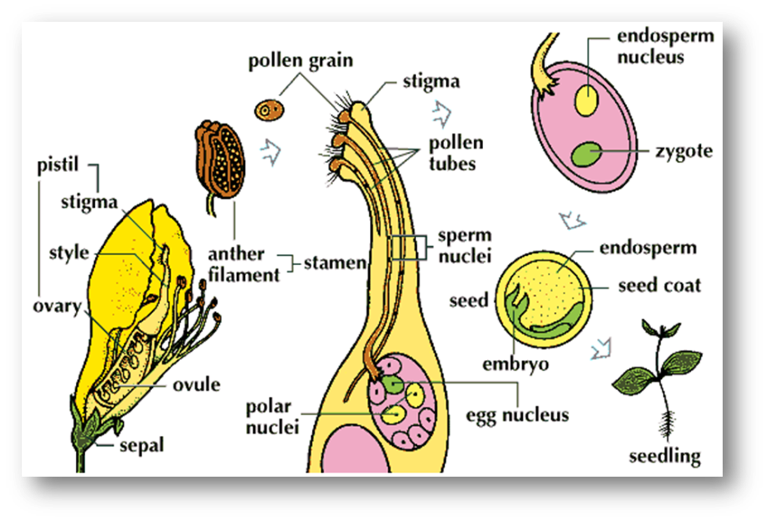
Plant Propagation Test Review B-I-N-G-O
Plant Fertilization
Meeting of the male and female gametes

Slide 13
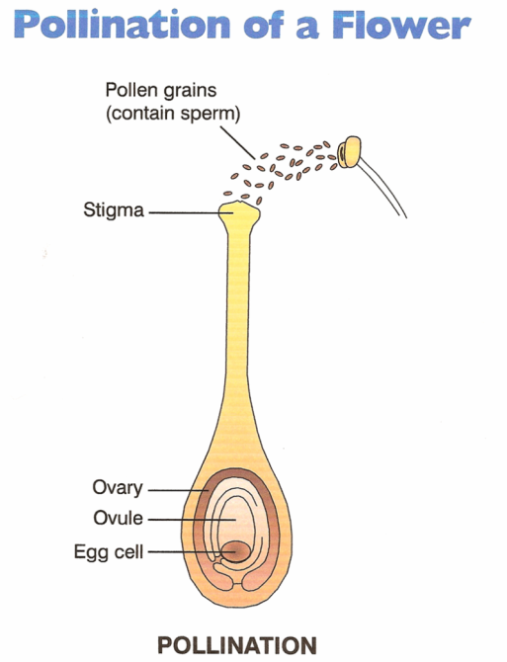
Plant Propagation Test Review B-I-N-G-O
Pollination
Transfer of pollen from anther to stigma

Slide 14
Plant Propagation Test Review B-I-N-G-O
Cross Pollination:
Pollen from one plant is transferred to a DIFFERENT plant

Slide 15
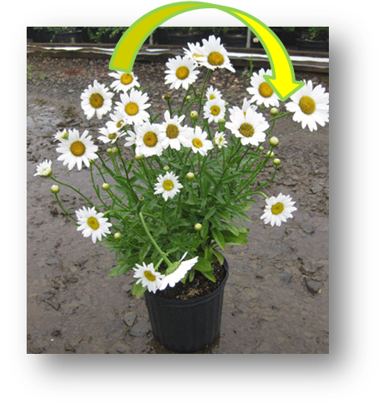
Plant Propagation Test Review B-I-N-G-O
Self Pollination:
Pollen is transferred to a flower on the SAME plant

Slide 16
Plant Propagation Test Review B-I-N-G-O
Pollinators: (Bees, Insects, Wind)
Methods of transferring pollen

Slide 17
Plant Propagation Test Review B-I-N-G-O
Asexual Plant Propagation:
Use of stems, roots, and/or leaves to produce new plants

Slide 18
Plant Propagation Test Review B-I-N-G-O
Separation/Division:
Method of asexual plant reproduction

Slide 19
Plant Propagation Test Review B-I-N-G-O
Layering
Method of asexual plant reproduction when a new plant is produced while its still attached to the mother plant

Slide 20
Plant Propagation Test Review B-I-N-G-O
Ground Layering
Any method of layering when it’s in the ground

Slide 21
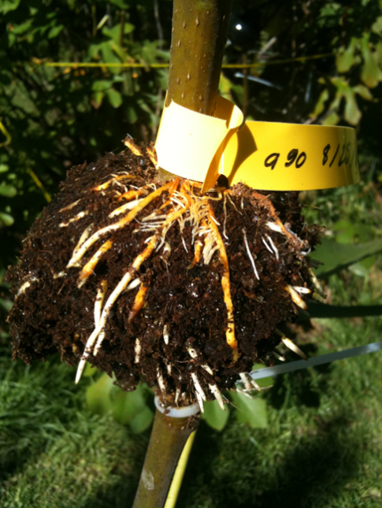
Plant Propagation Test Review B-I-N-G-O
Air Layering
Method of asexual plant reproduction

Slide 22
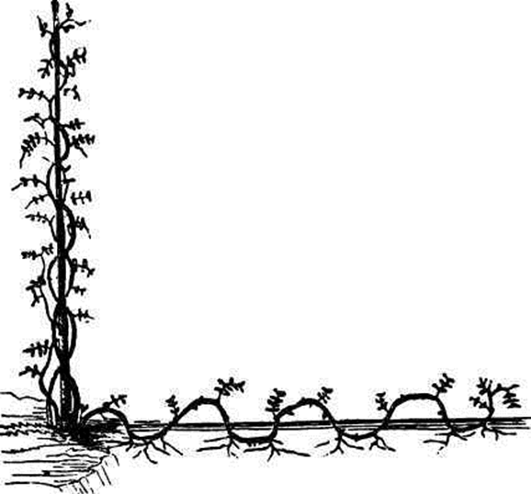
Plant Propagation Test Review B-I-N-G-O
Ground Layering:
Method of asexual plant reproduction

Slide 23
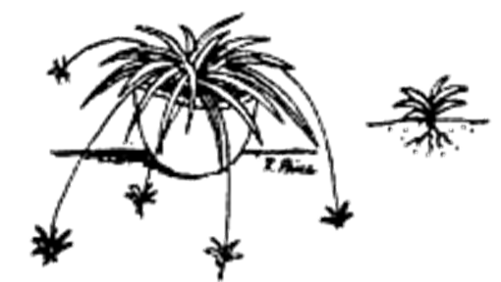
Plant Propagation Test Review B-I-N-G-O
Stolons & Runners
Method of ground layering

Slide 24
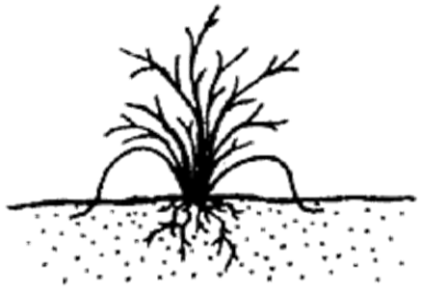
Plant Propagation Test Review B-I-N-G-O
Tip Layering
Method of ground layering

Slide 25
Plant Propagation Test Review B-I-N-G-O
Cuttings
Method of asexual plant reproduction

Slide 26
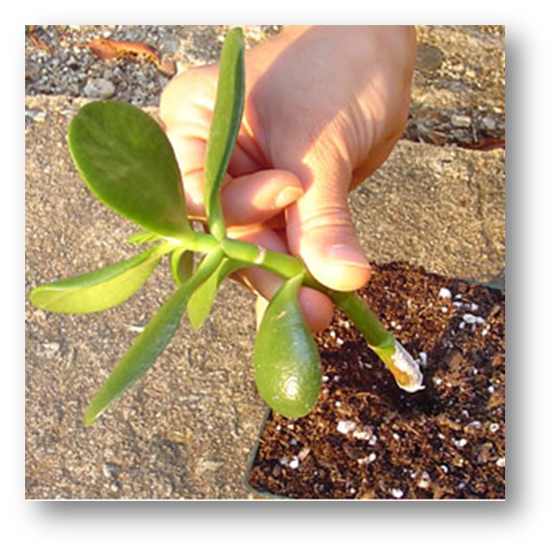
Plant Propagation Test Review B-I-N-G-O
Stem Cuttings
Method of taking cuttings

Slide 27
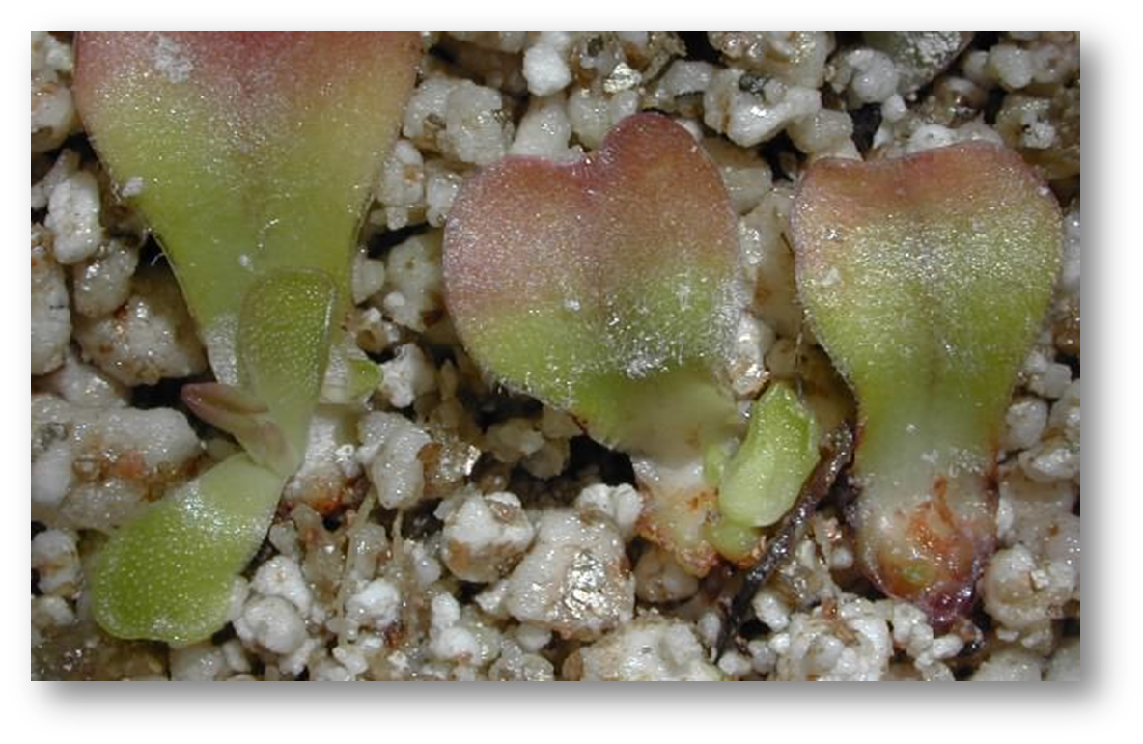
Plant Propagation Test Review B-I-N-G-O
Leaf Cuttings
Method of taking cuttings

Slide 28
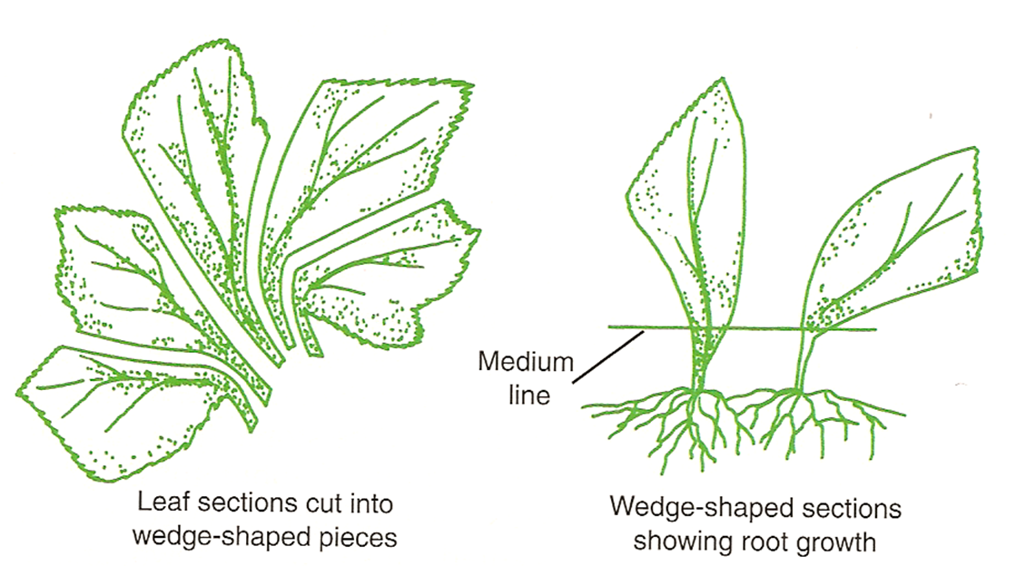
Plant Propagation Test Review B-I-N-G-O
Leaf Section Cuttings
Method of taking cuttings

Slide 29
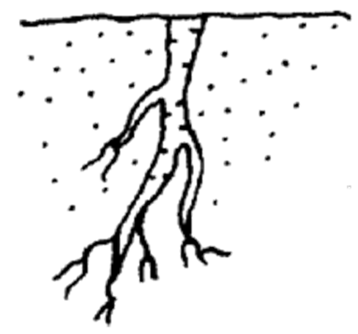
Plant Propagation Test Review B-I-N-G-O
Root Cuttings
Method of taking cuttings

Slide 30
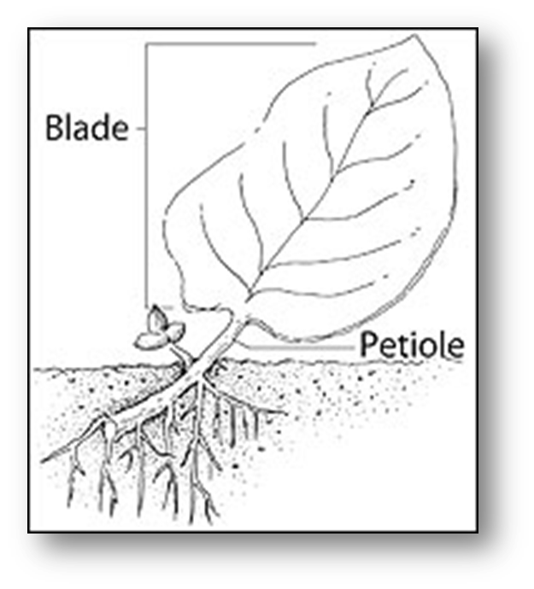
Plant Propagation Test Review B-I-N-G-O
Leaf Petiole Cuttings
Method of taking cuttings

Slide 31
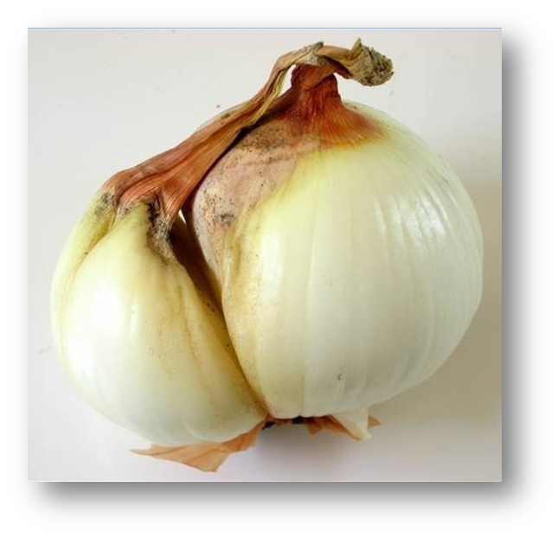
Plant Propagation Test Review B-I-N-G-O
Bulbs
Method of asexual plant reproduction

Slide 32
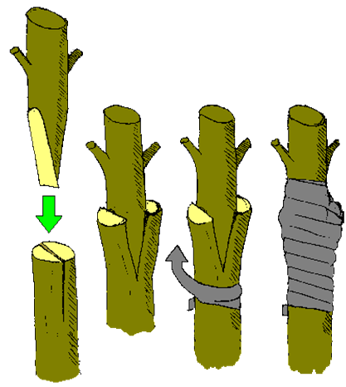
Plant Propagation Test Review B-I-N-G-O
Grafting
Connecting 2 pieces of living plant material together

Slide 33
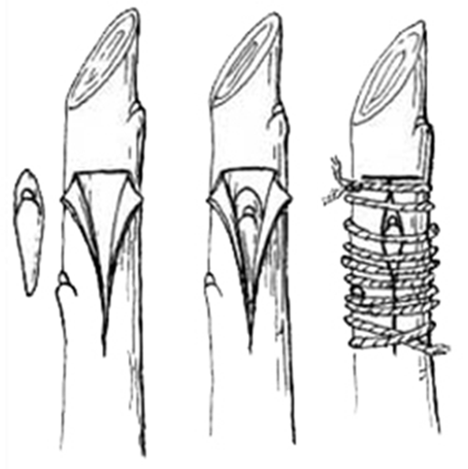
Plant Propagation Test Review B-I-N-G-O
Budding
Grafting technique where only a bud is transferred

