Slide 1
BIAS…
Assumptions, Attitudes or Behaviors based on Stereotypes of groups of people

Slide 2
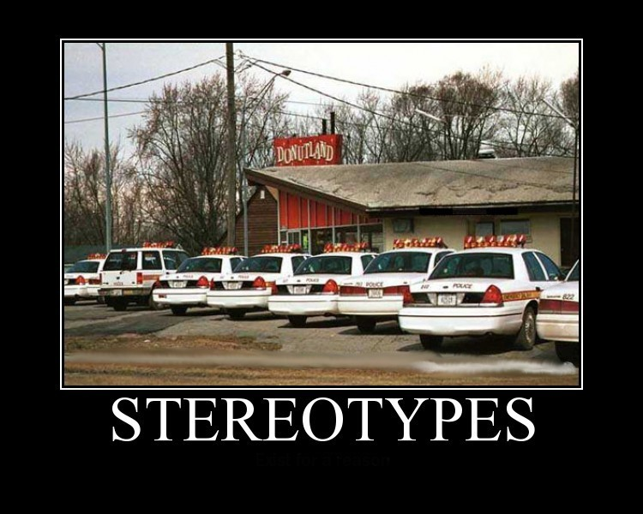

Slide 3
BIAS-FREE Language
Language that
does not
offend, demean or
exclude people
on the basis of gender, race, ethnicity, religion, age, ability or sexual orientation.

Slide 4
