Slide 1
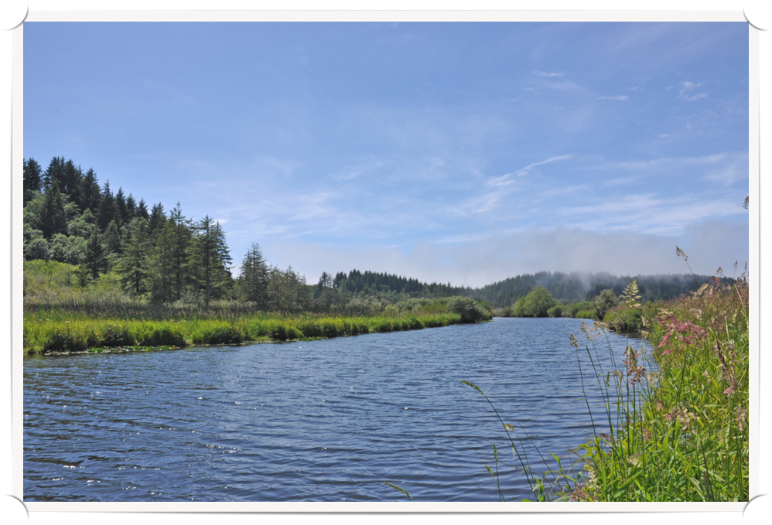
Natural Resources
Careers

Slide 2
OBJECTIVES
Identify basic career information related to environmental science.
Describe several environmental and natural resources science careers.
Identify leaders in the conservation movement.
Learn how to set goals and put together a resume and cover letter

Slide 3
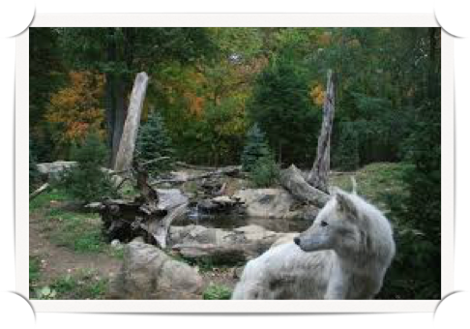
Habitat Conservationist
Commonly employed in local, state and federal government, wildlife conservationists work to preserve the habitats of plants and animals.
Their job duties include studying soil and water, as well as striving to prevent wildfires.
Entry-level jobs in wildlife conservation typically require a bachelor's degree in wildlife biology, environmental sciences, agricultural science or a related field.

Slide 4
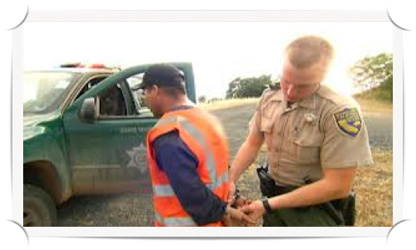
Game Warden
Patrols assigned area to prevent game law violations, investigate reports of damage to crops and property by wildlife, and compile biological data.
Travels through area by car, boat, airplane, horse, and on foot to observe persons engaged in taking fish and game, to ensure method and equipment used are lawful, and to apprehend violators.

Slide 5
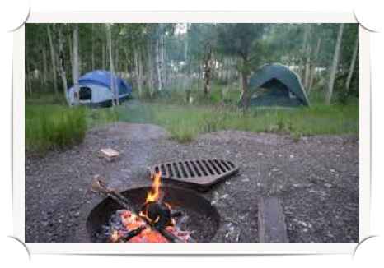
Parks and Recreation Supervisor
Conduct recreation activities with groups in public, private, or volunteer agencies or recreation facilities.
Organize and promote activities, such as arts and crafts, sports, games, music, dramatics, social recreation, camping, and hobbies, taking into account the needs and interests of individual members.

Slide 6
Miner
Mines ore, coal, or rock in underground mine, performing any combination of following tasks in areas where high production equipment is limited by economic factors or natural formations: Cuts channel under working face to facilitate blasting, using pick, or by operating cutting machine.

Slide 7
Environmental Service Coordinator
An environmental coordinator is someone who is responsible for formulating, researching, and enforcing environmental policies. Environmental coordinators can work in a wide variety of settings, depending on their area of interest.
Most have at least a bachelor's degree in environmental science or a related topic, along with work experience in the environmental field.

Slide 8
Fishery Scientist
Fisheries scientists come from many different backgrounds, but all are dedicated to effective management, use, and conservation of aquatic plants and animals.
As researchers, managers, administrators, or educators, they use their expertise in biology, ecology, statistics, genetics, economics, policy and administration, and law to protect and enhance recreational, commercial, and aquacultural fisheries resources.

Slide 9
Soil Conservationist
Soil conservationists possess a practical knowledge of the methods and techniques of soil, water, and environmental conservation as they relate to agricultural operations and land use measures.
These personnel also help landowners with issues such as dealing with soil, water, air, plants, and animal resource concerns.

Slide 10
Cartographer
Cartography is the study and practice of making maps.
Combining science, aesthetics, and technique, cartography builds on the premise that reality can be modeled in ways that communicate spatial information effectively.

Slide 11
Wildlife Manager
Attempts to balance the needs of wildlife with the needs of people using the best available science.
Wildlife management can include game keeping, wildlife conservation and pest control.
Wildlife management draws on disciplines such as mathematics, chemistry, biology, ecology, climatology and geography to gain the best results.

Slide 12
Range Technician
Study rangeland management practices and research range problems to provide sustained production of forage, livestock, and wildlife.
Measure and assess vegetation resources for biological assessment companies, environmental impact statements, and rangeland monitoring programs.
Maintain soil stability and vegetation for non-grazing uses, such as wildlife habitats and outdoor recreation.
Manage forage resources through fire, herbicide use, or revegetation to maintain a sustainable yield from the land.

Slide 13
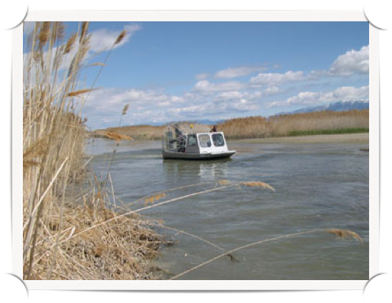
Ecologist
Ecologists are concerned with ecosystems as a whole, the abundance and distribution of organisms (people, plants, animals), and the relationships between organisms and their environment.
Ecologists usually choose a specialist area (e.g. freshwater, marine, terrestrial, fauna, flora) and then carry out a wide range of tasks relating to that area.

Slide 14
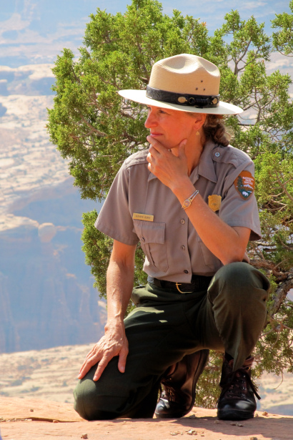
Park Ranger
Park rangers usually work for federal or state governments and are responsible for protecting woodlands, forests and conservatories.
They often work outdoors and patrol campgrounds, trails and surrounding areas.
Park rangers may conduct tours and answer questions from park guests. They also participate in search-and-rescue missions and make sure visitors follow fire and safety codes.
Prospective park rangers should pursue a bachelor's degree in a field such as biology or forestry.

Slide 15
Wildlife Rehabilitator
Working as a wildlife rehabilitator is one of those jobs in wildlife that will have you working directly with animals.
The central goal of a wildlife rehab center is to provide care for sick and injured local wildlife and then release those animals back into the wild.
Some wildlife rehabilitators and wildlife rehabilitation programs focus on specific groups of animals such as marine mammals or raptors.

Slide 16
Forest Technician
The forestry technician performs a variety of mostly outdoor assignments, for the purpose of implementing complicated forest management projects.
Forestry technician assignments may include: contract inspect & administer, contract prepare, survey & inventory, locate & assess, field measure & record, field designate, plan & design, quality control, appraisal, bid & negotiate, purchase & trade, and assist the professional foresters.

Slide 17
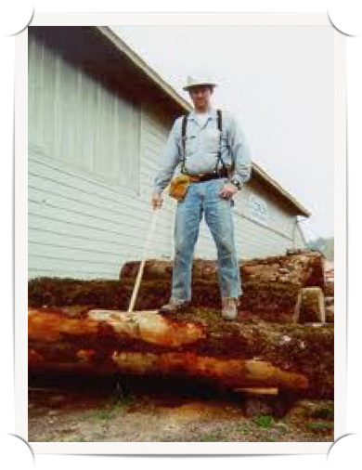
Log Grader
Grades logs in sorting yard, millpond, or log deck according to industry or company standards: Measures diameter and length of log, using scale stick, steel tape, or other measuring aid, and determines total volume, using conversion table.
Jabs log with metal end of scale stick and inspects log to ascertain conditions or defects, such as sound or water-soaked wood, splits, broken ends, rotten areas, twists, and curves.
Evaluates log's characteristics and determines grade according to established criteria.

Slide 18
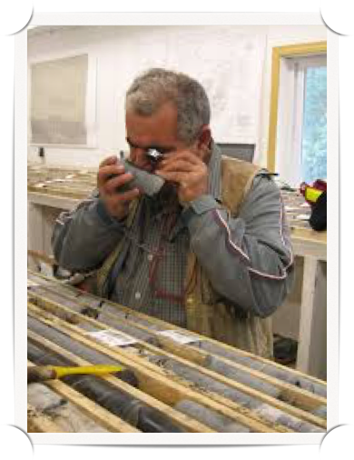
Geologist
Study composition, structure, and history of the earth's crust; examine rocks, minerals, and fossil remains to identify and determine the sequence of processes affecting the development of the earth.
Help locate mineral and petroleum deposits and underground water resources; prepare geologic reports and maps; and interpret research data to recommend further action for study.

Slide 19
Mining Engineer
A mining engineer ensures the safe and efficient development of mines and other surface and underground operations.
The role combines an understanding of the effects of these structures on their surrounding environment.
Mining engineers are involved at all stages of a project. They also manage and oversee mining production processes and are involved in the final closure and rehabilitation process.

Slide 20
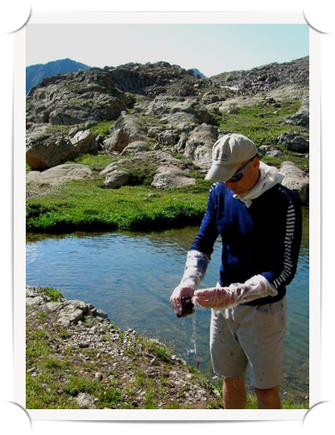
Water Monitoring Technician
Employees in this job perform a variety of water quality monitoring and control activities for the purpose of protecting the state's water resources for both environmental and recreational purposes by sampling and performing chemical tests of lakes, streams, and waste water treatment systems and their surrounding environments.

Slide 21
Hydrologist
Hydrologists are involved in the monitoring, management and protection of water and water resources in commercial, environmental and academic settings.
They ensure the effective flow of water through channels and pipes for the engineering and control of water provision.
Their work contributes to the efficient planning, development and sustainable use of natural and domestic water resources.

Slide 22
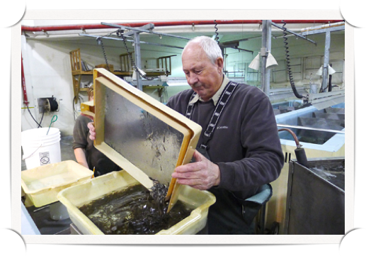
Fish Hatchery Manager
Fishery managers trap, spawn, and raise fish as cash crops or for release into bodies of fresh or salt water.
Their responsibilities include tracking fish life cycles and growth rates and controlling disease.
The biggest challenge for fishery managers is integrating innovative methods of breeding and trapping fish that are environmentally conscientious and economically profitable.

Slide 23
Fishing Vessel Operator
A fishing vessel operator is a fisherman who specializes in working from a boat, typically as part of a crew.
The job isn’t very different from that of a regular fisherman in many aspects, while on the other hand it requires some specific knowledge related to catching fish from a vessel.
Fishing vessel operators will most often catch their fish by using nets, and the traditional method of using rods isn’t very commonly used.

Slide 24
Wildlife Veterinarian
Wildlife veterinarians specialize in exotic animal medicine, which presents a unique set of challenges within the veterinarian job description.
These vets must become medical specialists in hundreds of different species, each with unique anatomy and responses to medicine, as well as understand normal verses abnormal behavior for each species.

Slide 25
LEADERS OF CONSERVATION
There are many people who have had an impact on the conservation movement over the past few centuries. Some of these people include John Muir, Theodore Roosevelt, Franklin Roosevelt, Aldo Leopold, Gifford Pinchot, Hugh Bennett, and Rachel Carson.

Slide 26
John Muir
(1838–1914)
He was partly responsible for the development of the Yellowstone and Sequoia National parks. It was through his encouragement that President Theodore Roosevelt established these parks.
Muir was also responsible for starting the Sierra Club, whose purpose is to promote conservation. A forest in California was also named for John Muir.

Slide 27
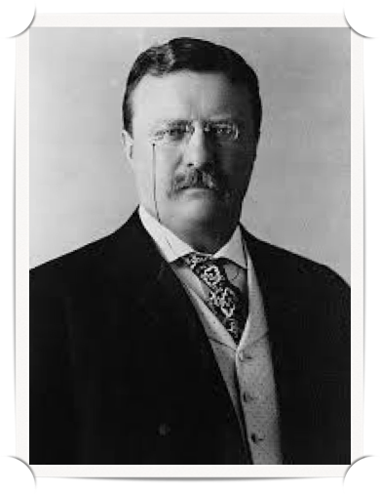
Theodore Roosevelt
(1858–1919)
Theodore Roosevelt was responsible for passing legislation to help protect our natural resources.
He is considered the “father of the conservation movement”.
Franklin Roosevelt was the president who set up the Soil and Water Conservation Department within the U.S.D.A.

Slide 28
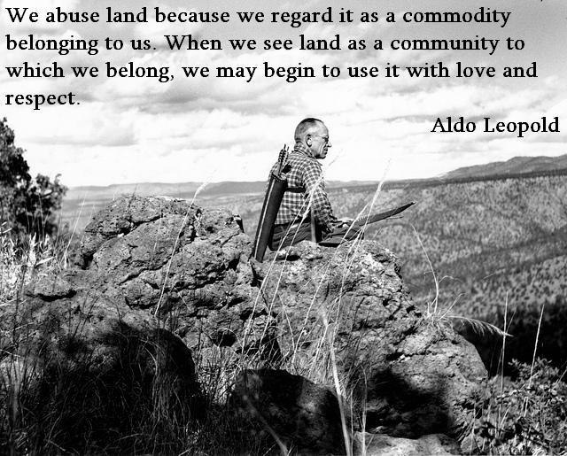
Aldo Leopold
(1886–1948)
He is noted for applying ecology to wildlife management.
Leopold believed that people should enjoy nature but not destroy it in the process.
His book Game Management was used to help educate future wildlife biologists.

Slide 29
Gifford Pinchot
(1865–1946)
He also authored a book, his was titled The Fight for Conserva- tion.
Pinchot’s efforts focused on the conservation of forests.
He was one of the first lead- ers of what eventually became known as the U.S. Forest Service.

Slide 30
Hugh Bennett
(1881–1960)
He was the first person to run the Soil Conservation Service.
He is known as the “father of soil conservation.”
He promoted the use of scientific investigation in determining soil needs.

Slide 31
Rachel Carson
(1907–1964)
She was responsible for making people aware of the problems caused by pesticides.
She was a biologist and a writer who authored a book titled Silent Spring.

Slide 32
How to set Career Goals
Before you set a career goal, there are few things that you should know about goals, as they are set on various levels.
First, decide what you want to do, accomplish, or be in life.
Secondly, split your larger goal into smaller and more achievable goals or targets that you have to achieve. This will make accomplishing your goal easier to manage and will help streamline the process into reaching your ultimate goal.
Finally, you will want to formulate and develop a proper plan for your goal. It can be best to establish a step by step plan that will enable you to start working towards achieving it.

Slide 33
Terms
Job: Part of a career that involves specific work and duties
Career: All the jobs or occupations in a person’s lifetime
Entrepreneur: Someone who provides a product or service for profit

Slide 34
Resume
Objective
Education
Skills
Experience

Slide 35
Cover Letter
Reason
Qualification
Why
Closing

