Slide 1
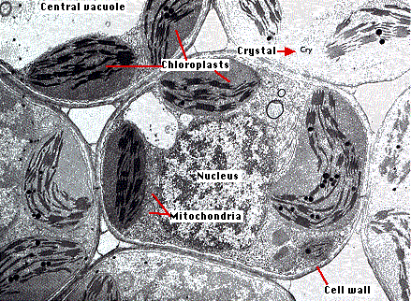
Plant Cell Structure and Cell Processes

Slide 2
Unit Objectives
1: Explain the structures of plant cells and important cell processes.
a. Describe the structures of a typical plant cell and their functions.
b. Compare and contrast mitosis and meiosis.

Slide 3
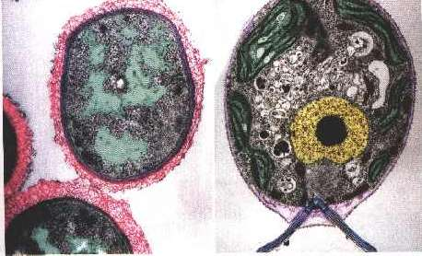
A brief review of cells!
1. Cell Types:
  Prokaryotes and Eukaryotes

Slide 4
Prokaryotic Cells Vs. Eukaryotic Cells
Prokaryotic Eukaryotic
Bacteria & Achaea Plants & Animals
Fungi, Protists
Primitive Advanced
No organized Nucleus Organized Nucleus
No membrane bound
organelles
Naked DNA DNA in Nucleus
Small Ribosomes Large Ribosomes

Slide 5
What type of cells are plants?
Eukaryotes
  Other Eukaryotes include animals, fungi and protists.

Slide 6
Animal Cells vs. Plant Cells
 |  | Animal Cells | Plant Cells
Cell Wall |  | Absent | Made of Cellulose
Plastids (Chloroplasts) |  | Absent | Present (many types)
Centrioles |  | Present | Absent
Vacuoles |  | Absent or small | Usually a single large vacuole
Lysosomes |  | Present | Absent
 | Cilia and Flagella absent in plants

Slide 7
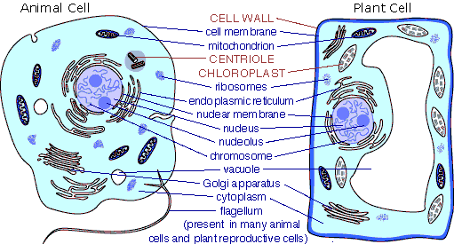
Comparison of plant and Animal Cells

Slide 8
Major Organelles of the Plant Cell
PSS.4.HO
Cell Wall
Cell Membrane
Chloroplasts
Endoplasmic Reticulum
Mitochondria
Nucleus
Nuclear Membrane
Vacuole
Cytoplasm

Slide 9
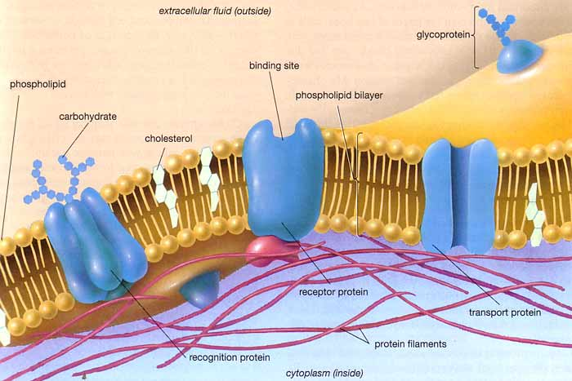
Cell Membrane
Selectively permeable- A plant cell allows certain things to come through the cell membrane i.e. water, while blocking other things from entering.
Phospholipids – what the membrane is made up of. Head (phosphate) and Tail (lipid). Head is hydrophilic and tail is hydro phobic.

Slide 10
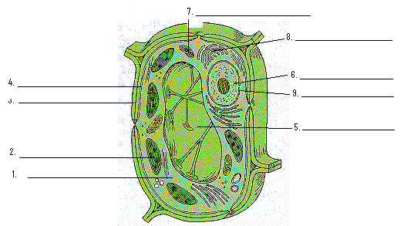
PSS.1.BC Name: _________________
Label the organelles of the cell below.

Slide 11
Plant Organelle Functions
Nucleus - Contains the DNA and manages most of the functions of the plant
Cell membrane - is selectively permeable in order to allow nutrients and other material in.
Lysosomes - Stores enzymes and waste products
Chloroplasts - Contain chlorophyll and is the location where photosynthesis occurs.
Mitochondria - Transfers energy from organic compounds to ATP
Nuclear Membrane - Surrounds the nucleus
Cytoplasm - The region of the cell between the cell membrane and the nucleus
Cell Wall - Supports and protects the cell, made of cellulose
Ribosome - Where proteins are created from the DNA
Vacuoles – large storage area in plants. Used to store water and nutrients.

Slide 12
Plant Cell Unique Features
Most plant reactions (photosynthesis, respiration, cell division, etc.) occur at the cellular level
A unique feature of plant cells is that they are totipotent.
  Totipotent: cells retain all of the genetic information (encoded in DNA) necessary to develop into a complete plant
This characteristic is the main reason that vegetative or asexual reproduction works (such as grafting or stem cuttings)
For example, the cells of a small leaf cutting from an African violet have all of the genetic information necessary to generate a root system, stems, more leaves, and ultimately flowers.

Slide 13
Do cells live forever? What is a cells life cycle?
Most cells live for only a short period of time.
The have a life cycle like all other living things.
Plant cells go through this cycle. Come reproduce and give us more plant cells other cells don’t.
What do we call cell reproduction?
  Mitosis!

Slide 14
Understanding the Cell Cycle
There are three major stages to the cell cycle – Interphase, Mitosis and Cytokinesis.
Interphase encompasses the phases of G1 (Growth 1), S (DNA Synthesis) and G2 (Growth 2) phase.
Mitosis encompasses the phases of prophase, metaphase, anaphase and telophase.
Cytokinesis (cytoplasm divides)
Let’s see what this look like!

Slide 15
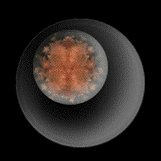
The Cell Cycle in Action!

Slide 16
The cell Cycle!
Repeating sequence of cellular growth and division throughout the life of an organism
The Phases of the Cell Cycle:
Interphase
G1
S
G2
M Phase
Cytokinesis

Slide 17
Interphase – an Overview
1st Growth Phase
S Phase: DNA Synthesis Phase
    (DNA Replication)
2nd Growth Phase

Slide 18
Phases of Interphase
A) 1st Growth Phase = (G₁)
  1. Cell grows rapidly and carries out routine functions
  2. Phase takes most of the cell’s life
  3. Muscle and nerve cells never divide, so they remain in G₁

Slide 19
Phases of Interphase (cont.)
B) Synthesis Phase (S)
  1. Cell’s DNA is copied
  2. At the end of the stage, each chromosome consists of 2 chromatids attached @ a centromere.

Slide 20
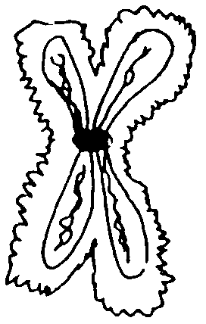
Chromosome Structure
Sister Chromatid
Centromere
DNA

Slide 21
Phases of Interphase (cont.)
C) Second Growth Phase (G₂)
  1. Hollow microtubules are assembled
  2. Microtubules are used to move chromosomes during mitosis

Slide 22
Second Phase of the Cell Cycle
D) Mitosis
  1. Nucleus is divided into 2 nuclei
  2. Each nucleus ends up with the same number of chromosomes as the original cell.
  3. Includes prophase, metaphase, anaphase and telophase.

Slide 23
Mitosis
Process by which the nucleus of the cell is divided into two nuclei, each with the same number and kinds of chromosomes as the parent cell.

Slide 24
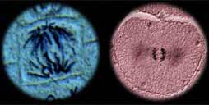
Why do we care about cell division?
A) Cell division of Mitosis is a process of reproducing cells. This occurs during growth, repair and development of tissues.

Slide 25
Prophase
Longest (50 - 60%)
Appearance of chromosomes
Nucleolus disappears
Nuclear membrane breaks down
Centrioles separate and migrate to opposite poles of cell
Spindle fibers from the centrioles attach to the centromeres
Chromatin coils up (shortens) into chromosomes

Slide 26
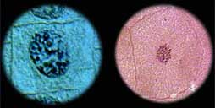
Plant and Animal Cells in Prophase
Plant & animal cells in prophase

Slide 27
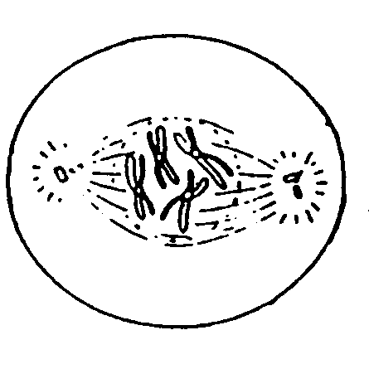
Prophase

Slide 28
Metaphase
Shortest
Chromosomes line up across center (equator) of cell
Spindle fibers from centromere to centrioles

Slide 29
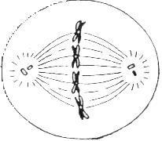
Metaphase
Chromosome
Centriole
Spindle Fiber

Slide 30
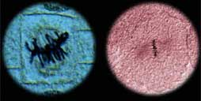
Plant and Animal Cells in Metaphase

Slide 31
Anaphase
Sister Chromatids split at Centromere
Individual Chromosomes move toward poles
Chromatid pairs from each chromosome separate from each other
Chromatids are pulled apart by the shortening of the microtubules in the spindle fibers

Slide 32
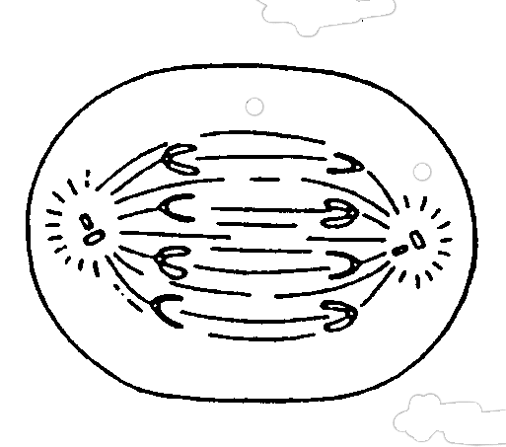
Anaphase

Slide 33
Plant and Animal Cells in Anaphase

Slide 34
Telophase
Final Phase
Spindle fibers breakdown
Chromosomes uncoil into Chromatin
Nuclear envelope (membrane) reforms
Nucleolus becomes visible
Chromosome reach the ends of the cell
The centrioles double
The cytoplasm is divided

Slide 35
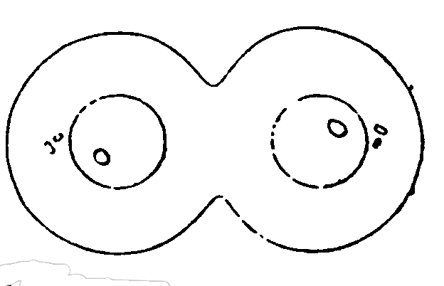
Telophase

Slide 36
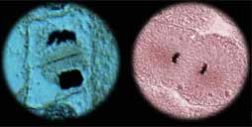
Plant and Animal Cells in Telophase

Slide 37
Mitosis in Whitefish and Onion

Slide 38
Final Stage of the Cell Cycle
Cytokinesis
  During this final stage, the cytoplasm divides.
  The process by which the cytoplasm divides, forming two new cells.

Slide 39
Cytokinesis
Animals
  Cell membrane
  pinches inward
Plants
  Cell plate

Slide 40
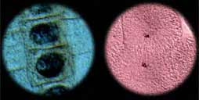
Plant and Animal Cells in Cytokenisis

Slide 41
Mitosis and Meioses
Mitosis – simple cell division.
Not all cells undergo mitosis
Four stages
  Prophase
  Metaphase
  Anaphase
  Telophase
Results in two genetically identical cells
Meiosis – reproductive cell division
Reduces chromosome to haploid
Eight stages
Results in four genetically different cells

Slide 42
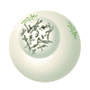
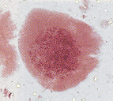
Meiosis
Cell division where one body cell produces four gametes, containing half the genetic material of the parent cell.
Pollen (sperm) and Ova or Eggs

Slide 43
Meiosis
Meiosis divided into two sections with a total of eight phases.
  Meiosis 1
  Meiosis II
These phases are continuous and flow one right after the other.

Slide 44
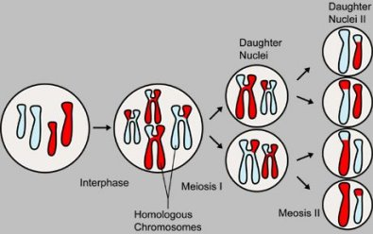
The stages of Meiosis

Slide 45
