Slide 1
Plant Processes

Slide 2
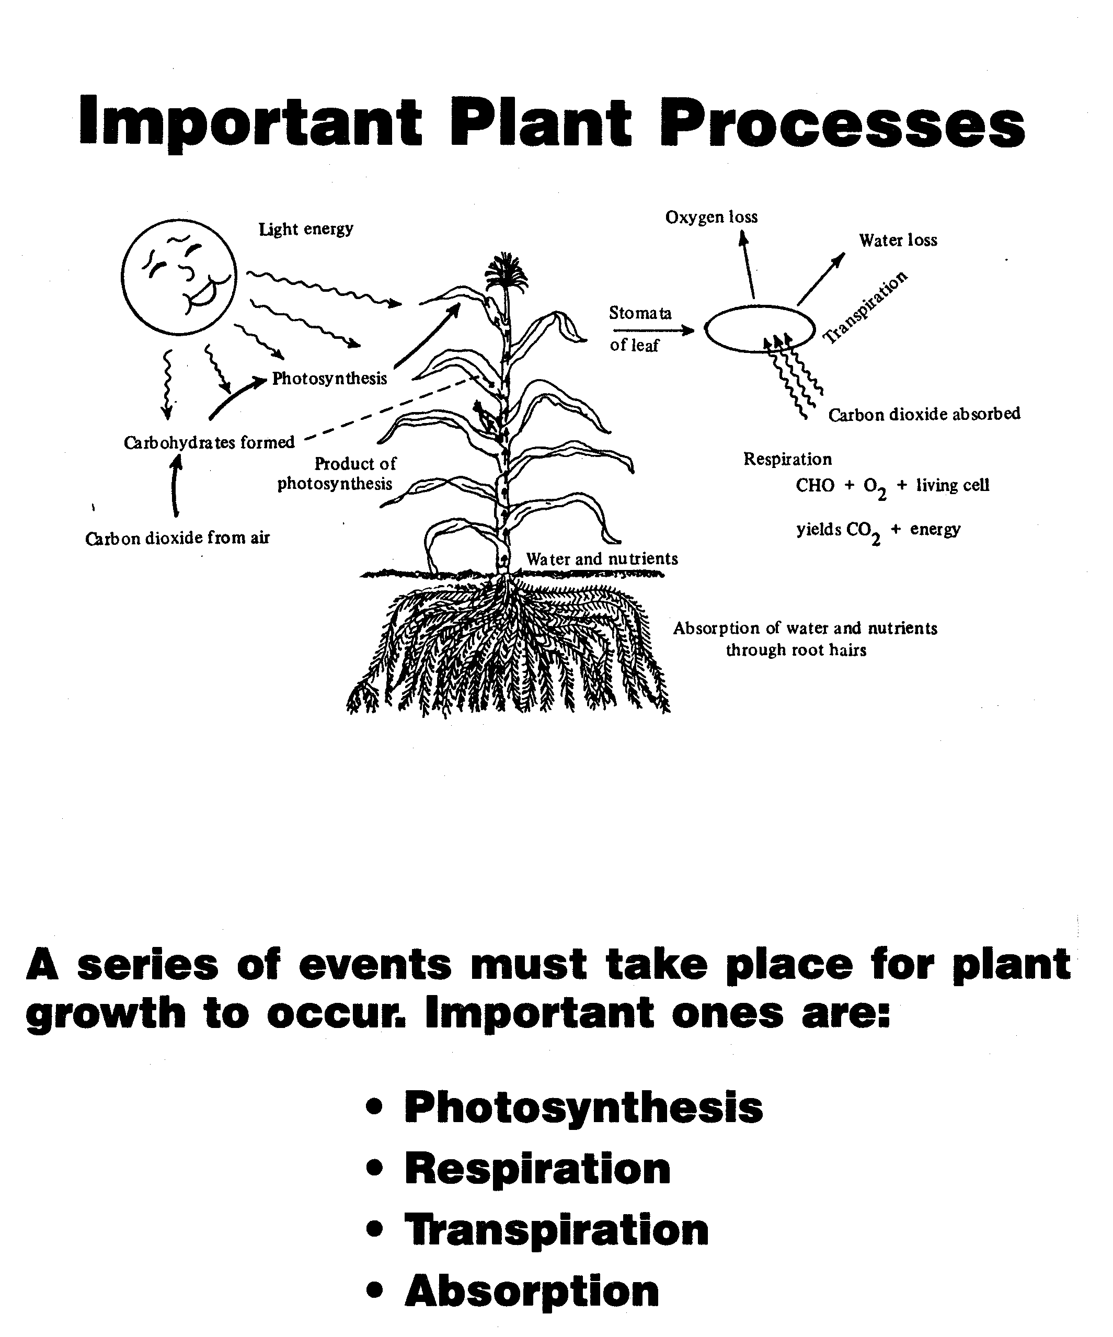

Slide 3
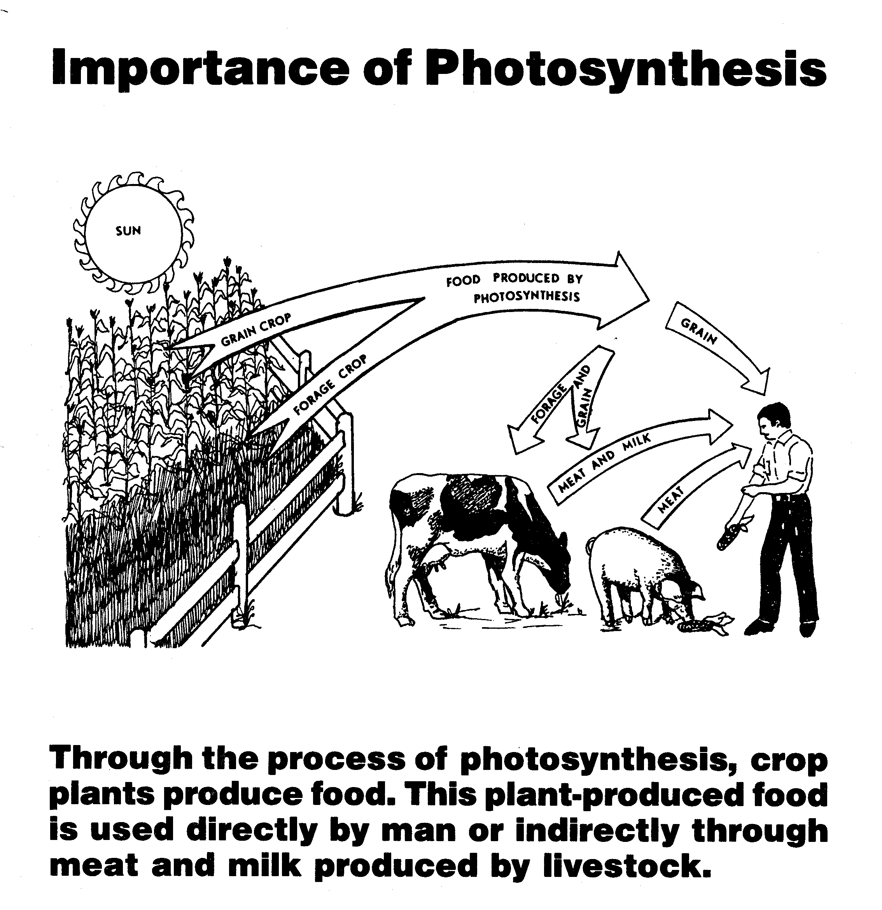
Photosynthesis: most important process in the world
Plants produce food
Plants produce food used directly by man
Plants produce food used indirectly by man through meat and milk

Slide 4
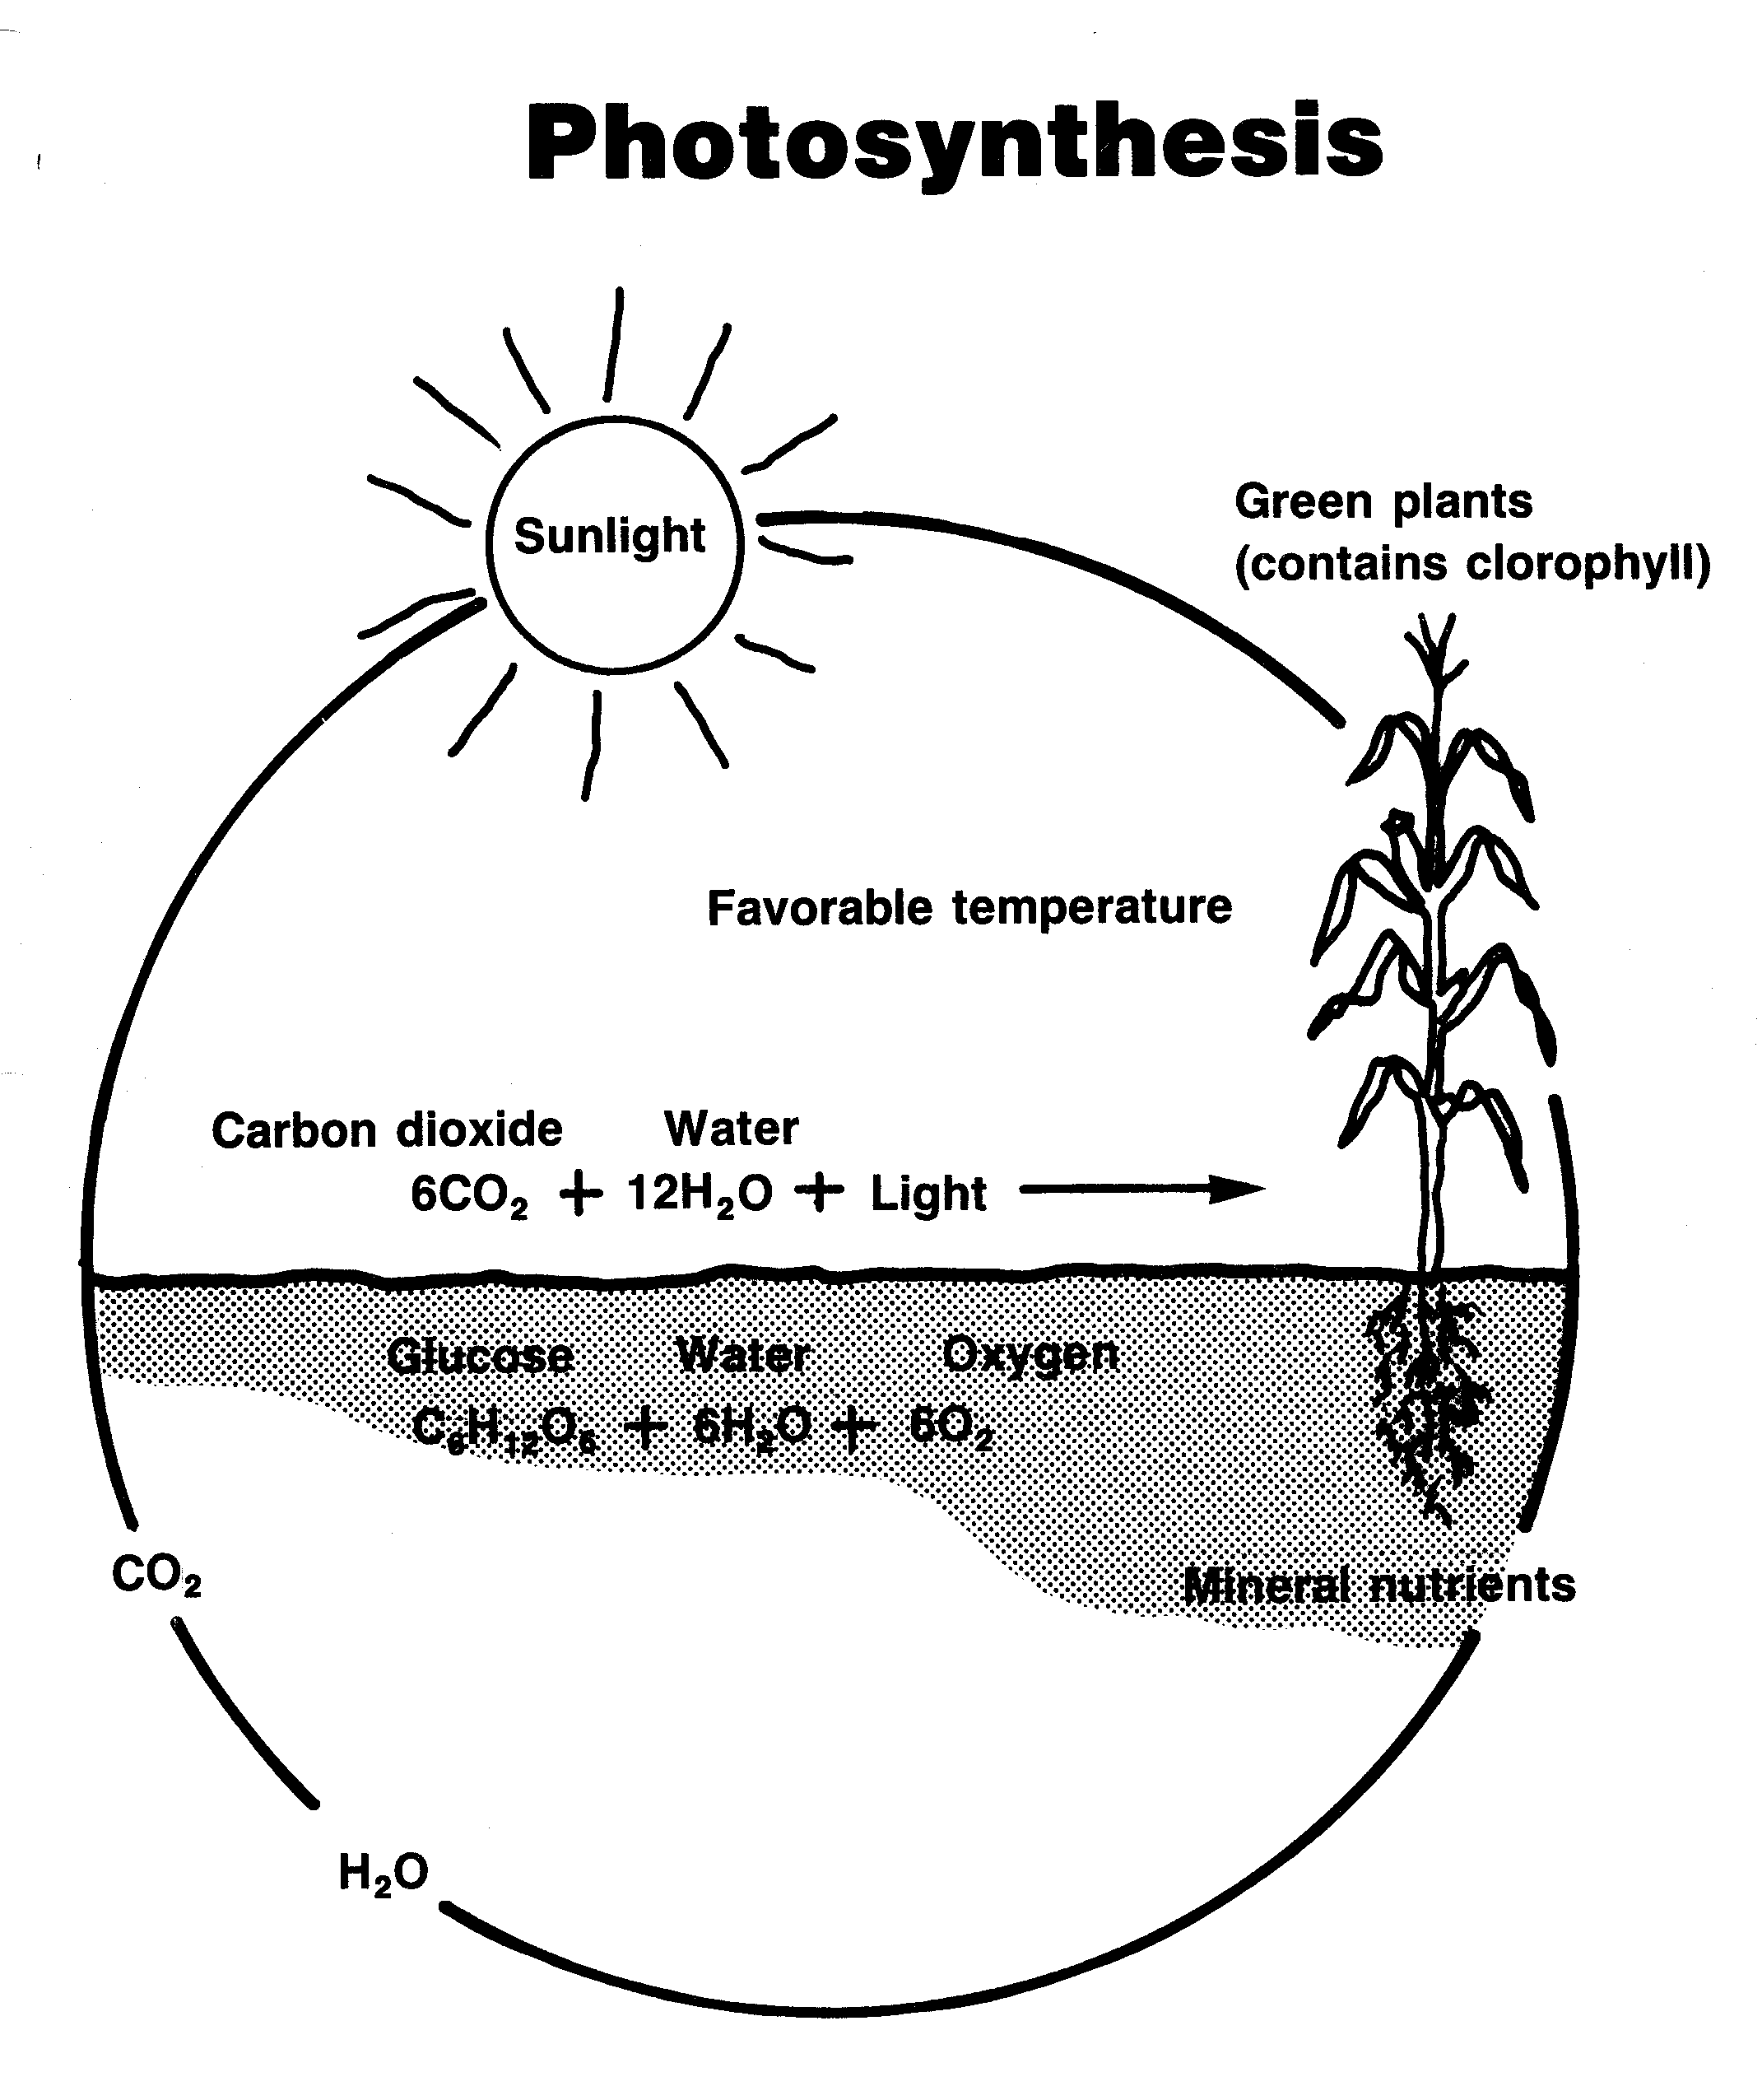
Process of Photosythesis
Carbon dioxide (CO₂) enters leaf from surrounding area through the stoma
Water moves from soil into root, stems, and leaves through the xylem tissue
Molecules of water (H₂O) and carbon dioxide (CO₂) are synthesized, put together, in the chlorophyll of a plant with energy from the sunlight
End result is the formation of sugar which is transported by the phloem tissue to the part of the plan where it is used

Slide 5
Factors Affecting Photosynthesis Rate
Water Supply
Temperature
Light Quality
Light Intensity
Deficiency of Certain Plant Nutrients

Slide 6
Respiration Process
Sugar is broken down to produce energy for essential plant functions
Respiration consumes oxygen (O₂) and glucose (C₆H₁₂O₆)
Respiration gives off carbon dioxide (CO₂) and water (H₂O)

Slide 7
Photosynthesis and Respiration Relationship
Photosynthesis
Respiration
Building process
Sugars manufactured
CO₂ is consumed
O₂ is given off
Requires light
Only takes place in cells containing chlorophyll
Sugar (C₆H₁₂O₆) is the end product
Destruction process
Sugars consumed
CO₂ is given off
O₂ is consumed
Goes on day and night
Carried on in all cells
Energy produced for plant functions is the end product

Slide 9
Absorption of nutrients and water
Diffusion- movement of gases or liquid from high concentration to low concentration
Osmosis- movement of a substance from greater concentration through a semi-permeable membrane to lesser concentration
Non-root feeding (leaf feeding)- nutrients and water entering the plant through leaves and stems

Slide 10
Absorption Process
Soil solution enters root hairs by the process of osmosis
After the soil solution is absorbed by the root hairs, it moves through the epidermal cells, cortex and phloem to the xylem
The xylem conducts solution to other plant parts

Slide 11
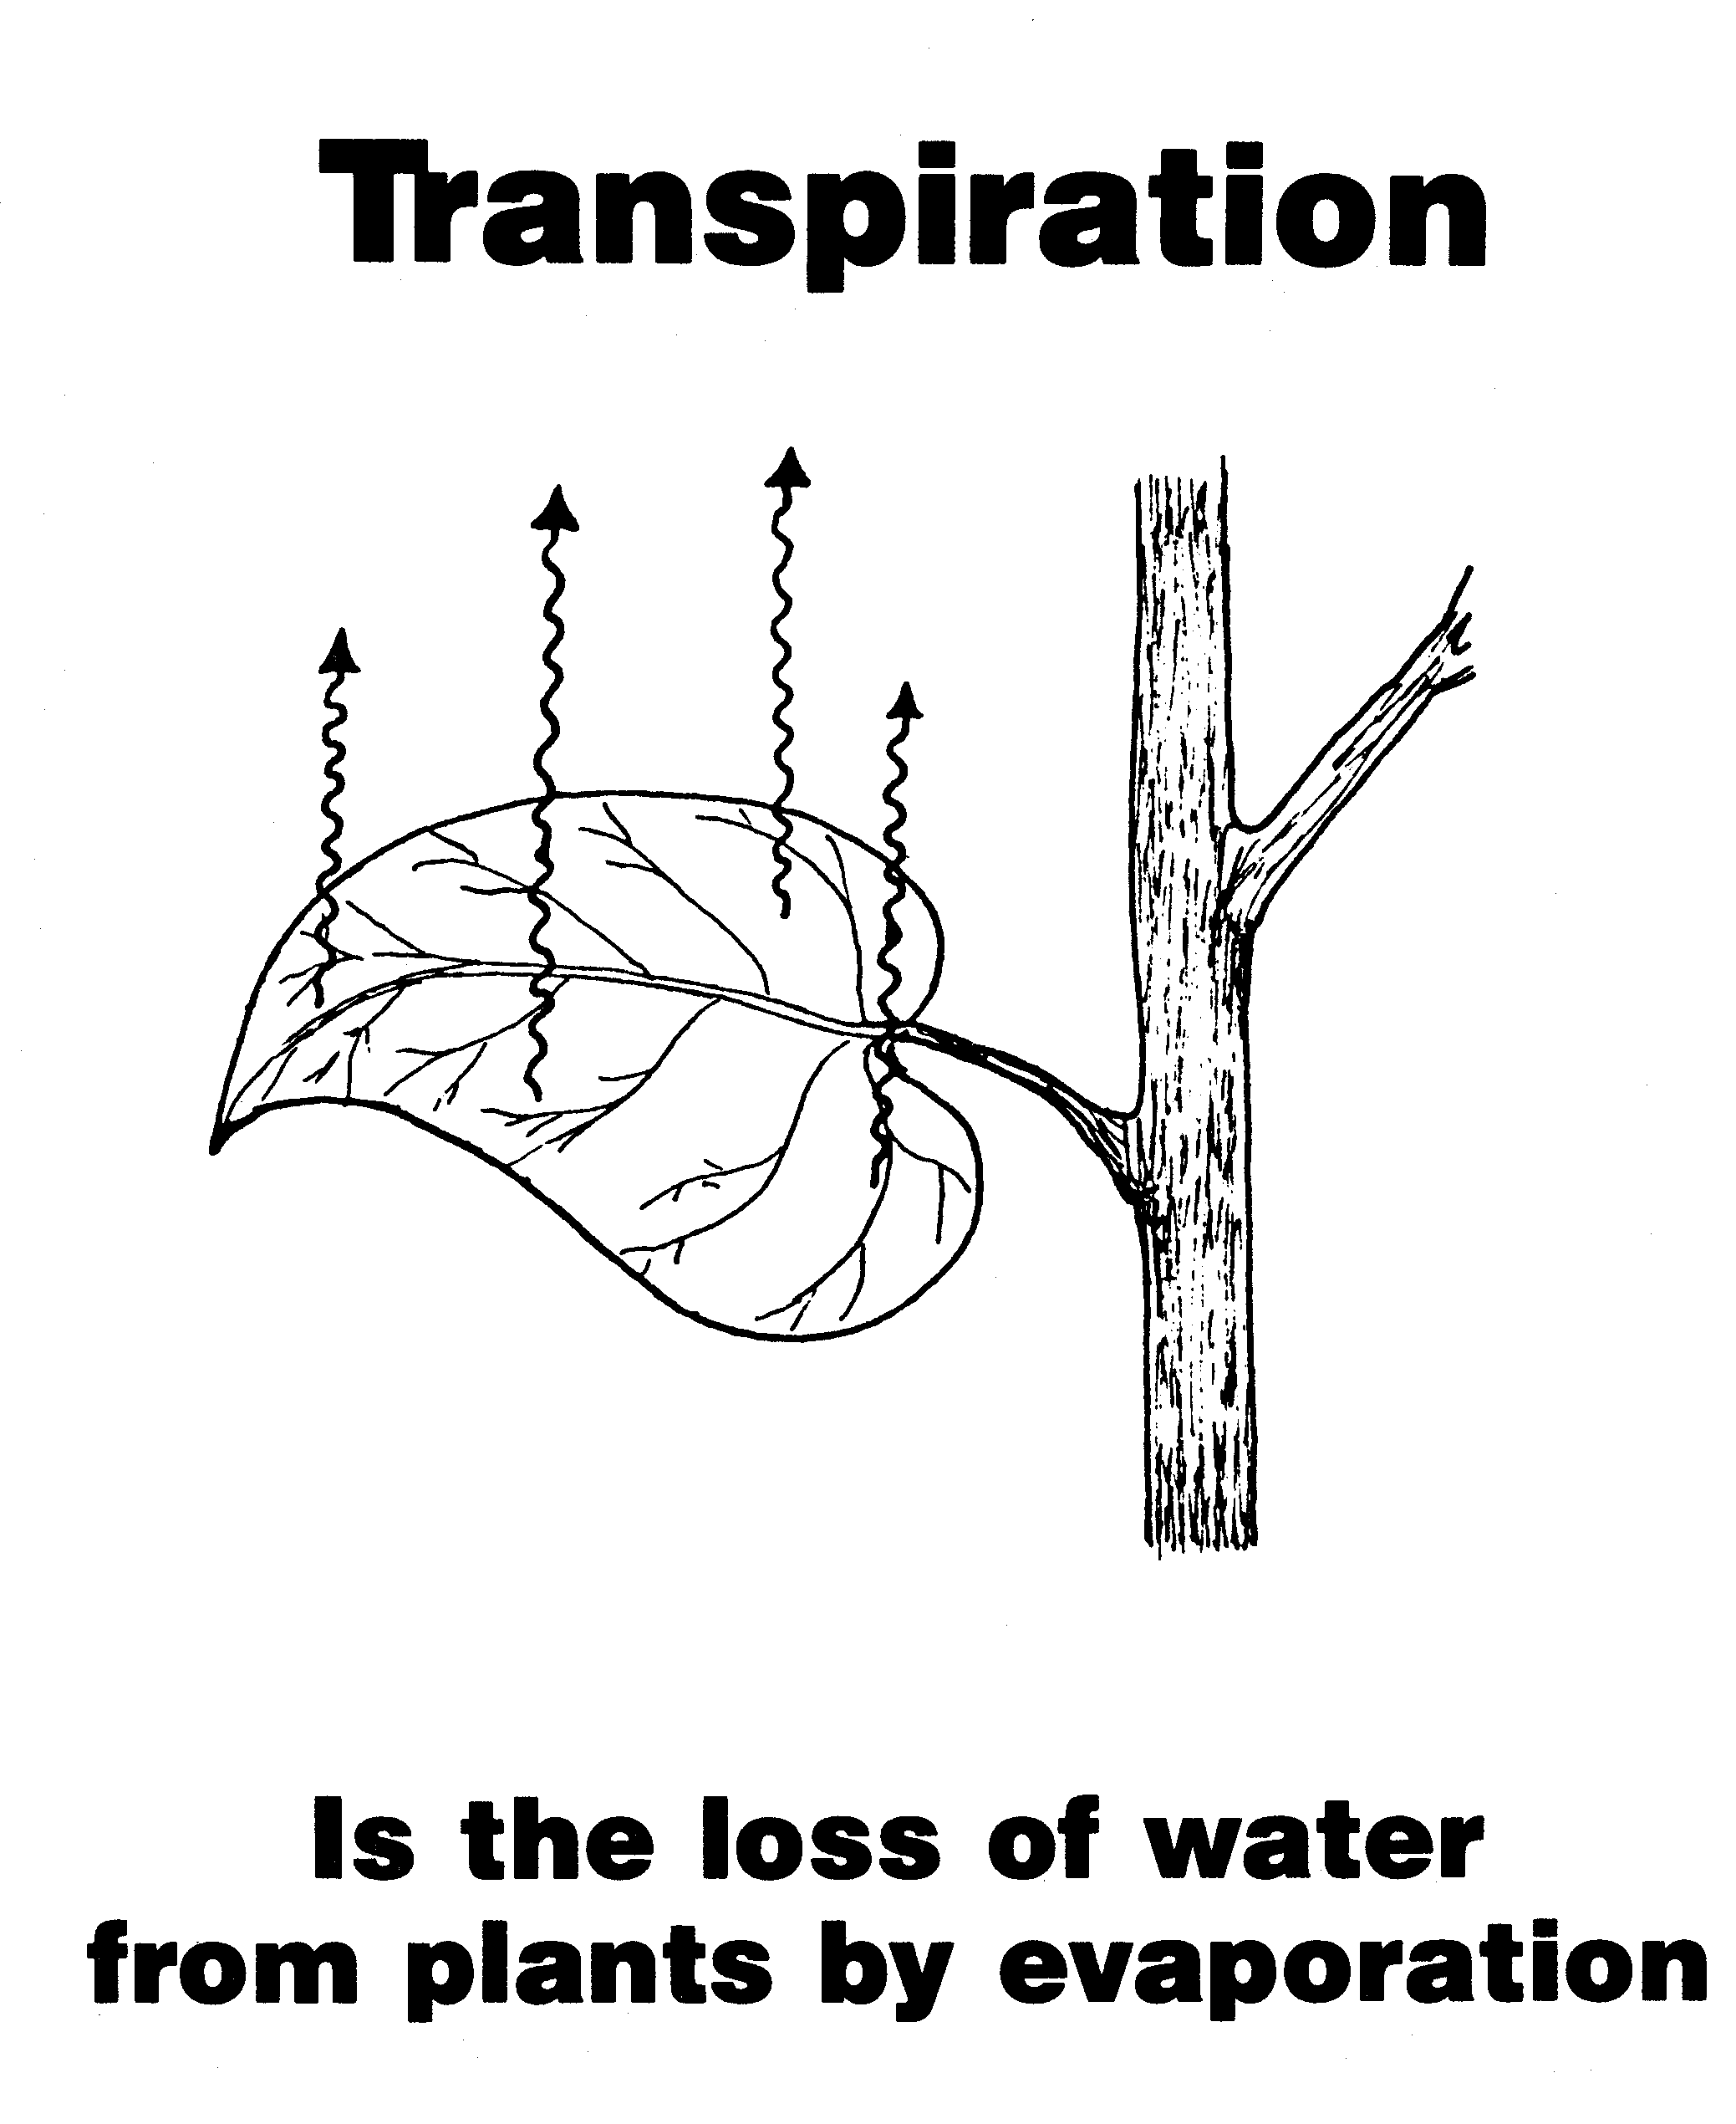

Slide 12
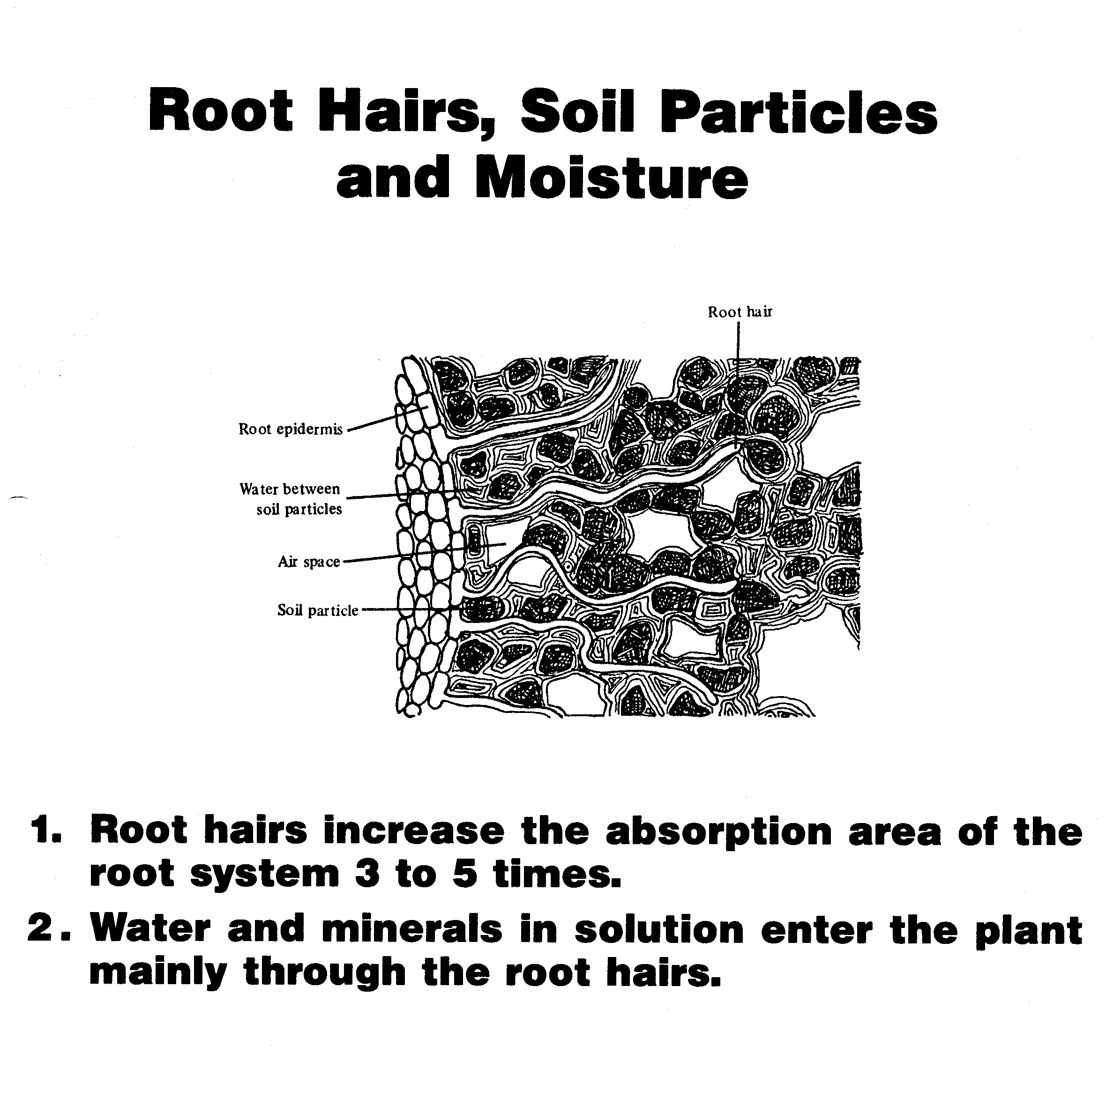
Transpiration Process
Water enters plant through root hairs
Water passes to xylem and up to the stem to leaves
Small amount of water is used in photosynthesis
The remainder is lost by transpiration

Slide 13
Factors Affecting Water Loss by Transpiration
Climate conditions
Number of stoma on leaves
Availability of soil moisture to plant
General plant structure
Soil fertility

Slide 14
