Slide 1
Supervised Agricultural Experience
A. Describe a Supervised Agricultural Experience (SAE);
B. List and differentiate 5 types of SAE’s;
C. Explore SAE opportunities and possibilities;
D. Select, plan for, and implement a SAE;
Describe what Proficiency Awards are and select the proficiency area that best fits your SAE;
Describe the benefits of having a successful SAE project;
G. Maintain up to date SAE records.

Slide 2
What is SAE?
A. Describe a Supervised Agricultural Experience (SAE);
Project related to agriculture:
Animals
Plants
Mechanics
Science
Work for someone else
OR
for yourself
Student directed. YOU choose your project

Slide 3
SAE Types
B. List and differentiate 5 types of SAE’s;
Placement
Work for someone else
With or without pay
Job relates to an area of agriculture

Slide 4
SAE Types
B. List and differentiate 5 types of SAE’s;
Entrepreneurship
Work for yourself
Invest your money in hopes of earning more money

Slide 5
SAE Types
B. List and differentiate 5 types of SAE’s;
Exploratory
Introductory project
Short term
Helps you find a long term project to fit your interests

Slide 6
SAE Types
B. List and differentiate 5 types of SAE’s;
Agriscience
Do your own research
Solve problems & find the best solutions

Slide 7
SAE Types
B. List and differentiate 5 types of SAE’s;
Improvement
Pick a project to improve something at a house, farm, or public place

Slide 8
Examples of PLACEMENT SAE’s
C. Explore SAE opportunities and possibilities;
Work at a:
Flower Shop
Greenhouse
Feed Store
Pet Store
Dairy Farm
Ranch
Horse Barn
Grow a vegetable garden at your house
Manage your family’s landscape
Feed & Care for your family’s animals

Slide 9
PLACEMENT SAE’s in our FFA Chapter
C. Explore SAE opportunities and possibilities;
Show pictures and highlight your student’s SAE’s here

Slide 10
Examples of ENTRPRENEURSHIP SAE’s
C. Explore SAE opportunities and possibilities;
Raise a livestock animal and sell it at the fair
Raise hens and sell their eggs
Train horses, dogs, or other animals to sell
Breed animals to sell (dogs, cats, rabbits, livestock, etc)
Grow a vegetable garden and sell produce
Operating a lawn care business
Design web pages for ranchers and farmers
Corn Maze

Slide 11
ENTRPRENEURSHIP SAE’s in our FFA Chapter
C. Explore SAE opportunities and possibilities;
Show pictures and highlight your student’s SAE’s here

Slide 12
Examples of EXPLORATORY SAE’s
C. Explore SAE opportunities and possibilities;
Spend a day job shadowing
Spend a weekend learning at your friend’s farm
Volunteer for a day at the animal shelter
Research what type of projects you can do with small animals

Slide 13
Examples of EXPLORATORY SAE’s
C. Explore SAE opportunities and possibilities;

Slide 14
EXPLORATORY SAE’s in our FFA Chapter
C. Explore SAE opportunities and possibilities;
Show pictures and highlight your student’s SAE’s here

Slide 15
Examples of AGRISCIENCE SAE’s
C. Explore SAE opportunities and possibilities;
Conduct an experiment to find the best fertilizer to grow geraniums
Compare rate of gain in pigs with different feeds
Test tarp materials to find the most durable material to cover hay/straw
Compare metal finishes on fence panels to see which resist rust the best

Slide 16
AGRISCIENCE SAE’s in our FFA Chapter
C. Explore SAE opportunities and possibilities;
Show pictures and highlight your student’s SAE’s here

Slide 17
Examples of IMPROVMENT SAE’s
C. Explore SAE opportunities and possibilities;
Help remodel your house
Build a new dog kennel/house
Repair a shed
Pour concrete

Slide 18
IMPROVMENT SAE’s in our FFA Chapter
C. Explore SAE opportunities and possibilities;

Slide 19
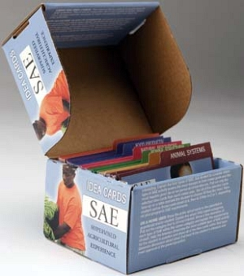
SAE Exploration
C. Explore SAE opportunities and possibilities;
SAE Idea Shuffle
Divide into 7 groups
Every group gets 1 category of the SAE Idea cards
Shuffle through idea cards in each category
Choose 5 SAE ideas for each SAE type that you would be interested in doing

Slide 20
Plan YOUR SAE
D. Select, plan for, and implement a SAE;
Step 1: Choose your SAE
…and the WINNER is:
___________________________________________
…2nd Place:
___________________________________________
…3rd Place:
___________________________________________

Slide 21
Plan YOUR SAE
D. Select, plan for, and implement a SAE;
Step 2: Make a SAE Plan
Every successful project starts with a plan
Who will help you?
Where?
How much money do you need? Where will it come from?
What do you want as an outcome?
What facilities do you need?

Slide 22
Proficiency Awards
Describe what Proficiency Awards are and select the proficiency area that best fits your SAE;
Award to recognize excellent SAE projects
Awards include:
Certificates, Plaques, Medals
Cash!
Recognized on many levels
Chapter
State
National

Slide 23
Proficiency Awards
Describe what Proficiency Awards are and select the proficiency area that best fits your SAE;
Find your SAE award area!

Slide 24
Benefits of the SAE Program…
Describe the benefits of having a successful SAE project; and
FFA Degree Advancement
Project must grow with each degree
Greenhand
PLANS for SAE
Chapter
250 Hours
State
$1000 earned & invested
American
$7500 earned & invested

Slide 25
Benefits of the SAE Program…
Describe the benefits of having a successful SAE project; and
Star Awards
FFA Recognizes “Star” degrees in each category
Star Chapter Greenhand
Star State Greenhand
Star Chapter Farmer
Star State Farmer
Star American Farmer

Slide 26
Benefits of the SAE Program…
Describe the benefits of having a successful SAE project; and
FFA Officers & Leadership
Chapter, State, and National officers must hold specific FFA degrees

Slide 27
Benefits of the SAE Program…
Describe the benefits of having a successful SAE project; and
Career Exploration
Find what you want to be when you grow up!

Slide 28
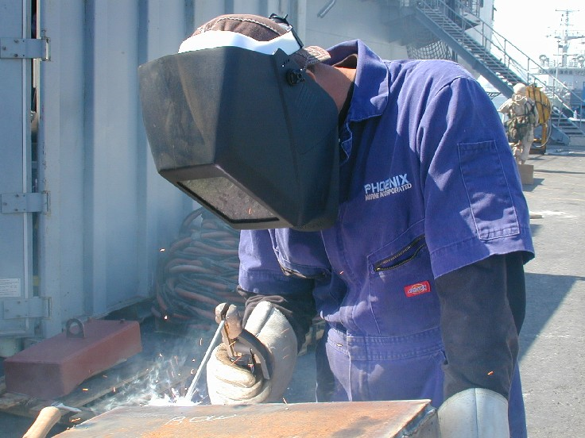
Benefits of the SAE Program…
Describe the benefits of having a successful SAE project; and
And More…
Develop skills
Earn Money!!

Slide 29
Why keep records?
G. Maintain up to date records using the AET system.
Identify areas to improve your SAE
Know your exact gains or losses
Advance in FFA degrees, apply for awards, and earn scholarships

Slide 30
Match the Experience with the Type of SAE
Exploratory
Research/ Experimentation
Ownership/ Entrepreneurship
Placement
Working in a florist shop
Owning a Christmas tree farm
Comparing the effect of hormones on plant growth
Shadowing a veterinarian on career day
Growing and selling bedding plants
Working in school greenhouse after school

Slide 31
Bell Quiz Obective A & B
List the 4 TYPES of SAE we’ve learned so far
What type of SAE would someone have if they work at CAL Ranch?
What type of SAE would a student have if they run a business mowing lawns in their neighborhood?
What type of SAE would a student have if they train horses for clients?
If you don’t know what you’d like to have for a SAE project, what kind of project can you do to introduce yourself to a SAE area? (short term)
If you are interested in science and want to do research on what breed of cattle yields the best marbling, what type of SAE project would you have?

Slide 32
Bell Quiz Obective C & D
Why should you develop a SAE Plan?
List 3 things that should be included in a good SAE Plan.
What type of things should you consider when choosing a SAE you will actually carry out?
List 2 ideas for placement SAE’s
List 2 ideas for entrepreneurship SAE’s

Slide 33
Bell Quiz Obective E & F
What is a proficiency award?
What is a “Star” award?
List 3 benefits of having a successful SAE
Why is it important to keep records?
How are SAE projects related to degree advancement in the FFA?
How are SAE projects related to eligibility for FFA offices?

