Slide 1
Careers in Animal Science
Identify career clusters within the animal science industry
Recognize trends in the animal industry and how they affect the job market
Develop a career plan

Slide 2
Meal Career Web
Nutritionist
Potato Farmer
Hay Rancher
Dinner:
Steak & Potatoes
Engineer
Developed harvesting equipment
Cattle Rancher
Tractor Salesman
Truck Driver
Butcher/Meat Processor
Mechanic

Slide 3
Meal Career Web
Group 1- Breakfast (Eggs, Bacon, Toast)
Group 2- Breakfast (Pancakes, Orange Juice, Sausage)
Group 3- Lunch (Pizza)
Group 4- Lunch ( Turkey Sandwich, apple, corn chips)
Group 5- Dinner (Pork Chops, Mashed Potatoes, Green Salad)
Group 6- Dinner (Enchiladas, Corn, Rice)

Slide 4
Career Clusters
Identify career clusters within the animal science industry
Production
Works directly with breeding and raising animals
Most traditional career in animal science
Farmers & ranchers

Slide 5
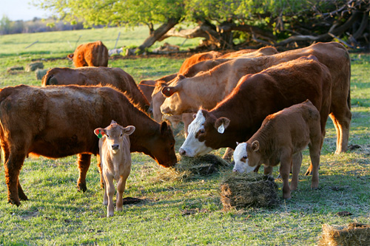
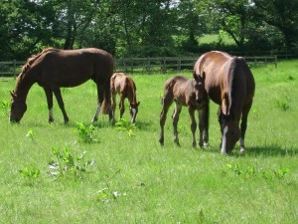
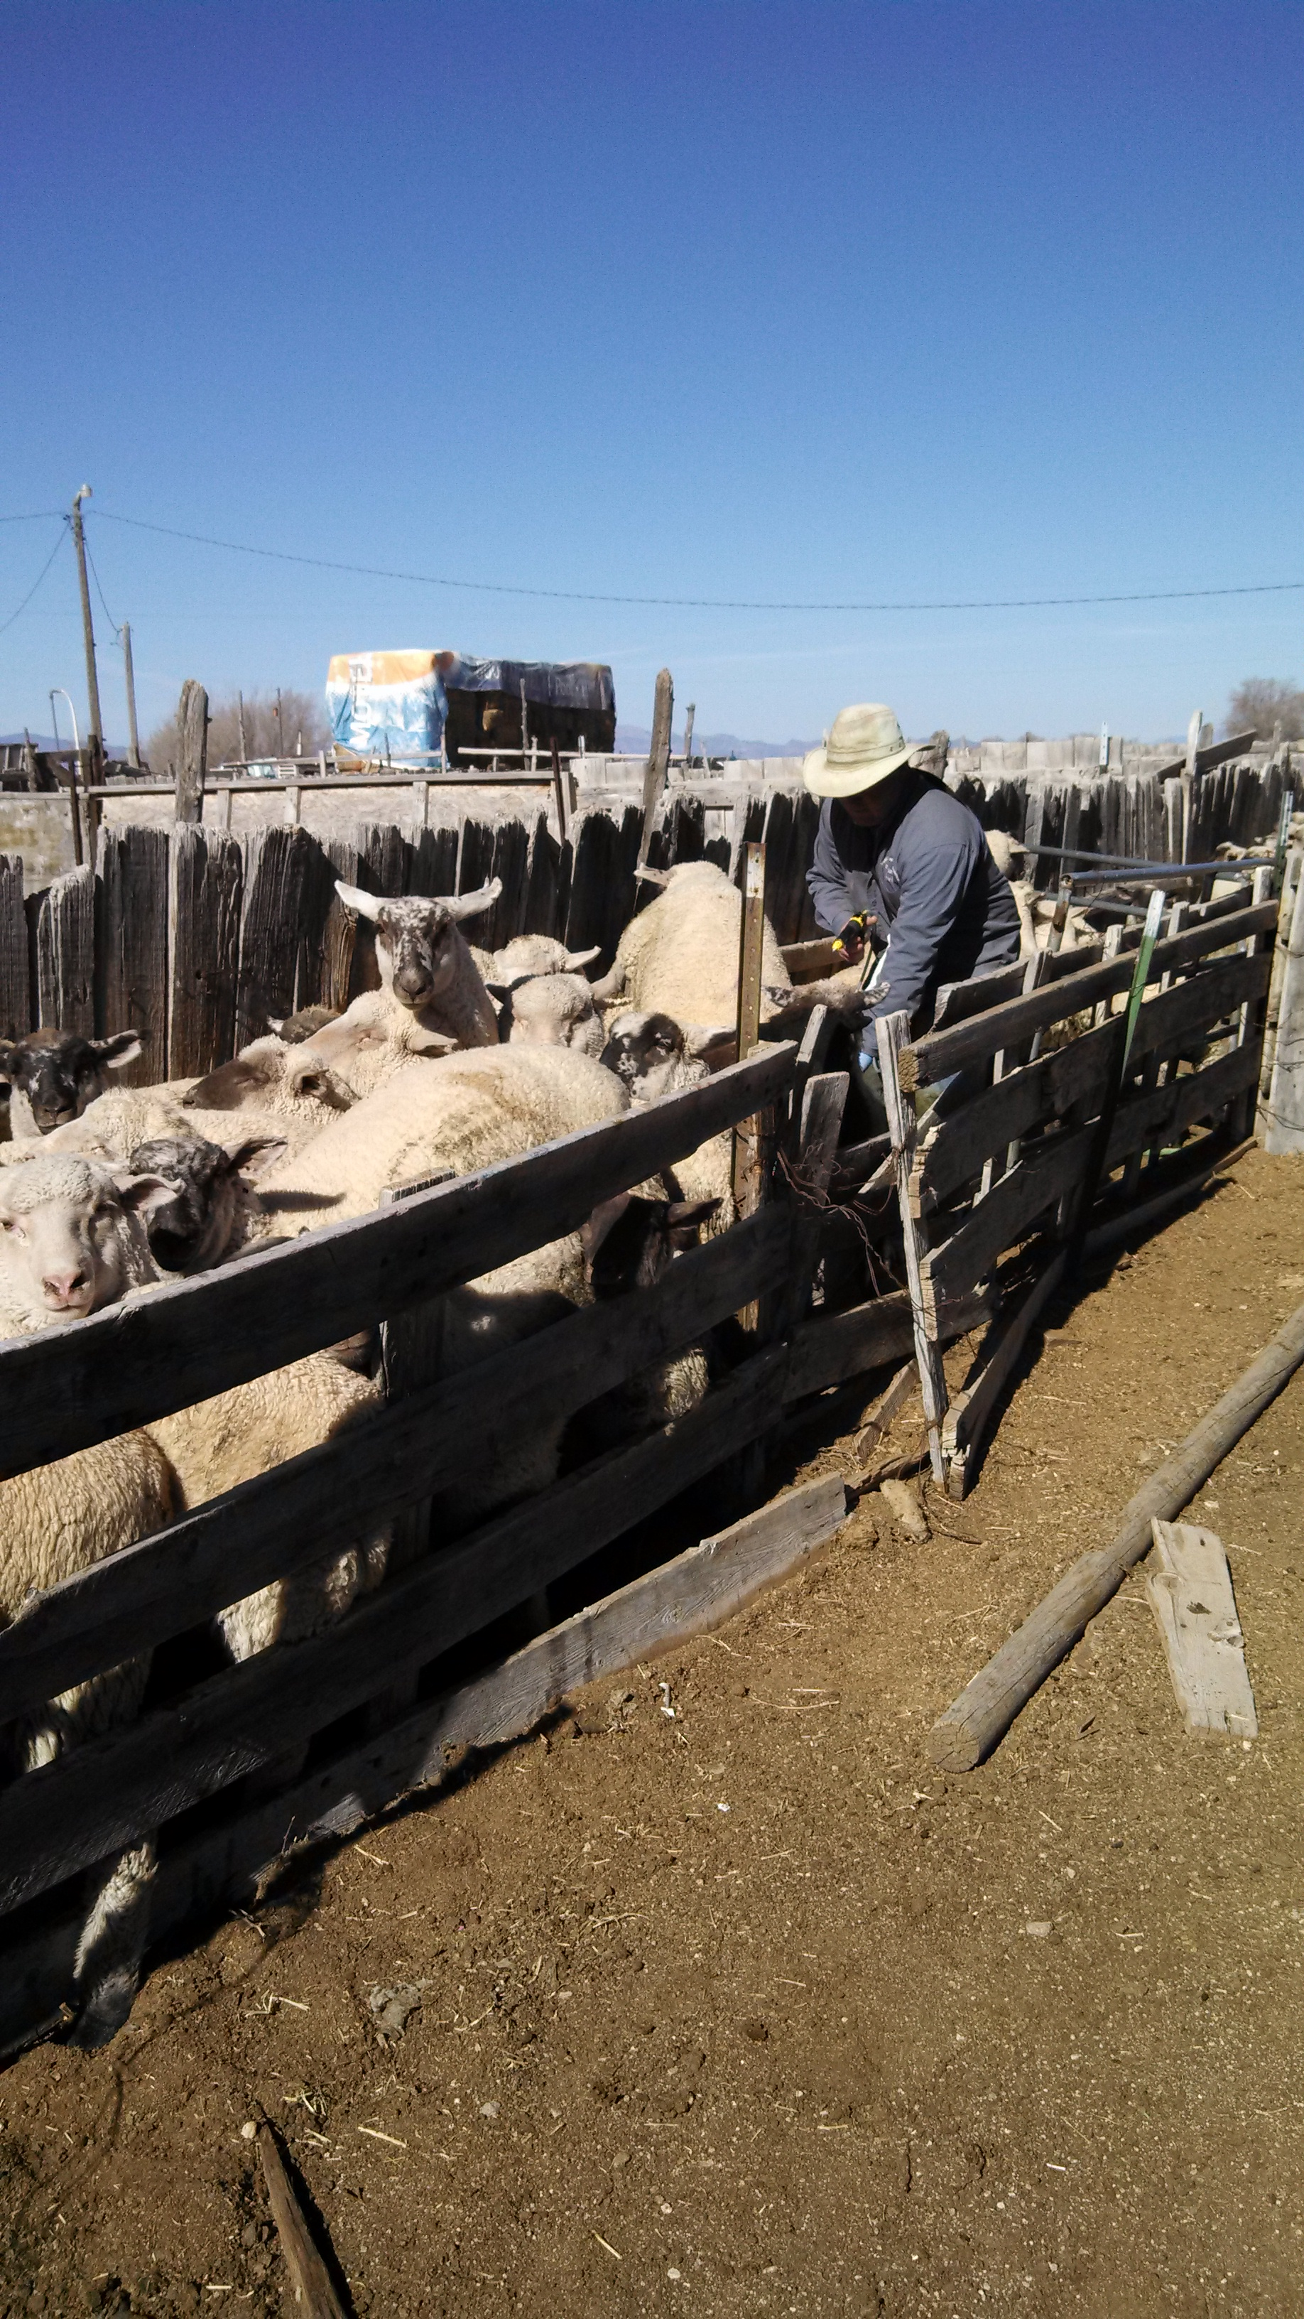
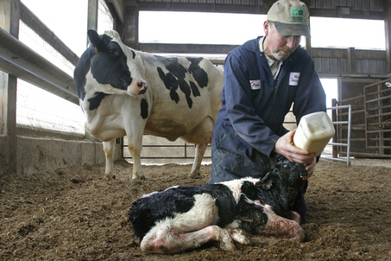
Career Clusters
Identify career clusters within the animal science industry
Horse Breeder
Cattle Rancher
Dairy Farmer
Sheep Farmer
Production
Notes:
Dairy Farmer Video Link: http://www.youtube.com/watch?v=EJHJWFS_bvo&list=PL7B61381EE0438243

Slide 6
Career Clusters
Identify career clusters within the animal science industry
Sales & Marketing
Sells animals & their products produced by farmers & ranchers
Develops advertising to promote agricultural products
Sells products to farmers and ranchers

Slide 7
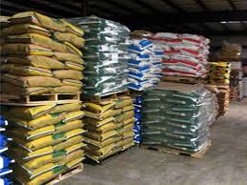
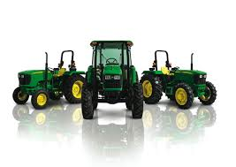
Career Clusters
Identify career clusters within the animal science industry
Marketing Director
Feed Salesman
Equipment Salesman
Graphic/Video Designer
Sales & Marketing
Notes:
Equipment Salesman: http://www.youtube.com/watch?v=X-xa93lfAfk&list=PL7B61381EE0438243

Slide 8
Career Clusters
Identify career clusters within the animal science industry
Services
Provides services to farmers and ranchers
Ensures safety of animal derived products

Slide 9
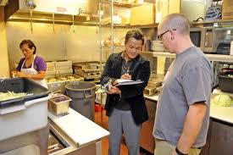
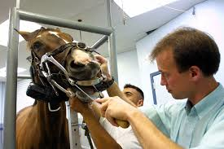
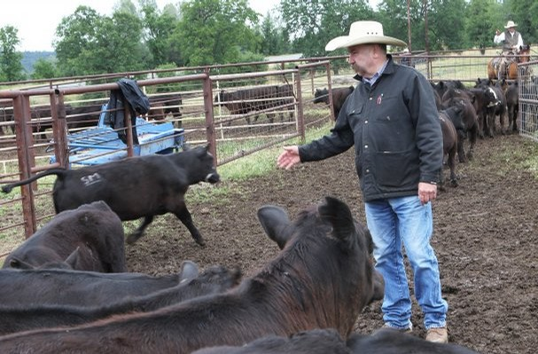
Career Clusters
Identify career clusters within the animal science industry
Breeding Services
Health Inspector
Veterinarian
Brand Inspector
Services
Notes:
Veterinarian Video Link: http://www.youtube.com/watch?v=ktkXlyxMI4s&list=PL7B61381EE0438243
Health Inspector Video Link: http://www.youtube.com/watch?v=yyp2GP1rLI0&list=PL7B61381EE0438243

Slide 10
Career Clusters
Identify career clusters within the animal science industry
Processing
Prepares raw products for sale

Slide 11
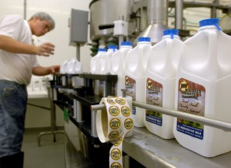
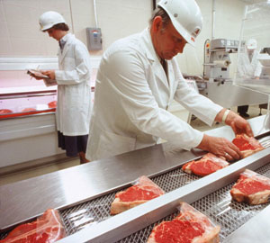
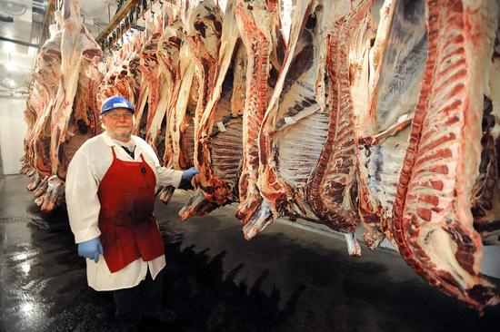
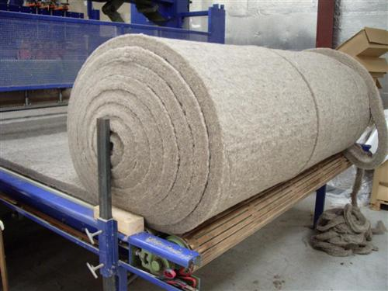
Career Clusters
Identify career clusters within the animal science industry
Meat Processor
Milk Processing
Butcher
Fabric Production
Processing
Notes:
Milk Processing Video Link: http://www.youtube.com/watch?v=TE85K90cIe8&list=PL7B61381EE0438243

Slide 12
Career Clusters
Identify career clusters within the animal science industry
Education & Research
Research new and better methods to use in agriculture
Educate public about agriculture
Formally in school
Through extension programs

Slide 13
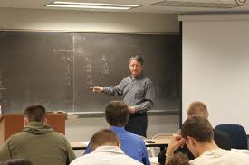
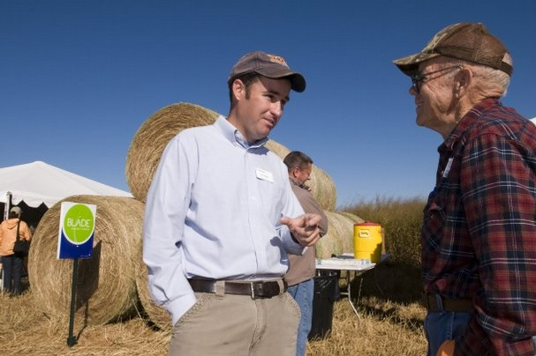
Career Clusters
Identify career clusters within the animal science industry
Ag Teacher
Genetics Research
Extension Agent
University Professor
Education & Research
Notes:
Extension Agent Video Link: http://www.youtube.com/watch?v=1u1RhRCp7Nk&list=PL7B61381EE0438243
Genetics Research Video Link: http://www.youtube.com/watch?v=0buscLptSWc&list=PL7B61381EE0438243

Slide 14
Trends
B. Recognize trends in the animal industry and how they affect the job market
Trend /trend/ (noun)
A general direction in which something is developing or changing.
Are there trends in agriculture?

Slide 15
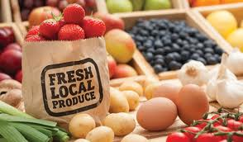
Trends
B. Recognize trends in the animal industry and how they affect the job market
Increased consumer demand for locally produced food

Slide 16
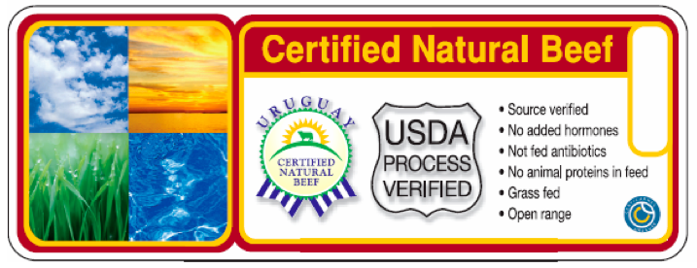
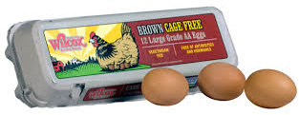
Trends
B. Recognize trends in the animal industry and how they affect the job market
Increased consumer demand for labels indicating how food was produced
Free range, cage free
Grass fed

Slide 17
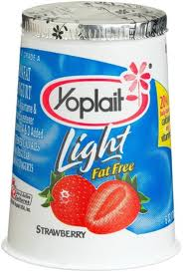
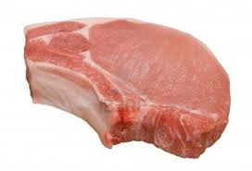
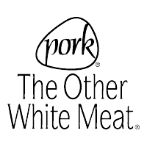
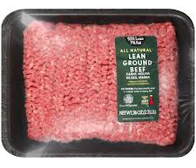
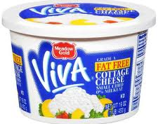
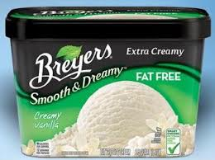
Trends
B. Recognize trends in the animal industry and how they affect the job market
Animal production follows the trends of human food consumption
Lower fat

Slide 18
Trends
B. Recognize trends in the animal industry and how they affect the job market
How do trends affect animal production?
Farmers & ranchers produce what consumers demand

Slide 19
Trends
B. Recognize trends in the animal industry and how they affect the job market
How do trends affect job market?
Trends either increase or diminish job markets
Trends show LESS people consuming lamb
There will be fewer careers within the sheep industry
IF…
then…

Slide 20
Trends
B. Recognize trends in the animal industry and how they affect the job market
How do trends affect job market?
Consumers purchase more low/non fat dairy products
The dairy industry will look for ways to expand low/non fat dairy products
IF…
then…
Consumers will pay more for locally grown produce
More people will produce and market produce locally
IF…
then…

Slide 21
Trends
B. Recognize trends in the animal industry and how they affect the job market
How do trends affect job market?
New dietetic research shows benefits of consuming white meat
Pork Producers will hire dieticians and marketers to educate public about benefits of consuming pork
IF…
then…
Dairy products are socially targeted as ‘bad’ because of their fat content
Dairy producers will invest in marketers and educators to teach of the nutritional benefits of low fat dairy products
IF…
then…

Slide 22
Career Plan
C. Develop a career plan
Plan for your education
Prepare financially
Doctorate
Degree
(8= years)
Master’s
Degree
(6 years)
Bachelor’s Degree
(4 years)
Associate’s Degree
(2 years)
On the job or technical school training

Slide 23
Career Plan
C. Develop a career plan
Get experience early
Internships
Entry level jobs in related fields
Career Development Events

