Slide 1
Plant Propagation
Sexual Reproduction of Plants
List & describe common methods of sexual plant propagation
Describe the process and environmental conditions of seed germination
Diagram the process of plant fertilization
Explain the importance of seed viability and vigor.
Explain pollination, cross-pollination, and self-pollination of flowering plants.
Asexual Reproduction of Plants
List & describe methods of asexual plant propagation
Describe optimal conditions for asexual propagation.
Demonstrate techniques used to propagate plants by cuttings, division, separation, and layering.
Describe grafting techniques.

Slide 2
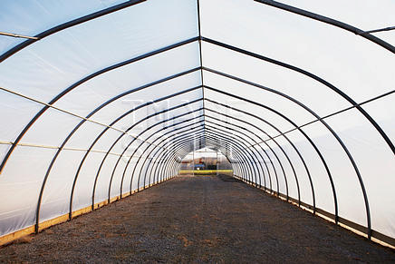
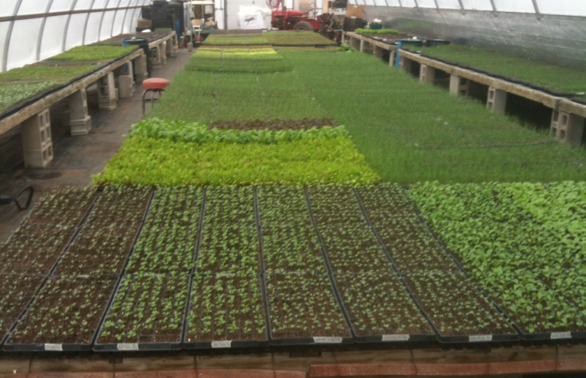
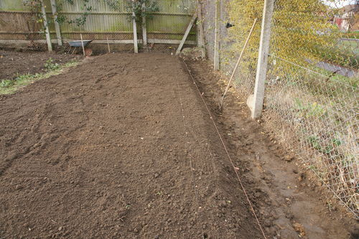
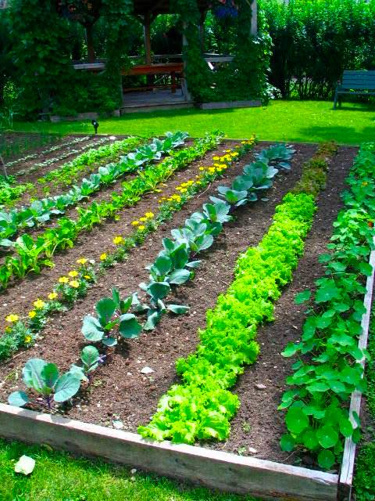
When & Why do you need to reproduce or “propagate” plants?
Empty Greenhouses??
OR…
Empty Gardens??
Notes:
Start lesson by brainstorming reasons of why it’s necessary to reproduce plants. Start discussion with only the question on the screen. Eventually add the pictures of the empty greenhouse and garden. Guide discussion to help students realize they would not have a food supply without the practice of plant reproduction.

Slide 3
Sexual Plant Propagation
List & describe common methods of sexual plant propagation

Slide 4
Sexual Plant Propagation
List & describe common methods of sexual plant propagation
Plant Propagation=
Reproduction of plants
Sexual Plant Propagation
Reproduction of plants by seed or spore by the uniting of 2 gametes
Offspring plants are genetically different than parent plants
Notes:
Pass out guided notes

Slide 5
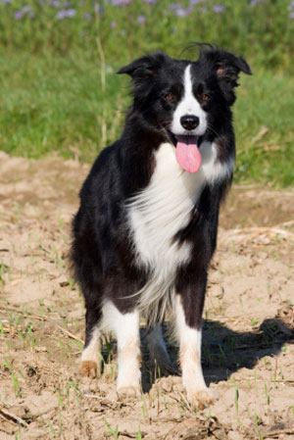
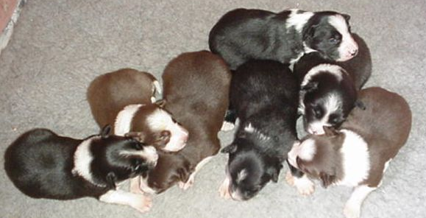
Sexual Plant Propagation
List & describe common methods of sexual plant propagation
Sexual Reproduction in Animals…
Example:
Offspring has ½ of it’s genes from it’s mother & ½ from it’s father
Offspring is genetically different than both parents
Notes:
Use example of sexual reproduction in animals to help students recall a familiar example that they SHOULD already know about sexual reproduction.

Slide 6
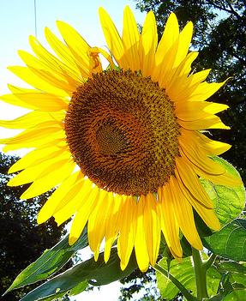
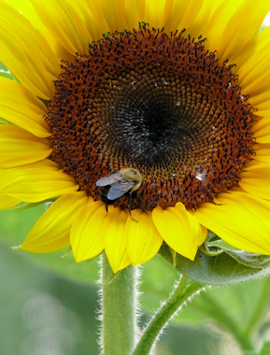
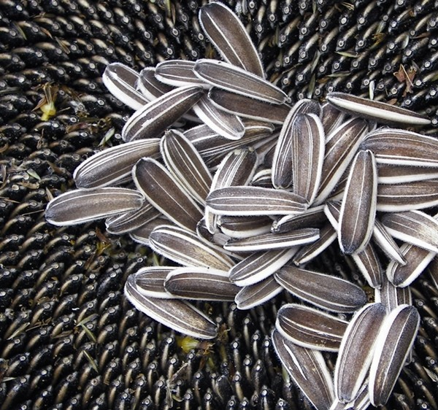
Sexual Plant Propagation
List & describe common methods of sexual plant propagation
Sexual Reproduction in Plants…
Flower Produces Seeds
Seeds are pollinated (fertilized) by insects/wind
Seed is harvested & planted to produce new plant
Notes:
Use same principles of sexual reproduction in animals and relate it to plants.

Slide 7
Sexual Plant Propagation
List & describe common methods of sexual plant propagation
Sexual Reproduction in Plants…
Offspring plant has ½ of it’s genes from 1 plant & ½ from another
Offspring plant is genetically DIFFERENT than both parent plants

Slide 8
Sexual Plant Propagation
List & describe common methods of sexual plant propagation
Genetics Review
Who is Gregor Mendel?
What did he study?
What is a phenotype?
What is genotype?
Why are offspring NOT genetically identical to their parents?
What causes genetic variation?

Slide 9
Methods of Sexual Plant Propagation
List & describe common methods of sexual plant propagation
What is the most common method of reproducing plants?
Notes:
Have students draw on prior knowledge by asking them what method THEY THINK is most common in reproducing plants.

Slide 10
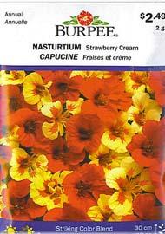
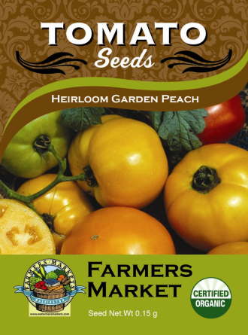
Methods of Sexual Plant Propagation
List & describe common methods of sexual plant propagation
Seed:
Seeds are harvested from flowers and planted
Most common method of plant reproduction

Slide 11
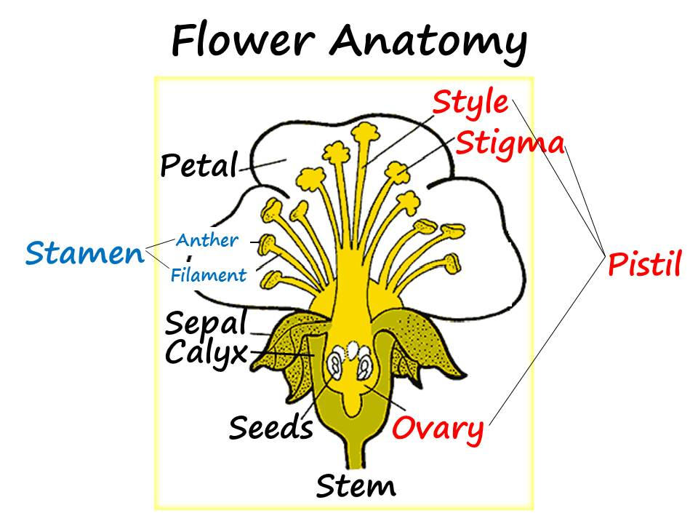
Methods of Sexual Plant Propagation
List & describe common methods of sexual plant propagation
Where do seeds come from?
Seeds develop in ovary of flower & are harvested
Seeds are kept to grow another season
Collected at home OR
Commercially
Notes:
Ask students where seeds come from. They should already know flower structures.

Slide 12
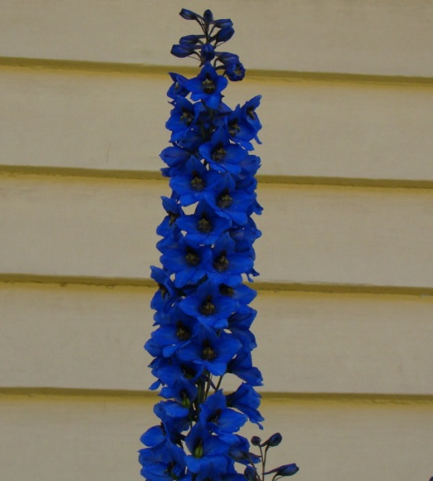
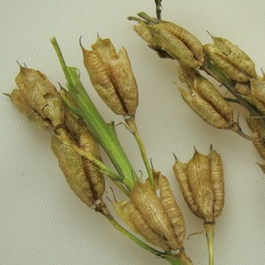
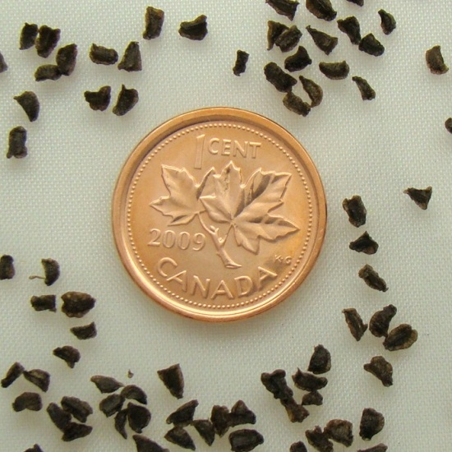
Methods of Sexual Plant Propagation
List & describe common methods of sexual plant propagation
How are seeds harvested?
1-Flower blooms & dies
2-Petals fall off and seed pod dries
3-Seeds are collected from pod
Notes:
Use example of the Delphinium flower showing the life cycle of the flower. For more pictures and examples of flowers, seed pods, and seeds, go to www.theseedbasket.com

Slide 13
Methods of Sexual Plant Propagation
List & describe common methods of sexual plant propagation
Farm in California
Specializes in Ranunculus
Sells cut flowers & bulbs
Diversified business as a farm & tourist attraction
Video
Notes:
Career & Farm Highlight: Show students the Youtube video about “The Flower Fields” in California. The video clip tells about the farm, which primarily grows ranunculus. Stop video clip when they explain how they’ve used selective breeding to improve the flower from having 5 petals to being the much larger, prettier flower that it is now. You could also talk about some basic Ag Business principles and highlight how the farm has diversified their product by producing the agricultural crop IN ADDITION to being a tourist attraction to see the flowers. YouTube video: http://www.youtube.com/user/TheFlowerFields#p/u/6/2lsBhENsq34

Slide 14
Methods of Sexual Plant Propagation
List & describe common methods of sexual plant propagation
Parts of a Seed
Seed Coat
Hard surface that protects interior of plant
Embryo
The new plant that develops as result of fertilization

Slide 15
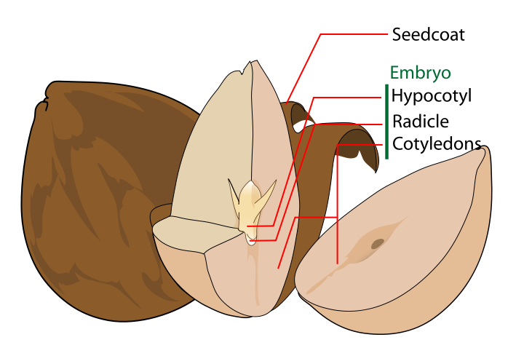
Methods of Sexual Plant Propagation
List & describe common methods of sexual plant propagation
Parts of a Seed

Slide 16
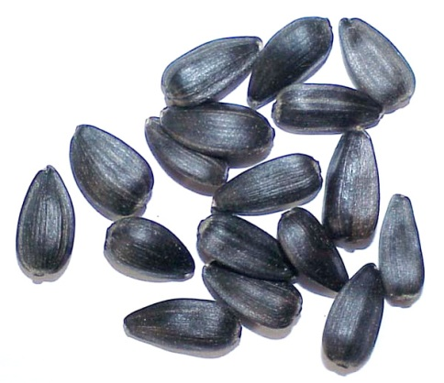
Methods of Sexual Plant Propagation
List & describe common methods of sexual plant propagation
Types of commercial seed
Raw
Pelleted
coated to make seed bigger and easier to handle

Slide 17
Methods of Sexual Plant Propagation
List & describe common methods of sexual plant propagation
Hybrid Seed
“Hybrid” can apply to any cross-pollinated plant
Plants grown from seed that is the result of special breeding
Considered genetically superior

Slide 18
Methods of Sexual Plant Propagation
List & describe common methods of sexual plant propagation
Hybrid Seed
Seedlings have “Hybrid Vigor”
Result of controlled crossing of a dedicated ‘female line’ and a dedicated ‘male line’
Both lines are genetically pure and will have the best traits from both parents
Seed saved from hybrid plants does not produce quality plants

Slide 19
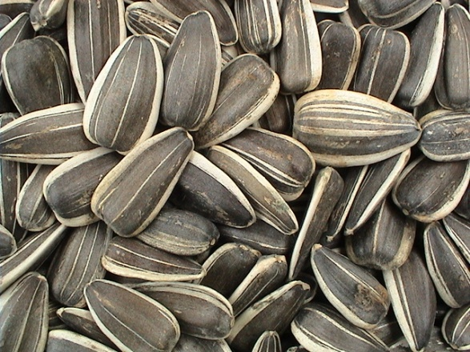
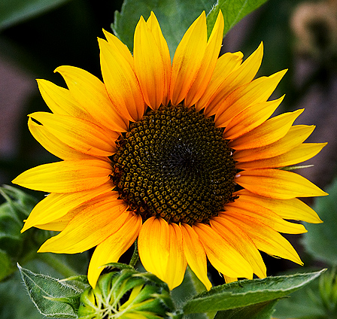
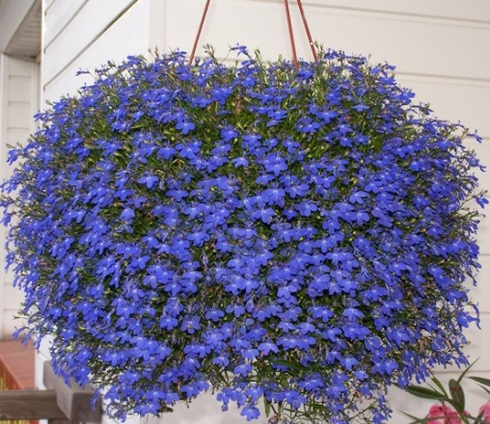
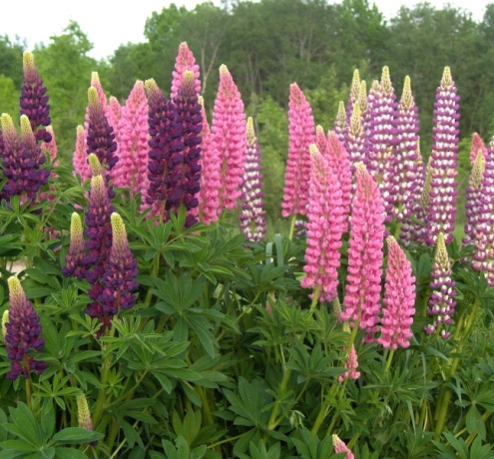
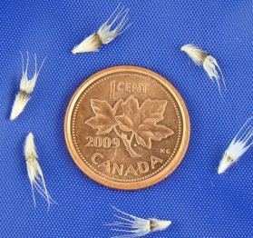
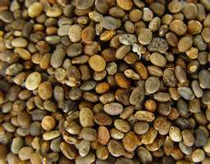
Methods of Sexual Plant Propagation
List & describe common methods of sexual plant propagation
Name the seed…
1
3
2
4
Notes:
For a quick break from notes, have a competition to see if your students can name any of the seeds pictured. 1-Sunflower, 2-Lobelia, 3-Lupine, 4-Gaillardia

Slide 20
Methods of Sexual Plant Propagation
List & describe common methods of sexual plant propagation
If a plant does not have a flower, can it reproduce sexually?
What type of plants DON’T have flowers?
Notes:
To transition from seeds to spores, ask these 2 questions to have students start thinking of other ways plant reproduce.

Slide 21
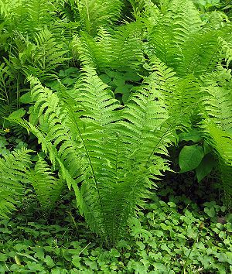
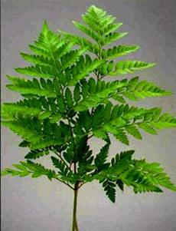
Methods of Sexual Plant Propagation
List & describe common methods of sexual plant propagation
Spores:
Primarily with ferns
Ferns do not have flowers

Slide 22
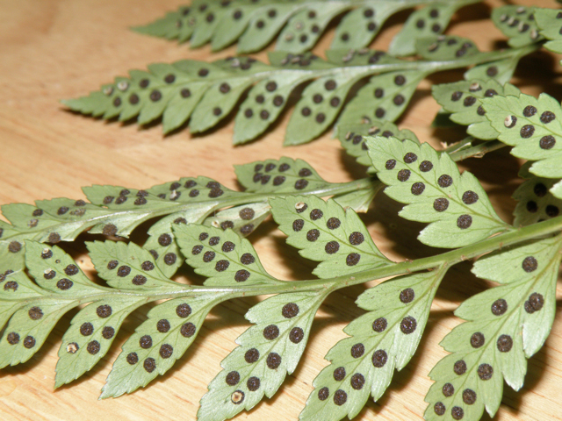
Methods of Sexual Plant Propagation
List & describe common methods of sexual plant propagation
Spores:
Usually found on back of fern
They drop to ground and grow into a new plant

Slide 23
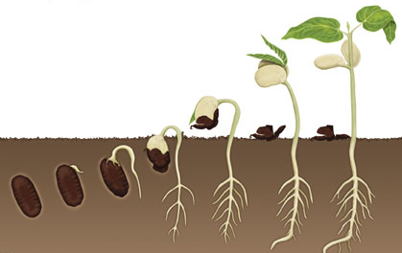
Seed Germination
B. Describe the process and environmental conditions of seed germination
Germination:
Development of a seed from a resting stage to a stage of growth.

Slide 24
Seed Germination
B. Describe the process and environmental conditions of seed germination
Environmental Requirements:
Oxygen
Sun
Temperature
Water

Slide 25
Plant Fertilization
C. Diagram the process of plant fertilization
Plant Fertilization:
The meeting of the male gamete with the female gamete
Takes places in ovary of flower

Slide 26
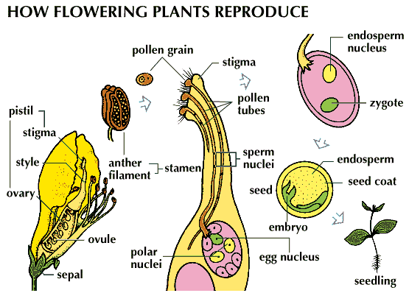
Plant Fertilization
C. Diagram the process of plant fertilization
1- Pollen from anther transferred to stigma
2- Pollen moves to ovary
3- Haploid cells (pollen & seed embryo) unite

Slide 27
Seed Viability
D. Explain the importance of seed viability and vigor.
The most viable seed is:
Collected from strong, healthy parent plants
Pollinated properly prior to seed harvest
Kept at moisture/temperature level to keep seed in dormancy
*Remember, a seed is living, it’s just in dormancy til proper environmental conditions take it out of dormancy

Slide 28
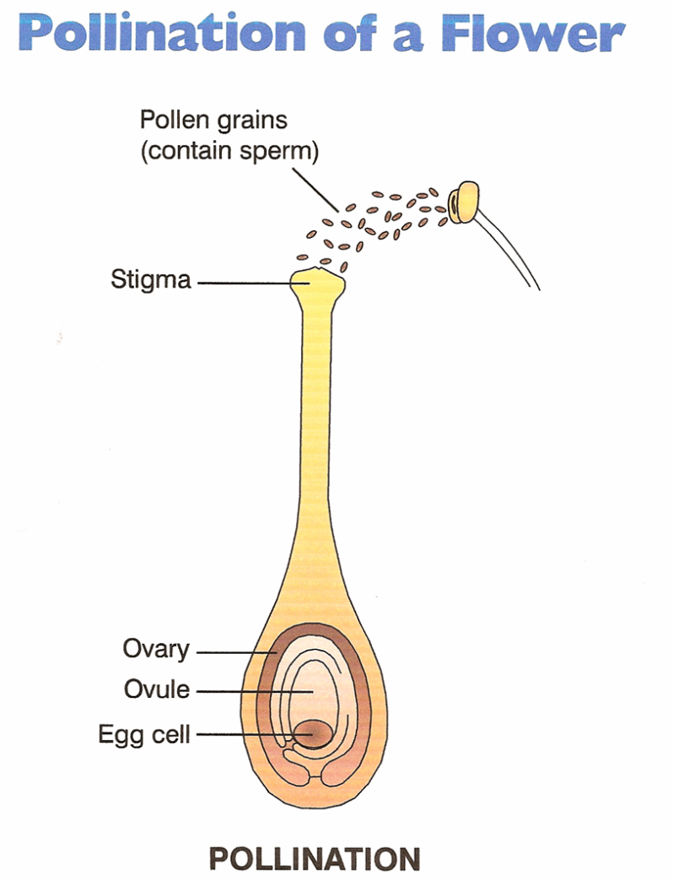
Pollination
E. Explain pollination, cross-pollination, and self-pollination of flowering plants.
Pollination:
Transfer of pollen from an anther to a stigma of a flower of the same species

Slide 29
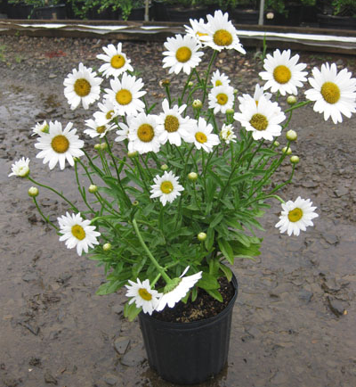
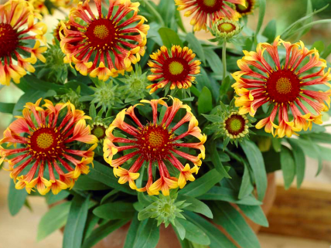
Pollination
E. Explain pollination, cross-pollination, and self-pollination of flowering plants.
Self Pollination:
Pollen from a plant pollinates a flower on the SAME plant
Cross Pollination:
Pollen from a plant pollinates a flower on a DIFFERENT plant

Slide 30
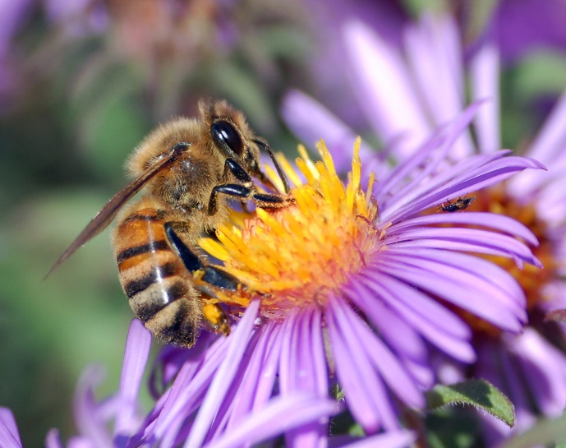
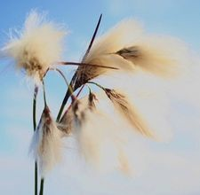
Pollination
E. Explain pollination, cross-pollination, and self-pollination of flowering plants.
Methods of Pollination:
Insects
Bees
Butterflies
Moths
Wind

Slide 31
Asexual Plant Propagation
F. List & describe methods of asexual plant reproduction

Slide 32
Asexual Plant Propagation
F. List & describe methods of asexual plant propagation
Asexual Reproduction:
Reproduction of plant without the use of reproductive organs (flower pistil & stamen)
Also called “vegetative” propagation
Use of stems, leaves, or roots to grow a new plant
Produces genetically identical plants (clones)

Slide 33
Asexual Plant Propagation
F. List & describe methods of asexual plant propagation
Benefits:
Can be quicker
Assures characteristics to be passed to offspring
Less expensive
Drawbacks:
Can’t be used with all plants
No genetic diversity

Slide 34
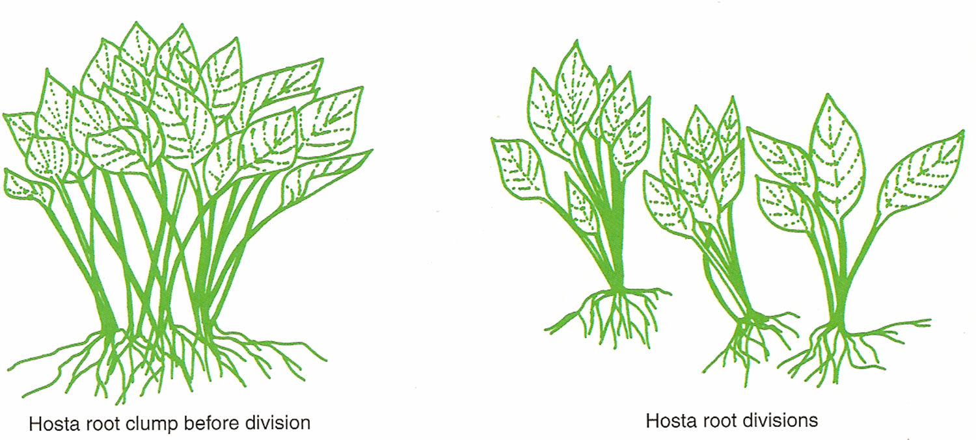
Asexual Plant Propagation
F. List & describe methods of asexual plant propagation
Separation/Division:
Separating or dividing one plant into several smaller plants

Slide 35
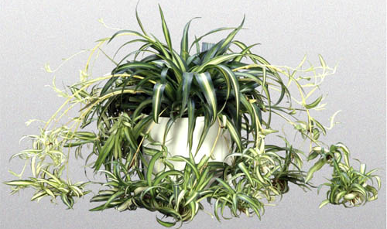
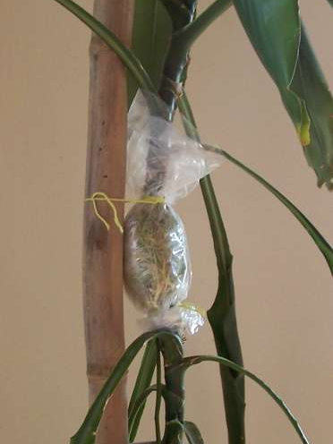
Asexual Plant Propagation
F. List & describe methods of asexual plant propagation
Layering:
Reproduce a new plant while offspring plant is still connected to parent.
Advantage: No water stress

Slide 36
Asexual Plant Propagation
F. List & describe methods of asexual plant propagation
Tissue Culture:
Also called “Micropropagation”
Propagation of plants from nearly microscopic parent plants
Benefit= Mass production of a cultivar from an extremely limited amount of parent stock

Slide 37
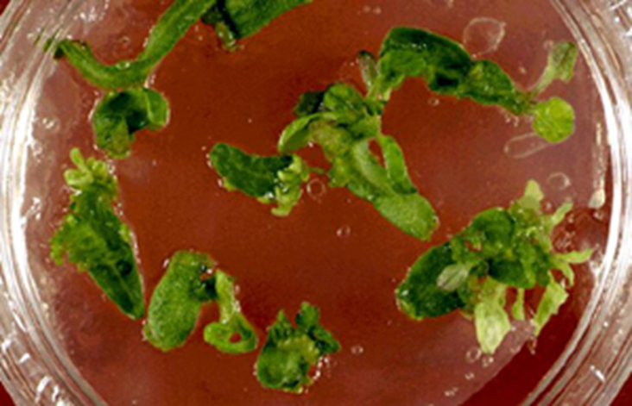
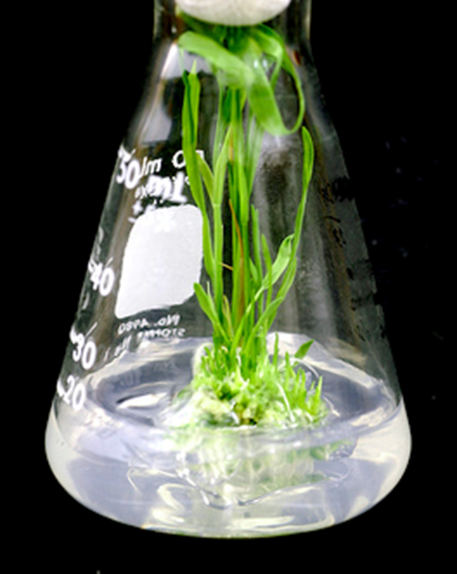
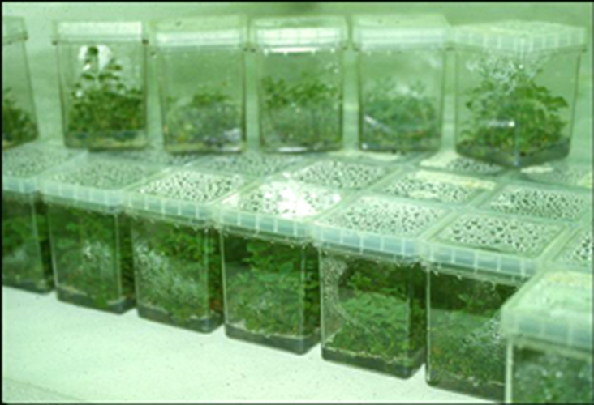
Asexual Plant Propagation
F. List & describe methods of asexual plant propagation
Tissue Culture:

Slide 38
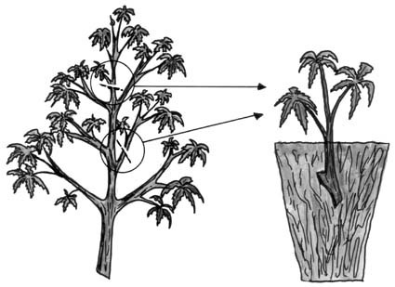
Asexual Plant Propagation
F. List & describe methods of asexual plant propagation
Cuttings:
Using a section of stem and/or leaf to produce a new plant
“Mother Plant”
Offspring Plant

Slide 39
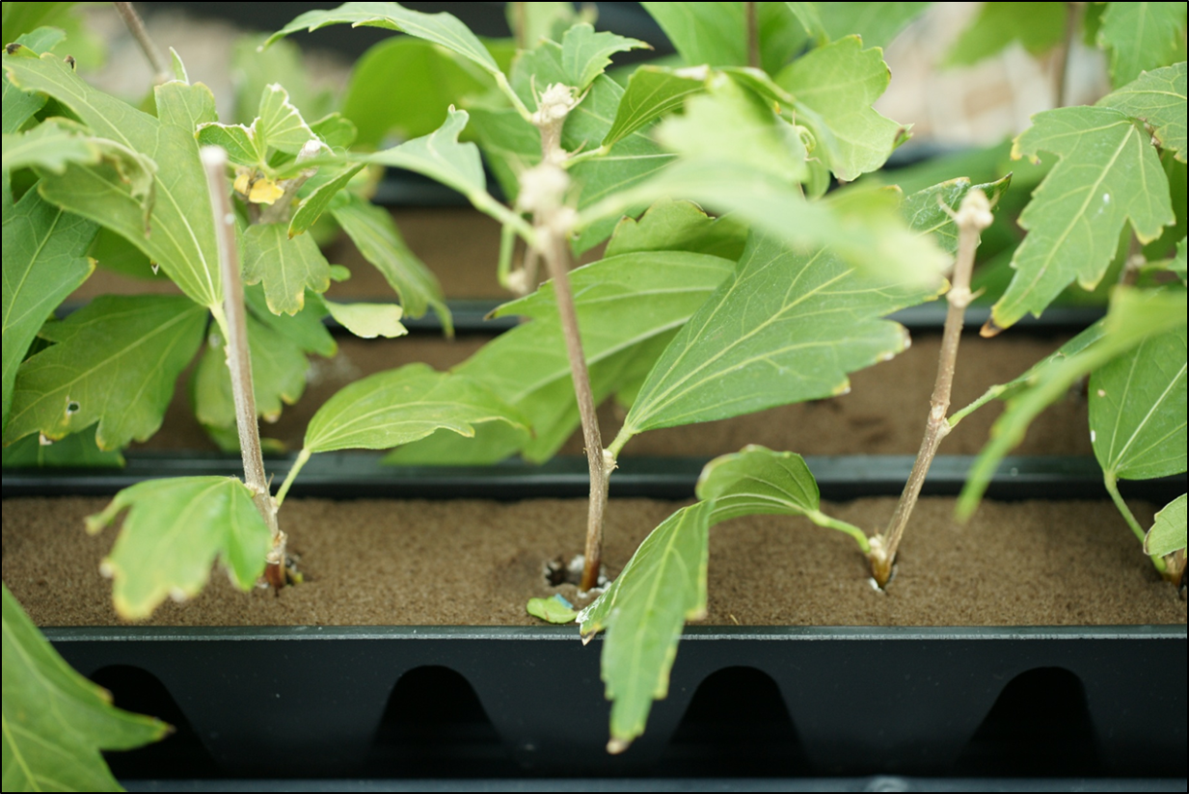
Asexual Plant Propagation
F. List & describe methods of asexual plant propagation
Cuttings:
Cuttings placed in Oasis foam

Slide 40
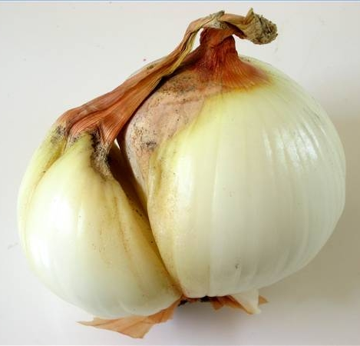
Asexual Plant Propagation
F. List & describe methods of asexual plant propagation
FYI…
Bulbs reproduce asexually
At the end of the season, the bulb splits and forms “bulblets”

Slide 41
Optimal Conditions
G. Describe optimal conditions for asexual propagation
Do asexual propagation methods need special environmental conditions to succeed??

Slide 42
Optimal Conditions
G. Describe optimal conditions for asexual propagation
Environment
Humidity & Moisture
*Remember, they don’t have roots anymore
Good draining soil
Plants
Healthy & strong mother plants
Correct plant varietes
*Some plants don’t propagate well asexually

Slide 43
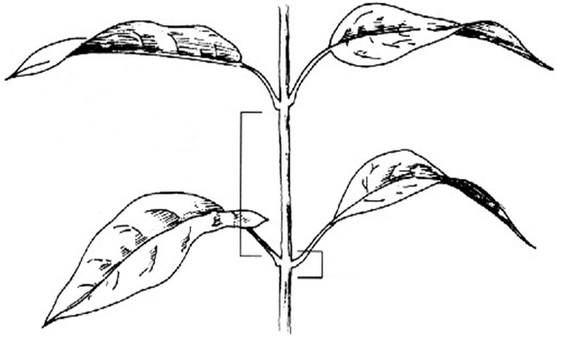
How to take cuttings…
G. Demonstrate techniques used to propagate plants by cuttings, division, separation, and layering.
Cuttings:
Label Stem Parts
Leaf
Petiole
Internode
Node
Notes:
This slide goes with the “Cuttings Lab.”

Slide 44
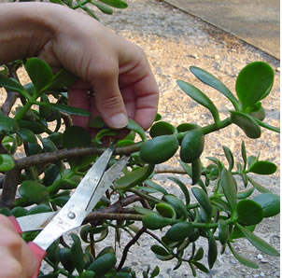
How to take cuttings…
H. Demonstrate techniques used to propagate plants by cuttings, division, separation, and layering.
Stem Cuttings:
Cut a section of stem
Be sure there are at least 2 nodes
Notes:
This slide goes with the “Cuttings Lab.”

Slide 45
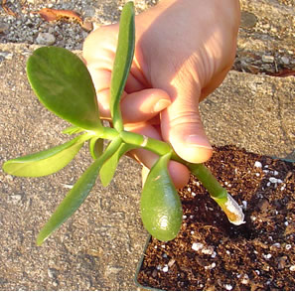
How to take cuttings…
H. Demonstrate techniques used to propagate plants by cuttings, division, separation, and layering.
Stem Cuttings:
2. Strip leaves from bottom nodes
Notes:
This slide goes with the “Cuttings Lab.”

Slide 46
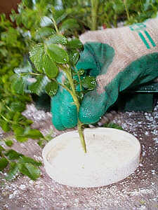
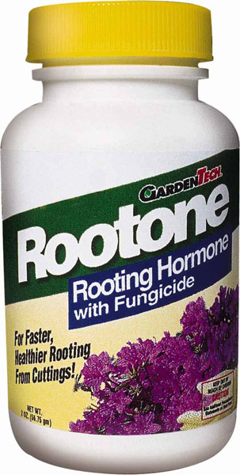
How to take cuttings…
H. Demonstrate techniques used to propagate plants by cuttings, division, separation, and layering.
Stem Cuttings:
3. Dip in rooting hormone
Notes:
This slide goes with the “Cuttings Lab.”

Slide 47
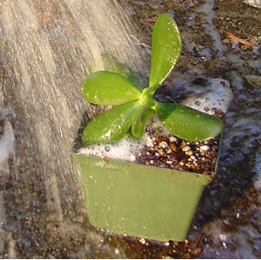
How to take cuttings…
H. Demonstrate techniques used to propagate plants by cuttings, division, separation, and layering.
Stem Cuttings:
Plant in soil less media & Water
Notes:
This slide goes with the “Cuttings Lab.”

Slide 48
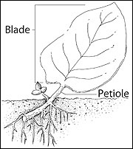
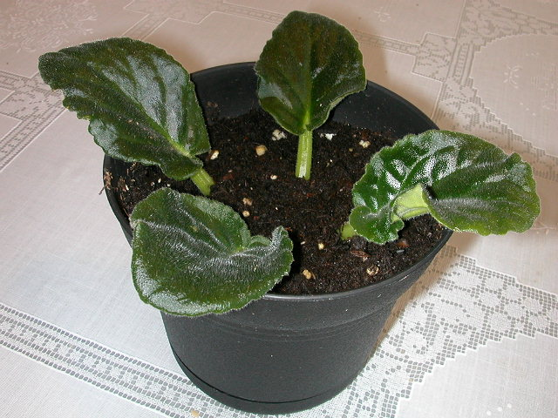
How to take cuttings…
H. Demonstrate techniques used to propagate plants by cuttings, division, separation, and layering.
Leaf Cuttings:
1. Cut a leaf from the stem and plant in soil less media
Notes:
This slide goes with the “Cuttings Lab.”

Slide 49
How to take cuttings…
H. Demonstrate techniques used to propagate plants by cuttings, division, separation, and layering.
Leaf Cuttings:
Pinguicula 'Pirouette' before leaf pullings were taken
Pull away leaves
Notes:
This slide goes with the “Cuttings Lab.”

Slide 50
How to take cuttings…
H. Demonstrate techniques used to propagate plants by cuttings, division, separation, and layering.
Leaf Cuttings:
Place on Vermiculite & cover to create humidity
Notes:
This slide goes with the “Cuttings Lab.”

Slide 51
How to take cuttings…
H. Demonstrate techniques used to propagate plants by cuttings, division, separation, and layering.
Leaf Cuttings:
After a month or so, leaf starts to root and sprout new growth
Notes:
This slide goes with the “Cuttings Lab.”

Slide 52
How to take cuttings…
H. Demonstrate techniques used to propagate plants by cuttings, division, separation, and layering.
Leaf Cuttings:
Leaf Cutting of Tuberous Begonia
Notes:
This slide goes with the “Cuttings Lab.”

Slide 53
How to take cuttings…
H. Demonstrate techniques used to propagate plants by cuttings, division, separation, and layering.
Other Types of Cuttings:
Leaf Section Cuttings
Notes:
This slide goes with the “Cuttings Lab.”

Slide 54
How to take cuttings…
H. Demonstrate techniques used to propagate plants by cuttings, division, separation, and layering.
Other Types of Cuttings:
Root Cuttings
Notes:
This slide goes with the “Cuttings Lab.”

Slide 55
How to take cuttings…
H. Demonstrate techniques used to propagate plants by cuttings, division, separation, and layering.
Other Types of Cuttings:
Heel Cuttings
Notes:
This slide goes with the “Cuttings Lab.”

Slide 56
How to take cuttings…
H. Demonstrate techniques used to propagate plants by cuttings, division, separation, and layering.
Other Types of Cuttings:
Eye Cuttings
Notes:
This slide goes with the “Cuttings Lab.”

Slide 57
How to take cuttings…
H. Demonstrate techniques used to propagate plants by cuttings, division, separation, and layering.
Tips for Cuttings:
Rooting Hormone isn’t always necessary, but may increase speed of root formation
Remove ALL flowers
Remove excessive leaves
Notes:
This slide goes with the “Cuttings Lab.”

Slide 58
How to Separate Plants
H. Demonstrate techniques used to propagate plants by cuttings, division, separation, and layering.
Division/Separation:
1. Dig up plant with as many roots as possible
Notes:
This slide goes with the Division/Separation lab

Slide 59
How to Separate Plants
H. Demonstrate techniques used to propagate plants by cuttings, division, separation, and layering.
Division/Separation:
2. Wash off excess soil and split roots at the natural separation
Notes:
This slide goes with the Division/Separation lab

Slide 60
How to Separate Plants
H. Demonstrate techniques used to propagate plants by cuttings, division, separation, and layering.
Division/Separation:
3. Replant, water well, and keep in shade til completely re-rooted
Notes:
This slide goes with the Division/Separation lab

Slide 61
Steps
H. Demonstrate techniques used to propagate plants by cuttings, division, separation, and layering.
Division/Separation:
Be sure each separation has it’s own root system
Notes:
This slide goes with the Division/Separation lab

Slide 62
Steps
H. Demonstrate techniques used to propagate plants by cuttings, division, separation, and layering.
Division/Separation:
Plants that are easily separated:
Aloe Vera
Hostas
Notes:
This slide goes with the Division/Separation lab

Slide 63
Steps
H. Demonstrate techniques used to propagate plants by cuttings, division, separation, and layering.
Division/Separation:
Plants that are easily separated:
**Some perennial flower beds need to be trimmed back after a few years of establishment so they don’t overgrow the area.***
Many Perennials
Notes:
This slide goes with the Division/Separation lab

Slide 64
Steps
H. Demonstrate techniques used to propagate plants by cuttings, division, separation, and layering.
Ground Layering:
Often done with vine plants
Take section of vine & place under soil
In time, new roots form
Notes:
This slide goes with the Layering Lab Sheet

Slide 65
Steps
H. Demonstrate techniques used to propagate plants by cuttings, division, separation, and layering.
Air Layering: 1 & 2: With sharp knife, cut away outer layer
3. Cover in wet sphagnum peat moss
4. Cover tightly with plastic
Notes:
This slide goes with the Layering Lab Sheet

Slide 66
Steps
H. Demonstrate techniques used to propagate plants by cuttings, division, separation, and layering.
Air Layering:
Result
Will take at least 1 month or more
Notes:
This slide goes with the Layering Lab Sheet

Slide 67
Steps
H. Demonstrate techniques used to propagate plants by cuttings, division, separation, and layering.
Other Types of Layering:
Stolons and Runners
Tip Layering
Compound Layering
Simple Layering
Notes:
This slide goes with the Layering Lab Sheet

Slide 68
Steps
H. Demonstrate techniques used to propagate plants by cuttings, division, separation, and layering.
Air Layering:
Successful with woody stemmed plants
Decreases plant stress because it’s connected to mother plant until rooted
Notes:
This slide goes with the Layering Lab Sheet

Slide 69
I. Describe grafting techniques.
What kind of trees are in bloom in this orchard?

Slide 70
I. Describe grafting techniques.
What kind of trees are in bloom in this orchard?
Almonds!
BUT… did you know every tree actually has the trunk and roots of a peach tree?

Slide 71
Grafting
I. Describe grafting techniques.
Grafting:
Connecting 2 pieces of living plant material together to form a single plant

Slide 72
Grafting
I. Describe grafting techniques.
Grafting:
Scion= New plant material
Rootstock= old plant material

Slide 73
Grafting
I. Describe grafting techniques.
Benefits of Grafting:
Increase the strength and disease resistance of roots
Peach trees have stronger roots that are more resistant to root rot than almond tree roots
Several Varieties grown on one tree/bush
Apple trees with 2-3 varieties of apple
Rose bushes with multiple colors of roses

Slide 74
Grafting
I. Describe grafting techniques.
Types of Grafts:
Wedge Graft
Saw Kerf Graft

Slide 75
Grafting
I. Describe grafting techniques.
Types of Grafts:
Whip & Tongue Graft

Slide 76
Grafting
I. Describe grafting techniques.
Budding:
Grafting technique where only a single bud is transferred

Slide 77
What is Genetic Engineering?
Does it apply to plants?
How?

Slide 78
GENETIC ENGINEERING
Genetic engineering can harness the biological machinery of bacteria and viruses to…
Manufacture otherwise hard-to-obtain plant products.
Combat genetically caused diseases.
Improve tolerance of plants to adverses.
Attain other similar commendable goals.
For plant improvement, it changes the genetic makeup of plants, without breeding or selection.
Its main advantage is that it makes possible the transfer of genes between completely unrelated plants or bacteria.
In rare cases, even from animals to plants.

Slide 79
COMMERCIAL APPLICATION OF GENETIC ENGINEERING
In commercial horticultural production, research has centered mainly on vegetable and fruit crop genetic engineering.
With a limited amount on flowers and other crops.
Although genetically engineered crops are in widespread cultivation, most are not horticultural.

Slide 80
COMMERCIAL APPLICATION OF GENETIC ENGINEERING
Generally, genetic engineering of horticultural crops has focused on
Imparting disease and pest resistance.
Imparting resistance to herbicides.
Extending the length of product shelf life.
Altering color.
In flowers.
Imparting cold-temperature resistance.
In strawberries and eucalyptus trees.

Slide 81
COMMERCIAL APPLICATION OF GENETIC ENGINEERING
One of the best known genetically engineered horticultural crops is the ‘Flavr Savr’ tomato.
Engineered to retain a firm texture longer than normal.
Tomatoes destined for fresh eating must be hand-harvested to prevent bruising.
Unlike canning tomatoes that can be harvested mechanically—a less expensive process.
Fresh tomatoes must also be transported quickly and with careful packaging.
To ensure that they arrive at the supermarket in an attractive condition, appealing to the buyer.

Slide 82
COMMERCIAL APPLICATION OF GENETIC ENGINEERING
The ‘Flavr Savr’ inhibits expression of the genetic material that causes fruit to soften when it ripens.
The softening part of ripening is slowed, although the flavor continues to develop.
This allows mechanical harvesting, increased transport time, and longer fresh shelf life in the supermarket.

Slide 83
COMMERCIAL APPLICATION OF GENETIC ENGINEERING
A second genetically engineered crop receiving widespread attention is a Thompson Seedless grape variety engineered to be virus resistant.
One of the most commonly cultivated table grapes.
Also a component of blended wines.

Slide 84
COMMERCIAL APPLICATION OF GENETIC ENGINEERING
Scientists hope that genetically engineered virus resistance will reduce the expense of chemicals, and their entry into the environment.
Because it will no longer be necessary to spray to prevent the disease.
At present, only papaya & squash have been engineered successfully for virus resistance and put into field production.

Slide 85
COMMERCIAL APPLICATION OF GENETIC ENGINEERING
Some opponents of genetic engineering fear it could upset the ecosystem in unknown ways.
They feel that the accelerated pace of genetic change could inundate the environment with bizarre plants, causing an unstable ecological situation.
Some organic farmers fear a biological pesticide, which they use to control infestations of worms, will no longer be effective due to insect resistance as a result of widespread incorporation in many crops.
Bacillus thuringiensis, is the source of genetic material put into plants to cause their cells to produce an insect poison.

Slide 86
COMMERCIAL APPLICATION OF GENETIC ENGINEERING
The Environmental Protection Agency (EPA) has approved a number of genetically engineered plants.
Over 3 million acres of genetically engineered corn, cotton, and potatoes were planted in the U.S. in 1997.
A class-action suit has been filed against the EPA by thirty-one groups who charge that the EPA has been negligent in its approval of genetically engineered crops.

Slide 88
Review
What are the brown, rice shaped structures that you can see in this cross section of a Rudbeckia flower?

Slide 89
Review
What stage of growth is this plant in?
Reproductive
Vegetative

Slide 90
Review
What stage of growth is this plant in?
Reproductive
Vegetative

