Slide 1
How does MILK compare to other drinks?

Slide 2
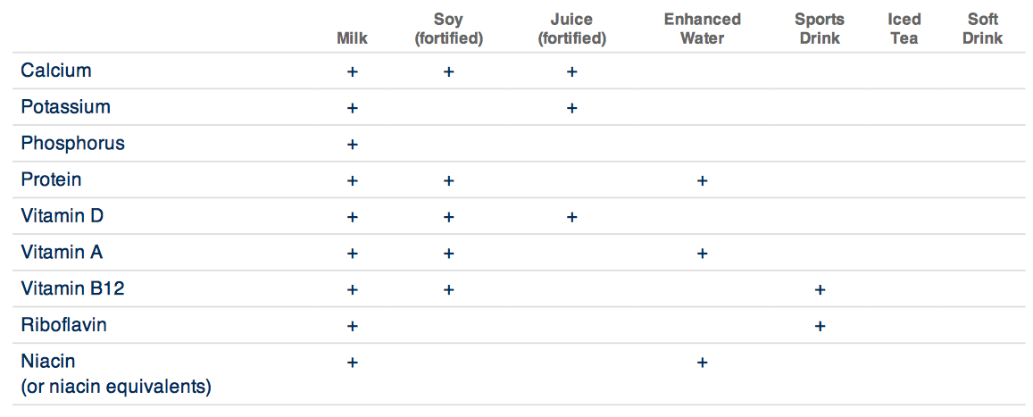
Moo-ve Over for Milk
What you drink is as important as what you eat.
Milk is packed with nine essential vitamins and minerals in each glass, including calcium, potassium, and vitamin D. It’s powerful nutrient package helps nourish your body, not just your bones.
See how milk delivers compared to other popular beverages.
Notes:
Source: http://www.dairymakessense.com/nutrition/milk/

Slide 3
What are the benefits of eating yogurt?

Slide 4

Go for Yogurt!
Yogurt is an excellent source of protein, calcium and potassium, provides numerous vitamins and minerals and is relatively low in calories. It is extremely versatile and makes an excellent choice for a quick and easy breakfast.
Yogurt is a milk product that is thickened by live and active cultures, or probiotics, added to milk. Probiotics are often added in specific amounts to yogurt for their health effect. They can help maintain the balance of bacteria necessary for a healthy digestive system and boost the immune system, shortening the length and severity of sickness. Like cheese, yogurt is a good dairy option for those with lactose intolerance. Yogurt contains lower amounts of lactose than milk because the cultures help to digest the lactose.
Get Your Greek On
Greek yogurt is one of the hottest items on the grocery shelf these days. It has a tangy flavor and a deliciously creamy texture. Both traditional and Greek yogurts are packed with calcium and live bacterial cultures that promote digestive health. The difference is that Greek yogurt is strained to remove much of the whey, lactose, and sugar giving it a thicker consistency. In some cases, Greek yogurt can pack up to double the protein and roughly half the carbohydrates of regular yogurt. Kids may still prefer the flavor of traditional yogurts, so remember all the low-fat yogurt, whether Greek or not, can fit into a healthy diet.
Notes:
Source: http://www.dairymakessense.com/nutrition/yogurt/

Slide 5
What are the benefits of eating cheese?

Slide 6

Smile and Say “Cheese”
Cheese gives everyone something to smile about! It packs a protein punch, and it provides essential nutrients, including calcium, vitamins A and B12, riboflavin, phosphorus, potassium and magnesium, which help you maintain your muscles and build strong bones and teeth.
Cheese also can help you reach three daily servings of dairy, as outlined in the 2010 Dietary Guidelines for Americans. One serving of cheese is 1/5 ounces of natural cheese or 2 ounces of processed cheese. A visual reminder of a serving of cheese is 4 cubes the size of playing dice.
Cheese not only tastes great, it’s a convenient, portable and versatile food. When paired with fruits, vegetables and whole grains, it may help people eat more of these recommended food groups, as well as dairy. And because it is a complete source of natural, high quality protein, it can help curb your hunger.
Cheese Fits Your Lifestyle
Cheese is versatile, convenient and nutritious! With more than 300 American varieties of cheese to choose from and packed with a powerful package of nutrients, it easily fits into almost any eating plan. Plus, cheese is great for pairing with fruits, vegetables and whole grains or incorporating into recipes.
Notes:
Source:

Slide 7
What 9 essential nutrients do milk products provide?

Slide 8
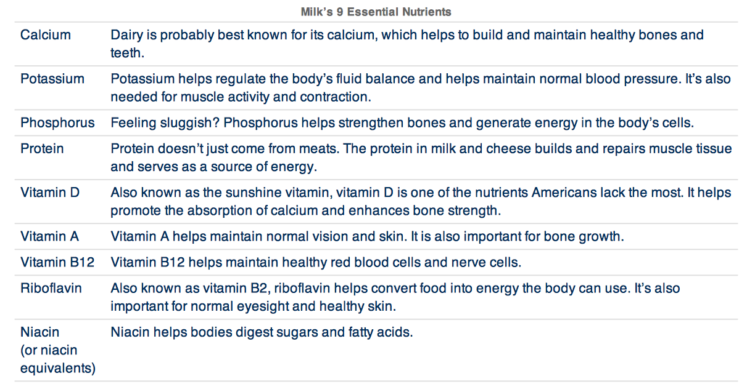
Dairy’s Unique Nutrient Package
Did you know that milk provides you with nine essential nutrients? The USDA defines an “essential nutrient” as a dietary substance required for healthy body functioning. Essential nutrients must come from the diet because the human body can’t manufacture them in sufficient quantities to meet daily needs. And, it’s more than calcium and vitamin D. From helping repair muscle tissue to maintaining healthy red blood cells, the nine nutrients in milk work together to help keep the body in optimal health.
Notes:
Source: http://www.dairymakessense.com/nutrition/9-essential-nutrients/

Slide 9
In addition to building bones, what diseases does calcium help prevent?

Slide 10
Notes:
Source: http://www.midwestdairy.com/0p17i283/dairydelivers-food-for-thought/

Slide 11
How much calcium do YOU need?
How many servings of dairy should you consume daily?

Slide 12
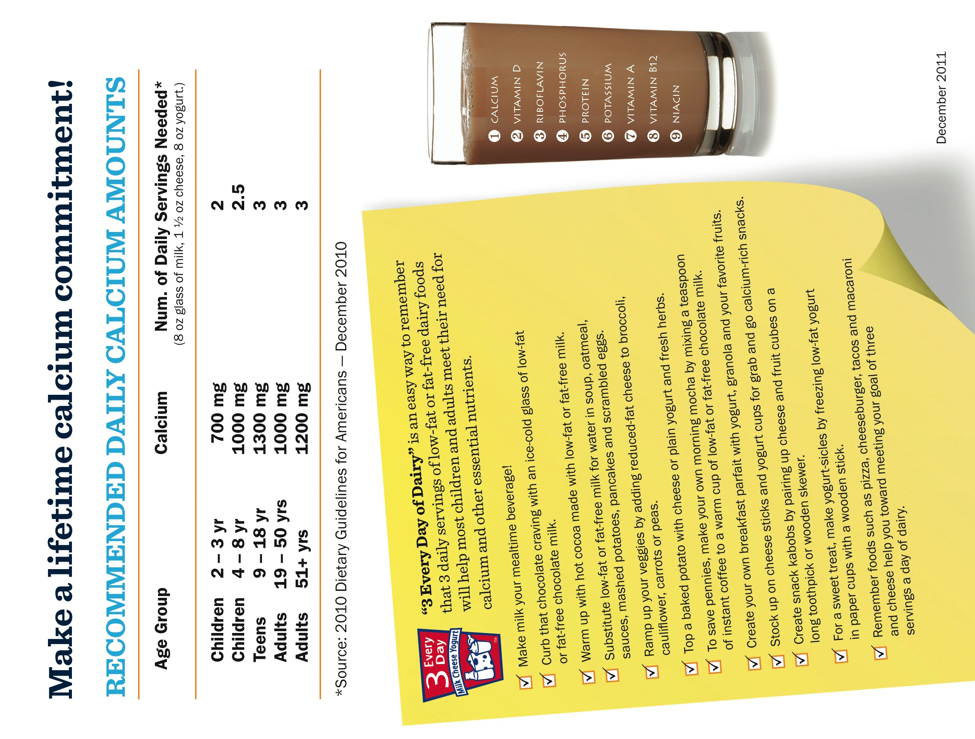
Notes:
Source: http://www.midwestdairy.com/0p17i283/dairydelivers-food-for-thought/

Slide 13
Why should athletes consume chocolate milk?

Slide 14
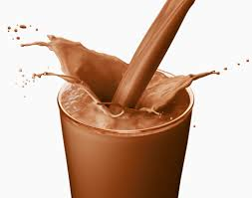
Why Chocolate Milk for Athletes?
After a long race, many runners are picking up a bottle of chocolate milk instead of a bottle of water or sports drink. Turns out, chocolate milk doesn’t just quench your thirst; it may also help improve the body's recovery after those miles on the road. It also could help athletes across the sports spectrum get the most from their workouts.
Building Muscle
Milk does more than just help muscles recover. Ivy found that you can build more muscle and lose fat during training if you drink chocolate milk after a workout. His research found that people who drank low-fat chocolate milk after a workout ended up with a three-pound lean muscle advantage over those who had a regular sports drink after about four weeks.
Recovery
After a workout, you need to consume some protein alongside carbohydrates to help repair any microtears that occur in muscles during the workout and restore energy. Chocolate milk is a good source of both. The naturally occurring mix of protein and carbs offers many benefits for athletes, says Dr. John Ivy, lead researcher on the studies and chair of The University of Texas at Austin College of Education’s Department of Kinesiology and Health Education.
Improved Performance
Chocolate milk also has been found in some studies to improve performance of athletes. Ivy’s research at the University of Texas found that cyclists who drank chocolate milk rode faster and had more power than those who drank a sports drink. His research found that milk drinkers had twice the improvement in maximal oxygen uptake than those who consumed a sports drink. That’s important, because your energy supply depends on how much oxygen can be delivered to your muscles as they work. A study in a 2011 issue of “Journal of Strength and Conditioning Research” found that college soccer players who drank chocolate milk between morning and afternoon workouts could perform longer before becoming fatigued compared to players who drank a sports drink.
Rehydration
When you complete any endurance exercise – whether it’s an intense workout at the gym or a long run – you need to rehydrate your body with essential nutrients lost through sweat. Chocolate milk may be a better choice than a sports drink or water. Milk has a good supply of electrolytes such as sodium, potassium and other minerals – all of which you lose through sweat. Milk also empties more slowly from the stomach, which means its nutrients gets absorbed much slower, says Brian D. Roy in the “Journal of the International Society of Sports Nutrition.”
Notes:
Source:http://healthyeating.sfgate.com/benefit-drinking-chocolate-milk-athletes-6965.htmlhttp://www.google.com/url?sa=i&rct=j&q=chocolate+milk&source=images&cd=&cad=rja&docid=kTW7fcRfHzPwJM&tbnid=CY4VECWP-lLCQM:&ved=&url=http%3A%2F%2Frunning.competitor.com%2F2012%2F06%2Fnutrition%2Fboost-post-race-recovery-with-chocolate-milk_53500&ei=VknIUquEGJbioASB8oLgAQ&bvm=bv.58187178,d.cGU&psig=AFQjCNEJURBEU78HJzTTW1se02efWil11w&ust=1388944086868296

Slide 15
How can milk & milk products help you lose weight?

Slide 16
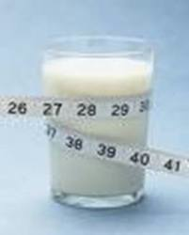
Can Dairy Help Trim Your Waistline?
Everyone wants to look and feel their best. Many people struggle with their weight and are seeking a "magic bullet" that will help them lose weight quickly. While there are no such foods that guarantee easy weight loss, certain foods can help manage your weight.
One area getting a lot of interest in weight control is dairy and calcium intake, with some research suggesting that three servings of milk, cheese or yogurt each day as part of an energy-restricted diet help people lose weight. Such a diet also may help shed body fat, reduce waist circumference and increase lean mass. Many studies have been done on this link between dairy intake and weight:
A 2004 study concluded that people who consume three servings of dairy each day while on a reduced-calorie diet lose more weight than individuals consuming the same calorie-level, low-dairy diet.
Another study found that adequate calcium intake--specifically from milk and dairy foods--decreases the risk of overweight people becoming obese or developing metabolic syndrome, type 2 diabetes and cardiovascular disease.4
These results extend to children and adolescents as well:
A 2008 study analyzing National Health and Nutrition Examination Survey (NHANES) data found that adolescents who ate more dairy food had less body fat and a lower body mass index (BMI) than those who ate less.
Adolescent girls whose diets more closely resembled the DASH eating pattern—rich in low-fat dairy products, fruits, vegetables and whole grains—had smaller gains in BMI (body mass index) over 10 years. Their dairy and fruit intakes were most closely linked to lower weight gains.
While not all studies are consistent,7 the majority of the evidence indicates that consuming adequate calcium from dairy may help with weight loss and improve body composition when dieting. The mechanism of this effect is under investigation:
Calcium, specifically from dairy products, may help burn fat which could result in less fat being stored.
Components (such as protein) in dairy products may lead to earlier satiety. (Feeling full)
Calcium in the intestine may bind with fat, preventing its absorption.
Many people avoid dairy products when dieting as a way to cut calories, not realizing this is counter-productive. It is important to include dairy products in any diet plan for their benefits to bone health, blood pressure, cancer as well as these possible benefits to weight management. Overall, dairy products contribute only 9 percent of the calories in the U.S. food supply, yet they provide a large proportion of several essential nutrients such as protein, calcium, potassium, magnesium and vitamins A, B12 and D.
Notes:
Source: http://www.healthyeating.org/Milk-Dairy/Health-Benefits-of-Milk/Article-Viewer/Article/43/Dairy-Can-It-Trim-Your-Waistline.aspx

