Slide 1
Alfalfa Hay
Source:
Alfalfa plant grown in a field
Processing:
Alfalfa is cut, dried, and baled for storage
Feed Type:
Roughage
Grass Hay
Source:
Various varieties of grass grown in a field
Processing:
Grass is cut, dried, and baled for storage
Feed Type:
Roughage
Haylage
Source:
Alfalfa plant grown in a field
Processing:
Alfalfa is cut and either baled wet, and/or stored in a silage pit to ferment
Feed Type:
Roughage
Corn Silage
Source:
Corn grown in a field
Processing:
Entire corn stalk, including cob is chopped in pieces and stored in silage pit to ferment
Feed Type:
Roughage

Slide 2
Grass or Pasture
Source:
Grass grown in a field
Processing:
None- Animal eats directly from the ground
Feed Type:
Roughage
Whole Corn
Source:
Field Corn
Processing:
Corn kernels are harvested from cobs
Feed Type:
Concentrate
Steam Flaked Corn
Source:
Field Corn
Processing:
Corn kernels are harvested from cobs and cooked with steam under pressure for 20-30 min. which increases digestibility
Feed Type:
Concentrate
Whole Barley
Source:
Seed of a barley plant
Processing:
Plant dries in field, then seed is harvested.
Feed Type:
Concentrate

Slide 3
Rolled Barley
Source:
Seed of a barley plant
Processing:
Plant dries in field, then seed is harvested and rolled to increase digestibility.
Feed Type:
Concentrate
Whole Oats
Source:
Seed of an oat plant
Processing:
Plant dries in field, then seed is harvested.
Feed Type:
Concentrate
Rolled Oats
Source:
Seed of an oat plant
Processing:
Plant dries in field, seed is harvested, then rolled to increase digestibility
Feed Type:
Concentrate
Beet Pulp
Source:
Sugar Beet
Processing:
Pulp from sugar manufacturing process is dried as flakes or compressed into pellets
Feed Type:
Roughage

Slide 4
Soybean
Source:
Soybean plant
Processing:
Meal: Ground to powder
Whole: dried in field, then harvested
Feed Type:
Concentrate
Cotton Seed
Source:
Seed inside a cotton plant
(by-product of cotton industry, used mostly in the dairy industry)
Processing:
Seed is extracted from cotton flower.
Feed Type:
Roughage
Molasses
Source:
Sugarcane or Sugar beet plant
Processing:
By product of sugar refining process. Used in animal feeds in a powder or liquid form.
Feed Type:
Supplement
Used to increase palatability (taste)
of feed
Salt
Source:
Sea water or salt lakes
Processing:
Mined or harvested through solar evaporation
Feed Type:
Supplement

Slide 5
Straw
Source:
Stalks of barley or wheat plants
Processing:
Plant is dried, cut, then baled
Feed Type:
Roughage
Blood & Bone Meal
Source:
By-product from animal slaughter facilities
Processing:
Ground up animal bones and dehydrated blood
Feed Type:
Supplement
Mineral Block
Source:
Inorganic elements found in the earth (soil)
Processing:
Powdered minerals pressed and formed into blocks
Feed Type:
Supplement
Protein Block
Source:
Ground grain products and inorganic elements found in the earth
Processing:
Grain products, molasses, vitamins, and minerals mixed and pressed into a block or tub
Feed Type:
Supplement

Slide 6
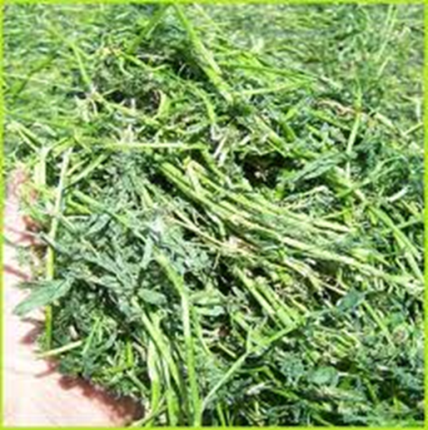
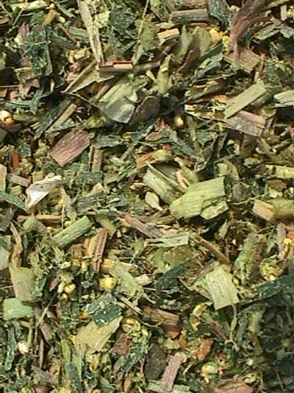
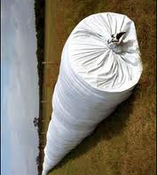
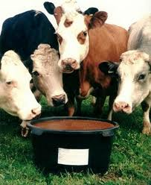
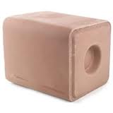
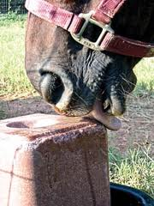
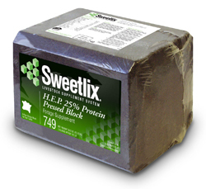

Slide 7
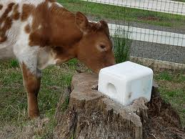
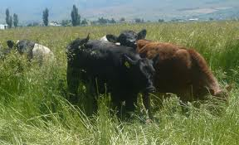
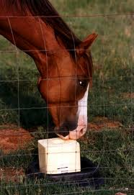
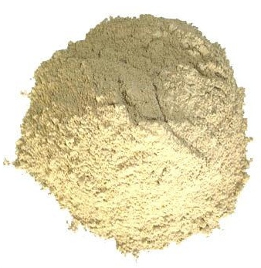
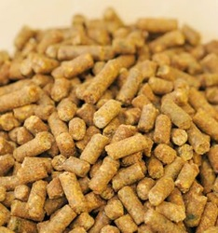
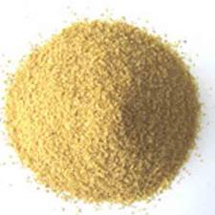
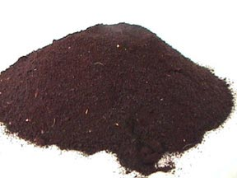
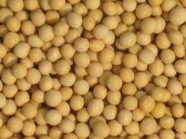
Comes in blocks or granulated to be added to mixed feed
Pellets
Bone Meal
Meal
Blood Meal
Whole

Slide 8
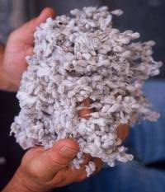
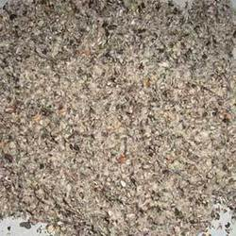
Whole Cottonseed
Cottonseed Meal

