Slide 1
Can you name the company?

Slide 2
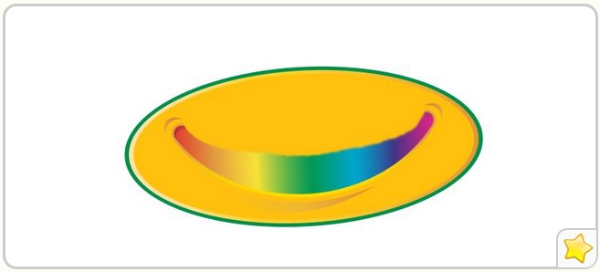
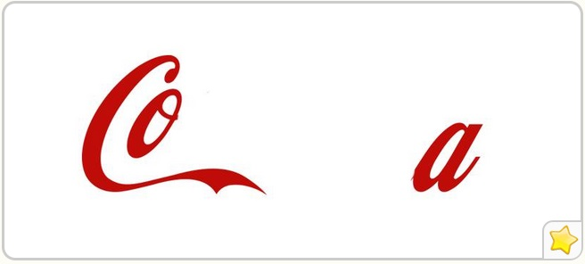

Slide 4
Can you name the company?

Slide 5
Choosing a name
How will it look?
Web, logo, social media?
What connotations does it evoke?
Too corporate, culture, market, philosophy
Unique
Pick something that hasn’t been claimed
Keep it short
Southern Ohio Amalgamated Steam Traction Engine and Boiler Manufacturing Company
Be careful with puns
Lettuce Eat, Florist Gump

Slide 6
Flowerworks
Doris the Florist
Dandelion Division
Kabloom
Floral N’ Hardy
Back to the Fuchsia
Posy Pusher
Lily’s of the Valley
The Enchanted Florist
Petal Pushers
The Stalk Market
Petal Faster
Austin Flowers
Thistle Do Nicely
Florist Gump
I C Flowers
Blooms and Grooms
Plant Parenthood
The Lone Arranger
Sherwood Florist
Whimsical Flowers
Ferns and Blooms
Floral Paradise
Flower Patch
Garden of Eden
Fleur-di-lis
La Flor
Casablanca Flower Shop
Flower Valley Florist
Eufloria
Flower Artistry
Rose and Trellis
Just Flowers
Floral Rush
Bellissimo Flowers

Slide 7
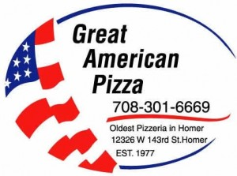

Slide 8
Creating a Logo
Describable
Memorable
Effective without color
Scaleable
Keep it simple
Think ahead
Relevance
Unique

Slide 9
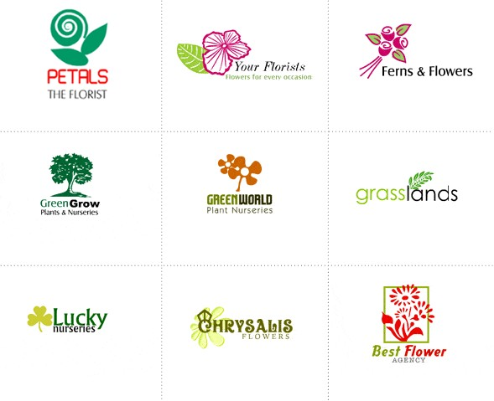

Slide 10
Creating a Slogan
Start from the logo
Top brands change their slogans
Keep it simple
No more than one sentence
Be honest
If your just starting you probably aren’t number 1

Slide 11
Lesher’s Floral Shop
They’re fresher from Lesher
Concord Flower Shop
Shouldn’t your flowers be unique too?
1-800-Flowers
Let us arrange a smile for you
Interflora
The power of flowers
Viviano Flower Shop
For all life’s celebration

Slide 12
Notes:
Dentastix

Slide 13
Notes:
BMW

Slide 14
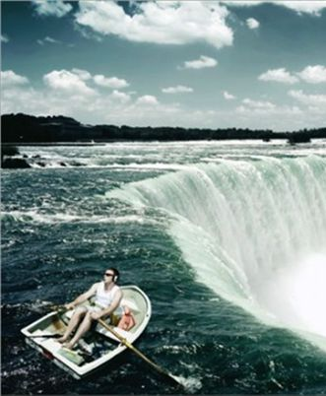
Notes:
BOSE headphone

Slide 15
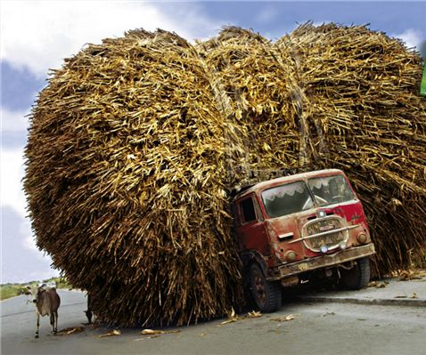
Notes:
Scotch tape

Slide 16
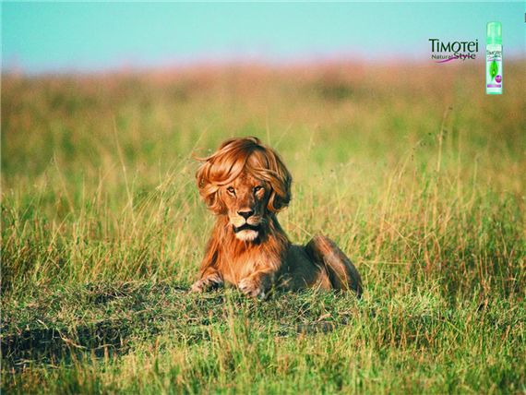
Notes:
Hair care

Slide 17
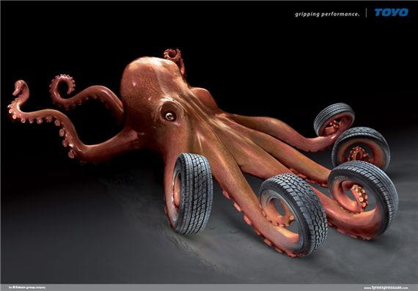
Notes:
Toyo tires

Slide 18
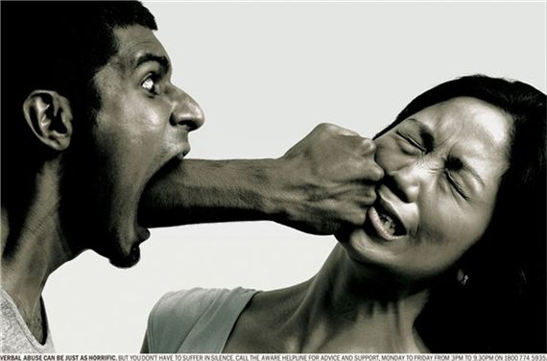
Notes:
Verbal Abuse

Slide 20
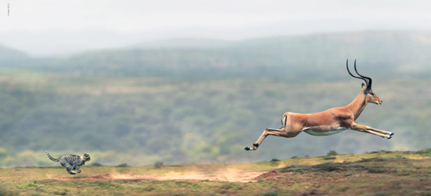

Slide 21
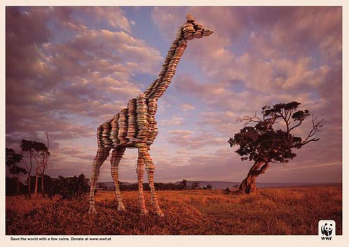
Notes:
WWF

Slide 22
Notes:
Axe

Slide 23
Notes:
High Heels

Slide 24
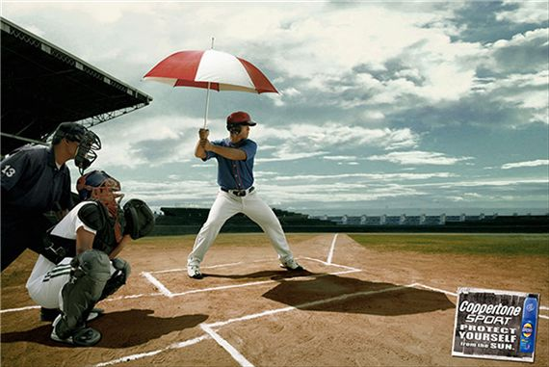
Notes:
Coppertone Sunblock

Slide 25
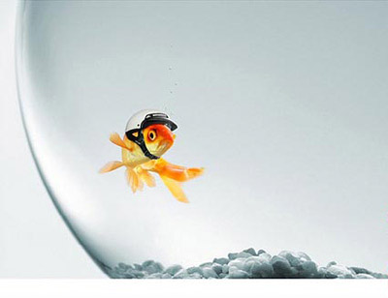
Notes:
Glassex Glass cleaner

Slide 28
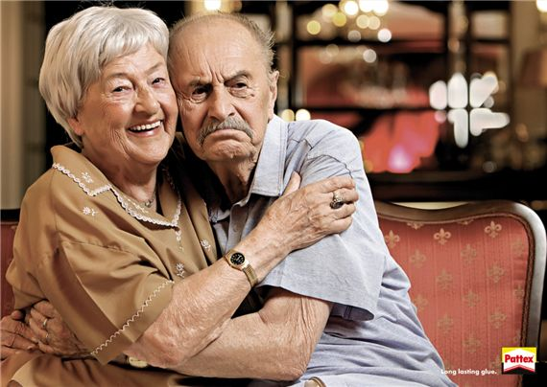
Notes:
Glue

Slide 29
Notes:
Ikea Home delivery

Slide 30
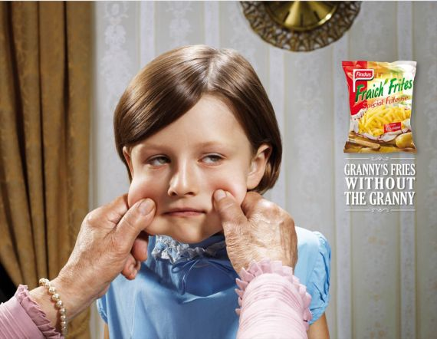
Notes:
Grandmas frenchfries

Slide 31
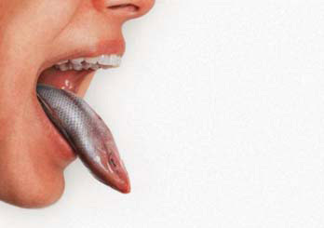
Notes:
Clorets breath mints

Slide 32
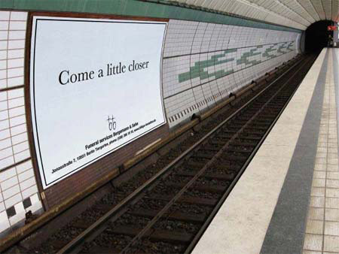

Slide 33
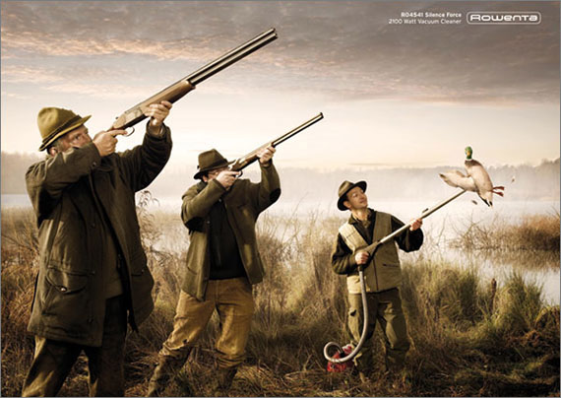
Notes:
Rowenta vacuum cleaner

Slide 34
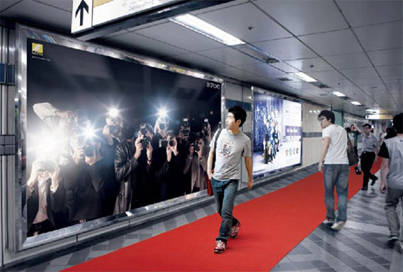

Slide 35
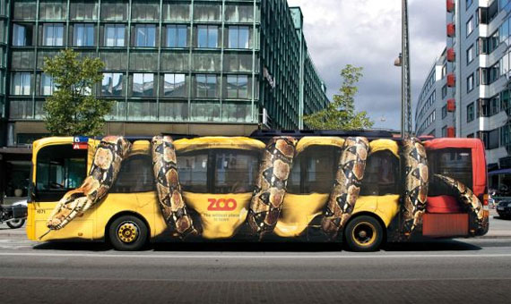

Slide 36
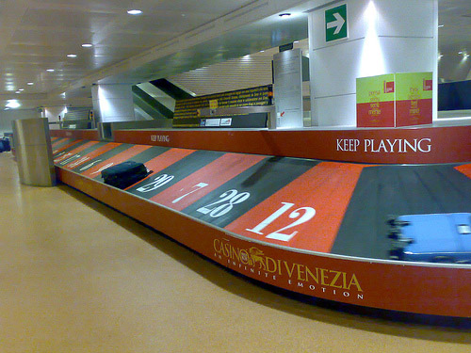

Slide 37
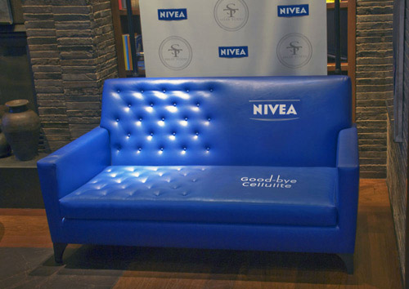

Slide 38
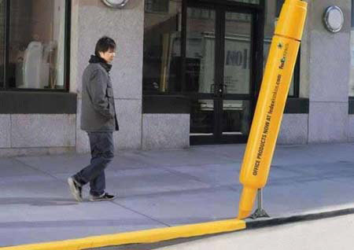
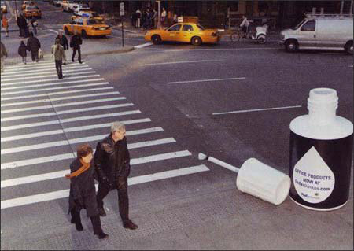

Slide 41
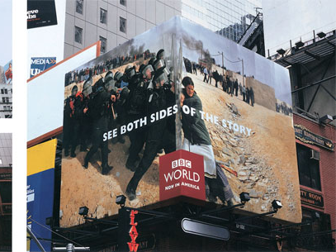

Slide 42
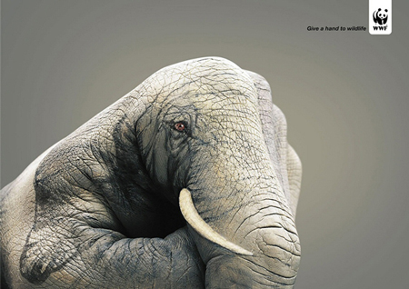
Notes:
WWF

Slide 43
What types of advertising are there?

Slide 44
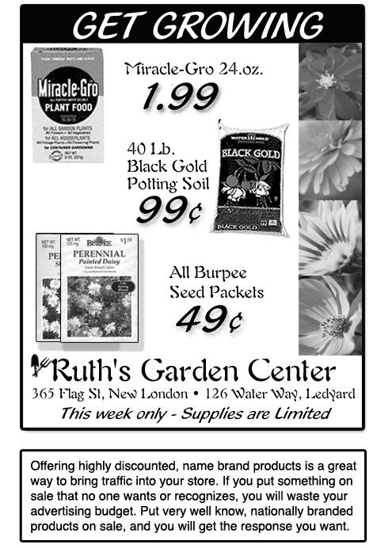
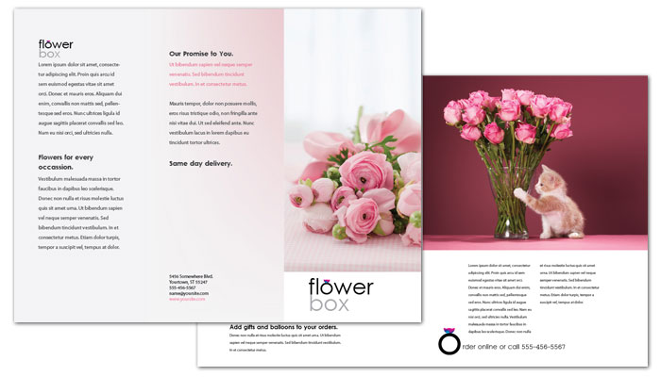
Advertising
Print
Newspapers
Magazines
Brochures
Fliers

Slide 45
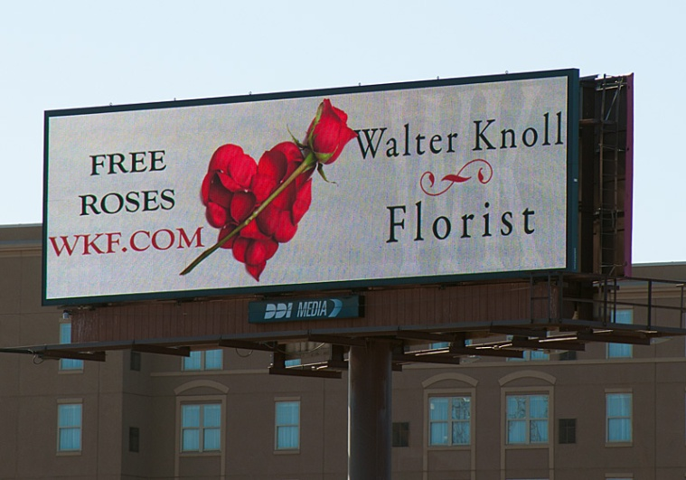
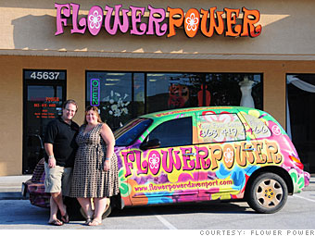
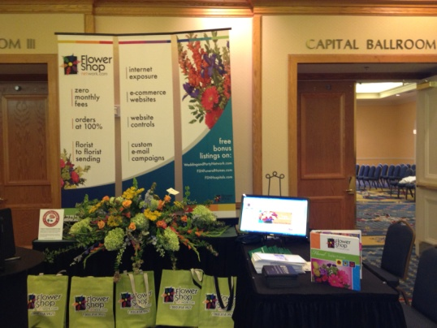
Advertising
Outdoor
Billboards
Kiosks
Trade-shows
Events

Slide 46
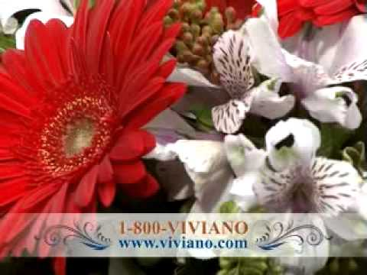
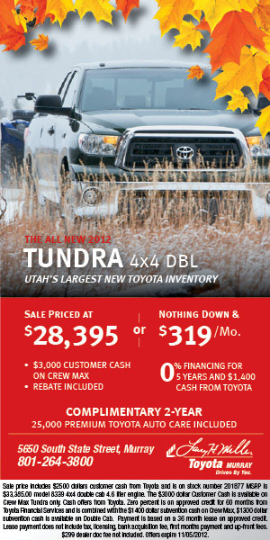
Advertising
Broadcast
Television
Radio
Internet
Covert
Advertising in movies

Slide 47
Effective Advertising
It pays to advertise
Cost-effective
Reach largest audience
Attract new customers
Target Audiences
Niche markets
Don’t just create a generic ad
Your ad should speak to your target audience on a personal level
Highlight your competitive advantage
Benefits of your company

Slide 48
Effective Advertising
Establish an image
Be consistent
Logos, slogans, etc.
You have to spend money to make money
Advertising is not the spot to cut corners
It may cost some money, but it works
Advertise in the right places
Understand your audience

Slide 49
Effective Advertising
Diversify
Don’t put all your eggs in one basket
Don’t try to be everything to everyone
You won’t be able to reach all markets
Find the one that is easiest to reach and be everything to that audience
Monitor your ads
Ask new customers where they heard about you

Slide 50
What works for the floral industry
Connection with other professionals
Wedding planners, photographers, venues, funeral directors, special event coordinators
Distribute flyers and brochures
Corporate offices, hotels, high schools,
Flower stands
Put things where people can see them
Online
Website
E-mail marketing
Be Creative
Freebies
Social networking
Notes:
Man in California brought an arrangement to local corporate office. Ended up being able to leave the arrangement and got a contract for every week to leave one for the reception desk. He also was able to leave his business information for when people asked where they got it.
Put flowers out on the street during peak times such as Valentines day and Mothers day (Main Street Floral

Slide 51
What else can I do?
Free informational classes
Get people in the door by offering classes
You demonstrate (you could charge and allow them to do an arrangement as well)
Collaborate with other businesses
Lunchtime Love Package
Donate
Donate flowers to local events!

Slide 52
Your job
Come up with a marketing/advertising plan
This will be three pages
Page 1
Example of one advertisement
Page 2
Example of one advertisement

Slide 53
At the shop

Slide 54
Order Forms
You should have an order form that each person who works at the shop can easily fill out
They may also be something that someone can fax in
Tells specific information on what needs to take place

Slide 55
Information
Name of recipient
Address (if delivering)
Business or residential
Phone number
Date of delivery or pickup
What they are ordering
What do they want to spend
How are they paying
What do they want on the card

Slide 56
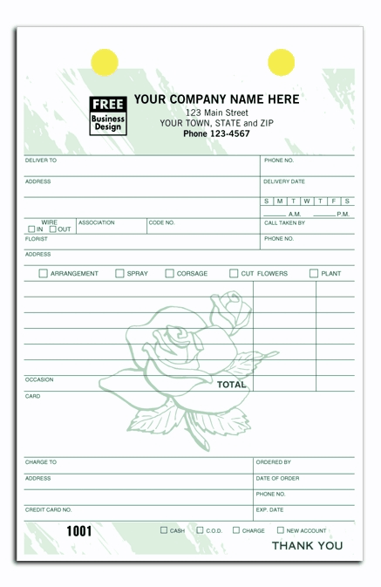

Slide 57
Your job
In your group you have 2 orders that you need to fulfill. You will need to find another group to work with.
Group 1 will “call” group 2 and order an arrangement
Group 1 should be using good phone etiquette and writing down the order as best as possible
Group 2 will then “call” group 1 to order an arrangement.
Repeat until you each have done ordered 2

