Slide 1
The Digestive System
Biology

Slide 2
Function of the Digestive System
Break food down into small molecules that can be passed to the cells that need them.
Why Is this important?
Provides materials and energy for all life processes.

Slide 3
Function of the Digestive System (not on outline)
Vocabulary:
Intracellular: digestion inside cells.
Extracellular: digestion in a body system and nutrients are then passed to the cells.
Mechanical: Physically breaking food into smaller pieces.
Chemical: breaking food into molecules by breaking chemical bonds.

Slide 4
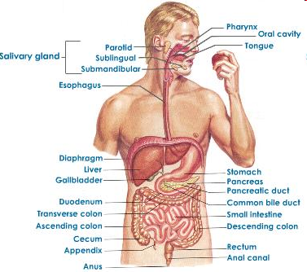
Structure of the Digestive System

Slide 5
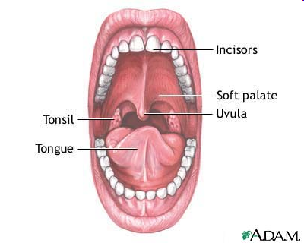
Mouth
Function: to begin mechanical and chemical digestion
Structures:
TEETH are responsible
for mechanical digestion
by crushing, cutting,
and tearing food.

Slide 6
Mouth
Structure:
SALIVA moistens the food and makes it easier to chew.
Enzymes: Saliva contains an enzyme called amylase that breaks down starches into sugar.
Does the mouth do Chemical, Mechanical or Neither type of digestion?

Slide 7
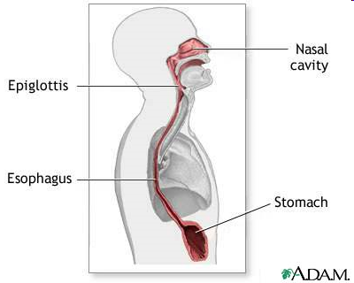
Esophagus
Also known as the food tube.
Function: Moves food from the mouth to the stomach. <iframe width="640" height="390" src="//www.youtube.com/embed/aPMw7acrVro" frameborder="0" allowfullscreen></iframe>

Slide 8
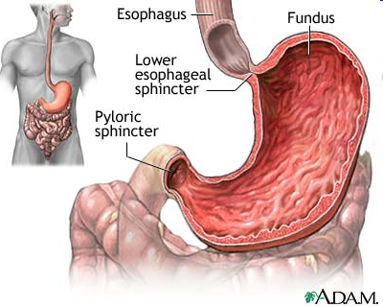
Stomach
Function: continues both the mechanical and chemical digestion of food.
Structure: the stomach is a large, muscular sac.

Slide 9
Stomach
The stomach’s hydrochloric acid and an enzyme called pepsin help break down proteins. This is chemical digestion.
The stomach’s muscles contract to churn and mix stomach fluids and food. This is mechanical digestion.

Slide 10
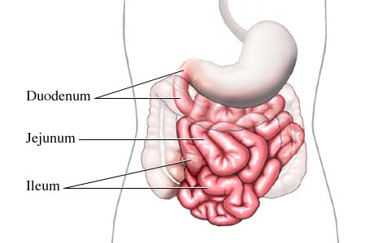
Small Intestine
Function: Nutrients are
absorbed from here.
Structure: long, narrow tube approx. 20 feet long with villi (vill-I).
The first part of the small intestine, called the duodenum (do-a-dee-num), completes the chemical digestion of food.
The rest of the small intestine absorbs nutrients.

Slide 11
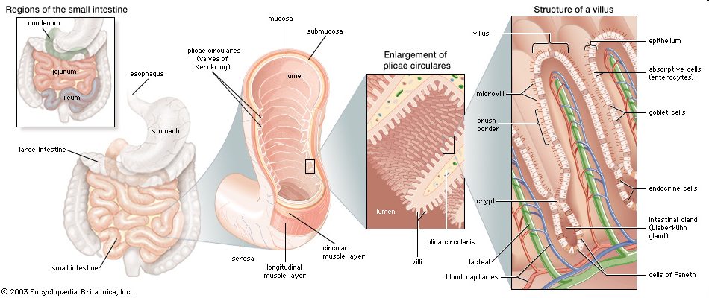
Small Intestine Structure

Slide 12
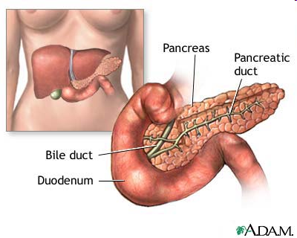
Pancreas
Function: adds enzymes and other chemicals to the first part of the small intestine (duodenum).
The enzymes break down carbs, proteins, and lipids.
A chemical, sodium bicarbonate, neutrilizes stomach acid.

Slide 13
Pancreas

Slide 14
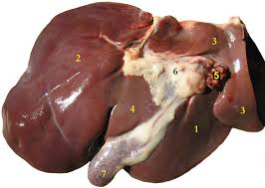
Liver
Function: produces bile, which helps dissolve fat.
This is also added in the first part of the small intestine.
Alcohol kills the liver; drugs kill the liver; caffeine harms the liver… all in the attempt to detoxify.

Slide 15
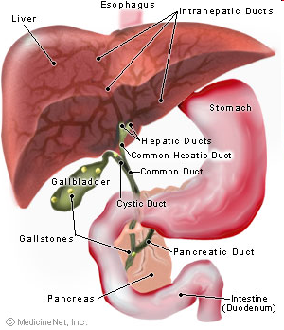
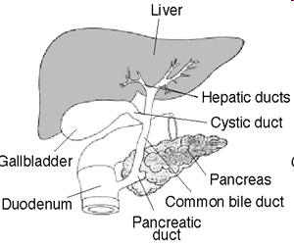
Liver

Slide 16
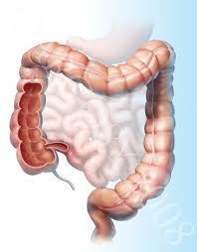
Large Intestine
Function: absorb water.
By the time food leaves the small intestine, it is basically nutrient-free. Water is left behind, and the large intestine removes this water.
After most of the water has been removed, the food exits the body through the rectum and anus.

Slide 17
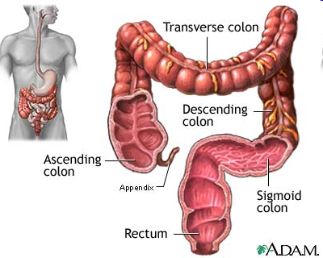
Large Intestine

Slide 18
Let’s take a break!
We are going to model what happens in your stomach.
Notes:
Gizmo – or http://www.teachengineering.org/view_lesson.php?url=collection/cub_/lessons/cub_biomed/cub_biomed_lesson05.xml

Slide 19
1. Break the bread into small pieces
What organ of the digestive system are his hands representing?
Is digestion happening? If so, what kind?

Slide 20
2. Put the bread into the ziplock bag.
What organ is the ziplock back?

Slide 21
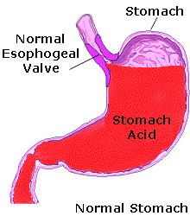
3. Add 1 cup of soda to the bag.
What does the soda represent?
4. Mix up the bread and soda very well.
What kind of digestion is happening here?

Slide 22
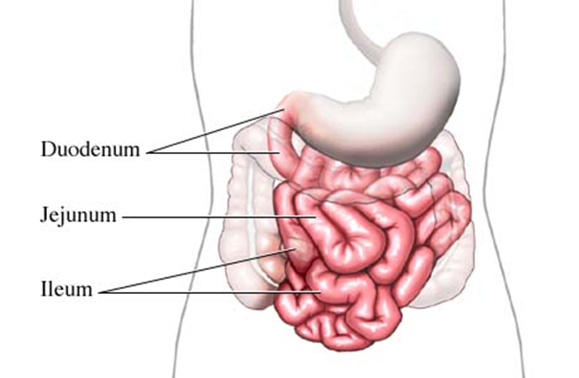
5. Cut a small corner of your bag and empty the contents into the nylon sock.
What does the nylon sock represent?
What kind of digestion is happening here?

Slide 23
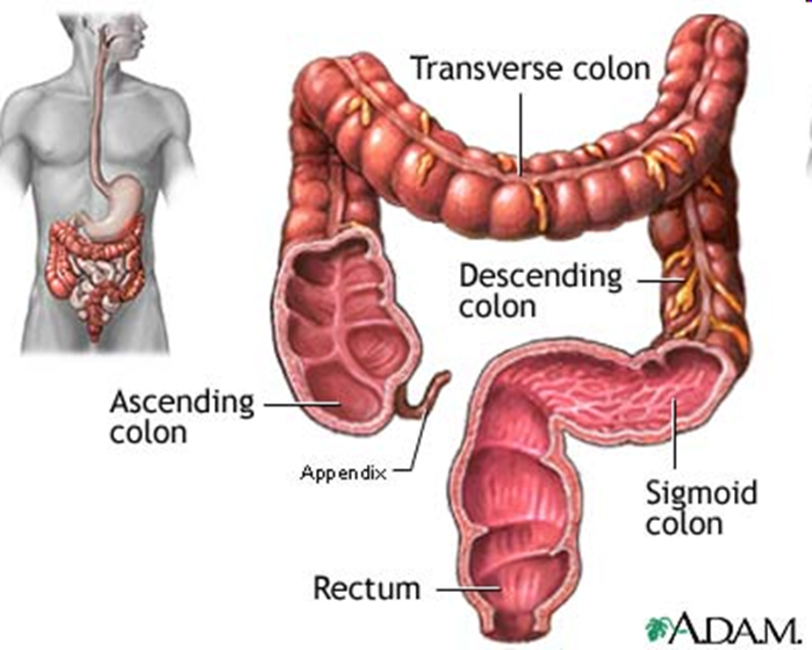
6. Now squeeze any excess moisture out of the mixture through the sock.
Where in the digestive system do you remove moisture from waste?

Slide 24
Cut the bottom off the nylon sock and squeeze the mixture into another bag.
What does this bag represent?

Slide 25
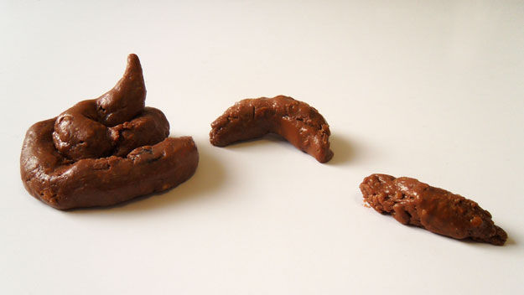
Cut the bottom tip off the bag and squeeze out the waste.
This is the end of the digestive system, what is it?

Slide 26
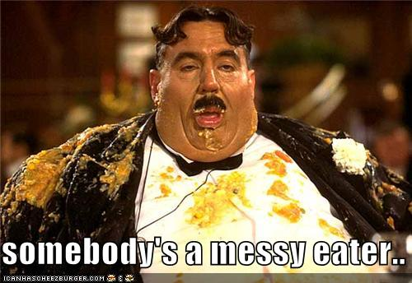
Hungry?

Slide 27
What did we learn?
What did we learn from this stomach-modeling experience?

Slide 28
Function of the Digestive System (not on outline)
Vocabulary:
Intracellular: digestion inside cells.
Extracellular: digestion in a body system and nutrients are then passed to the cells.
Mechanical: Physically breaking food into smaller pieces.
Chemical: breaking food into molecules by breaking chemical bonds.

Slide 29
Hydra Digestion
Hydra digest intracellularly and extracellularly.

Slide 30
Hydra Digestion
Have a single opening that serves as both a mouth and an anus.
Have a gastrovascular cavity, which is a simple digestive chamber with a single opening with some specialized digestive tissues.
http://www.cedarville.edu/personal/jwf/bio100/lecturequiz21b.swf

Slide 31
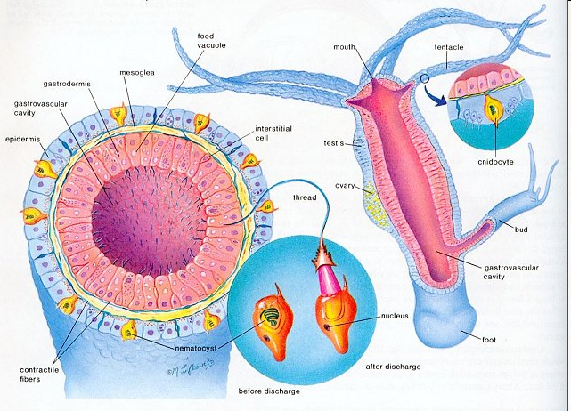
Hydra Digestion

Slide 32
Earthworm Digestion
Earthworms have extracellular digestion because they have a digestive system.
They have a mouth, gizzard, an intestine, and anus.
The gizzard grinds up food.
What organs serve the same purpose in humans?
Food is absorbed in the intestine.

Slide 33
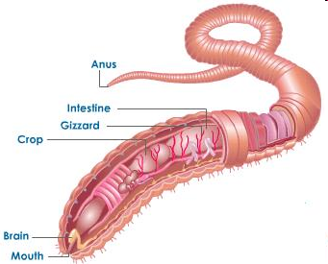
Earthworm Digestion

Slide 34
Crayfish Digestion
Crayfish have extraxcellular digestion because they have a digestive system.
They have a mouth, esophagus, stomach, an intestine, digestive glands, and an anus.

Slide 35
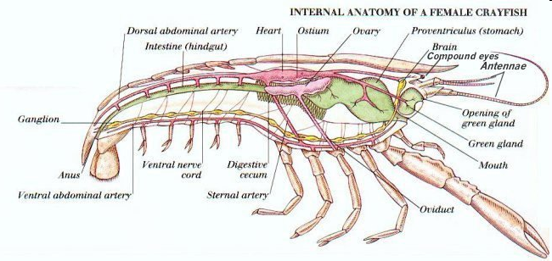
Crayfish Digestion

Slide 36
Sea Star Digestion
Sea stars have extracellular digestion because they have a digestive system.
They have a mouth, two stomachs, intestine, ceca, and an anus.
The cardiac stomach exits the sea star’s body and begins the digestion of food. The cardiac stomach is then brought back inside the body, and the partially digested food is moved to the pyloric stomach where it is digested more.
Ceca produce digestive enzymes.

Slide 37
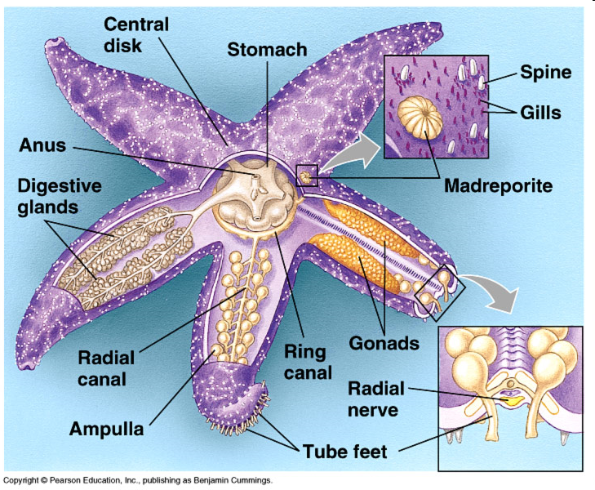
Sea Star Digestion

Slide 38
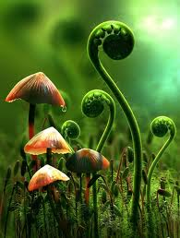
Plants
Do plants eat?
Do plants need energy?
How do plants get the fuel to make energy if they don’t eat?

Slide 39
How Plants get Nutrition
How do plants make their own food?
Photosynthesis
What ingredients are used in this process?
Water, Carbon dioxide and light energy!

Slide 40
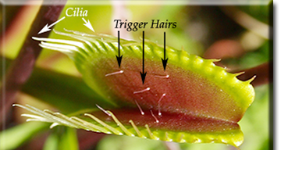
Beyond Photosynthesis
Carnivorous plants like venus flytraps either secrete enzymes to digest insects or wait for them to decompose and then absorb the nutrients.

Slide 41
Summary
Each organism accomplishes the function of digesting food.
They have different structures to accomplish the food.

Slide 42
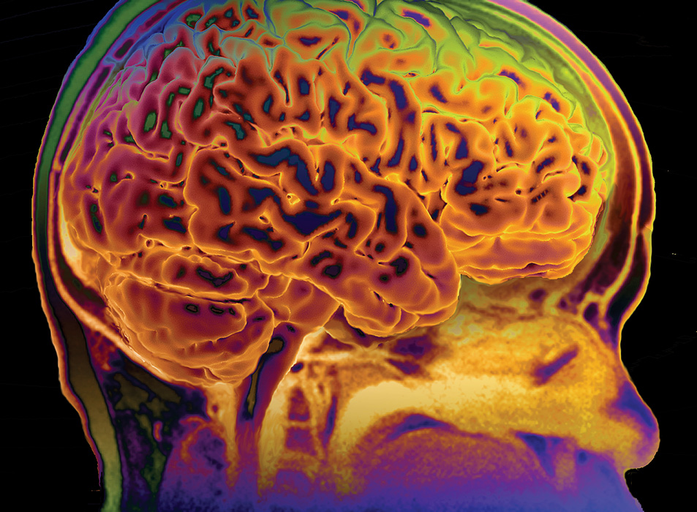
Nervous System
Function:
The central nervous system interprets information, and the peripheral nervous system gathers and transmits information.

Slide 43
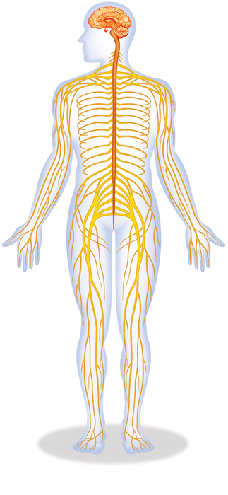
Two types:
Central Nervous System (CNS)
Structures: Brain; Brain Stem & Spinal Cord
Peripheral Nervous System (PNS)
Structures: nerves (voluntary & involuntary). Unlike the CNS, PNS is not protected by bone or blood-brain barrier, leaving it exposed to toxins and injuries.

Slide 44
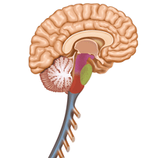
The brain has three parts.
cerebrum controls thought, movement, emotion
cerebellum allows for balance
brain stem controls basic life functions

Slide 45
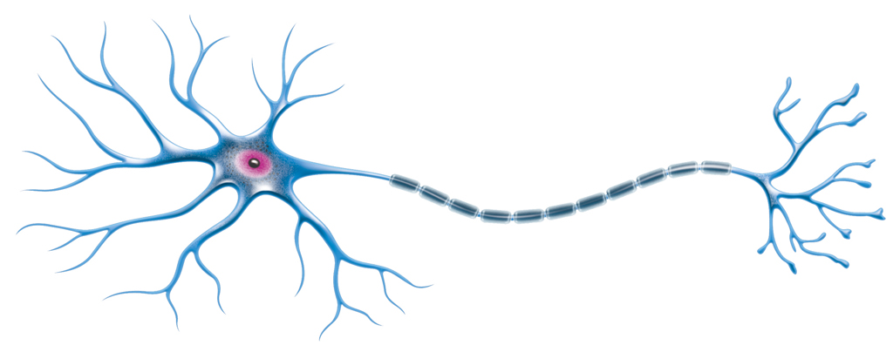
Neurons
Dendrites receive impulses

Slide 46
Neurons
Axon carries impulses

Slide 47
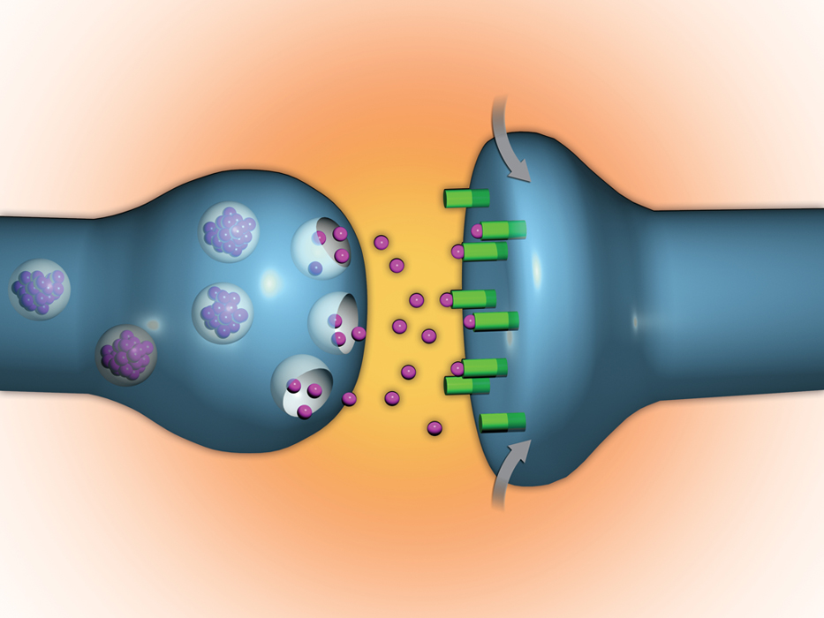
Neurons
A chemical signal passes between neurons.
Neurotransmitters released into synapse.
Neurotransmitters stimulate next cell.

Slide 48
Video Clip:
Neurons how they work
Notes:
http://www.youtube.com/watch?v=FR4S1BqdFG4

