Slide 1
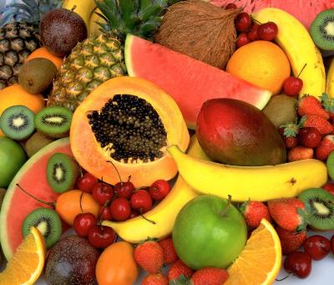
Fruit
HORTICULTURE

Slide 2
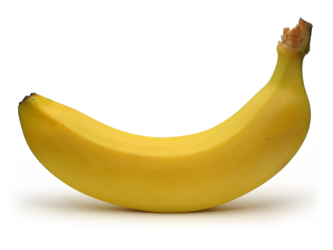
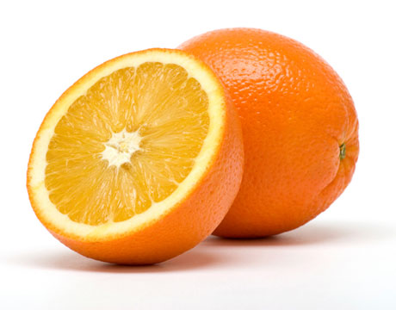
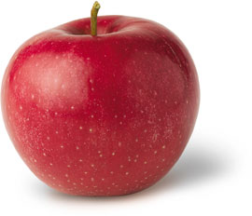
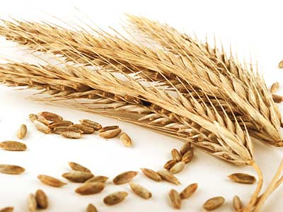
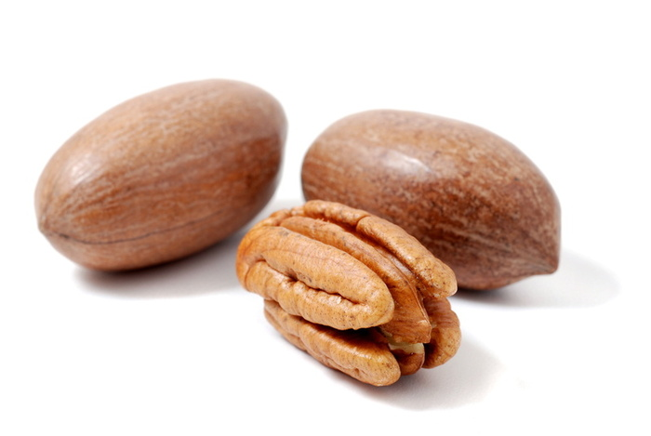
Fruit
When you think of fruit you typically think of a juicy edible object, such as an apple, orange or banana. However fruit includes many plant-derived structures, such as grains, nuts, and many vegetables.
A fruit is an enlarged ovary, often with some accessory tissue, that develops after a flower has been pollinated. After pollination, seed development begins, and soon the peripheral parts of the flower fall away leaving the immature fruit.

Slide 3
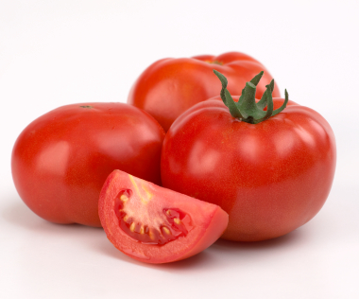
Fruit vs. Vegetables
Botanical definition- fruit forms on a flower, vegetables are from other plant parts
Functional or ‘Grocery Store’ definition- fruits are sweet, vegetables generally are not
Botanically, a tomato is a fruit (a berry), but it is not sweet, so it is functionally used as a vegetable in the real world.

Slide 4
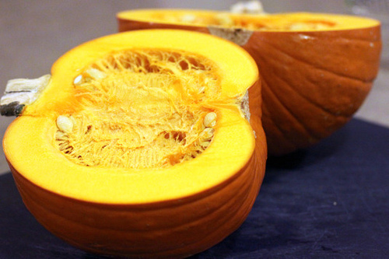
Fruit Structure
Almost all fruits have a general structure that consists of an outer layer called the pericarp. The pericarp, in turn, encloses the seed or seeds. Usually there is a space between the seed and the pericarp, called a locule.
The pumpkin is a good illustration of this structure. With orange rind as the pericarp, the hollow space within the locule, and the seeds inside the locule.

Slide 5
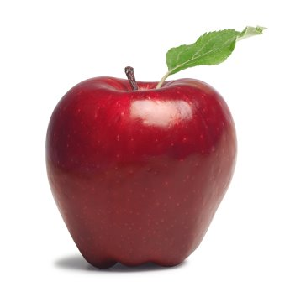
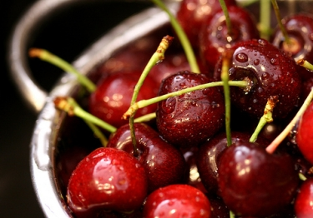
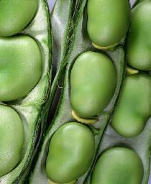
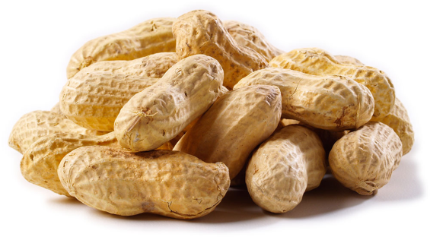
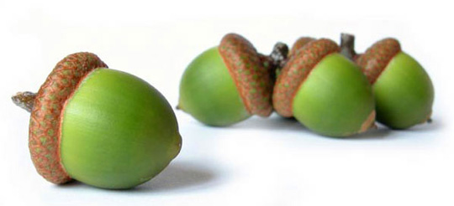
Different kinds of fruit
Some, such as cherries, tomatoes, and apples, have a fleshy, juicy pericarps.
Others, such as peanuts, milkweed, pods, and acorns, have dry pericarps.

Slide 6
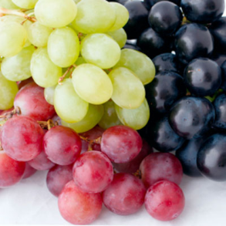
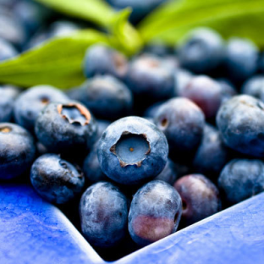
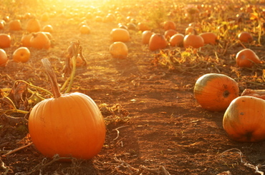
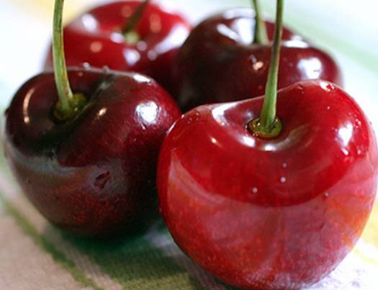
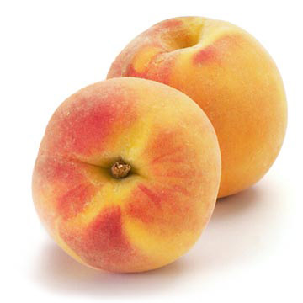
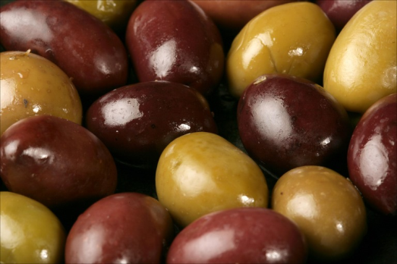
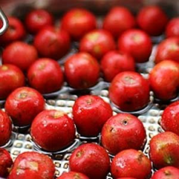
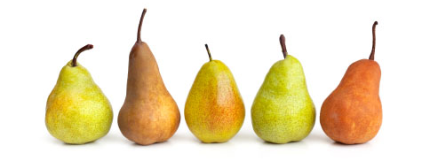
Types of Fruits
Simple fruits are comprised of a single ovary with or without some other flower parts that have developed as part of the fruit.
Fleshy Pericarp
Berries- Have a fleshy ovary wall and 2 or more carpels containing seeds. The outer wall may be hard or leathery. Examples are tomatoes, grapes, blueberries, pumpkins, and oranges.
Drupes- Are single carpels with 3 layers and a single seed. Examples are cherries, peaches, and olives.
Pomes- Are composed of several fused carpels and the flesh of the fruit is derived mostly by flower tissue outside the ovary. Examples are apples, mayhaws, and pears.

Slide 7
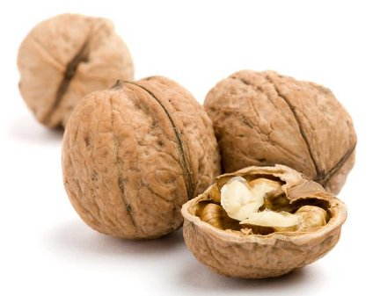
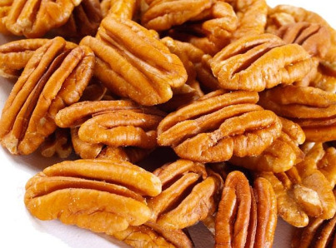
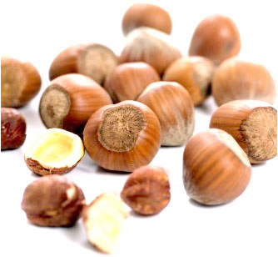
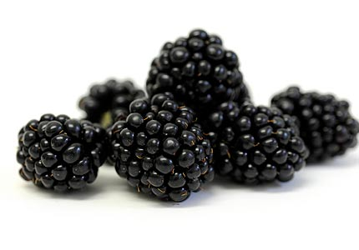
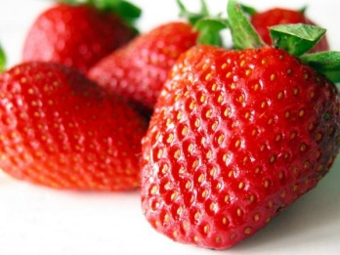
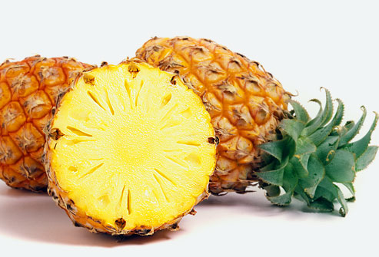
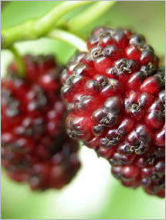
Types of Fruit
Dry Pericarp- Achenes are one-seeded, dry fruits. Strawberries are an aggregate fruit with achenes on their surface.
Nuts- are one-seeded fruits, often produced from a compound ovary. Examples are walnuts, pecans, and hazelnuts.
Aggregate fruits are comprised of a single receptacle (base of flower) with masses of similar fruitlets. Examples are blackberries and strawberries.
Multiple fruits are comprised of ovaries of many separate, but closely clustered, flowers. Examples are mulberries and pineapples.

