Slide 1
Mitosis & Meiosis Board Notes

Slide 2
Mitosis: Cell replication & Division
Interphase: DNA replication occurs and other regular cell processes
Mitosis begins!!
1. Prophase: Chromosomes condense. Microtubules attach.
2. Metaphase: Chromosomes line up in the MIDDLE of the cell.
3. Anaphase: Sister Chromatids (Chromosomes) are pulled APART
4. Telophase: New nucleus & other cell parts appear. Cell membrane starts to divide.
Mitosis Ends!!
Cytokinesis: New cell membranes form.
Mitosis happens in Diploid cells. At the end of mitosis, we have 2 identical diploid cells. (They look the same as the original cell)
Diploid: Chromosomes have pairs
Haploid: Chromosomes don't have pairs (Reproductive cells)

Slide 3
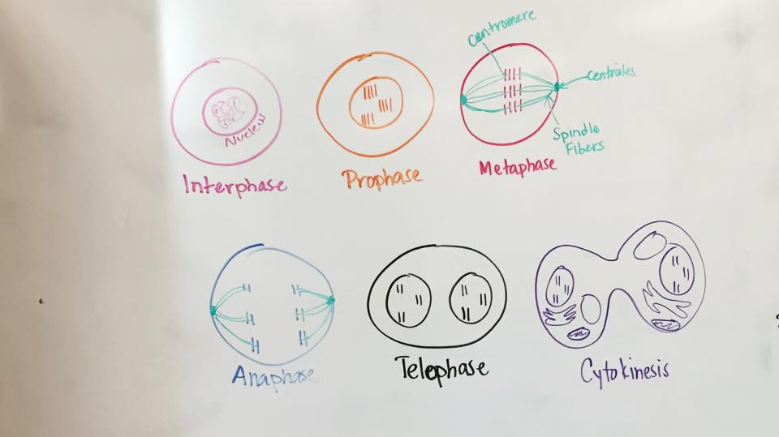

Slide 4
Meiosis: The production of REPRODUCTIVE CELLS!
Interphase: DNA replicates & other processes
Meiosis Begins!!
1. Prophase 1 (CROSSING OVER: Switching some DNA around between chromosomes)
2. Metaphase 1
3. Anaphase 1
4. Telophase 1
5. Prophase 2
6. Metaphase 2
7. Anaphase 2
8. Telophase 2 (Nuclear membranes form around the DNA)
At the end of MEIOSIS we have 4 GENETICALLY DIFFERENT HAPLOID CELLS (These are called GAMETES)
ZYGOTE: Two gametes fused together to make a new organism (Sperm+Egg, Pollen+Seed)

Slide 5
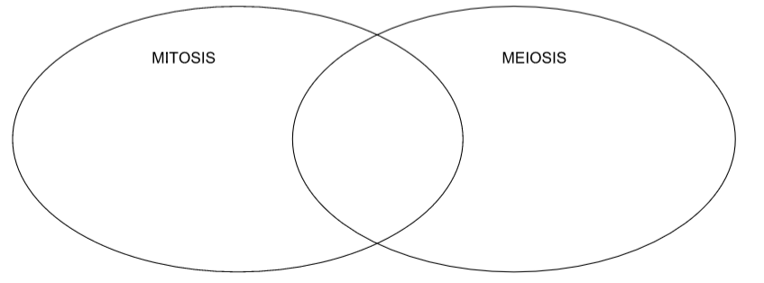
List at least three differences and similarities

