Slide 1
Principles of Desi gn

Slide 2
Principles of Desi gn
Balance
Proportion
Focal Point
Lines
Size
Color
Shapes
Spacing
Rhythm
Harmony
Unity
– Accessories
– Texture
– Direction
– Framing

Slide 3
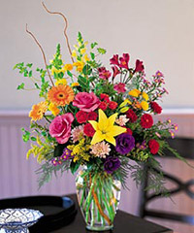
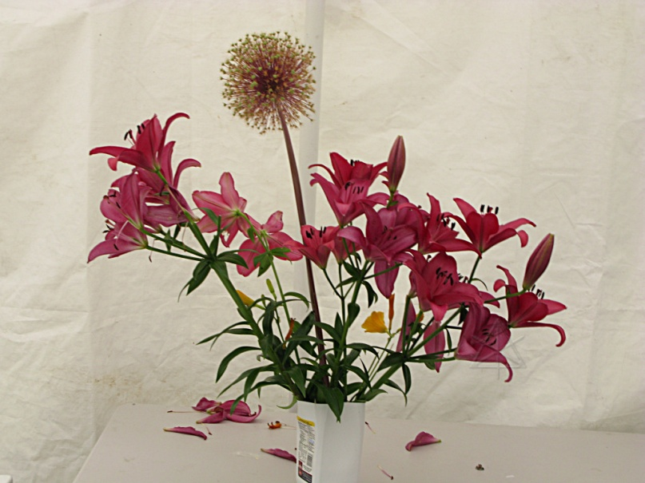
Balance
Stability of Arrangement
Materials placed around central axis
Can also be affected by color and texture
Symmetrical and Asymmetrical balances are used

Slide 4
PrOPoRtiOn
Gives viewer a sense of balance & harmony
Size of arrangement compared to environment
Floral material should be 1 ½ times the height of the container if vertical, and 1 ½ times the width if it’s a horizontal arrangement

Slide 5
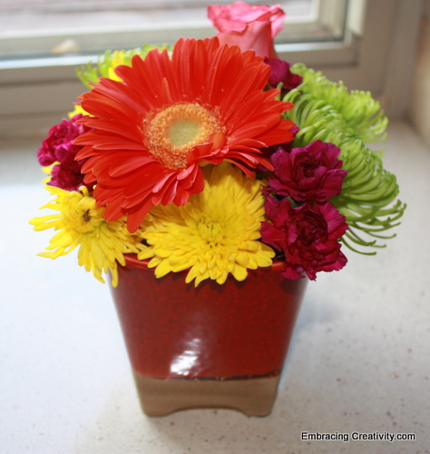
Focal Point
Center of interest
Where the eye travels to
Dominant point

Slide 6
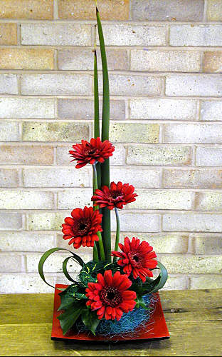
Creating Focal Point
Lines: radiate from central point outward
Size: Smaller flowers on perimeter (outside)
Largest flowers near focal point
Color: Lighter colors on perimeter
Brighter, Darker colors at focal point

Slide 7
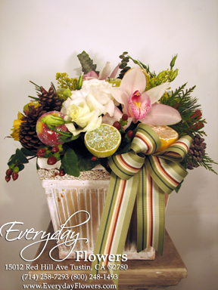
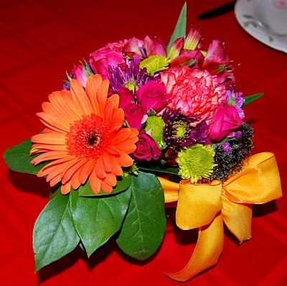
Creating Focal Point
Direction: Directional facing and flower placement form center of interest toward an inward focal point
Spacing: Flowers further apart at perimeter, closer together near focal point
Accessories: Use to establish focal point
Example: Bows

Slide 8
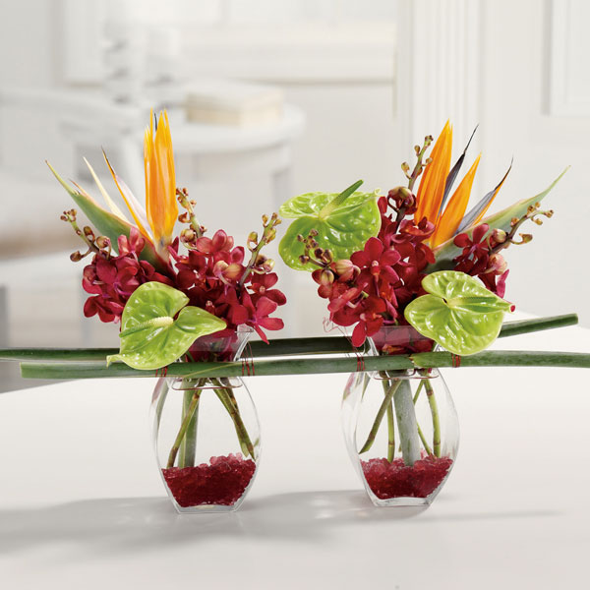
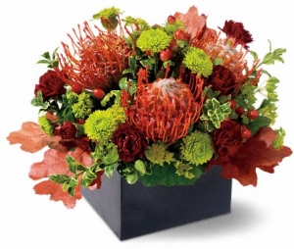
Creating Focal Point
Texture: Heavy, course textures establish focal point
Framing: Helps enhance focal point
Shapes: Use form or unusual plants
Examples: Orchids, bird of paradise, protea

Slide 9
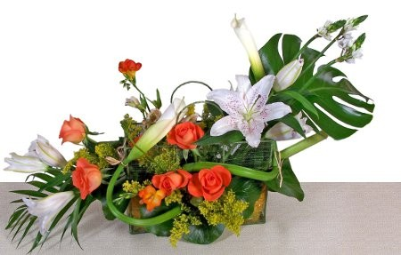
Rhythm
Movement toward or away from focal point
Sense of motion as eye travels from one point to the next
Can be accomplish through:
Repetition of color, flowers, shapes
Transitions: Flower size, Spacing, Colors (Light to dark, one hue to another)

Slide 10
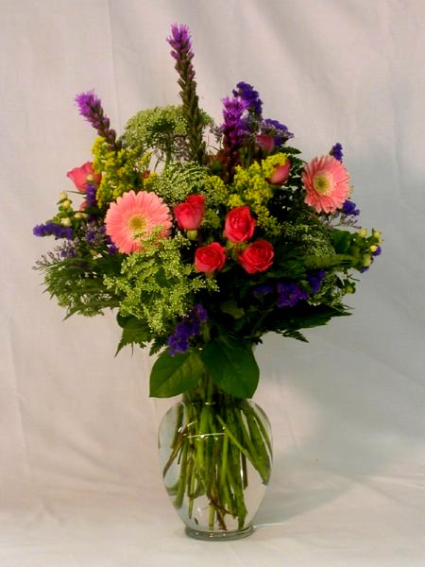
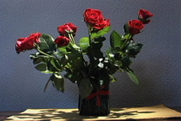
Harmony
When all components of design blend well
Pleasing to the eye

Slide 11
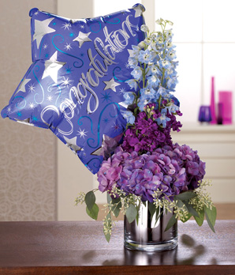
Unity
Design parts suggest a single thought or impression

